Slide 1
Project 2: Values differences and similarities between China and India
Group 11
Ng Chan Hin 1155072285
Ng Kwong Sing 1155079656
Lam Ka Yan 1155078863
Peng Zhichao 1155062015
Lee Chi Long Gavin 1155078572

Slide 2
Introduction
Dataset:
The data collection is designed to allow cross-national comparison of values and opinions in a wide variety of area
2 Data sets: China and India (both with missing data)
Observations: China :1000, India: 2500
31 Variables, describing the values and attitudes of mass publics in different societies around the world
V91,V146 and V353 are binary data

Slide 3
Handling Missing Data

Slide 4
Missing Data
Both dataset China and India have missing data coded 999
3 Types of Missing Data
Missing completely at random (MCAR)
Missing at random (MAR)
Not missing at random (NMAR)
List of R Packages that can duel with missing data
MICE
Amelia
missForest
Hmisc
mi

Slide 5
Handling Missing Data by “MICE”
Steps of “MICE”:
Get an overview of missing types
Delete NMAR
Treat other missing values as MAR and filling them up by “MICE” package
Compare the dataset after filling the original one

Slide 6

Example: China Dataset
Get an overview of Missing Data types
R-code: pMiss<-function(x){sum(is.na(x))/length(x)*100} apply(china,2,pMiss)
Result:
V317 show 100.0 of missing data, that means it is NMAR and other variables have proportion of missing data less than 8.0
Reason: V317 is correspond to political assassination. So it is a quite sensitive question in China as it is related to politics. So the question might be removed from the questionnaire.
Therefore, we remove V317 .

Slide 7
Example: China Dataset
After removing V317, we use R-code: md.pattern from “MICE” package to obtain a tabular form of missing values present in each variable in the data set. And then we know that there 768 complete data among 1000 observations.
It is hard to understand the pattern so we also plot a histogram to obtain the distribution of the missing data: R-code: aggr_plot=aggr(china,col=c('navyblue','red'),numbers=TRUE,sortVars=TRUE,labels=names(china),cex.axis=.7,gap=3,ylab=c("Histogram of missing data","Pattern"))

Slide 8
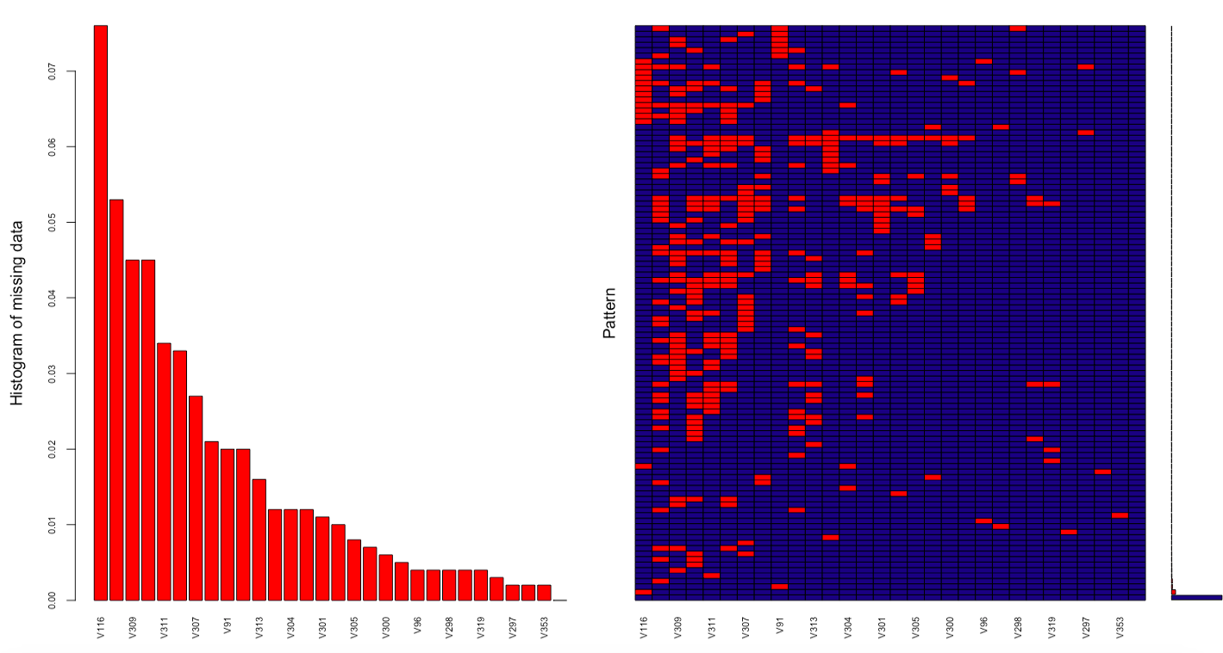

Slide 9
Example: China Dataset
Filling up the missing data
R-code: imputed_china=mice(china,m=5,maxit=50,meth='pmm',seed=500) completeChina=complete(imputed_china,1)
After filling the missing data, we plot few graphs to compare the distribution of the original data and the new one. densityplot(imputed_china) stripplot(imputed_china,pch=20,cex=1.2)

Slide 10
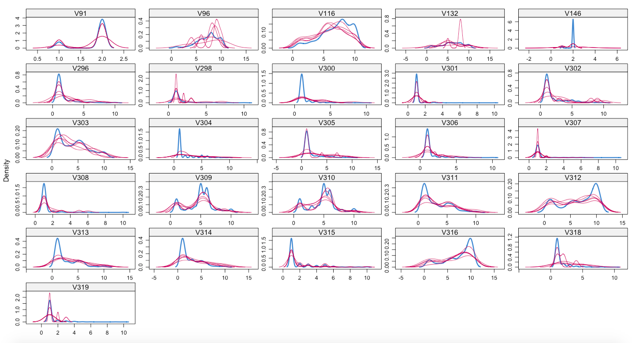

Slide 11
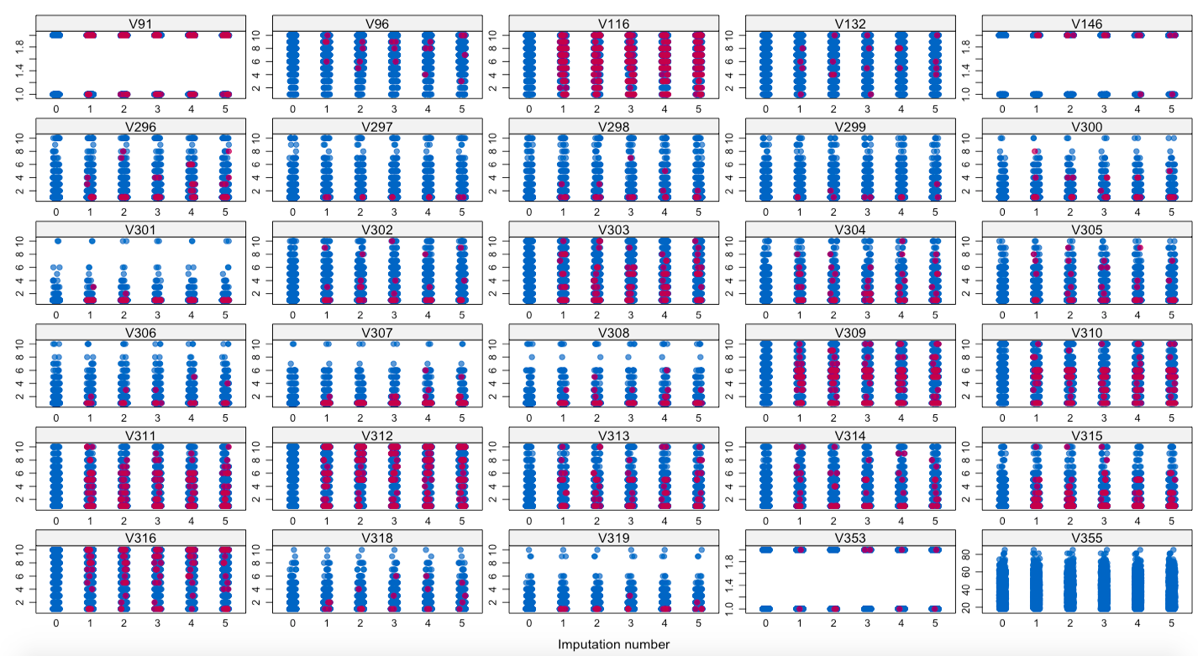

Slide 12
Factor Analysis & Regession

Slide 13
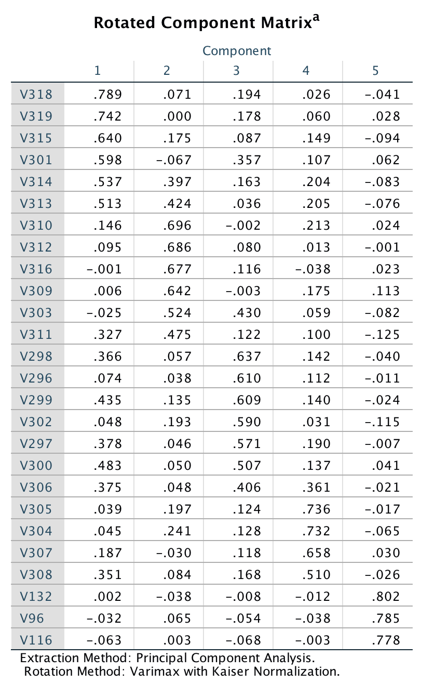
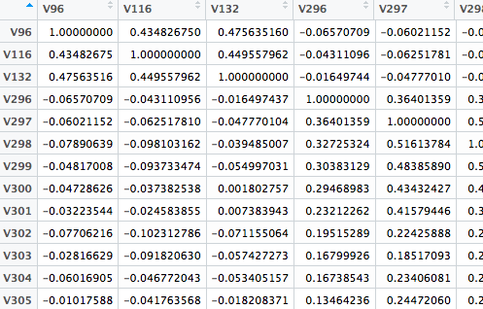
Exploratory Factor Analysis

Slide 14
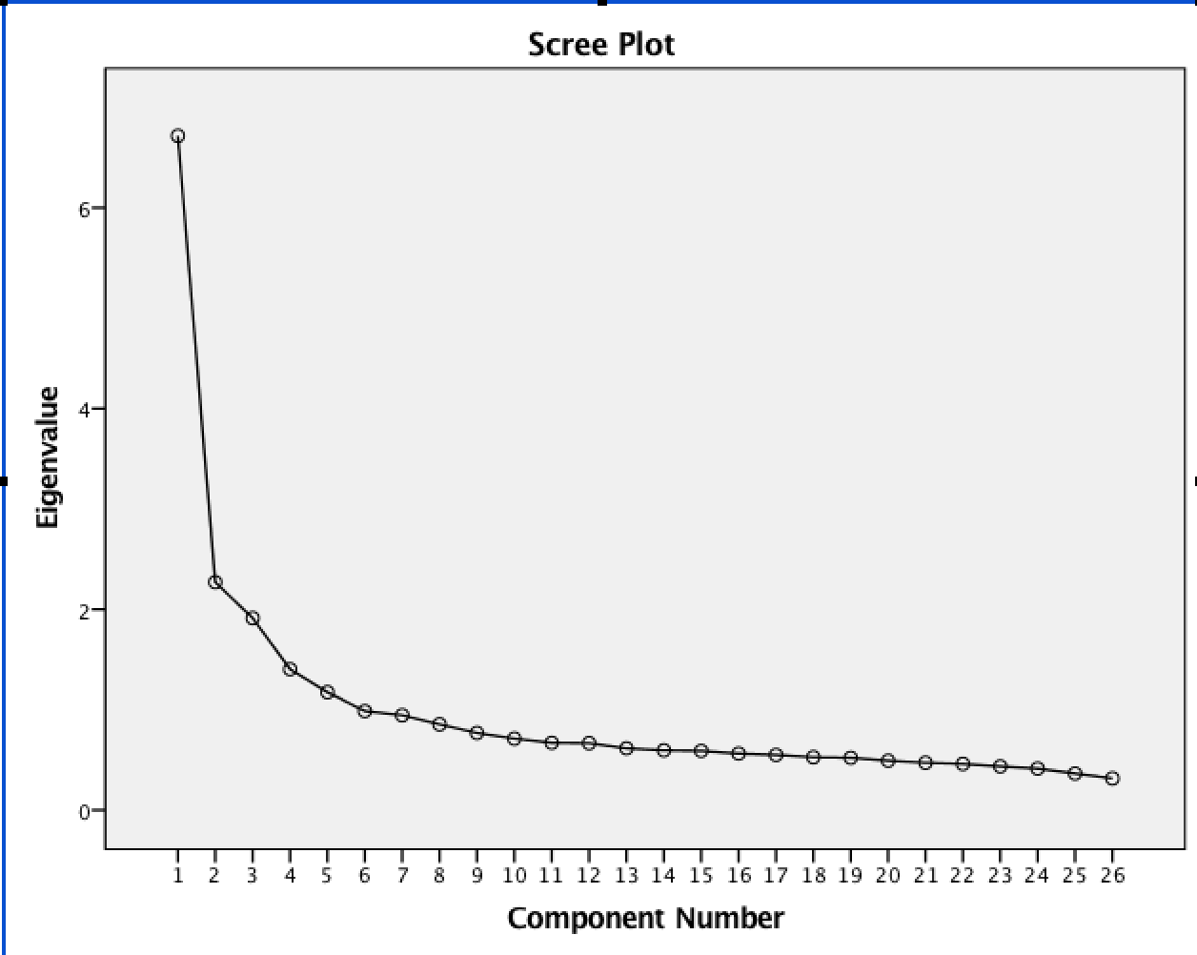
Exploratory Factor Analysis
From the Scree Plot we can see that there is no significant decrease of Eigenvalue after the 5th component.
Therefore five principal factors is created and we will try to interpret the factors based on the ranking of loading in front of the variables as well as the meaning of the variables themselves.

Slide 15
Exploratory Factor Analysis
We classify the questionnaire into mainly 6 parts: 1. Ethics with Interest 2. Meaning of Life 3. Ethics without Interest 4. Sex related 5. Happiness
6. Ordinary question V91 V146

Slide 16
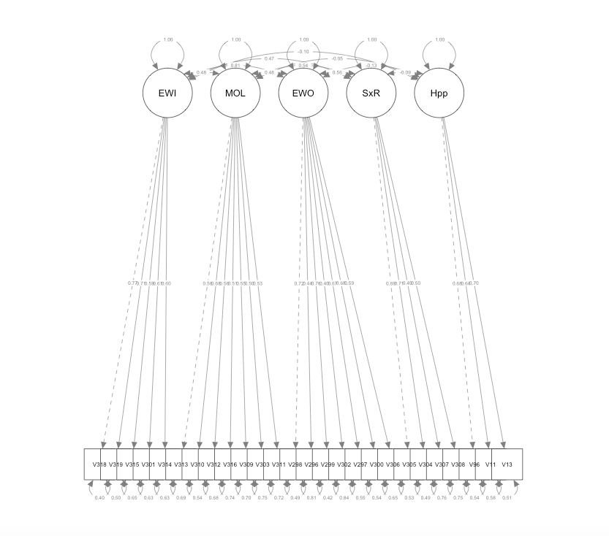
Confirmatory Factor Analysis
We use what we have defined as the model: 1. Ethics with Interest 2. Meaning of Life 3. Ethics without Interest 4. Sex related 5. Happiness

Slide 17
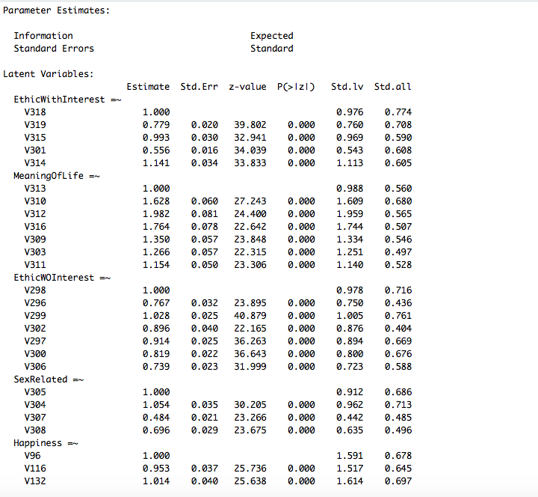
Confirmatory Factor Analysis
Aggregate the questions by using the linear combination of different variables and their loadings: 1. Ethics with Interest 2. Meaning of Life 3. Ethics without Interest 4. Sex related 5. Happiness

Slide 18
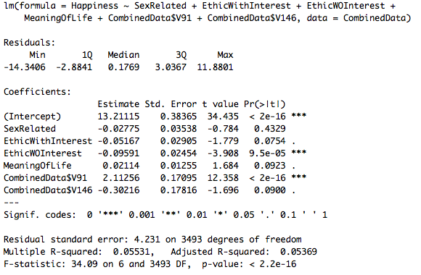
Linear Regression on Happiness
Conducting less bad behaviours will lead to more happiness
Having a belief will more likely to bring us a sense of joy.

Slide 19
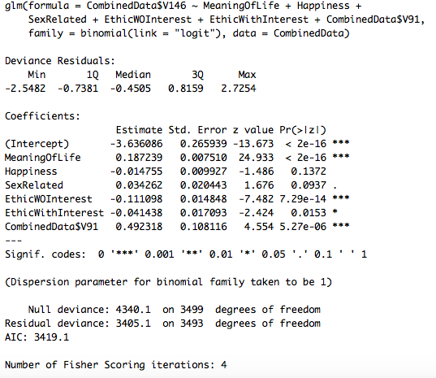
Regression on religion
Binary data, use logistic regression.
People will seek religion for redemption.
Misbehaviour individuals will probably not believe in religion.
Those who are depressed are not likely to seek help from religion.

Slide 20
Analysis on two data set using
Mean Test

Slide 21
Mean Test — T test with equal or unequal variance
To explore some interesting findings behind two data sets, we performed mean test to see any big difference between the two nations and two gender in various aspects.
First, a F-test was conducted to check the equality of variace of China and India data sets.
Then we were able to choose a suitable T test for analysis the means.

Slide 22
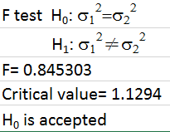
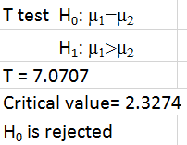
Mean Test — mean difference between China and India
For example, to analyze “V96 All things considered, how satisfied are you with your life as a whole these days?” , we first conducted a F test to check equality of variance.
We found that the null hypothesis was accepted so we adopted the T test with equal variance.
As a result, we could say that Chinese have a higher satisfaction level than Indian.

Slide 23
Mean Test — Interpretation of findings between nations
So when we conducted all the mean test of the two data sets classified by nations, we could show some meaningful findings as follows:
1. Chinese have a higher satisfaction level than Indian (V96) 2. Drug taking is more common in India than that in China (V301) 3. Suicide problem is more serious in China than that in India (V313)

Slide 24
Mean Test — Interpretation of satisfaction level between nations
For China: 1. More developed country with better living standard 2. More mature industries provides tertiary working opportunities which are less physical 3. Advanced technology makes people more convenient
For India: 1. Less developed country with lower living standard 2. Emphasize on primary industry such as agriculture and mining which are very physical

Slide 25
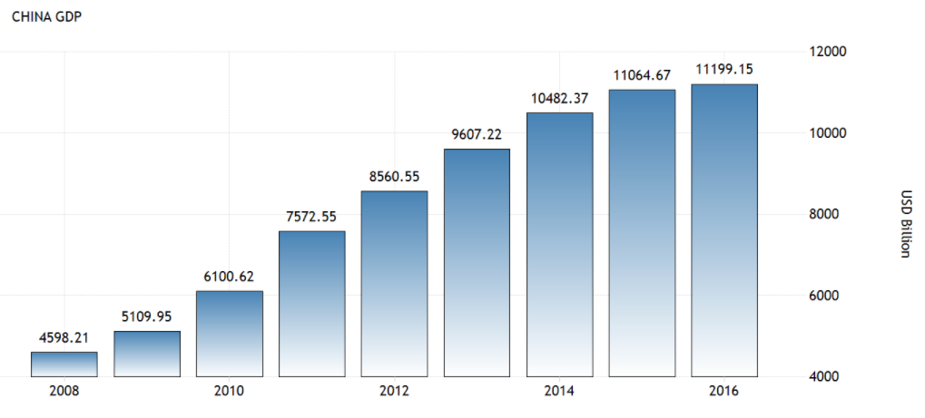
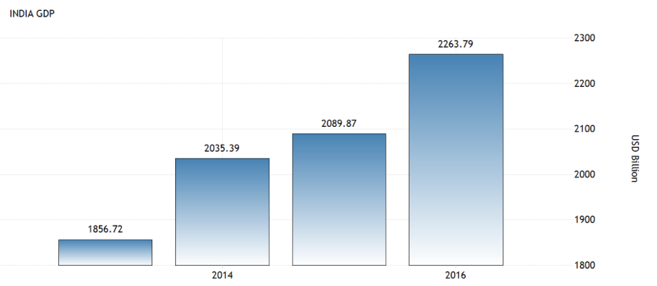
Mean Test — Interpretation of satisfaction level between nations
In comparison, we quoted the GDP of two countries to show the difference.
We can see the economy of China is much better
11199.15
2263.79

Slide 26
Mean Test — Interpretation of hashish taking problem between nations
For China: 1. Heavy punishment towards drug taking according to the law e.g. execution and long period imprisonment 2. Toughly restricted on drug imports in recent years 3. Local production of hashish is not common
For India: 1. Relatively light penalty towards drug taking e.g. money penalty and short imprisonment (10-20 years only for serious drug trading) 2. One of the major hashish production nation over the world, even export bulky amount of hashish.

Slide 27
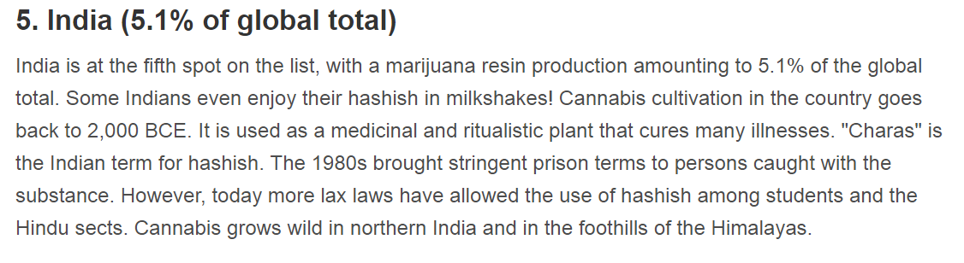
Mean Test — Interpretation of hashish taking problem between nations
Suppport: India is the fifth largest producer of hashish over the world while China not even in the top 10 list.

Slide 28
Mean Test — Interpretation of suicide problem between nations
For China: 1. Related law is unclear → unable to keep people from suicide 2. Higher pressure among daily life make people decide to commit suicide
For India: 1. Legal restriction on suicide 2. Religion as a great stoppage due to the high percent coverage of religious polulation

Slide 29
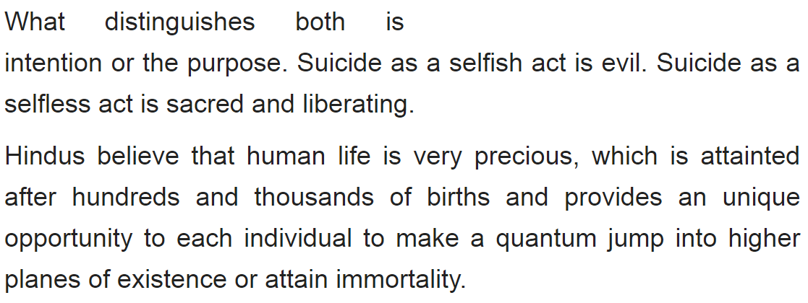
Mean Test — Interpretation of suicide problem between nations
Support:
Excerpted from article “About suicides in Hinduism” by Jayaram V

Slide 30
Mean Test — Sex under the legal age of consent between China Male and China Female
Acceptance level of China Male is higher than China Female
For male:
The physical burden or physical impact towards a male having sex under age of consent is not distinct with that to a adult male.
The concept of virginity of male in China is not emphasied.
For female:
Women might got pregnant after sexual intercourse which is not ready physically, mentally or economically.
woman’s own sexual pleasure was not considered important, but virginity is placed utmost importance.

Slide 31
Mean Test — Sex under the legal age of consent between China Male and China Female
Longtime women’s rights advocate Feng Yuan explains that the virgin complex has historical origins in patriarchal family structures. Lineage was crucial, and there were no DNA tests to prove paternity, so marrying a virgin was one way for men to safeguard their genetic lines. “This ‘blood is thicker than water’ notion was etched in the Chinese mindset, and it still influences some people’s views today,” she says. “In the patriarchal society, women were trophies to reflect male sccuess and achievement,” Feng argues. The thinking was that virgins could belong to their men entirely, because they had never been ‘possessed’ by another man before. As a woman’s own sexual pleasure was not considered important, given her duty to bear children, it was thought improper for a woman to have sex before marriage.
Quoted from article “Why is China Still Obsessed With Virginity”?

Slide 32
Mean Test — acceptance to divorce between China Female and India Female
Acceptance level of China Female is higher than India Female
For China female:
More economic independence.
The marriage background of the women were not placed emphasis on.
divorce rate is 2.8% in 2015
For India female:
The dependence of economy of women limited the possibility to pursue true love.
Marriage background is very important, divorce leads to negative intuition towards the women.
Once they are married couples will often remain in the relationship just to protect the honor of the two families.
divorce rate is 0.4% in 2013
Quoted from article “Why is divorce a big taboo in India?”
Quoted from “Divorce statistics by country”

Slide 33
Mean Test — acceptance to divorce between China Female and India Female
India:
1. Traditionally, Indian women have been housewives only. Their sole source of livelihood has been their parents before marriage, their husbands after marriage and their sons if the husband dies or becomes financially incapable in his old age. No jobs, no inheritance from parents, no education and no know-how of dealing with many aspects of the world in absence of a male member of the family. There have been many exceptions, of course, but this is mostly how it used to be and still is in large parts of India.
2. The re-marriage of divorcees has been a thorny issue in Indian society. There is the mentality that there must be something wrong with the person,if he/she couldn't make the last marriage work. Ours being a patriarchal society, somehow it works in worse ways for the women than for the men.
Quoted from article “Why is divorce a big taboo in India?”

Slide 34
Mean Test — acceptance to divorce between China Female and India Female
China:
Many relationship experts and lawyers put the rising divorce rate down to higher expectations and growing financial independence, especially among women. But buried in the sharply climbing statistics lies a darker truth: domestic violence and extramarital affairs together are the leading causes of divorce in China.
Quoted from article “Why millions of Chinese people are filing for divorce every year”

Slide 35
Mean Test — acceptance to Abortion between China Female and India Female
Acceptance level of China Female is lower than India Female
For China female:
Better knowledge on contraceptives.
Higher restrictions towards abortion
For India female:
Lack of use of condoms and other contraceptives
Easy to reach for the abortion pills

Slide 36
Mean Test — acceptance to Abortion between China Female and India Female
According to government data released in August 2009, 13 million abortions a year are performed in China, mostly on single young women. The true figure is thought to be much higher. The numbers included only abortions performed at hospitals and did include those done at unregistered rural clinics, where a lot of abortions are performed, or medication-induced abortions. According to the data about 10 million abortion pills are sold every year and half the women who get abortion used no contraception. [Source: China Daily]
Quoted from article “1.6 crore abortions a year in India, 81% at home: Study”

Slide 37
Mean Test — acceptance to Abortion between China Female and India Female
A total of 15.6 million (1.56 crore) abortions took place across India in 2015, against the 7 lakh figure the Centre has been putting out every year for the last 15 years, according to a research paper published in The Lancet Global Health medical journal on Monday.
Quoted from article “Facts and Details of Abortion in China”

Slide 38
Mean Test — acceptance to married men /women having an affair between China Female and India Female
Acceptance level of China Female is larger than India Female
For China female:
Higher education
High ability to make money leading to economic independence
For India female:
Relatively lower education
Hard punishment with imprisonment

Slide 39
Mean Test — acceptance to married men /women having an affair between China Female and India Female
Both male and female “cheaters” make more monthly income and are relatively better educated that the average males and females. According to these descriptive statistics, more “feminist” females, as indicated by their less likely to do chores and less likely to agree the idea that women’s position is at home as compared to the average Chinese women are more likely to cheat on their spouse.
Quote from article “Extramarital Affairs in China: A Feminist Approach ”

Slide 40
Mean Test — acceptance to married men /women having an affair between China Female and India Female
Section-497- Adultery “Whoever has sexual intercourse with a person who is and whom he knows or has reason to believe to be the wife of another man, without the consent or connivance of that man, such sexual intercourse not amounting to the offence of rape, is guilty of the offence of adultery, and shall be punished with imprisonment of either description for a term which may extend to five years, or with fine, or with both. In such case, the wife shall not be punishable as an abettor.” Section-498- Enticing or taking away or detaining with criminal intent a married woman “Whoever takes or entices any woman who is and whom he knows or has reasons to believe to be the wife of any other man, from that man, or from any person having the care of her on behalf of that man, with intent that she may have illicit intercourse with any person or conceals or detains with that intent any such woman, shall be punished with imprisonment of either description for a term which may extend to two years, or with fine, or with both”.
Quote from article “What legal punishment is there for a husband or a wife in Indian Law if they are having extra-marital affairs?”
Notes:
want to sleep arrr

Slide 41
Analysis on two data set using
Logistic Regression Model

Slide 42
Binary Logistic Regression Model
Binary logistic regression model is a regression model where the dependent variable is categorical variable, and the output can only take the value ‘0’ or ‘1’.
In the regression model, the coefficient for each independent variable gives the size of the effect that independent variable is having on the dependent variable, and the sign of the coefficient (positive or negative) gives the direction of the effect.

Slide 43
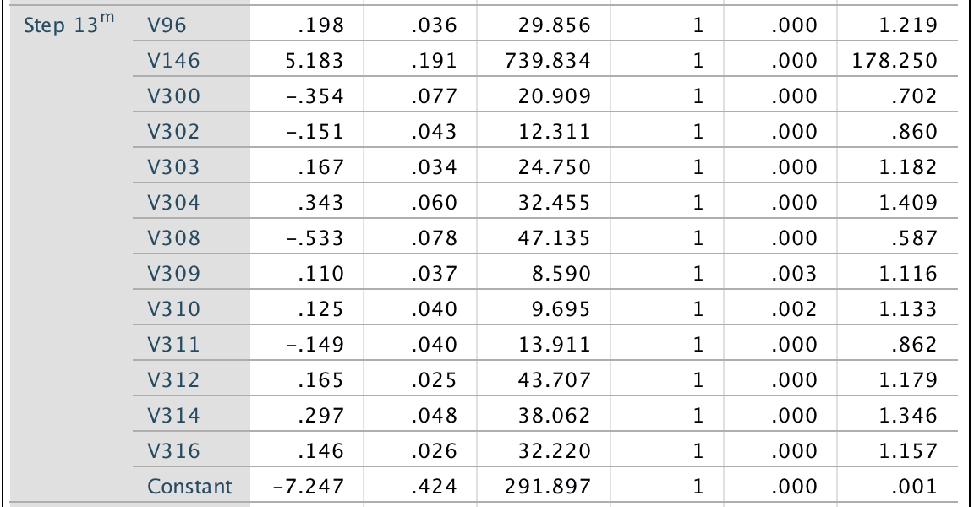
Binary Logistic Regression Model — Nation
We combine the data set of China and India and add a categorical variable with 0 corresponding to India and 1 corresponding to China.
Using SPSS to perform the stepwise binary logistic regression with alpha = 0.05 and the Hosmer-Lemeshow test to test goodness of fit of the model.
Input the nation indicator as dependent variable, and all other data as independent variable without variable V355 (age) and V353 (Gender)
The logistic regression model is :
Y=-7.244+0.198*V96+5.183*V146-0.354*V300-0.151*V302+0.167*V303+0.343*V304-0.533*V308+0.110*V309+0.125*V310-0.149*V311+0.165*V312+0.297*V314+0.146*V316

Slide 44
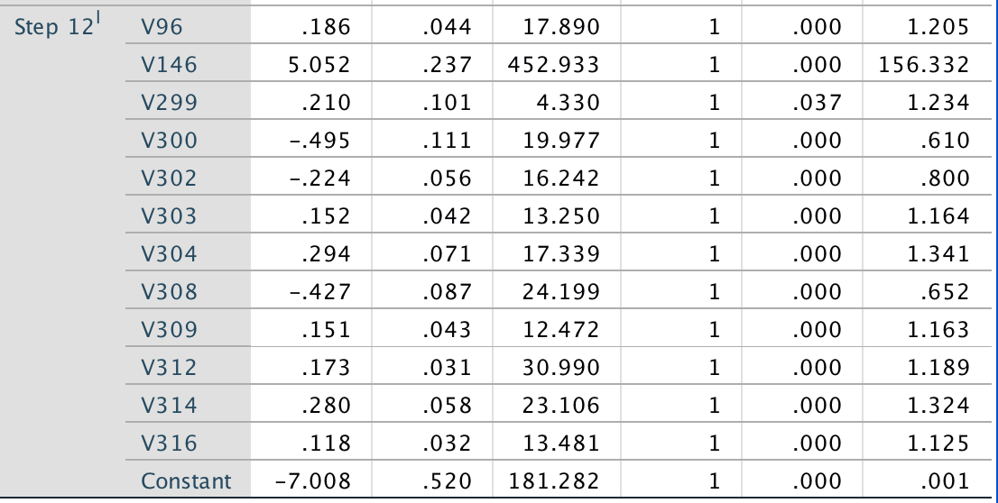
Binary Logistic Regression Model — Nation (Male)
Since there too many variable included, in order to make it more easy to analyze, we perform the stepwise logistic regression again with only male data and female data.
The logistic regression model of Male is :
Y=-7.008+0.186*V96+5.052*V146+0.210*V299-0.495*V300-0.224*V302+0.152*V303+0.294*V304-0.427*V308+0.151*V309+0.173*V312+0.28*V314+0.118*V316

Slide 45
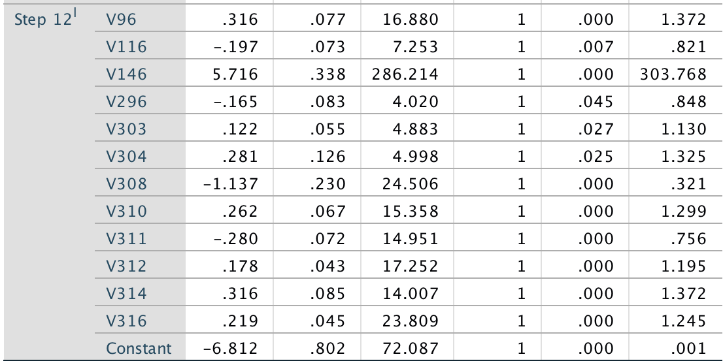
Binary Logistic Regression Model — Nation (Female)
The logistic regression model of female is :
Y=-6.812+0.316*V96-0.197*V116+5.716*V146-0.165*V296+0.122*V303+0.281*V304-1.137*V308+0.262*V310-0.28*V311+0.178*V312+0.316*V314+0.219*V316

Slide 46
Binary Logistic Regression Model — Differences between two Nation
Nation: Y=-7.064+0.206*V96+5.175*V146+0.187*V299-0.333*V300-0.421*V301-0.168*V302+0.160*V303+0.337*V304-0.49*V308+0.102*V309+0.135*V310-0.159*V311+0.163*V312+0.288*V314+0.144*V316
Nation(Male): Y=-7.008+0.186*V96+5.052*V146+0.210*V299-0.495*V300-0.224*V302+0.152*V303+0.294*V304-0.427*V308+0.151*V309+0.173*V312+0.28*V314+0.118*V316
Nation(Female): Y=-6.812+0.316*V96-0.197*V116+5.716*V146-0.165*V296+0.122*V303+0.281*V304-1.137*V308+0.262*V310-0.28*V311+0.178*V312+0.316*V314+0.219*V316
Among the three model, V146 and V308 appear with relatively high coefficient.
Meaning that these two questions have a significant effect for predicting the nationality of the respondents.
In other words,there are value differences towards these two questions between Chinese and Indian.

Slide 47
Binary Logistic Regression Model — Differences between two Nation
(V146)
V146 Were you brought up religiously at home?
Yes 1 No 2
V146 is a question asking about the religion.
It is categorical variable with 0 corresponding to Yes and 1 corresponding to No.
The positive coefficient means that Chinese tends to answer ‘No’ while Indian tends to answer ‘Yes’
Support :
A 2015 Gallup poll reported that 90% of Chinese citizens classify themselves as atheists or non-religious.
While Hinduism is the dominant religion in India, where Hindus form about 80 percent of the total population.

Slide 48
Binary Logistic Regression Model — Differences between two Nation
(V308)
V308 Prostitution
1 2 3 4 5 6 7 8 9 10
Never Always
V308 is a question asking about the prostitution, which is something about sexual.
The negative coefficient means that Chinese tends to answer smaller value while Indian tends to answer bigger value
In other words, Indian tends to support prostitution while Chinese tends to oppose prostitution.
Support :
In China, prostitution is illegal. China publish the law Decision on Strictly Forbidding the Selling and Buying of Sex (严禁卖淫嫖娼的决定) in 1991.
While in India, prostitution is illegal if soliciting such services at public places, carrying out such activities in hotels, being an owner of a brothel or even running one , etc.
Meaning that prostitution basically is legal in India.

Slide 49
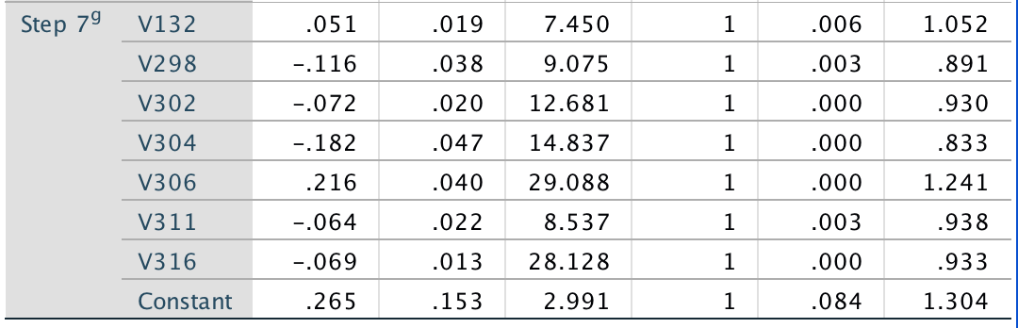
Binary Logistic Regression Model — Gender (India)
To investigate more about the value difference among gender between two country.
Similarly, we built up the binary logistic regression model for gender using the V353 (gender) as the dependent variable.
The logistic regression model of India is :
Y=0.265+0.051*V132-0.116*V298-0.072*V302-0.182*V304+0.216*V306-0.064*V311-0.069*V316

Slide 50
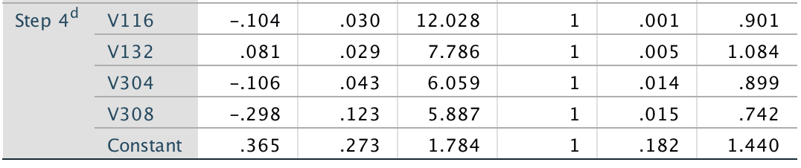
Binary Logistic Regression Model — Gender (China)
The logistic regression model of China is :
Y=0.365-0.104*V116+0.081*V132-0.106*V304-0.298*V308

Slide 51
Binary Logistic Regression Model — Similarities among gender between two Nation
India : Y=0.265+0.051*V132-0.116*V298-0.072*V302-0.182*V304+0.216*V306-0.064*V311-0.069*V316
China : Y=0.365-0.104*V116+0.081*V132-0.106*V304-0.298*V308
For the two model, both of them include the questions V132 with similar positive coefficient and V304 with similar negative coefficient.
Meaning that for V132 female tends to answer bigger value while V304 male tends to answer bigger value in both country.
In other words, for China and India, both male and female have similar values towards these two questions.
For other general discovery of logistic regression model, we will put it in the written report.

Slide 52
Problems on questionaire
Lack of question focused on political aspect
Some question may not reflect the actual situation between the two nations and cause bias e.g. Question about drug taking places the emphasis on hashish but not including other drugs such as cocaine and heroin
Most of the questions are too general where respondents may not able to answer accurately.

Slide 53
Limitation
The sample size of the data is definitely too small. Around 1000 and 2500 of samples can not cover various kinds of people as we do not know the sampling method.
Missing data may cause bias during analysis even we made redemption on filling them.

Slide 54
Reference
http://www.sixthtone.com/news/1000261/why-is-china-still-obsessed-with-virginity%3F
https://www.quora.com/Why-is-divorce-a-big-taboo-in-India
https://thediplomat.com/2017/07/indias-abortion-epidemic/
http://www.everydaywisdomforhealthyliving.net/divorce-rate-in-India.html
https://en.wikipedia.org/wiki/Divorce_demography
http://www.scmp.com/news/china/society/article/2117424/why-millions-chinese-people-are-filing-divorce-every-year
http://factsanddetails.com/china/cat4/sub15/entry-4312.html
https://timesofindia.indiatimes.com/india/1-6-crore-abortions-a-year-in-india-81-at-home-study/articleshow/62030066.cms
http://paa2007.princeton.edu/papers/71430
https://www.quora.com/What-legal-punishment-is-there-for-a-husband-or-a-wife-in-Indian-Law-if-they-are-having-extra-marital-affairs
htt/ps:/www.analyticsvidhya.com/blog/2016/03/tutorial-powerful-packages-imputing-missing-values/
https://tradingeconomics.com/china/gdp
https://tradingeconomics.com/india/gdp https://www.statista.com/statistics/256598/global-inflation-rate-compared-to-previous-year/ https://www.worldatlas.com/articles/countries-producing-the-most-marijuana-resin.html http://www.hinduwebsite.com/hinduism/h_suicide.asp
https://www.chinahighlights.com/travelguide/religion.htm
http://factsanddetails.com/world/cat55/sub354/item1358.html
https://en.wikipedia.org/wiki/Prostitution_in_China#Legal_responses
https://www.mapsofindia.com/my-india/india/legal-prostitution-in-india
http://www.real-statistics.com/handling-missing-data/types-of-missing-data

