Slide 1
Generative Pretraining from Pixels
Mark Chen, Alec Radford, Rewon Child, Jeff Wu, Heewoo Jun, Prafulla Dhariwal, David Luan, llya Sutskever
ICML 2020
Presented by Mingyu Yang

Slide 2
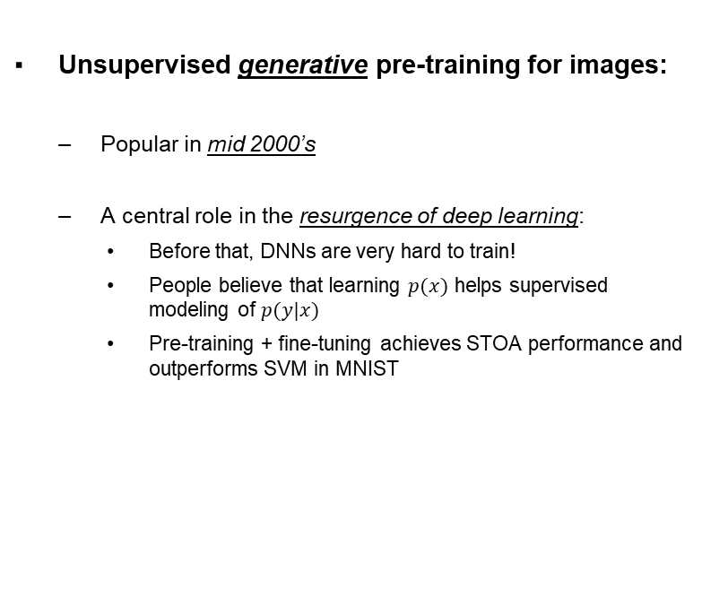
Background
Unsupervised generative pre-training for images:
Popular in mid 2000’s
A central role in the resurgence of deep learning:
Before that, DNNs are very hard to train!
People believe that learning $p(x)$ helps supervised modeling of $p(y|x)$
Pre-training + fine-tuning achieves STOA performance and outperforms SVM in MNIST

Slide 3
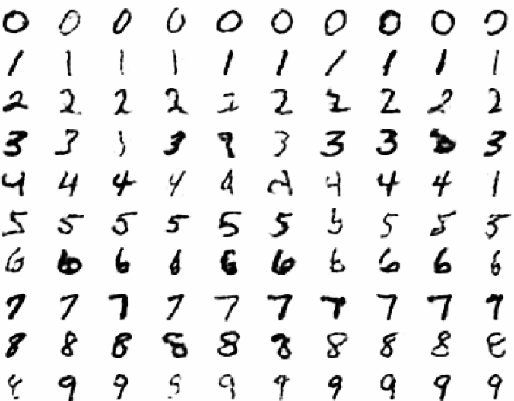
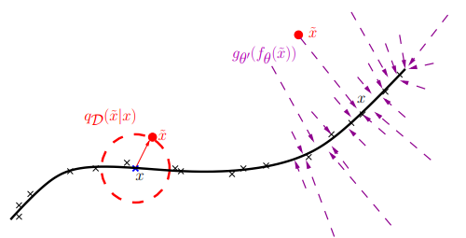
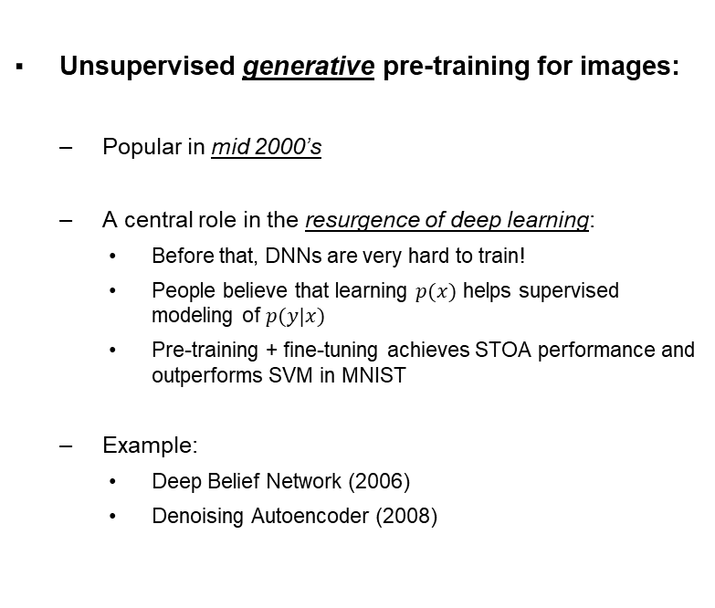
Background
Unsupervised generative pre-training for images:
Popular in mid 2000’s
A central role in the resurgence of deep learning:
Before that, DNNs are very hard to train!
People believe that learning $p(x)$ helps supervised modeling of $p(y|x)$
Pre-training + fine-tuning achieves STOA performance and outperforms SVM in MNIST
Example:
Deep Belief Network (2006)
Denoising Autoencoder (2008)
Digits generated from Deep Belief Networks
Manifold learning perspective of denoising autoencoder

Slide 4
Background
Unsupervised generative pre-training becomes less popular for images:
Deep Neural Networks are much easier to train
Better activation functions: ReLU, LeakyReLU, …
Improved initializations: Xavier, Kaiming, …
Normalization strategies: Batch Normalization …

Slide 5
Background
Unsupervised generative pre-training becomes less popular for images:
Deep Neural Networks are much easier to train
Better activation functions: ReLU, LeakyReLU, …
Improved initializations: Xavier, Kaiming, …
Normalization strategies: Batch Normalization …
Supervised pre-training achieves better performance

Slide 6
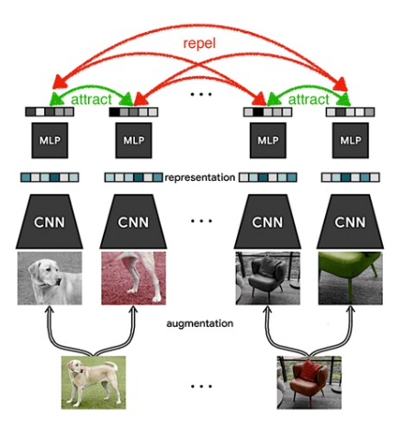
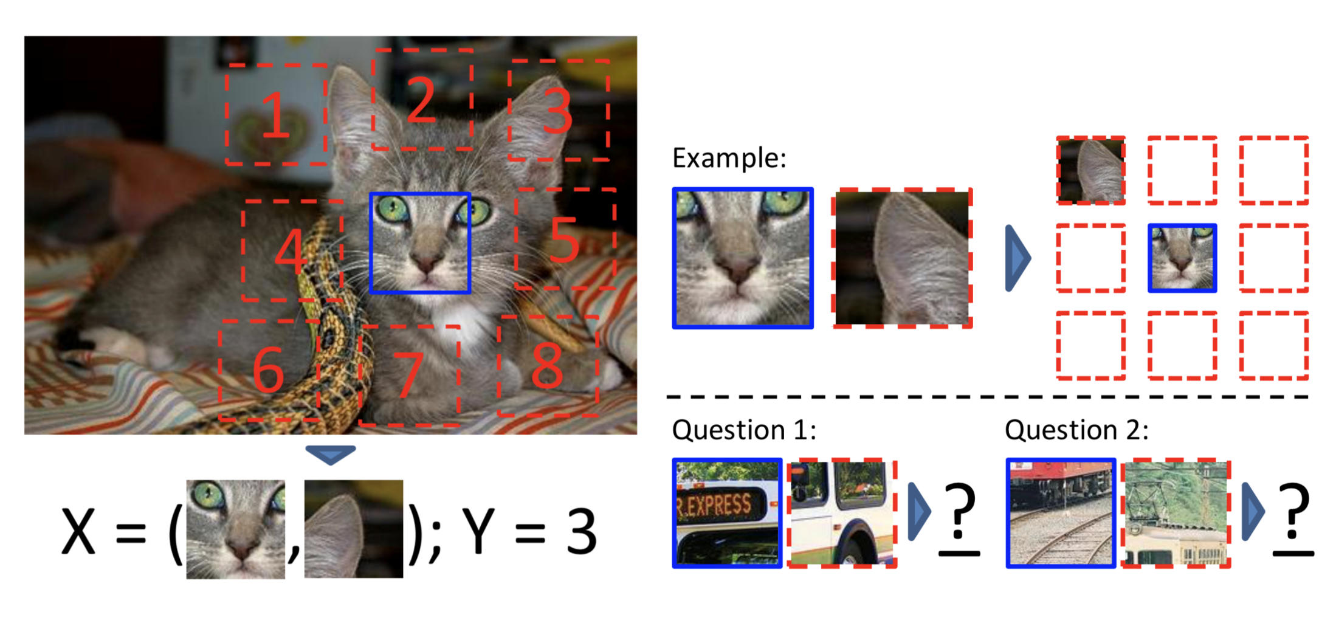
Background
Unsupervised generative pre-training becomes less popular for images:
People design different self-supervised learning methods model global structures (by solving pretext tasks) instead of the distribution
Predict relative positions
Mutual Information: AMDIM
Contrastive learning: MoCo, SimCLR
SimCLR (Chen et al., 2019)
Predicting relative positions (Doersch et al., 2015)

Slide 7



Background
Unsupervised generative pre-training flourished in NLP!
Learn the language model as pre-training
BERT (2018):
GPT-2 (2019), GPT-3 (2020):
Predict masked words: Conditional probability
Autoregressive model

Slide 8
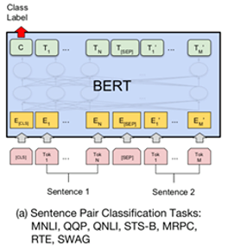
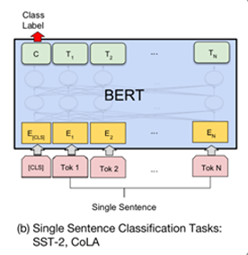
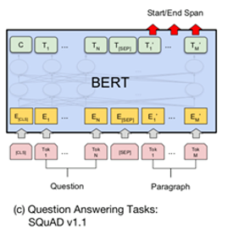
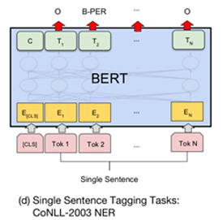
Background
Unsupervised generative pre-training flourished in NLP!
Fine-tuning for different tasks

Slide 9
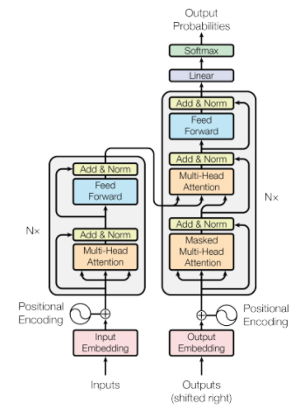
Background
Unsupervised generative pre-training flourished in NLP!
STOA methods benefit from attention mechanism
Transformer (2017)
Will be introduced later in this course
Motivation of this paper:
Can we do the same to images?
Can we get competitive performance?
Very similar to BigBiGAN presented last class
Autoregressive vs GAN
Transformer architecture

Slide 10
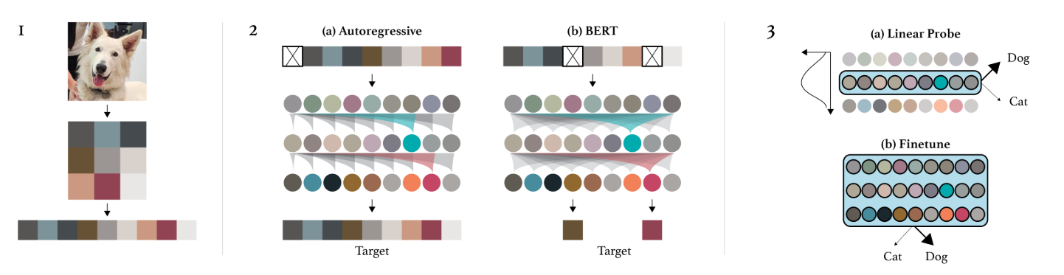
Method
Overview
Pre-processing
Pre-training
Fine-tuning

Slide 11
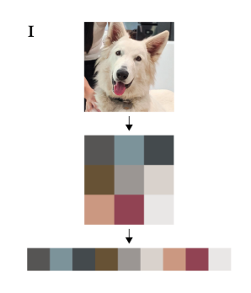
Method
Pre-processing:
Context Reduction:
Images are so large for transformers
ImageNet: 224x224x3
Downsampling:
Reduce the size to 32x32x3, 48x48x3, or 64x64x3
Reduce 3 dimensional (R,G,B) channels to 1 dimensional using K-means
512 clusters
Further reduce the size to 32x32, 48x48, or 64x64

Slide 12
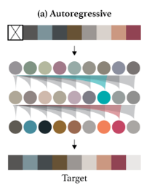


Method
Pre-training:
Autoregressive (AR):
Likelihood:
Minimize log-likelihood:
Raster order
Upper triangular mask to zero out the effect of future words (pixels)

Slide 13
Method
Pre-training:
Autoregressive (AR):
Likelihood:
Minimize log-likelihood:
Raster order
Upper triangular mask to zero out the effect of future words (pixels)

Slide 14
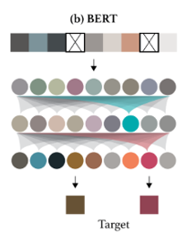

Method
Pre-training:
BERT:
Minimize the negative log-likelihood of the masked elements conditioned on the unmasked ones

Slide 15
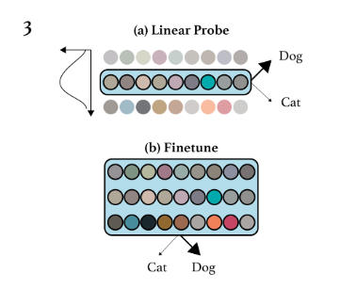
Method
Fine-tuning:
At each layer, each pixel gets a d-dimensional feature vector
Average pooling across the sequence dimension to get a d-dimensional feature vector for the whole image
Linear Probe & Fine-tuning

Slide 16

Method
Fine-tuning:
Linear Probe (transfer learning):
Treat the transformer as a fixed feature extractor
Learn a projection to class logits and minimize the cross entropy loss
Could extract the features at any intermediate layer

Slide 17

Method
Fine-tuning:
Fine-tuning:
Treat the learned transformer as an initialization
Learn a projection to class logits and minimize the joint objective

Slide 18
Method
More details:
Same model with GPT-2 with slight modification
 | # of layers | Embedding size | # of parameters
iGPT-S | 24 | 512 | 76M
iGPT-M | 36 | 1024 | 455M
iGPT-L | 48 | 1536 | 1.4B
iGPT-XL | 60 | 3072 | 6.8B
Model parameters

Slide 19
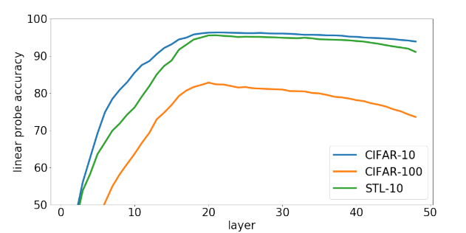
Evaluations for AR
Representations at different layers:
Linear probes for the features at different layers
Middle layers works the best (Not the last layer?)

Slide 20
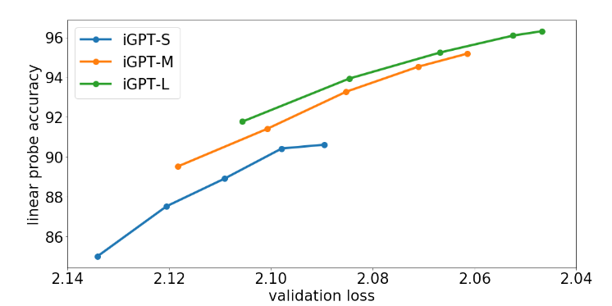
Evaluations for AR
Better generative models learn better representations:
Dotted markers denote checkpoints at steps 65K, 131K, 262K, 514K, and 1000K

Slide 21
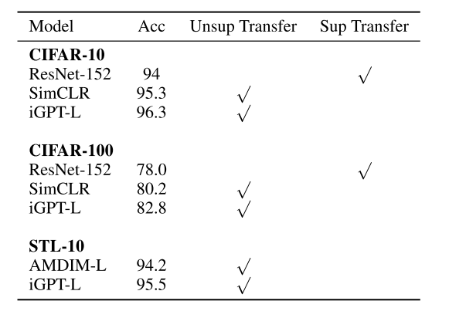
Evaluations for AR
Linear probes on CIFAR and STL-10:
Pre-trained on ImageNet
Outperform STOA unsupervised pre-training methods
pre-train with 32x32 down-sampled images
linear probes with 32x32 images
pre-train with 224x224 images
Transfer learning with 224x224 up-sampled images

Slide 22
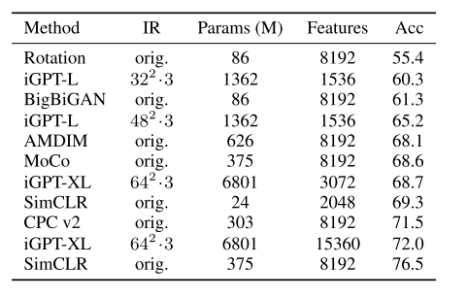
Evaluations for AR
Linear probes on ImageNet:
Comparable but not better performance than STOA (at that time)
Much larger model and longer features

Slide 23
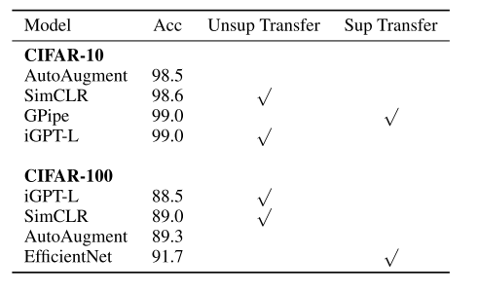
Evaluations for AR
Full fine-tuning:
Pre-trained on ImageNet
Achieve STOA performance on CIFAR-10
Achieve 66.3% on ImageNet with 32x32x3, which is worse than the STOA performance of 70.2% (Isometrix Neural Nets)

Slide 24
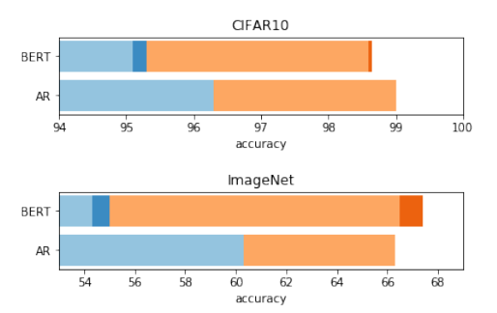
Evaluations for AR and BERT
BERT vs AR:
Linear Probes
Ensembling BERT masks
Fine-tuning
Ensembling BERT masks
AR outperforms BERT with linear probes
BERT catches up with fine-tuning

Slide 25
Summary
Pros:
Transformers do work for image pre-training
Achieves impressive performance on small dataset such as CIFAR-10
Large potential for future improvements (e.g., combine with CNN for large images, GPT-3, etc)
Cons:
Difficult to deal with high resolution images. Downsampling causes a loss of information
Huge memory and computation cost
Ignoring the spatial information

