Slide 1
First-Order Methods in Nonlinear Model Predictive Control
Dimitris Kouzoupis*
(H.J. Ferreau**, H. Peyrl**, M. Diehl*)
* Department of Microsystems engineering (IMTEK), University of Freiburg, Germany.
** ABB Corporate Research, Baden-Dätwill, Switzerland.

Slide 2
Outline
Principle of Model Predictive Control
Solving the underlying optimization problems
Application: Control of a pendulum on a cart

Slide 3
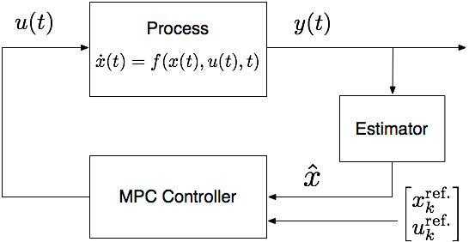

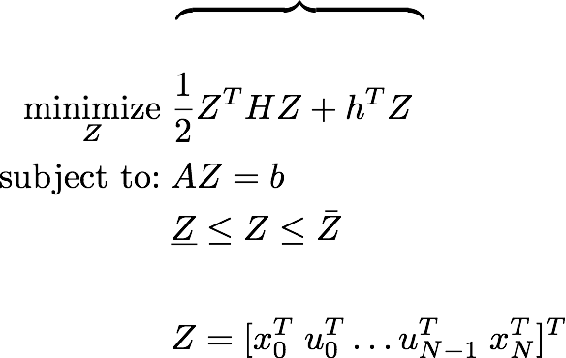
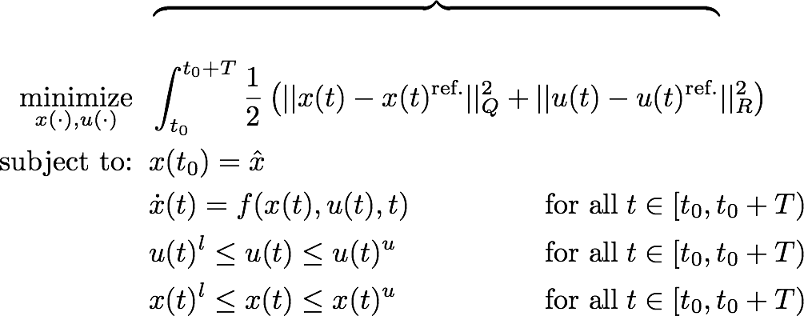
Principle of Model Predictive Control
Multiple shooting discretization
Real-Time Iteration scheme
Code generated integrators with sensitivity propagation
Interfaces to efficient Quadratic Programming (QP) solvers
xk value of states on grid points
uk value of controls on intervals
u0 applied control
ACADO
code generation
Structured QP

Slide 4
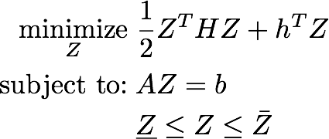
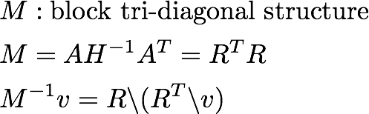
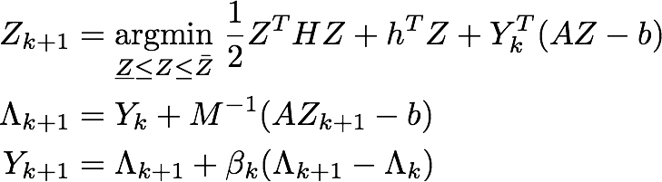
Solving the underlying QP subproblems
Many approaches for solving the arising QPs:
Interior-point methods
Active-set methods
First-order methods
…
Simple scheme
Parallelizable
Flexibility in trade-off between accuracy and performance
Generalized Dual Fast Gradient Method
Relaxation of equality constraints, unconstrained dual.
Matrix M allows different steps in different directions.
First step has an analytical solution when H is diagonal.

Slide 5
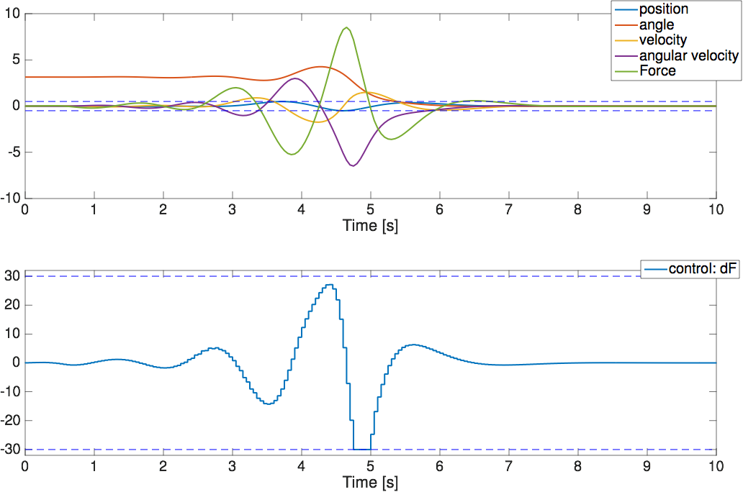
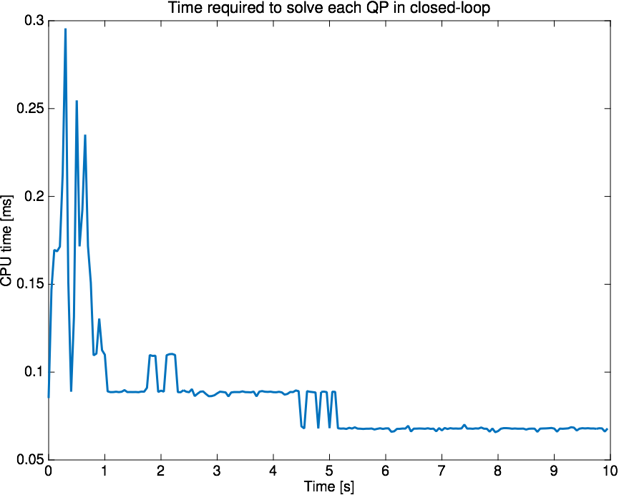
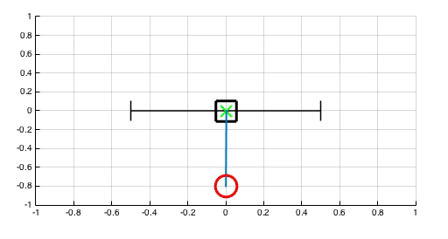
Control of pendulum on a cart
QP:
Ts = 50 ms
605 primal vars
505 dual vars

Slide 6
Conclusions
Fast, embedded MPC requires the solution of optimization problems with several hundred variables in a few milliseconds.
QP solvers based on first-order methods (e.g., fast gradient method, ADMM, …) are suitable candidates for real-time nonlinear MPC:
Simple, highly parallelizable algorithmic schemes.
Low cost per iteration.
Shifted optimal solution of previous QP provides a good initial guess that accelerates convergence.
References:
[1] D. Kouzoupis, H.J. Ferreau, H. Peyrl and M. Diehl, “First-Order Methods in Embedded Nonlinear Model Predictive Control”, in Proc. ECC, 2015.
[2] P.Giselsson, “Improved Fast Dual Gradient Methods for Embedded Model Predictive Control”, in Proc. IFAC World Congress, 2014.
[3] W. Zuo and Z. Lin, “A Generalized Accelerated Proximal Gradient Approach for Total-Variation-Based Image restoration”, IEEE Trans. on Image Processing, 2011.
[4] Y. Nesterov, Introductory lectures on convex optimization: a basic course, Kliwer Academic Publishers, 2004.
[5] www.acadotoolkit.org

Slide 7
Thank you for your attention.
Questions?

