Slide 1
Data assimilation for weather forecasting
G.W. Inverarity
06/05/15

Slide 2
Contents
What is data assimilation?
Global forecast optimization
Regional forecast optimization
Summary

Slide 3
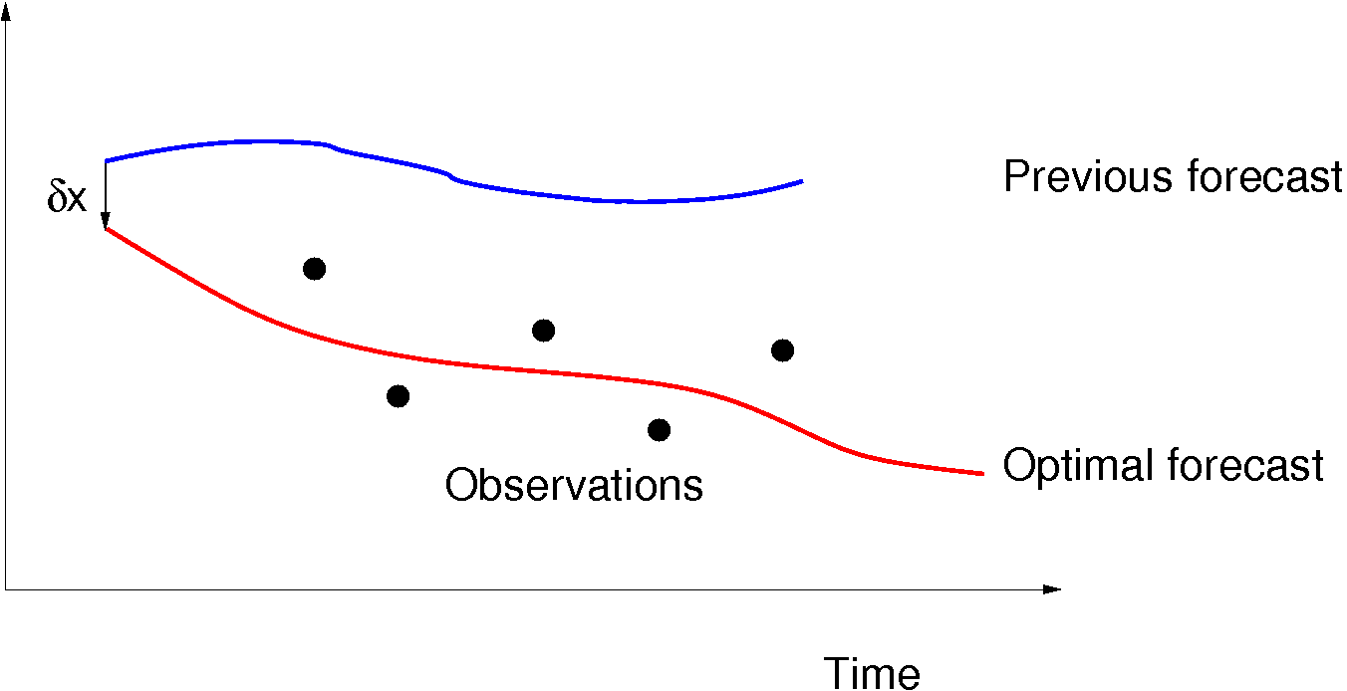
What is data assimilation?
We need to know the present state of the atmosphere to use as an initial condition for the forecast model.
Use observations collected in a recent time window to adjust the last forecast at the start of the window.
Majority of information comes from the forecast.

Slide 4
What is data assimilation?
Writing ||z||_{A}=(z^{T}A⁻¹z)^{1/2}
Good covariance representation of forecast and observation errors critical to success.
State vector typically has O(10⁹)elements so forecast-error covariance matrix with O(10¹⁸) entries is too large to represent explicitly. Either modelled using a sequence of transforms incorporating simplifying assumptions or estimated from an ensemble of forecasts.

Slide 5
Global forecast optimization
Observation operator and forecast model weakly nonlinear.
Conjugate gradient method preconditioned with Hessian eigenvectors.
Perform 30 minimization iterations of quadratic approximation to penalty function while computing leading eigenvectors.
Perform another 35 minimization iterations of the preconditioned penalty function, re-linearizing the observation operator every ten iterations.

Slide 6
Regional forecast optimization
Observation operator strongly nonlinear.
Limited-memory quasi-Newton minimization of non-quadratic penalty function.
Perform 10 minimization iterations, apply vertically adaptive grid (AG) transform, perform 10 minimization iterations, apply AG transform again then minimize to convergence (typically 60 iterations).

Slide 7
Summary
State vector has O(10⁹) elements but can only afford O(100) minimization iterations to assimilate O(10⁶) observations in 20 minutes for global or 5 minutes for regional forecast.
Global data assimilation uses Hessian-eigenvector preconditioned conjugate gradient method.
Regional data assimilation uses limited-memory quasi-Newton method.
Can we do better?

