Slide 1






Auto-tuned high-dimensional regression with the TREX: theoretical guarantees and non-convex global optimization
Jacob Bien¹, Irina Gaynanova¹, Johannes Lederer¹, Christian L. Müller^{2,3}
¹Cornell University, Ithaca ²New York University, ³Simons Center for Data Analysis, New York

Slide 2
High-dimensional variable selection in linear regression

Slide 3
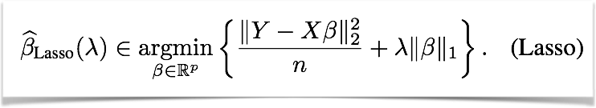
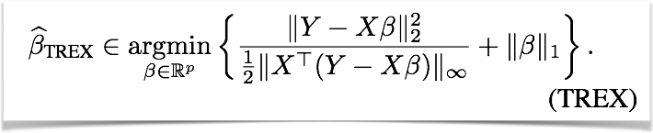
Standard approach: The LASSO (Tibshirani, 1996)
+ convex optimization problem
+ good statistical properties
- Tuning of regularization parameter required
Novel proposition: The TREX (Lederer and M., AAAI 2015)
+ good statistical properties
+ Tuning-free method
- non-convex optimization problem
BUT…

Slide 4
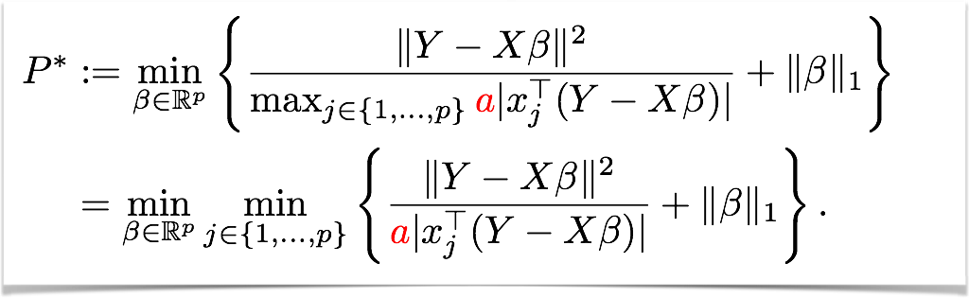
The non-convex TREX objective function can be globally optimally solved by using Second Order Cone Programming.
1.) The TREX (with e.g. constant a=0.5) can be written as:

Slide 5
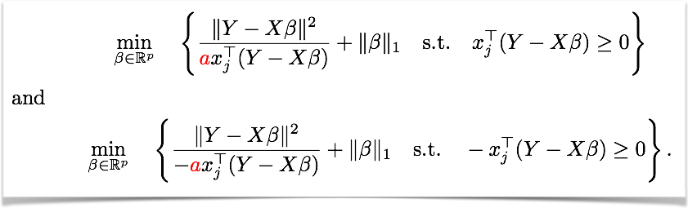
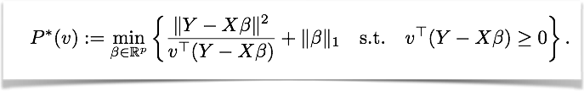
2.) For each index j this leads to a pair of problem of the form:
3.) or, in general, 2p problems of the quadratic over linear form:
Each problem is a Second-Order Cone Program!

Slide 6
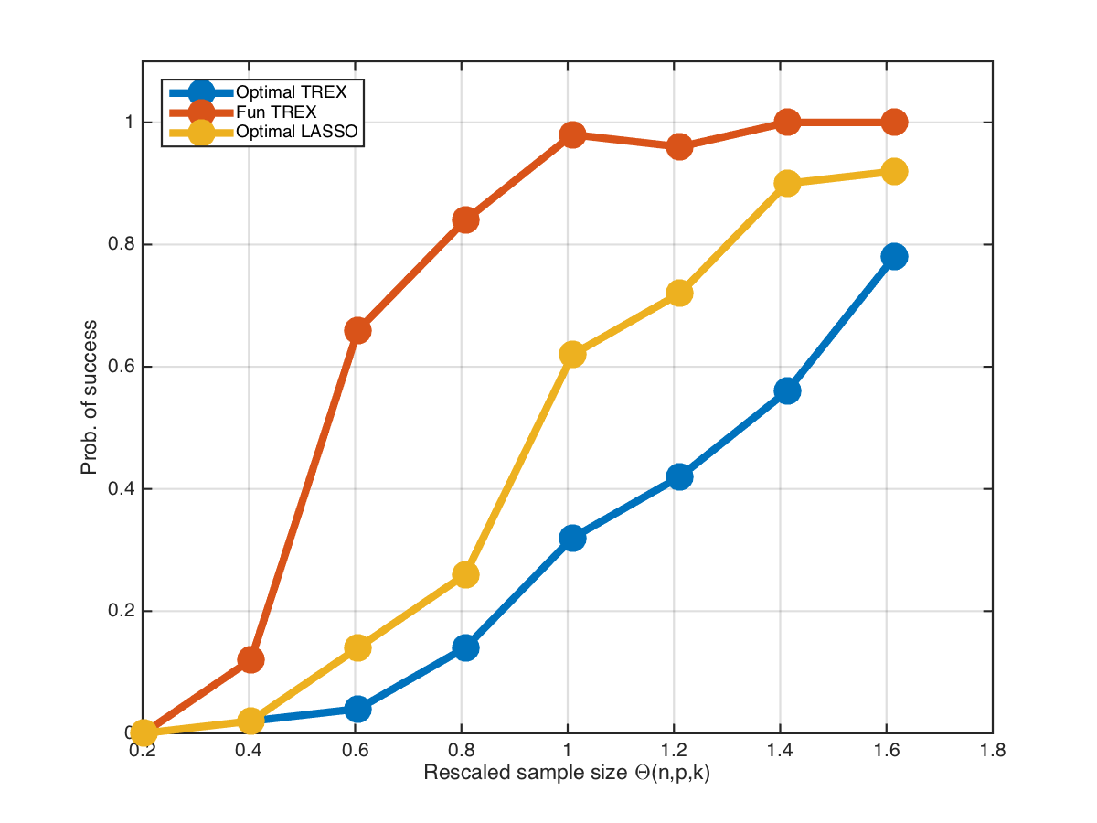
Phase transition of exact recovery with the TREX and the LASSO
p=64
k=0.2p^{0.75}
Prob. of EXACT recovery
Rescaled sample size Θ(n,p,k)=n/2 k log(p-k)
Figure 1: Success probability P[S±(β) = S±(β∗)] of obtaining the correct signed support versus the rescaled sample size θ(n, p, k) = n/[2k log(p − k)] for problem size p=64 with sparsity k = ⌈0.20 p^{0.75}⌉. The number of repetitions is 50. The optimal a=0.5 in TREX. The lambda in LASSO is automatically determined by MATLAB. Variable selection using the function gap property (Fun TREX) is shown in red.

Slide 7
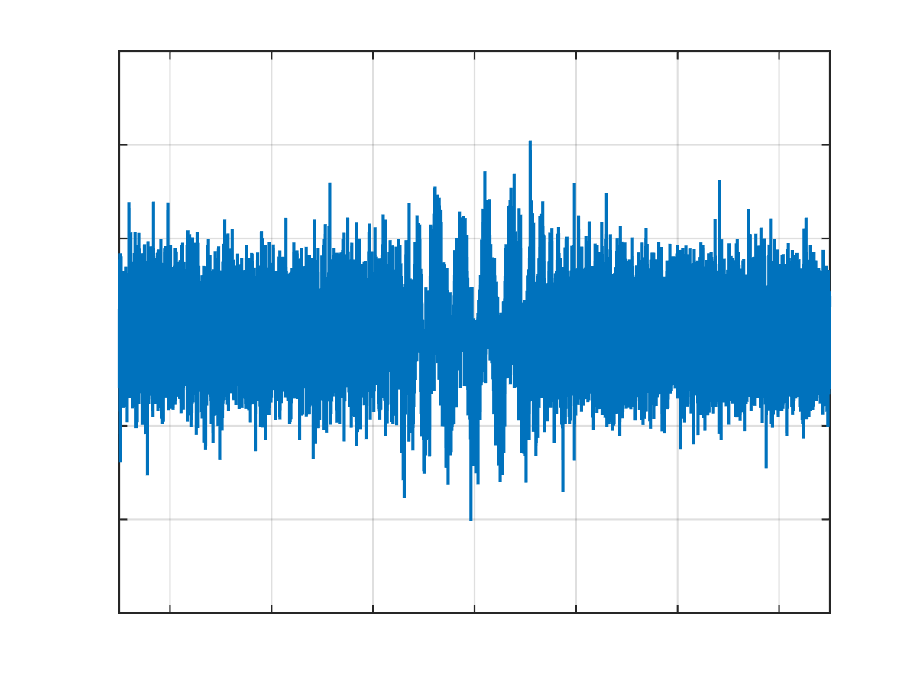
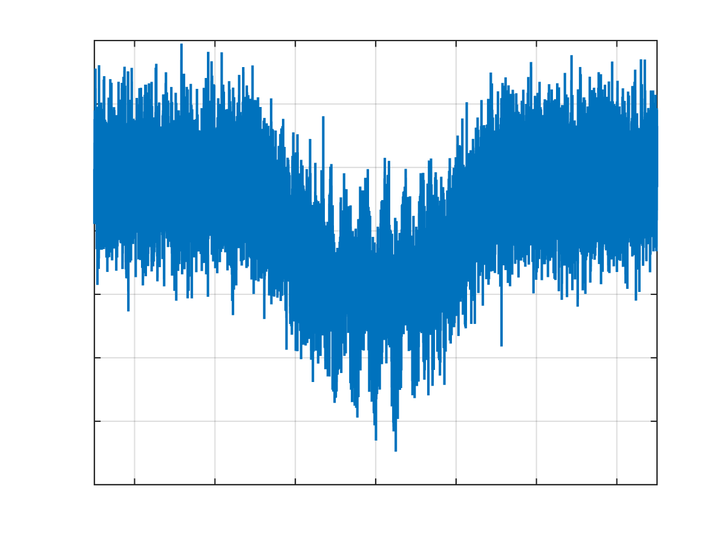
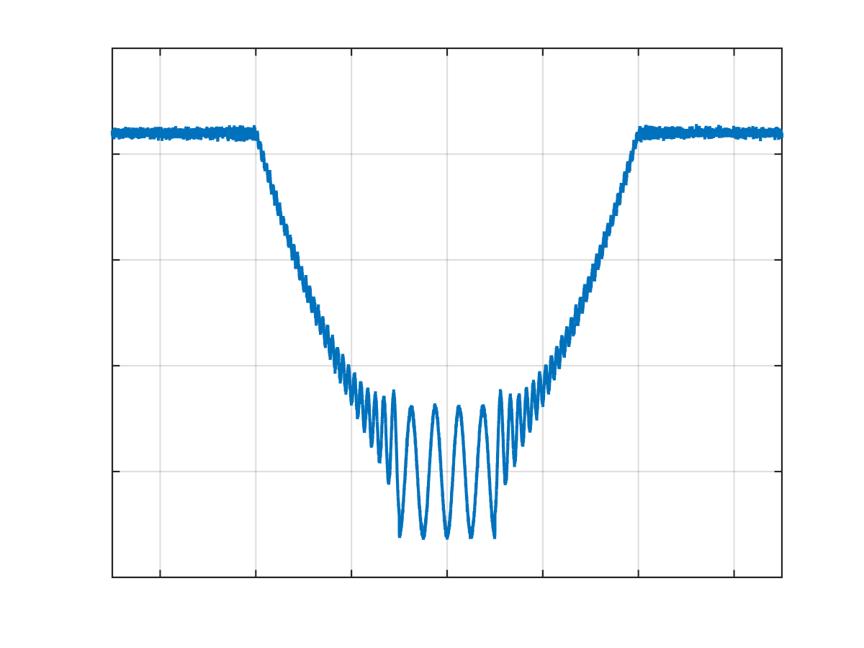
f_{TREX}
Sketching the topology of the TREX
Consider the case where data (p>>n) are generated from a linear model with a sparse β vector with k<<p non-zero entries of equal absolute value.
β_{TREX}
Increasing n
Solution space
The topology of the objective function can be used as an alternative variable selection method.
f_{TREX}
β_{TREX}
f_{TREX}
Solution space
β_{TREX}
Δf
k equivalent minima

Slide 8
How can we scale the TREX to BIG DATA?
Current solvers for SOCP
+ ECOS solver (Interior-Point method)
+ SCS solver (ADMM scheme)
Current solvers for local minimization of non-convex TREX function (smooth-non-convex + L1)
+ Projected scaled sub-gradient method (Mark Schmidt’s code)
+ Orthant-wise L-BFGS
+ Proximal gradient (Jason Lee’s package)
ANY IDEA HOW TO SPEED THINGS UP?

