Slide 1
Optimising parameter values in Climate Models: Observational/model synthesis
Simon Tett, Kuniko Yamazaki, Coralia Cartis, Mike Mineter and Lettie Roach

Slide 2
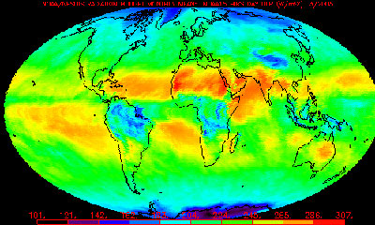

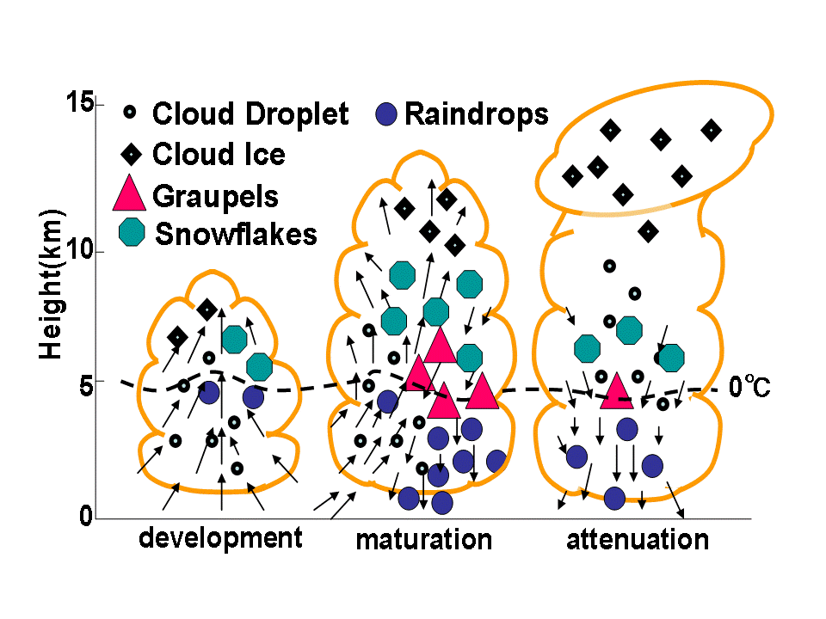
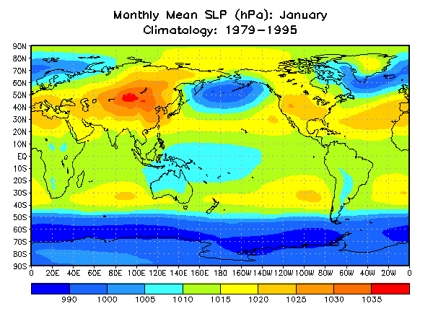
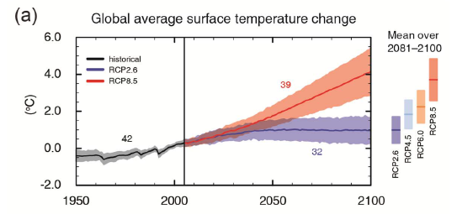
Climate models need to represent the effect of unresolved processes.

Slide 3
Optimisation
Parameters used in sub-grid scale models are uncertain.
Modifying them can have a large impact on the model simulation of observed climate and future climate.
Been experimenting with a Gauss-Newton algorithm to minimize model-observational difference by changing parameter values
Model runs as “batch” job on Eddie (or other computers) so some tricky technical issues.
Weighting of multiple observations by their inverse covariance.
Covariance matrix estimated from observational error and climate model noise.

Slide 4
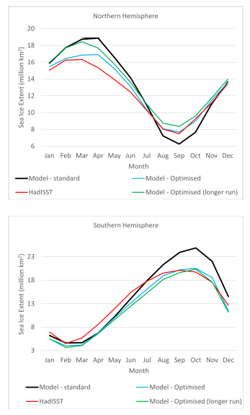
One example: Changing sea-ice parameters

