Slide 1
Distributed Optimization with Arbitrary Local Solvers
Optimization and Big Data 2015, Edinburgh
May 6-8, 2015
Jakub Konečný
joint work with Chenxin Ma, Martin Takáč – Lehigh University Peter Richtárik – University of Edinburgh Martin Jaggi – ETH Zurich

Slide 2
Introduction Why we need distributed algorithms

Slide 3
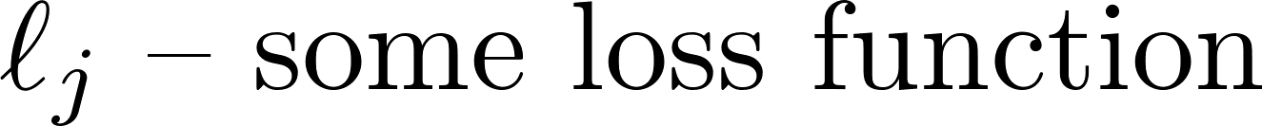
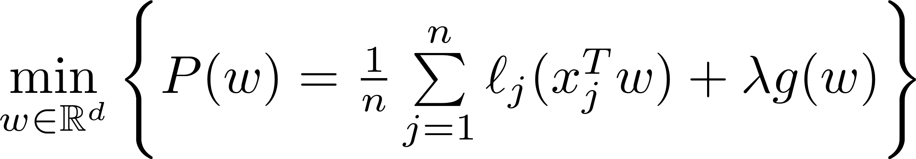

The Objective
Optimization problem formulation
Regularized Empirical Risk Minimization

Slide 4




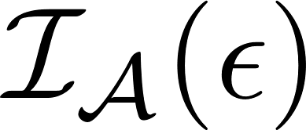
Traditional efficiency analysis
Given algorithm , the time needed is
Main trend – Stochastic methods
Small , big
Time needed to
run one iteration
of algorithm
Total number of
iterations needed
Target accuracy

Slide 5

Motivation to distribute data
Typical computer
“Typical” dataset
CIFAR-10/100 ~ 200 MB [1]
Yahoo Flickr Creative Commons 100M ~ 12 GB [2]
ImageNet ~ 125 GB [3]
Internet Archive ~ 80 TB [4]
1000 Genomes ~ 464 TB (Mar 2013; still growing) [5]
Google Ad prediction, Amazon recommendations ~ ?? PB
RAM: 8 – 64 GB
Disk space: 0.5 – 3 TB

Slide 6
Computational bottlenecks
Processor – RAM communication
Super fast
Processor – Disk communication
Not as fast
Computer – Computer communication
Quite slow
Designing an optimization scheme with communication efficiency in mind, is key to speeding up distributed optimization

Slide 7
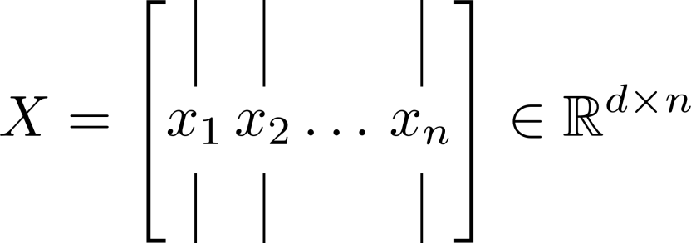
Motivation to distribute data
Where does the problem size come from?
Often, both would be BIG at the same time
Both can be in order of billions

Slide 8
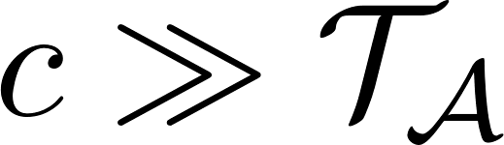
Distributed efficiency analysis
There is lot of potential for improvement, if because most of the time is spent on communication
Time for round of communication

Slide 9
Distributed algorithms – examples
Hydra [6]
Distributed coordinate descent (Richtárik, Takáč)
One round communication SGD [7]
(Zinkevich et al.)
DANE [8]
Distributed Approximate Newton (Shamir et al.)
Seems good in practice; theory not satisfactory
Show that above method is weak
CoCoA [9]
Upon which this work builds (Jaggi et al.)

Slide 10

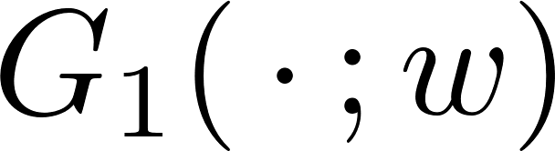
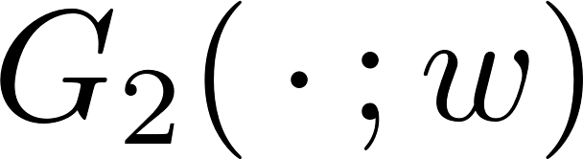
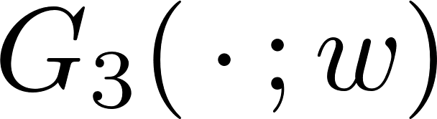

Our goal
Split the main problem to meaningful subproblems
Run arbitrary local solver to solve the local objective
Reach accuracy on the subproblem
Main problem
Subproblems
Solved locally
Results in improved
flexibility of this paradigm

Slide 11
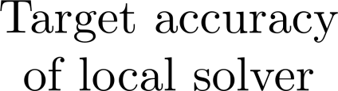

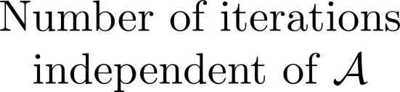
Efficiency analysis revisited
Such framework yields the following paradigm

Slide 12



Efficiency analysis revisited
Target local accuracy
With decreasing
increases
decreases
With increasing
decreases
increases

Slide 13

An example of Local Solver
Take Gradient Descent (GD) for
Naïve distributed GD – with single gradient step, just picks a particular value of
But for GD, perhaps different value is optimal, corresponding to, say, 100 steps
For various local solvers, different values of would be optimal.

Slide 14
Experiments (demo)
Local Solver – Coordinate Descent

Slide 15
Problem specification

Slide 16
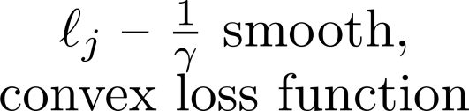
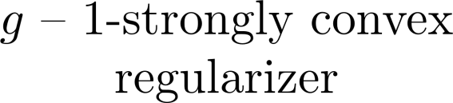
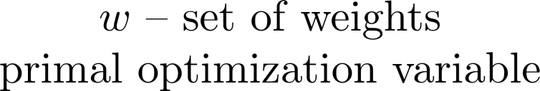
Problem specification (primal)

Slide 17


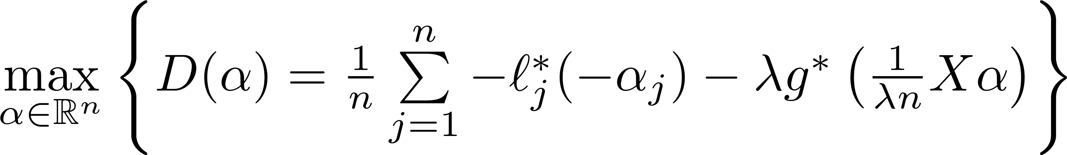

Problem specification (dual)
This is the problem
we will be solving

Slide 18


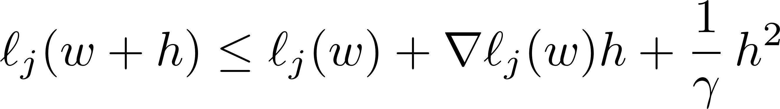


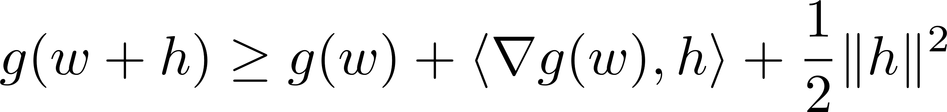

Assumptions
- smoothness of
Implies – strong convexity of
- strong convexity
Implies – smoothness of

Slide 19
The Algorithm

Slide 20

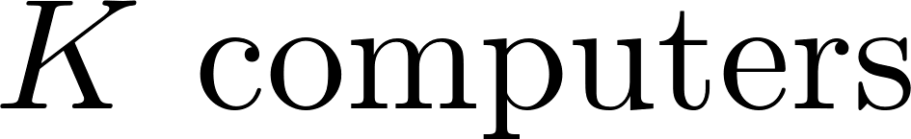
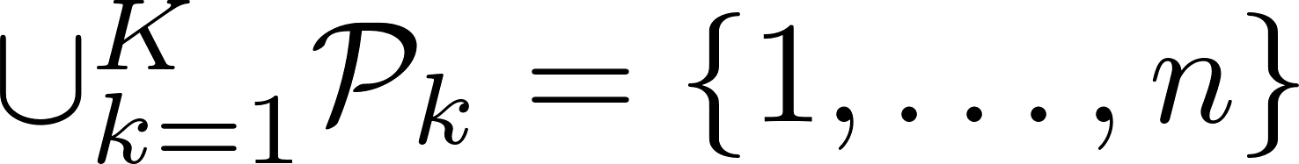
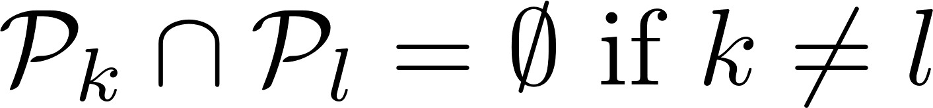
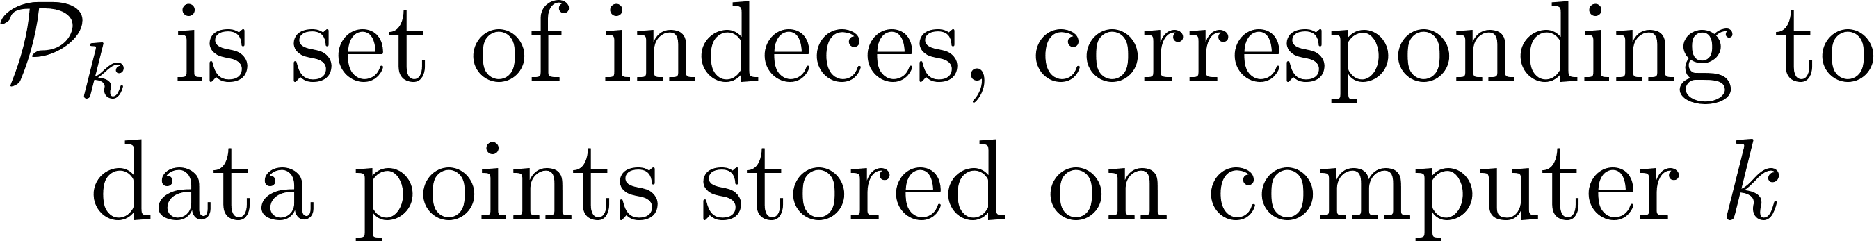

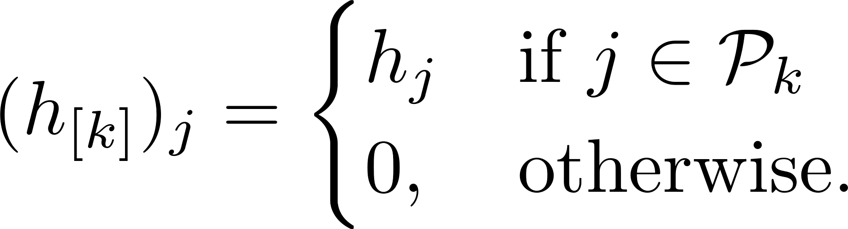
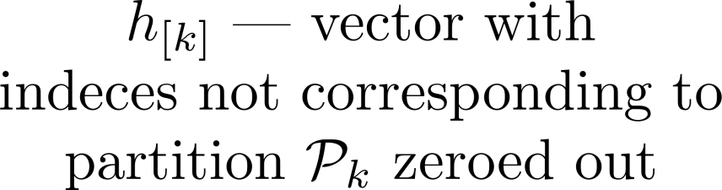
Necessary notation
Partition of data points:
Complete
Disjoint
Masking of a partition

Slide 21



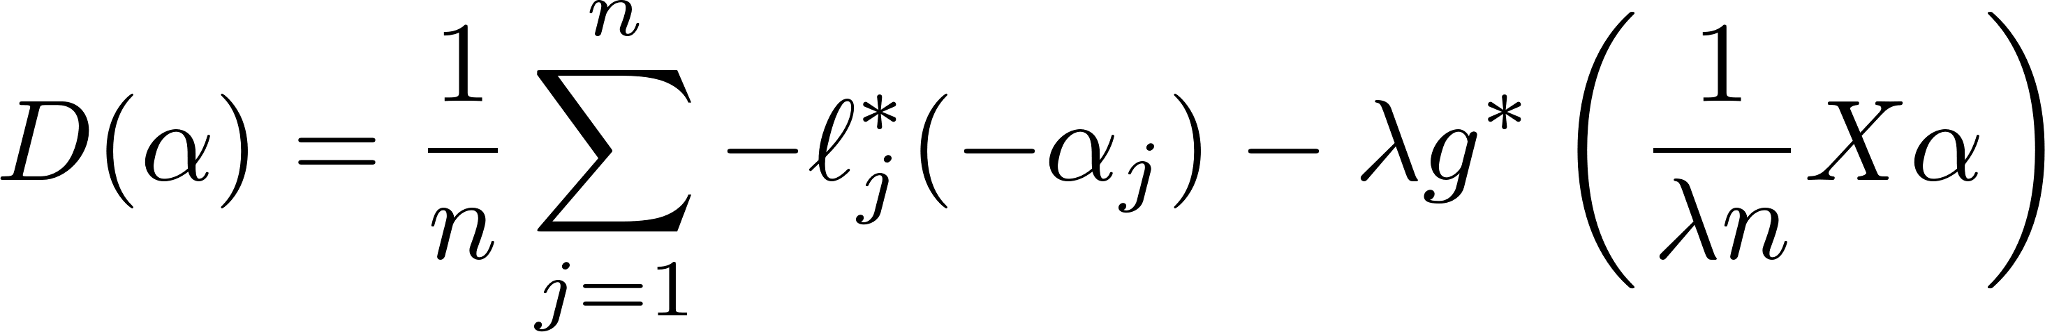
Data distribution
Computer # owns
Data points
Dual variables
Not a clear way to distribute the objective function

Slide 22
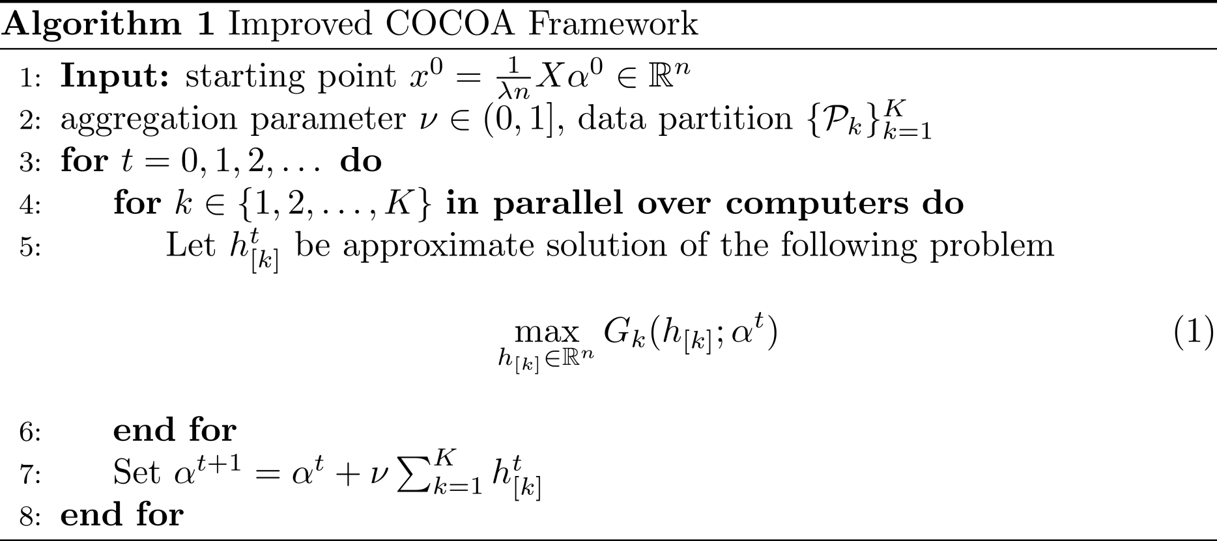
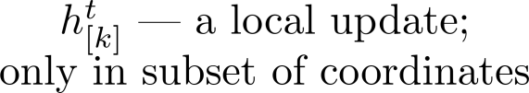

The Algorithm
“Analysis friendly” version

Slide 23


Necessary properties for efficiency
Locality
Subproblem can be formed solely based on information available locally to computer
Independence
Local solver can run independently, without need for any communication with other computers
Local changes
Outputs only – change in coordinates stored locally
Efficient maintenance
To form new subproblem with new dual variable we need to send and receive only a single vector in

Slide 24

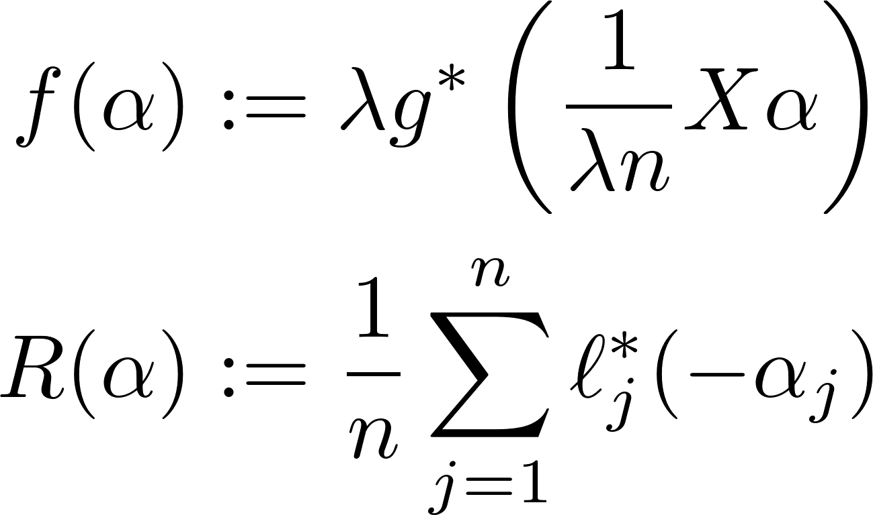
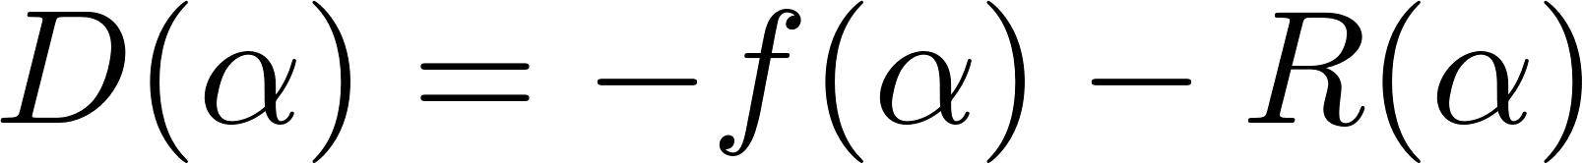
More notation…
Denote
Then,

Slide 25
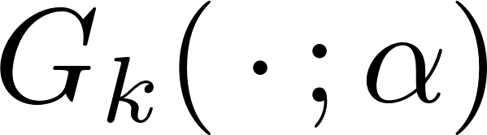

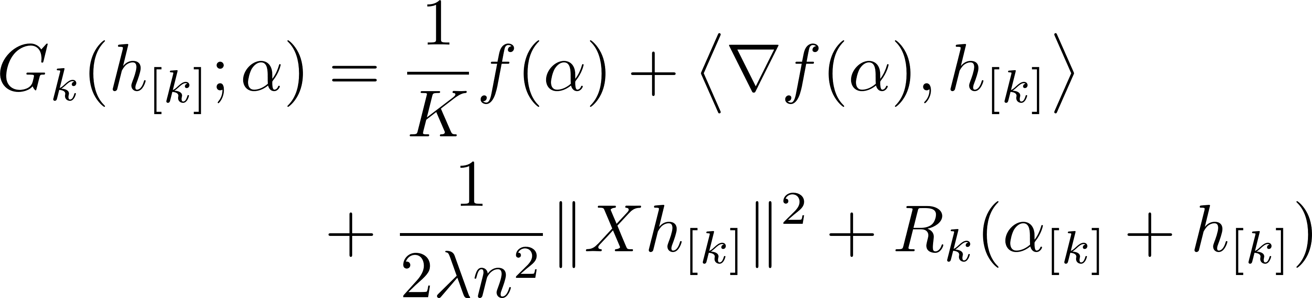
The Subproblem
Multiple ways to choose
Value of aggregation parameter depends on it
For now, let us focus on

Slide 26

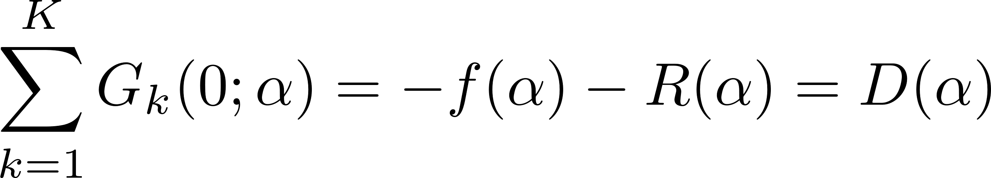
Subproblem intuition
Consistency in
Local under-approximation (shifted)

Slide 27
The Subproblem
Closer look
The problematic term It will be the focus
in the following slides
Constant; added for
convenience in analysis
Linear combination of
columns stored locally
Separable term; dependent
only on variables stored locally

Slide 28
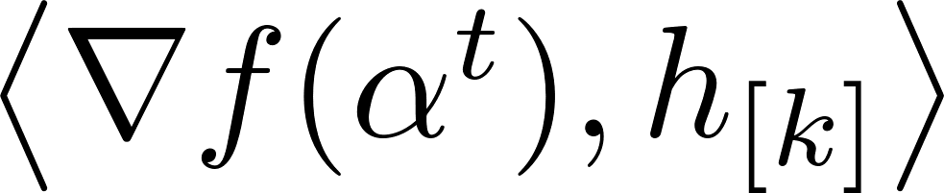
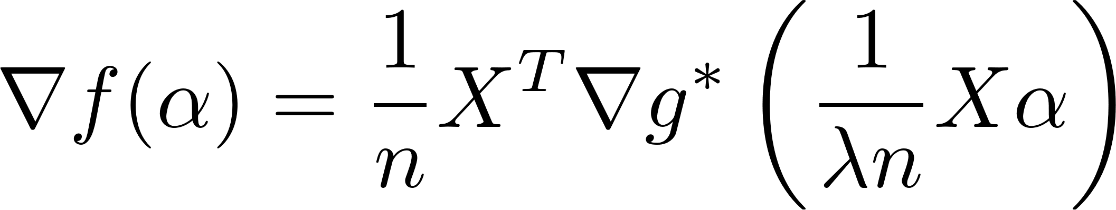


Dealing with
Three steps needed
(A) Impossible locally
(B) Easy operation
(C) Impossible locally – is distributed
(B) Apply gradient
(A) Form primal point
(C) Multiply by

Slide 29

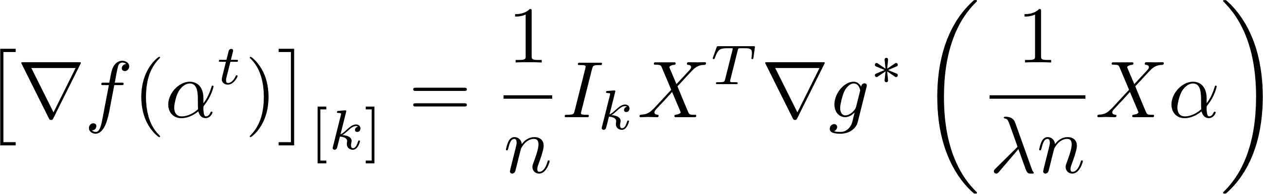



Dealing with
Note that we need only
Course
Suppose we have available, and can run local solver to obtain local update
Form a vector to send to master node
Receive another vector from master node
Form and be ready to run local solver again
The local coordinates
Partition identity matrix

Slide 30







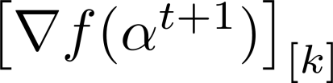

Dealing with
Local workflow
Run local solver in iteration
Obtain local update
Compute
Send to a master node
Master node:
Form
Compute and send it back
Receive
Compute
Run local solver in iteration
Master node has to remember extra vector
Single iteration

Slide 31
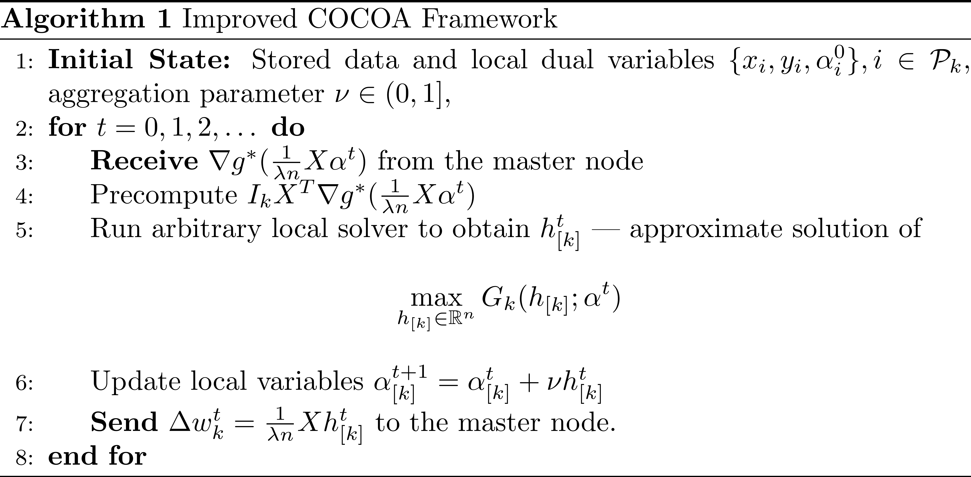
The Algorithm
“Implementation friendly” version

Slide 32
Results (theory)

Slide 33

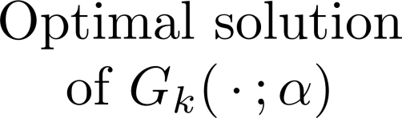
Local decrease assumption

Slide 34
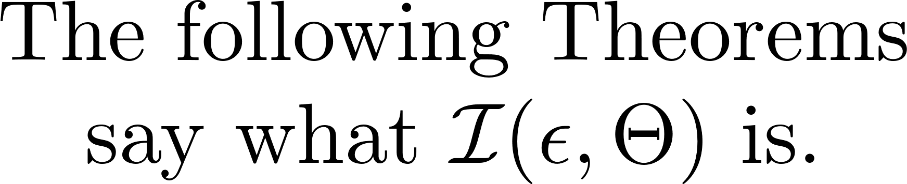
Reminder
The new distributed efficiency analysis

Slide 35

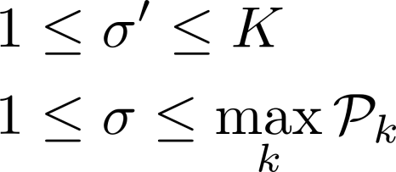
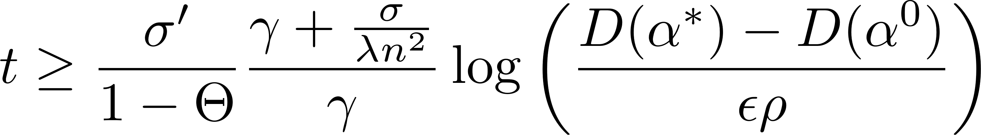



Theorem (strongly convex case)
If we run the algorithm with and then,

Slide 36
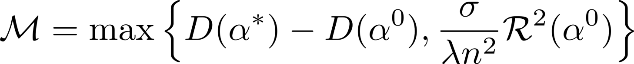
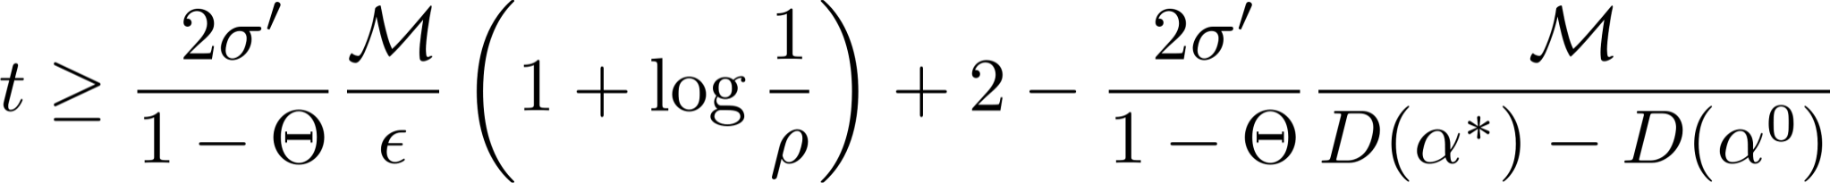
Theorem (general convex case)
If we run the algorithm with and then,

Slide 37
Results (Experiments)

Slide 38
Experimental Results
Coordinate Descent, various # of local iterations

Slide 39
Experimental Results
Coordinate Descent, various # of local iterations

Slide 40
Experimental Results
Coordinate Descent, various # of local iterations

Slide 41

Different subproblems
Big/small regularization parameter

Slide 42
Extras

Slide 43


Extras
Possible to formulate different subproblems

Slide 44

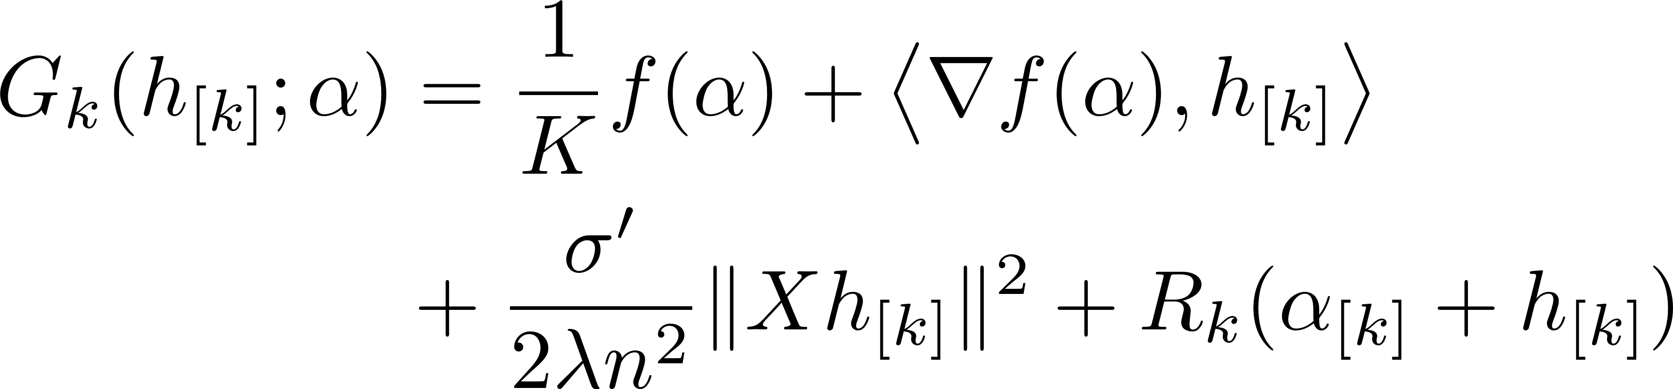
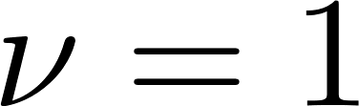
Extras
Possible to formulate different subproblems
With – Useful for SVM dual

Slide 45
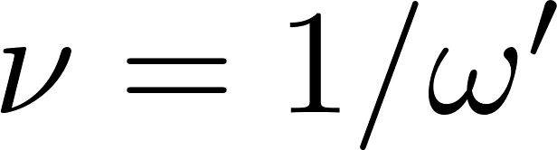
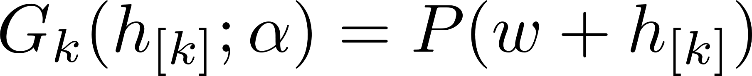

Extras
Possible to formulate different subproblems
Primal only
Used with (see [6])
Similar theoretical results

Slide 46
Mentioned datasets
[1] http://www.cs.toronto.edu/~kriz/cifar.html
[2] http://yahoolabs.tumblr.com/post/89783581601/ one-hundred-million-creative-commons-flickr-images
[3] http://www.image-net.org/
[4] http://blog.archive.org/2012/10/26/80-terabytes-of-archived-web-crawl-data-available-for-research/
[5] http://www.1000genomes.org

Slide 47
References
[6] Richtárik, Peter, and Martin Takáč. "Distributed coordinate descent method for learning with big data." arXiv preprint arXiv:1310.2059 (2013).
[7] Zinkevich, Martin, et al. "Parallelized stochastic gradient descent." Advances in Neural Information Processing Systems. 2010.
[8] Ohad Shamir, Nathan Srebro, and Tong Zhang. "Communication efficient distributed optimization using an approximate Newton-type method." arXiv preprint arXiv:1312.7853 (2013).
[9] Jaggi, Martin, et al. "Communication-efficient distributed dual coordinate ascent." Advances in Neural Information Processing Systems. 2014.

