Slide 1
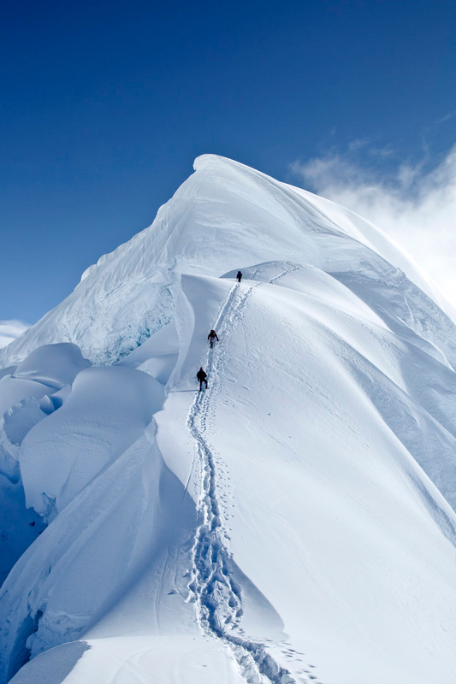

Extreme* Mountain Climbing
* in billions of dimensions
Peter Richtárik
School of Mathematics, University of Edinburgh
Edinburgh Research Group in Optimization (ERGO)
Numerical Algorithms and Intelligent Software (NAIS)
Edinburgh Compressed Sensing (E-CoS)
Algorithms and Complexity (A&C)

Slide 2

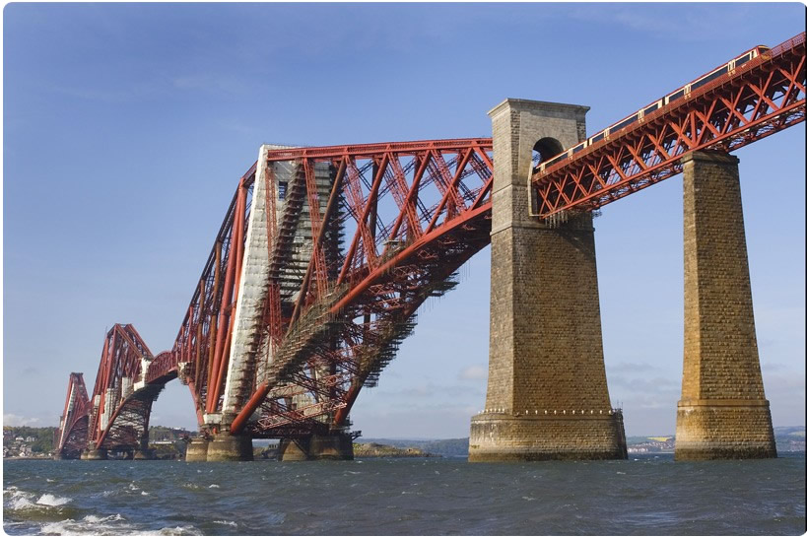
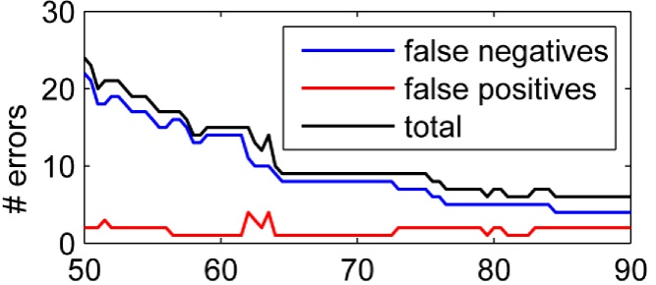
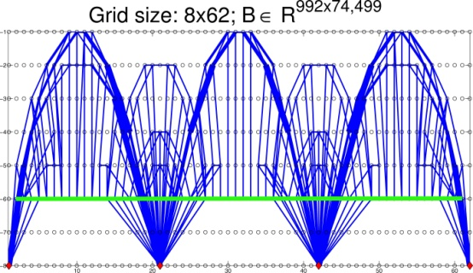
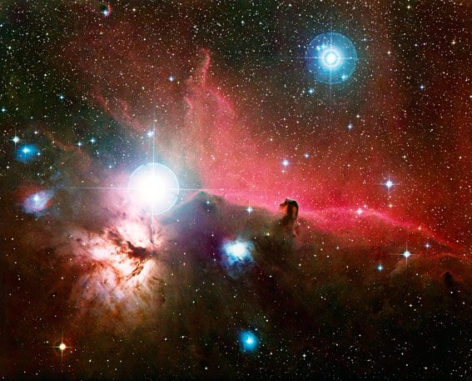


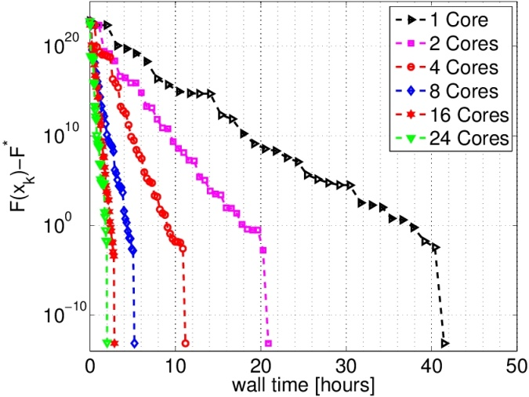
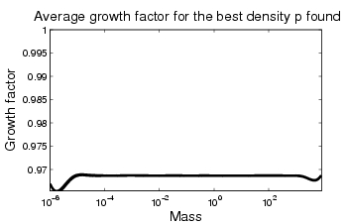
Arup
(Truss Topology Design)
Western General Hospital
(Creutzfeldt-Jakob Disease)
Ministry of Defence
dstl lab
(Algorithms for Data Simplicity)
Royal Observatory
(Optimal Planet Growth)

Slide 3

Get (near) the top in minimal time
Total time
=
(# steps) * (time / step)
Algorithm design depends on
  Shape
  Computer
  Dimension

Slide 4
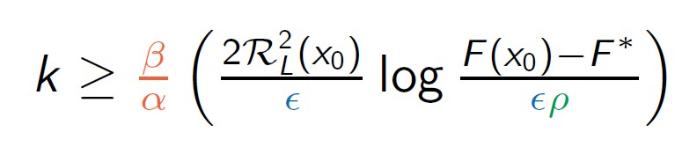

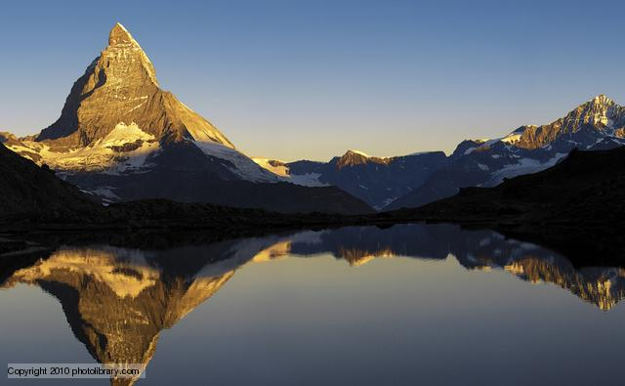


How to Climb a Mountain in a Billion Dimensional Space?
Algorithm: coordinate descent (serial/parallel/distributed/asynchronous/inexact)

