Slide 1
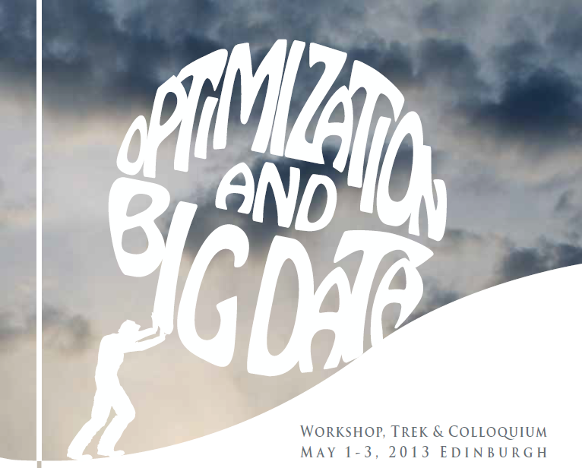




Semi-Stochastic Gradient Descent
Peter Richtárik
ANC/DTC Seminar, School of Informatics, University of Edinburgh
Edinburgh - November 4, 2014

Slide 2
Based on
Basic method: S2GD & S2GD+
  Konecny and Richtarik. Semi-Stochastic Gradient Descent Methods, arXiv:1312.1666, December 2013
Mini-batching (& proximal setup): mS2GD
  Konecny, Liu, Richtarik and Takac. mS2GD: Minibatch Semi-Stochastic Coordinate Descent in the Proximal Setting, October 2014
Coordinate descent variant: S2CD
  Konecny, Qu and Richtarik. S2CD: Semi-Stochastic Coordinate Descent, October 2014

Slide 3

The Problem

Slide 4

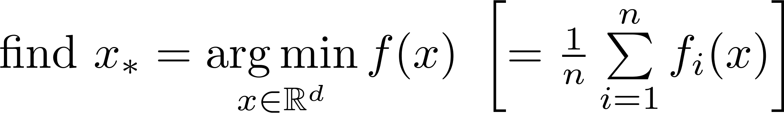
Minimizing Average Loss
Problems are often structured
Frequently arising in machine learning
is BIG
Structure – sum of functions

Slide 5
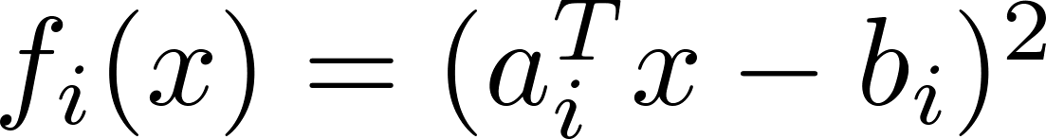
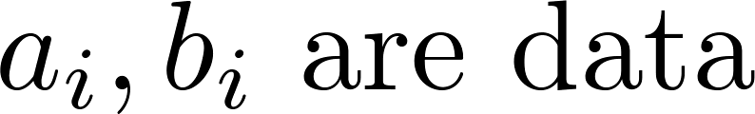
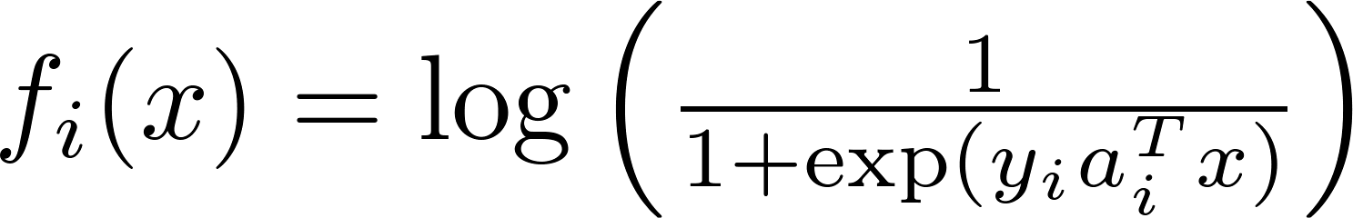
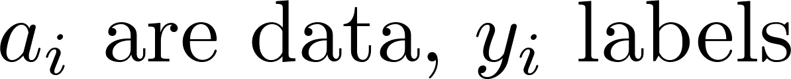
Examples
Linear regression (least squares)
Logistic regression (classification)

Slide 6


Assumptions
Lipschitz continuity of the gradient of
Strong convexity of

Slide 7
Applications

Slide 8

SPAM DETECTION

Slide 9
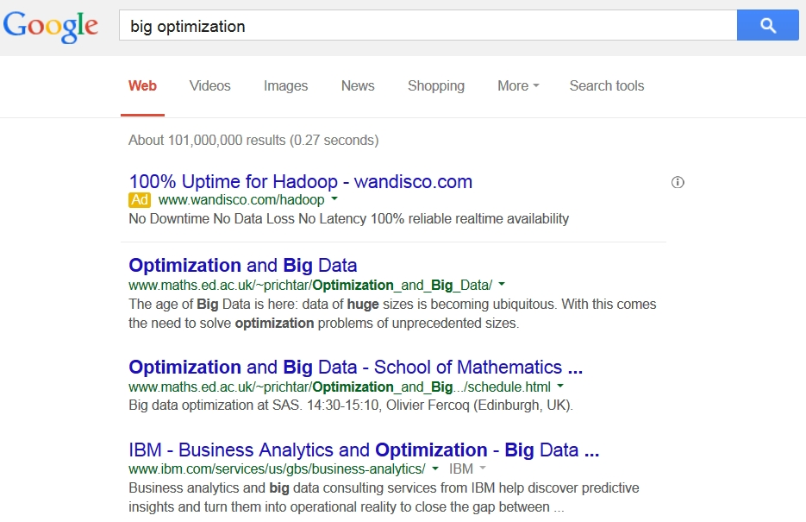
PAGE RANKING

Slide 10
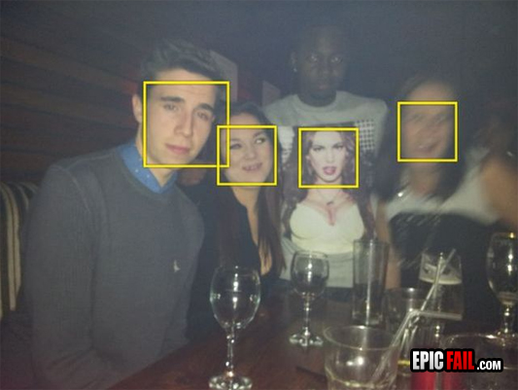
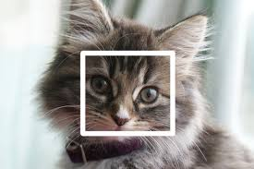
FA’K’E DETECTION

Slide 11

RECOMMENDER SYSTEMS

Slide 12
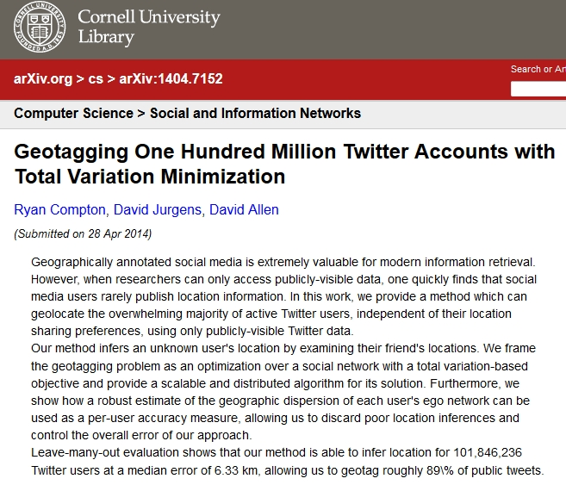

GEOTAGGING

Slide 13
Gradient Descent vs
Stochastic Gradient Descent

Slide 14
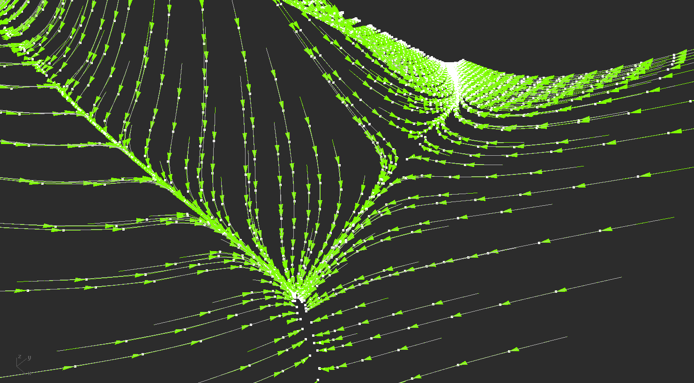
http://madeincalifornia.blogspot.co.uk/2012/11/gradient-descent-algorithm.html

Slide 15
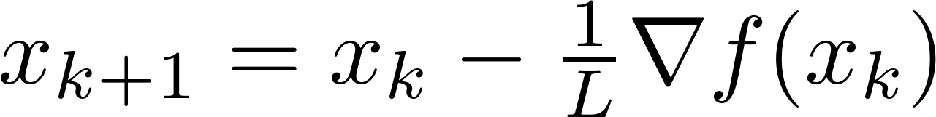
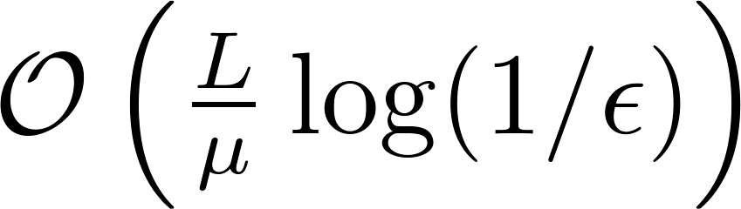
Gradient Descent (GD)
Update rule
Fast convergence rate
  Alternatively, for accuracy we need
  iterations
Complexity of single iteration:
(measured in gradient evaluations)

Slide 16
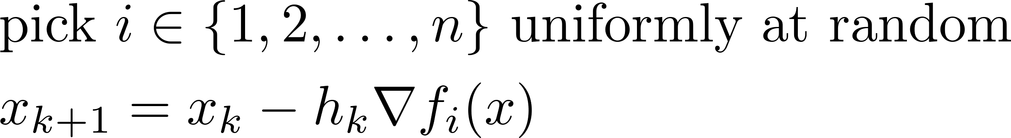
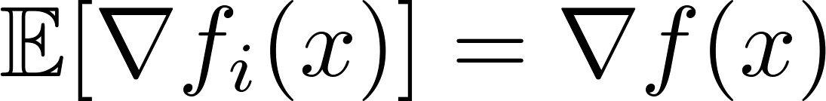

Stochastic Gradient Descent (SGD)
Update rule
Why it works
Slow convergence
Complexity of single iteration –
(measured in gradient evaluations)
a step-size parameter

Slide 17
Dream…
GD
SGD
Fast convergence
gradient evaluations in each iteration
Slow convergence
Complexity of iteration independent of
Combine in a single algorithm

Slide 18
S2GD:
Semi-Stochastic
Gradient Descent

Slide 19
Why dream may come true…
The gradient does not change drastically
We could reuse old information

Slide 20



Modifying “old” gradient
Imagine someone gives us a “good” point and
Gradient at point , near , can be expressed as
Approximation of the gradient
Gradient change
We can try to estimate
Already computed gradient

Slide 21
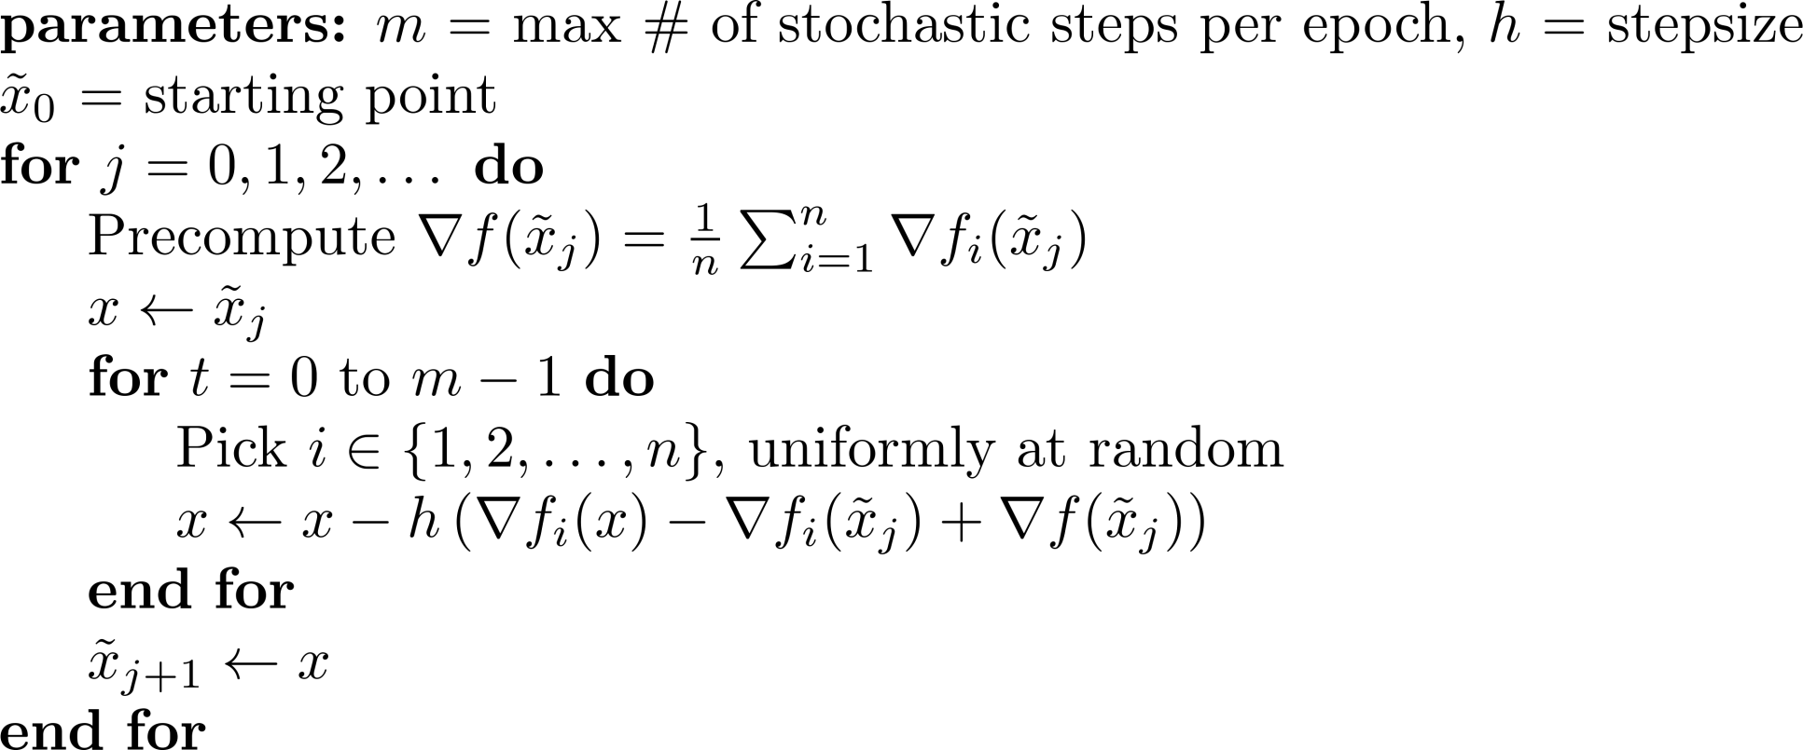
The S2GD Algorithm
Simplification; size of the inner loop is random, following a geometric rule

Slide 22
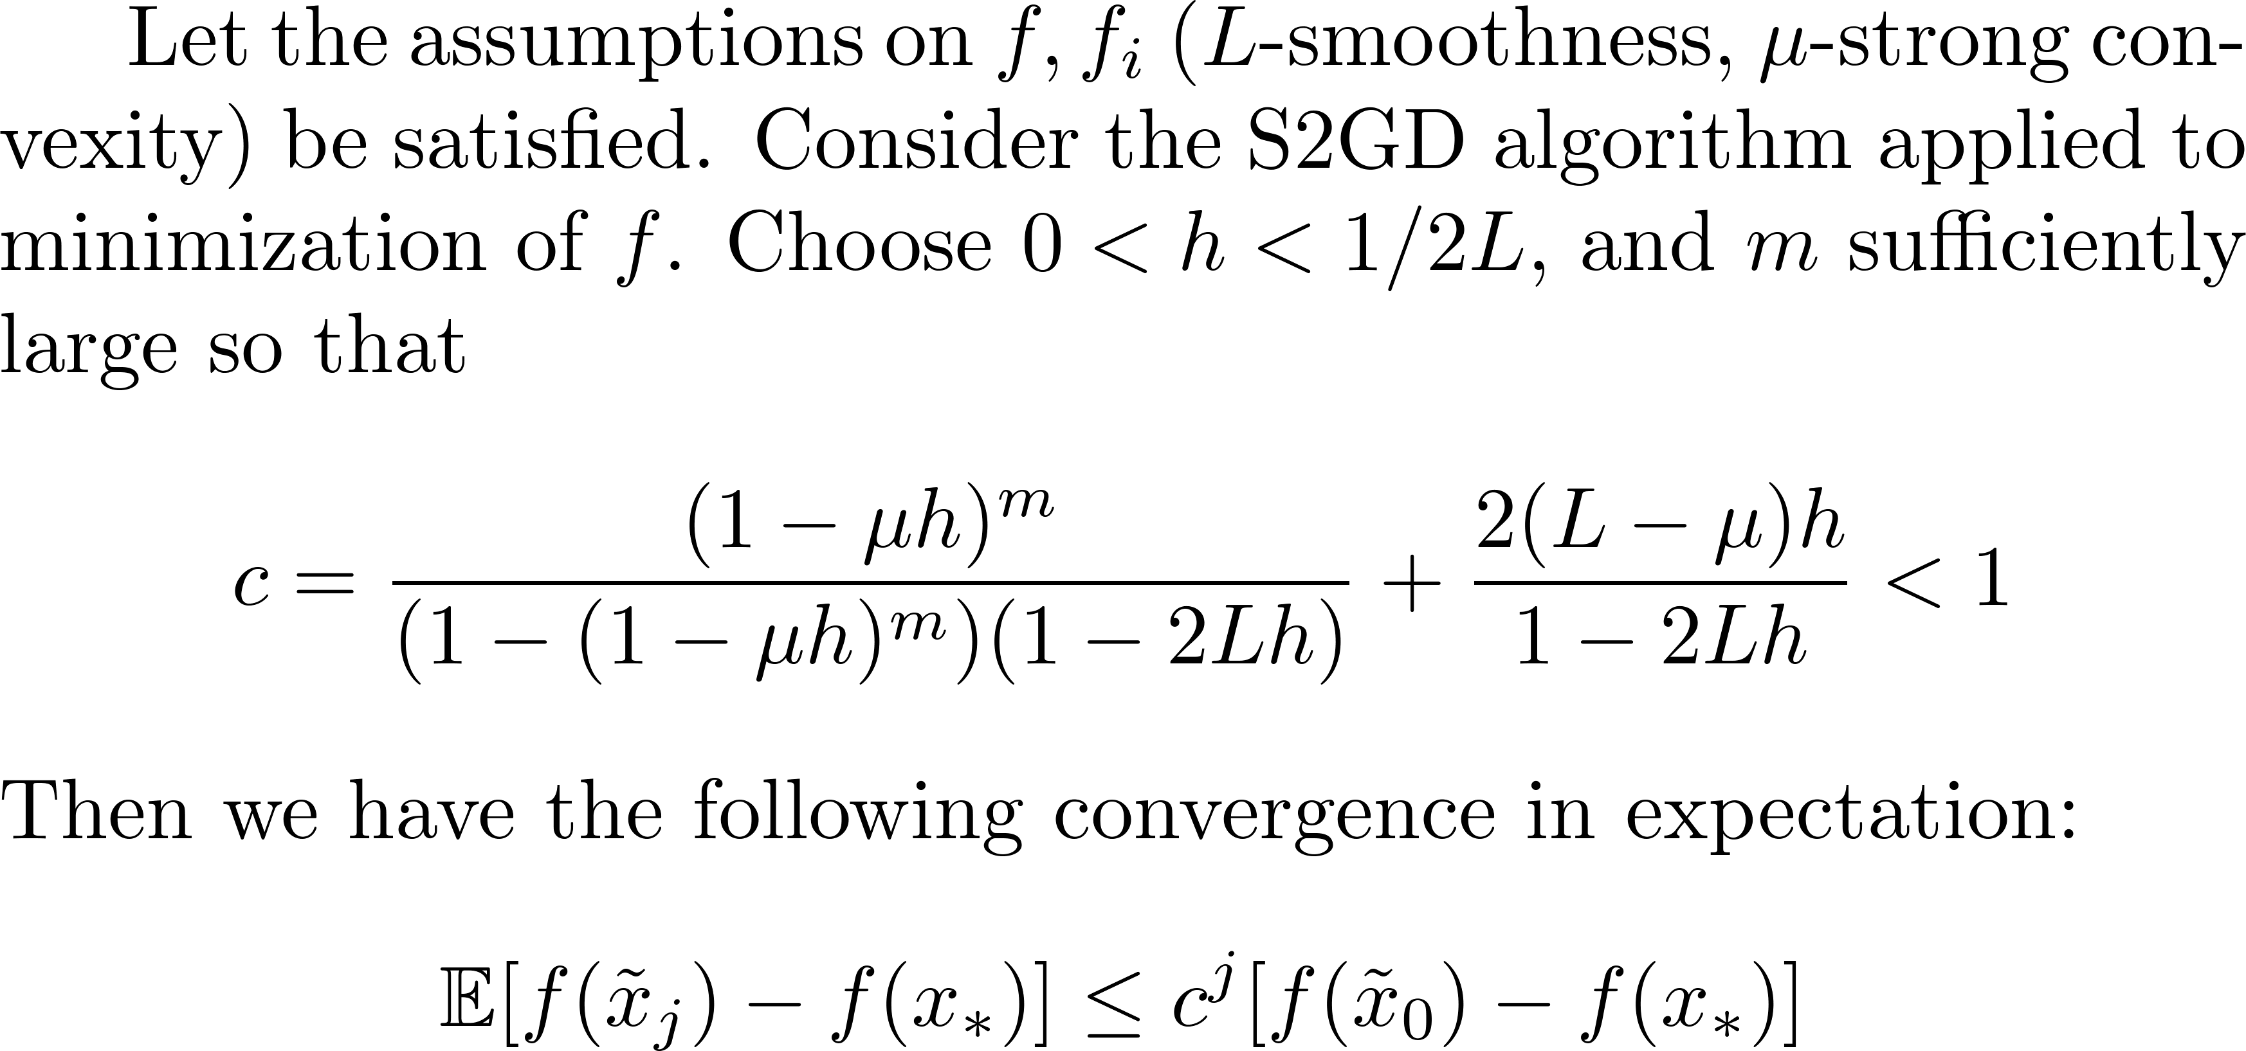
Theorem

Slide 23
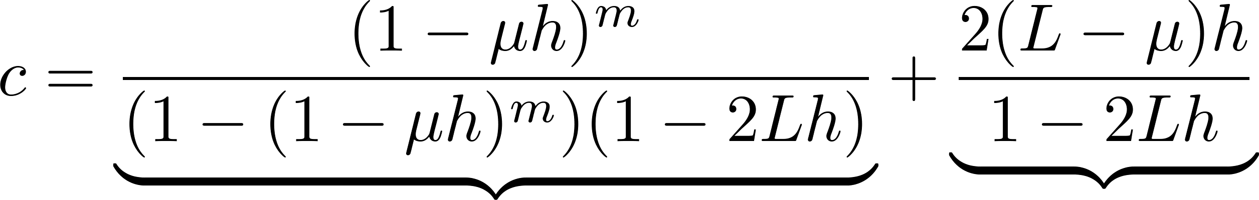



Convergence Rate
How to set the parameters ?
For any fixed , can be made arbitrarily small by increasing
Can be made arbitrarily small, by decreasing

Slide 24
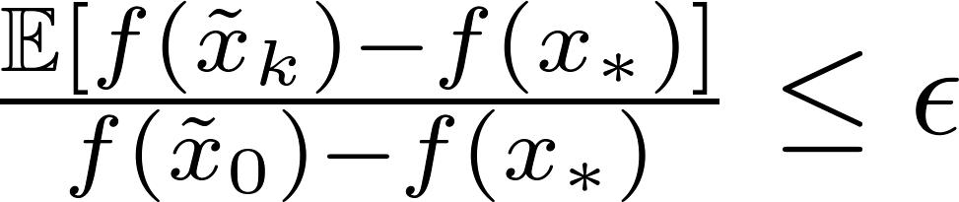
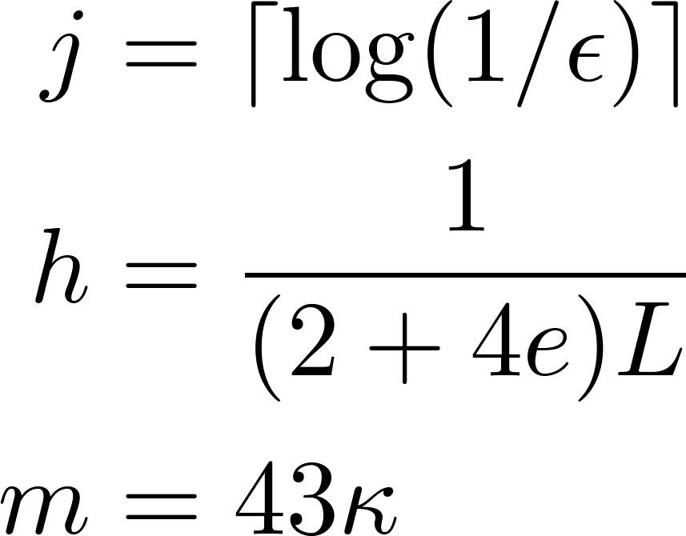
Setting the Parameters
The accuracy is achieved by setting
Total complexity (in gradient evaluations)
Fix target accuracy
# of epochs
stepsize
# of iterations
# of epochs
full gradient evaluation
cheap iterations

Slide 25
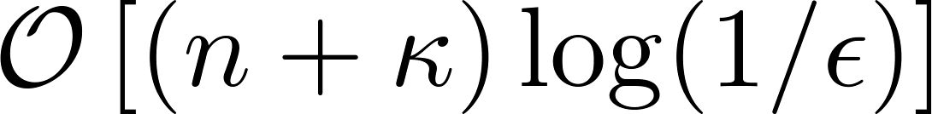
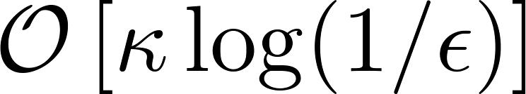

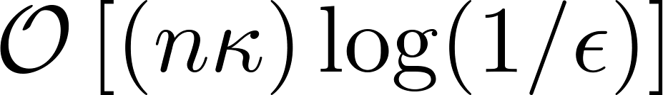
Complexity
S2GD complexity
GD complexity
  iterations
  complexity of a single iteration
  Total

Slide 26
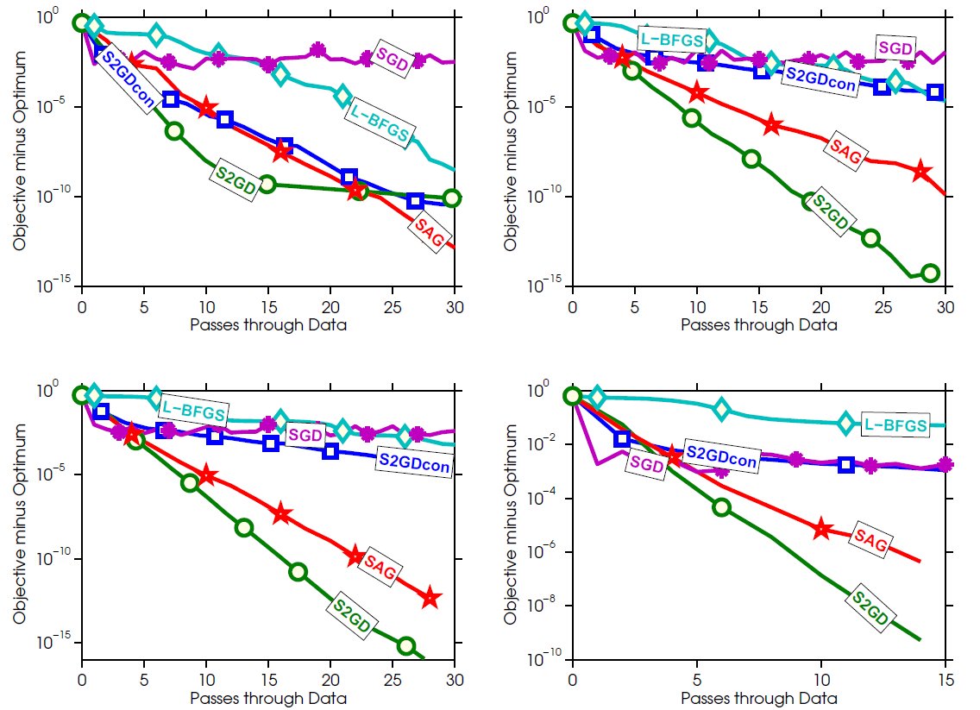
Experiment (logistic regression on: ijcnn, rcv, real-sim, url)

Slide 27
Related Methods
SAG – Stochastic Average Gradient
  (Mark Schmidt, Nicolas Le Roux, Francis Bach, 2013)
  Refresh single stochastic gradient in each iteration
  Need to store gradients.
  Similar convergence rate
  Cumbersome analysis
  SAGA (Aaron Defazio, Francis Bach, Simon Lacoste-Julien, 2014)
  Refined analysis
MISO - Minimization by Incremental Surrogate Optimization (Julien Mairal, 2014)
  Similar to SAG, slightly worse performance
  Elegant analysis

Slide 28
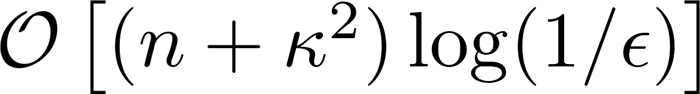
Related Methods
SVRG – Stochastic Variance Reduced Gradient
  (Rie Johnson, Tong Zhang, 2013)
  Arises as a special case in S2GD
Prox-SVRG
  (Tong Zhang, Lin Xiao, 2014)
  Extended to proximal setting
EMGD – Epoch Mixed Gradient Descent
  (Lijun Zhang, Mehrdad Mahdavi , Rong Jin, 2013)
  Handles simple constraints,
  Worse convergence rate

Slide 29
Extensions

Slide 30
Extensions
S2GD:
  Efficient handling of sparse data
  Pre-processing with SGD (-> S2GD+)
  Inexact computation of gradients
  Non-strongly convex losses
  High-probability result
Mini-batching: mS2GD
  Konecny, Liu, Richtarik and Takac. mS2GD: Minibatch Semi-Stochastic Coordinate Descent in the Proximal Setting, October 2014
Coordinate variant: S2CD
  Konecny, Qu and Richtarik. S2CD: Semi-Stochastic Coordinate Descent, October 2014

Slide 31
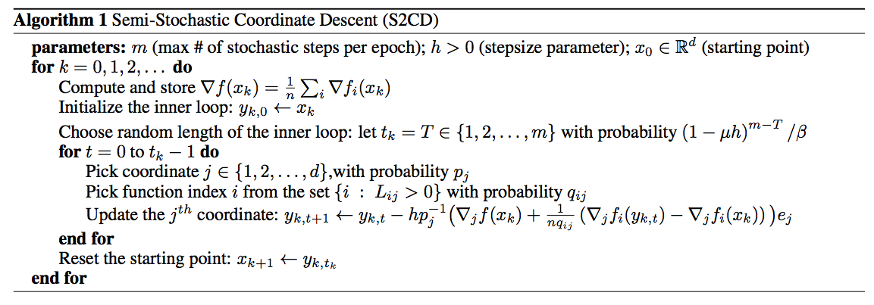
Semi-Stochastic Coordinate Descent
Complexity:
S2GD:

Slide 32
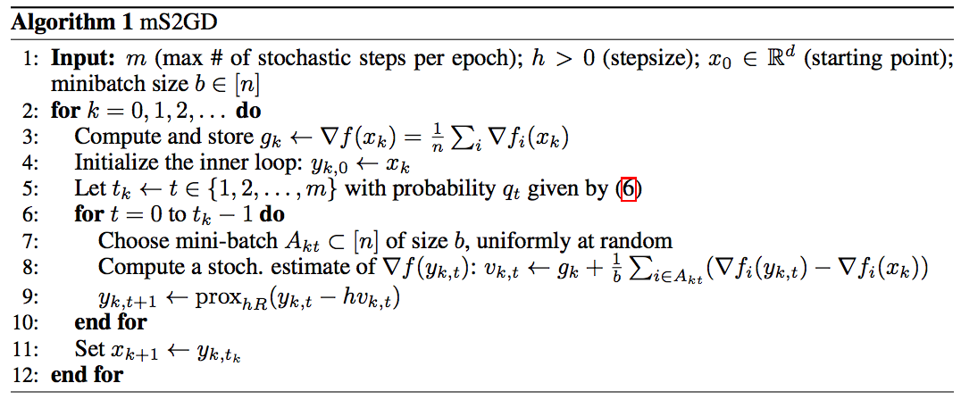
Mini-batch Semi-Stochastic Gradient Descent

Slide 33
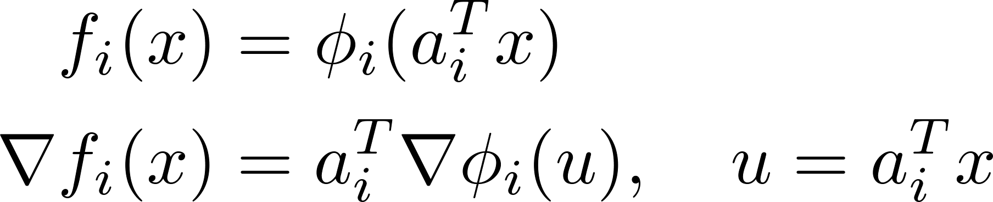
Sparse Data
For linear/logistic regression, gradient copies sparsity pattern of example.
But the update direction is fully dense
Can we do something about it?
SPARSE
DENSE

Slide 34





Sparse Data (Continued)
Yes we can!
To compute , we only need coordinates of corresponding to nonzero elements of
For each coordinate , remember when was it updated last time –
  Before computing in inner iteration number , update required coordinates
  Step being
  Compute direction and make a single update
The “old gradient”
Number of iterations when the coordinate was not updated

Slide 35
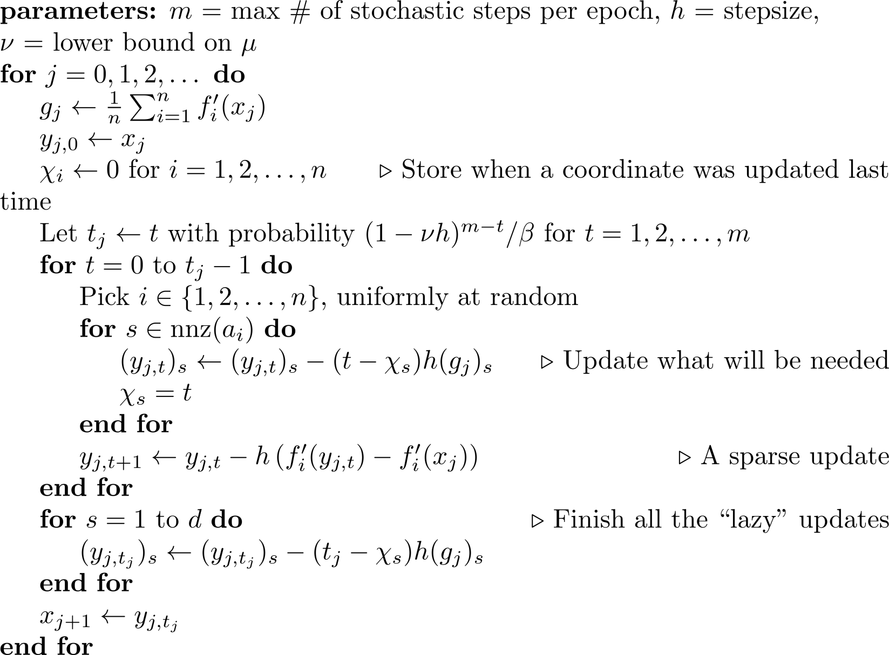
S2GD: Implementation for Sparse Data

Slide 36
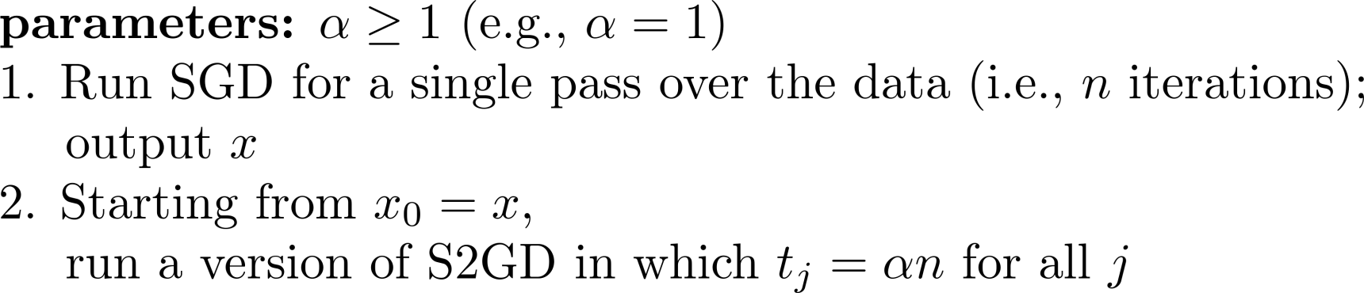
S2GD+
Observing that SGD can make reasonable progress while S2GD computes the first full gradient,
we can formulate the following algorithm (S2GD+)

Slide 37
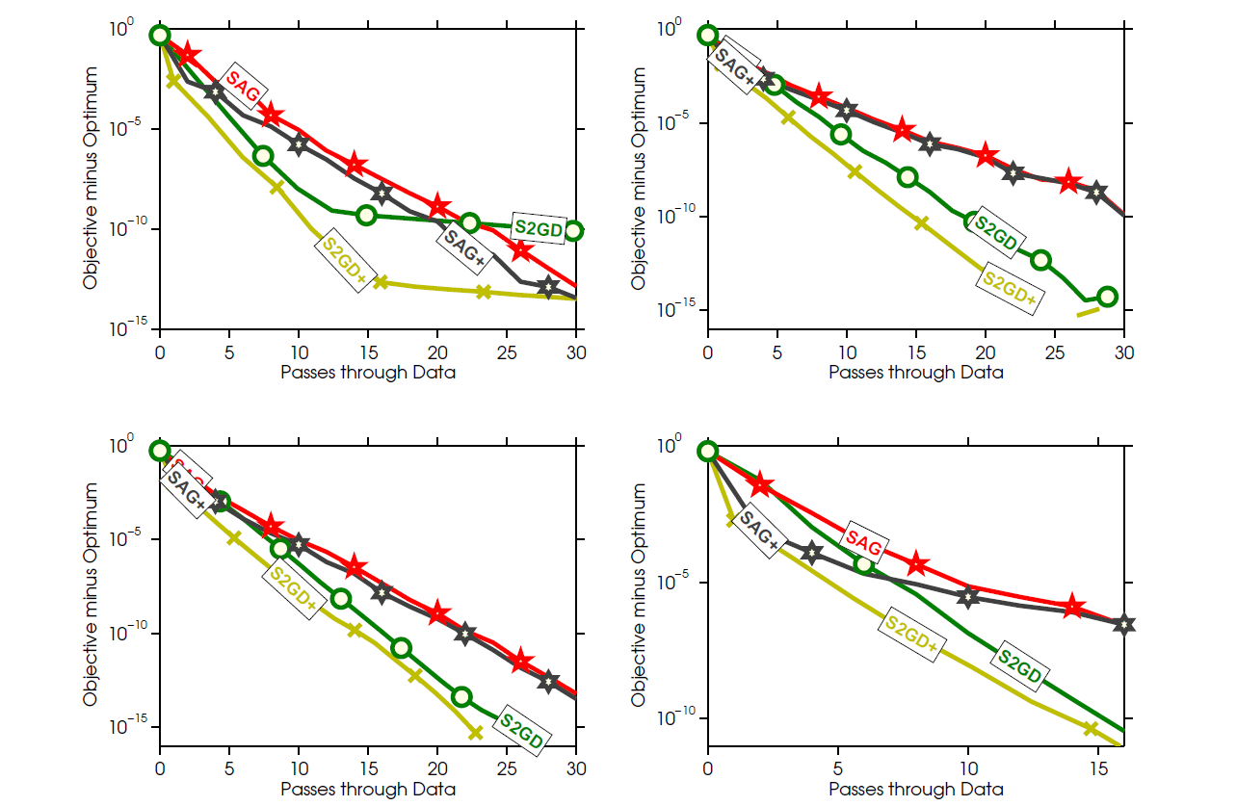
S2GD+ Experiment

Slide 38
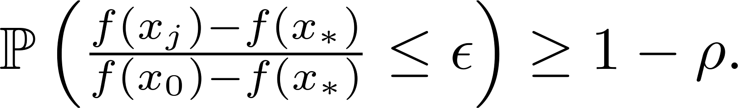
High Probability Result
The result holds only in expectation
Can we say anything about the concentration of the result in practice?
  For any
  we have:
Paying just logarithm of probability
Independent from other parameters

Slide 39
Inexact Case
Question: What if we have access to inexact oracle?
  Assume we can get the same update direction with error :
S2GD algorithm in this setting gives
with

Slide 40
Code
Efficient implementation for logistic regression -available at MLOSS
http://mloss.org/software/view/556/

