Slide 1





Distributed Coordinate Descent Method
Peter Richtárik
(joint work with Martin Takáč)
AmpLab All Hands Meeting - Berkeley - October 29, 2013

Slide 2
Randomized
Coordinate Descent in 2D

Slide 3
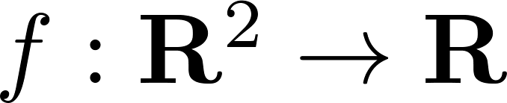
2D Optimization
Contours of a function
Goal:
Find the minimizer

Slide 4


Randomized Coordinate Descent in 2D
N
W
E
S

Slide 5
Randomized Coordinate Descent in 2D
N
W
E
1
S

Slide 6
Randomized Coordinate Descent in 2D
2
N
W
E
1
S

Slide 7
Randomized Coordinate Descent in 2D
2
3
N
W
E
1
S

Slide 8
Randomized Coordinate Descent in 2D
4
2
3
N
W
E
1
S

Slide 9
Randomized Coordinate Descent in 2D
4
5
2
3
N
W
E
1
S

Slide 10
Randomized Coordinate Descent in 2D
6
4
5
2
3
N
W
E
1
S

Slide 11
Randomized Coordinate Descent in 2D
SOLVED!
6
7
4
5
2
3
N
W
E
1
S

Slide 12
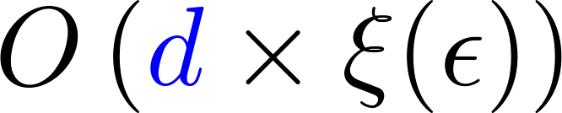

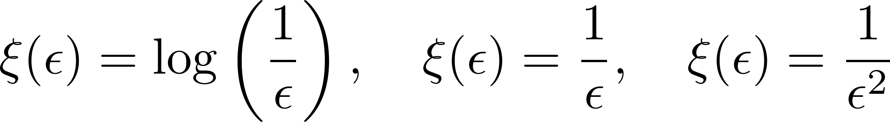
Convergence of
Randomized Coordinate Descent
Strongly convex f
Focus on d
(big data = big d)
Smooth or ‘simple’ nonsmooth f
‘difficult’ nonsmooth f

Slide 13
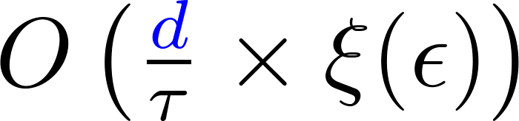
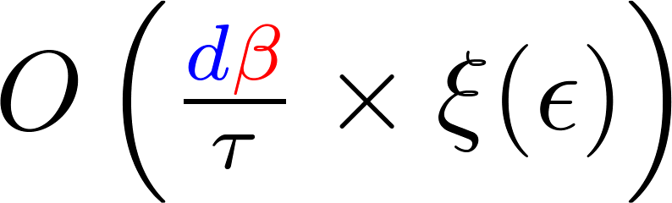
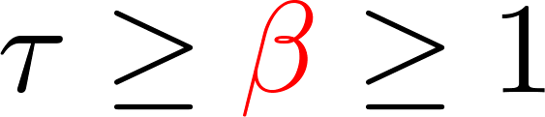
Parallelization Dream
Serial
Parallel
In reality we get something in between

Slide 14
How (not) to Parallelize
Coordinate Descent

Slide 15
“Naive” parallelization
Do the same thing as before, but with more or all coordinates
and add up the updates

Slide 16
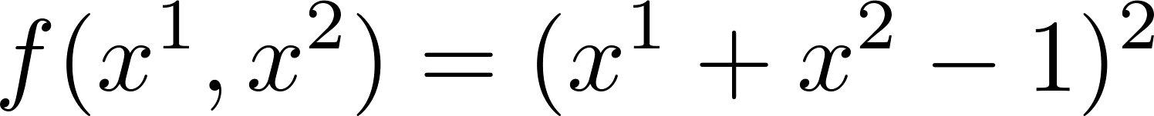


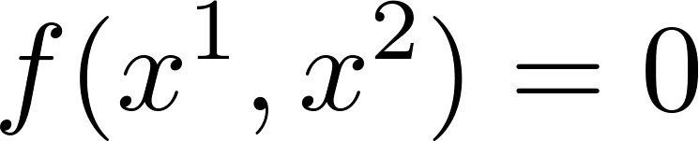
Failure of naive parallelization
1b
1a
0

Slide 17
Failure of naive parallelization
1b
1
1a
0

Slide 18
Failure of naive parallelization
2b
1
2a

Slide 19
Failure of naive parallelization
2b
1
2a
2

Slide 20

Failure of naive parallelization
OOPS!
2

Slide 21
Idea: averaging updates may help
1b
SOLVED!
1
1a
0

Slide 22
Averaging can be too conservative
2b
and so on...
1b
2
2a
1
0
1a

Slide 23
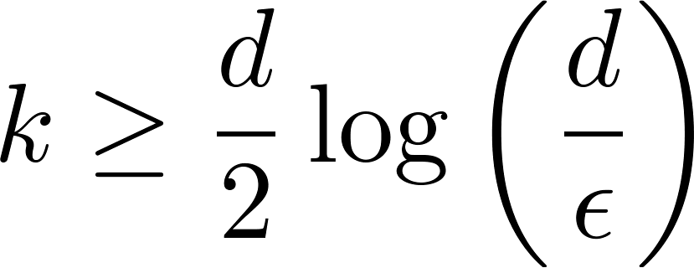
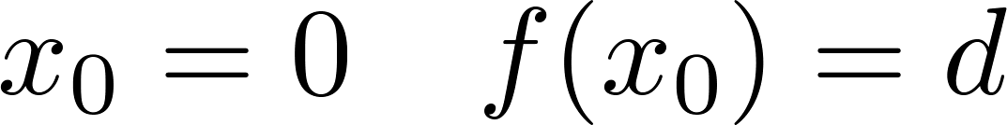
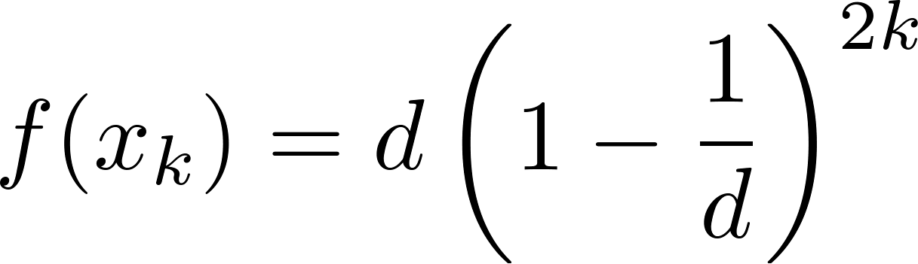

Averaging may be too conservative
BAD!!!
WANT

Slide 24
Minimizing
Regularized Loss

Slide 25
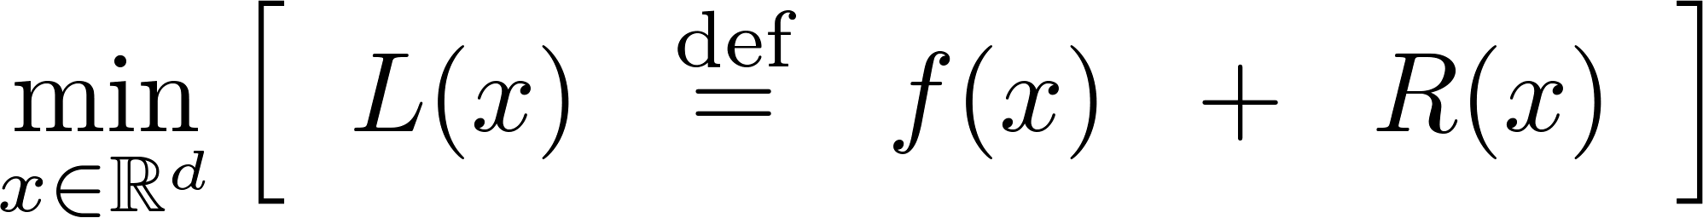

Minimizing Regularized Loss
Loss
Regularizer
Convex
(smooth)
Convex
(smooth or nonsmooth)
- separable
- allow

Slide 26
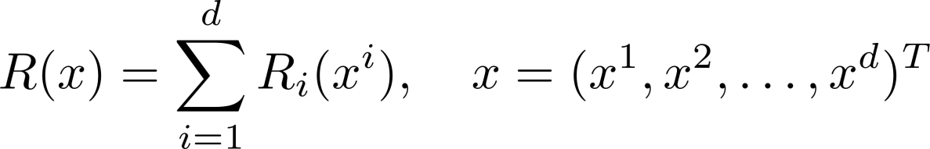

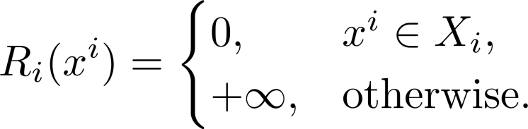
Regularizer: examples
e.g., LASSO
No regularizer
Weighted L1 norm
Box constraints
Weighted L2 norm
e.g., SVM dual

Slide 27



Structure of f
Considered in [BKBG, ICML 2011]

Slide 28

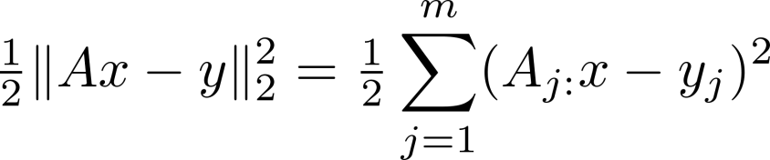
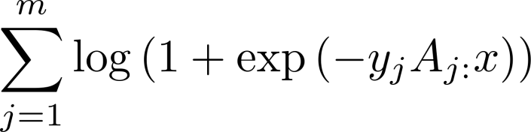


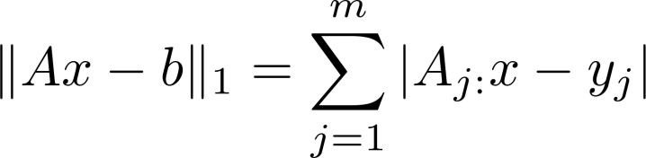
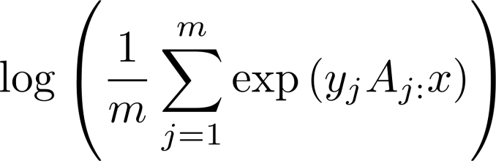
Loss: examples
Quadratic loss
BKBG’11
RT’11b
TBRS’13
RT ’13a
Logistic loss
Square hinge loss
L-infinity
L1 regression
FR’13
Exponential loss

Slide 29
Distributed Coordinate
Descent Method

Slide 30


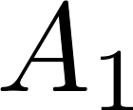
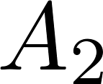
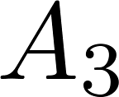






I. Distribution of Data
d = # features / variables / coordinates
Data matrix

Slide 31
II. Choice of Coordinates

Slide 32

II. Choice of Coordinates
Random set of coordinates (‘sampling’)

Slide 33
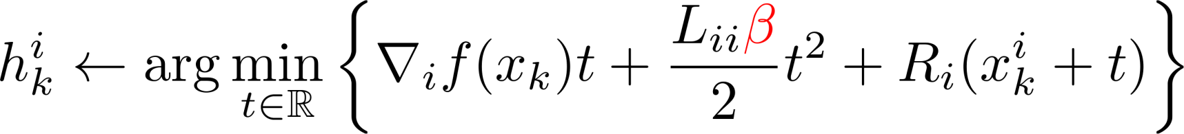
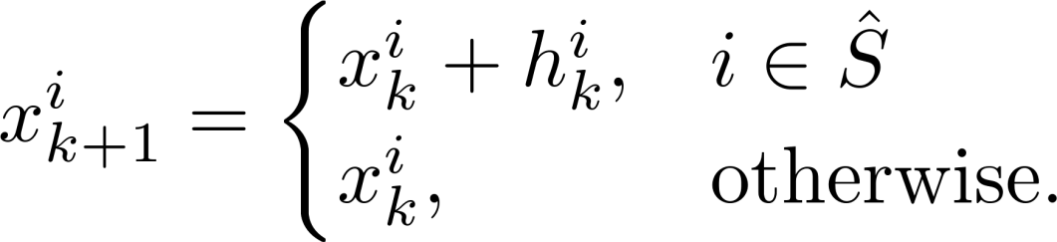
III. Computing Updates to Selected Coordinates
All nodes need to be able to
compute this (communication)
Random set of coordinates (‘sampling’)
Update to
i-th coordinate
New iterate
Current iterate

Slide 34


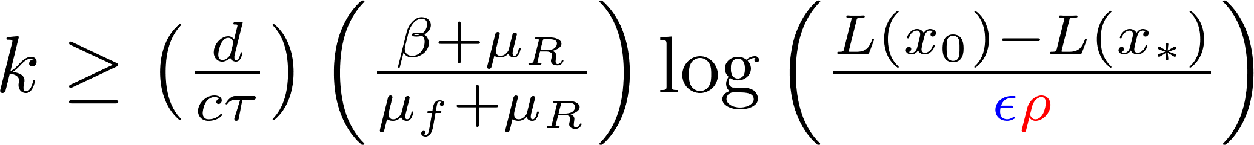
Iteration Complexity
Theorem [RT’13]
Strong convexity constant of the regularizer
# coordinates
# nodes
# coordinates updated / node
Strong convexity constant of the loss f
implies

Slide 35
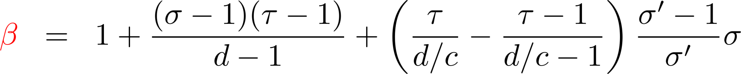


Bad partitioning at most
doubles # of iterations
spectral norm of the “partitioning”
Theorem [RT’13]

Slide 36
Experiment 1
1 node (c = 1)
LASSO problem
n = 2 billions d = 1 billion

Slide 37

Coordinate Updates

Slide 38
Iterations

Slide 39
Wall Time

Slide 40
Experiment 2
128 nodes (c = 512, 4096 cores)
LASSO problem
n = 1 billion d = 0.5 billion
data size = 3 TB

Slide 41
LASSO: 3TB data + 128 nodes

