Slide 1

NYC Rats
A decade exploration of rodent activity in the 5 boroughs - trends and recent hot spots
By Peter Berman

Slide 2
Why Rats?
Rats are a problem for property owners, residents, businesses and even entire neighborhoods. Damage caused by their gnawing and burrowing can spread disease, contaminate food, and reduce one's quality of life.
As a former pest control technician servicing the 5 boroughs of NYC working for my father and uncle's "mom and pop" exterminating company, I sought to bridge the gap between my past profession and current interests.

Slide 3
The Data
Source: NYC Department of Health and Mental Hygiene (DOHMH), Division of Environmental Health Pest Control Database
Description: This dataset contains rodent inspection information, updated daily since November 23, 2015
Size: 2.39 million rows, 20 columns, 511 mb, .csv
Location: https://data.cityofnewyork.us/Health/Rodent-Inspection/p937-wjvj

Slide 4
My Methods
Tools: Python, Tableau
Techniques: .head(), .columns, .unique(), .groupby(), .describe(), and .plot()
Python libraries: pandas, numpy
Visualizations:
bar graph, highlight tables, box and whisker plot – used to review data
line graph and map - used to review data & evidenced in this presentation
Data cleaning: focused data selection (removal of null/nan and un-needed columns)
Transformations: to_datetime() used to convert timestamp to date

Slide 5
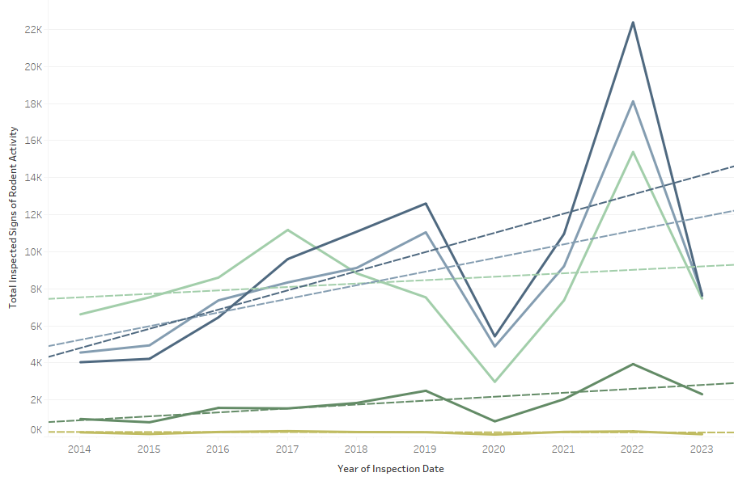
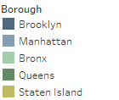
NYC Rodent Activity - Trends
Stats
Count: 50
Sum: 283,902
Average: 5,678
Minimum: 129
Maximum: 22,385
Median: 4,913
Standard deviation: 5,051
Skewness: 1.03
Observations
Brooklyn #1
All Boroughs trending up
2020 downswing
2022 upswing
Skewness = high
R2 = moderate
P-values = statistically significant

Slide 6
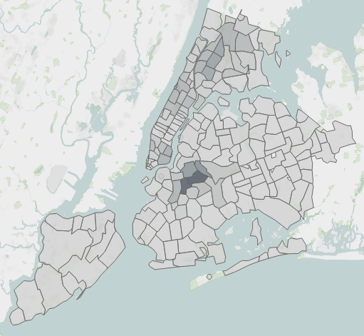

NYC Rodent Activity – Hot Spots
2021-present
Top Zip per Borough:
Brooklyn - Bushwick #18 pop.
Bronx - East Tremont #31 pop.
Manhattan - East Village #70 pop.
Queens – Glendale #2 pop.
Staten Island – Sunnyside #159 pop.
Theories:
Large in populus
High rental rates
Sizable volume of Restaurants & Bars
Any thoughts for those familiar with these neighborhoods?
# pop. = rank out of 1,792 NY zip codes

Slide 7
Conclusion
Based on the trend of rodent activity per borough from 2014 – 2023 it can be concluded that covid-19 had a direct impact in the fluctuation of inspection results.
The downtrend in 2020 can be attributed to the halt in dining and decrease of population due to mortality and domestic migration*. Less garbage equates to less food sources for rodents to thrive.
The uptrend in 2023 can be attributed to the ease in restrictions, particularly dining & the onset of outdoor dining. More garbage equates to more food sources for rodents to thrive.
*The City, May 31, 2022, Suhail Bhat, https://www.thecity.nyc/2022/5/31/23145072/nycs-population-plummeted-during-peak-covid-and-its-still-likely-shrinking

Slide 8
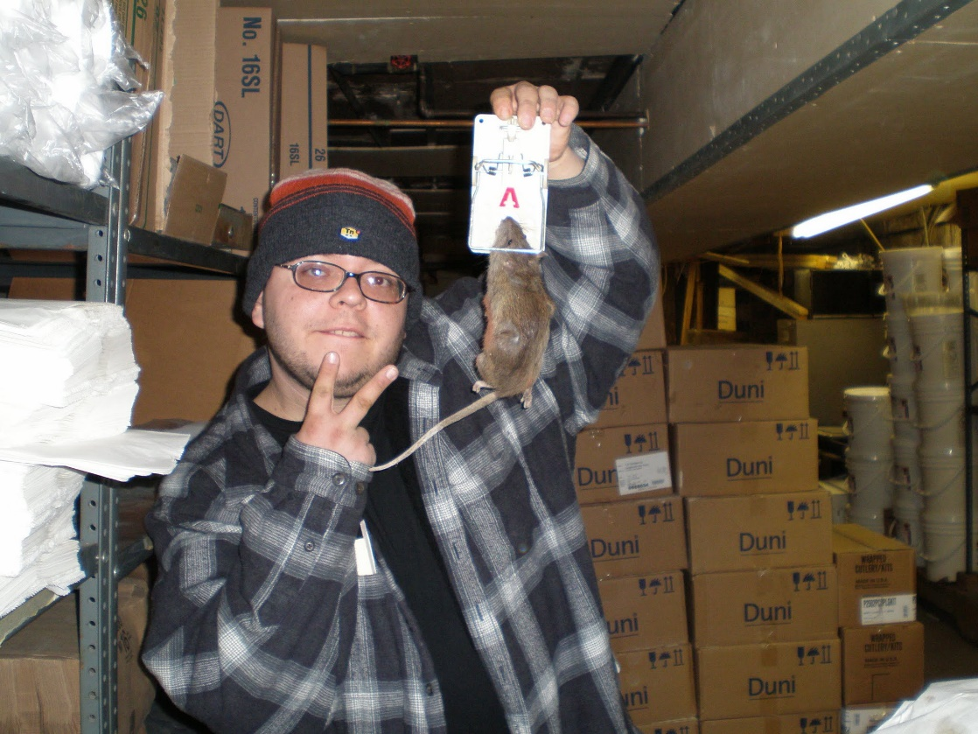

Questions?
Author, circa 2007, servicing bakery in Boro Park, Brooklyn

