Slide 1

ACADEMIC YEAR : 2026 -2027
DOMAIN: CLOUD COMPUTING
BATCH: A6
ML-BASED CLOUD RESOURCE PREDICTION & AUTO-SCALING SYSTEM
TEAM MEMBERS
PETER SAMUEL. R [23TH0269]
JOEL RAJKUMAR. W [23TH0237]
NAVAMANI. B [23TH0260]
JAYASURYA. K [23TH0235]
GUIDE NAME
Dr. A. PUNITHA, Ph.D,
ASSISTANT PROFESSOR(Sr.Gr)
DEPARTMENT OF IT

Slide 2
OBJECTIVES & ABSTRACT
OBJECTIVES
ABSTRACT
✓
Monitor resource utilisation and workload for healthy container replicas.
This project implements a Docker-based framework for comparing reactive, predictive, and error-aware adaptive predictive autoscaling. Locust sends controlled traffic through Nginx to healthy FastAPI replicas. The monitoring pipeline stores five-second CPU, memory, request-rate, response-time, and replica measurements in MongoDB. A Random Forest regression model predicts aggregate CPU 30 seconds ahead using only information available at the prediction time. The controller records prediction feedback and can retrain a candidate model after persistent errors, subject to chronological validation before activation.
✓
Predict future aggregate CPU utilisation with Random Forest regression.
✓
Apply reactive and predictive scaling within configured replica limits.
✓
Maintain safe Nginx membership for labelled Docker replicas.
✓
Detect persistent forecast errors and retrain only after validation.
✓
Evaluate policies under controlled workload patterns.
Primary target
Future aggregate CPU utilisation
Arithmetic mean across active healthy replicas
Measurement contract: 5-second monitoring interval | 30-second prediction horizon

Slide 3
EXISTING & PROPOSED ARCHITECTURE
The proposed design closes the loop from workload generation to validated model adaptation
EXISTING REACTIVE PATH
PROPOSED CONTROL LOOP
ERROR-AWARE ADAPTIVE LOOP
User / workload
Locust
Actual CPU
Nginx load balancer
Application
Prediction error
Healthy FastAPI replicas
Monitoring
Persistent error detection
Resource monitoring
MongoDB
Candidate retraining
Threshold decision
Random Forest prediction
Chronological validation
Scaling policy
Scale out / in
Docker replica management
Model activation
Nginx membership update
Scale-in safety: remove from Nginx upstream → validate configuration → graceful reload → stop replica
React dashboard ↔ Backend APIs

Slide 4
MODULE DESCRIPTION
1
Workload generation
2
Monitoring & data management
3
ML prediction
Locust scenarios: stable, gradual increase, sudden spike, sudden drop, periodic, and changing workload.
Traffic enters only through Nginx.
Five-second sampling of labelled healthy replicas.
CPU, memory, request rate, response time, replica count, and timestamps persist in MongoDB.
Leak-free dataset construction.
Random Forest predicts aggregate CPU 30 seconds ahead. Chronological validation reports MAE and RMSE.
4
Autoscaling & adaptation
5
Dashboard & experimentation
Reactive and predictive decisions use configured thresholds, cooldowns, and replica limits.
Persistent error gates candidate retraining and validation.
React dashboard exposes read-only live state and histories.
Experiment runner records raw observations and exports CSV/JSON.

Slide 5
STATUS SINCE REVIEW 1
Implemented and verified
Current final-stage work
✓
System architecture
COMPLETED
1
Final result analysis
ONGOING
✓
FastAPI application
COMPLETED
✓
Docker containerization
COMPLETED
2
Final report and documentation
ONGOING
✓
Nginx load balancing
COMPLETED
✓
Dynamic replica membership
COMPLETED
3
Demo refinement
ONGOING
✓
Monitoring pipeline
COMPLETED
✓
MongoDB integration
COMPLETED
4
Presentation preparation
ONGOING
✓
ML prediction model
COMPLETED
✓
Reactive scaling
COMPLETED
5
Viva preparation
ONGOING
✓
Predictive scaling
COMPLETED
✓
Adaptive retraining
COMPLETED
6
Final validation
ONGOING
✓
React dashboard
COMPLETED
✓
Experiment framework
COMPLETED
The prototype, data pipeline, policies, dashboard, and fixed evaluation matrix are complete. The remaining work prepares the final analysis, documentation, and demonstration.
✓
Evaluation experiments
COMPLETED

Slide 6
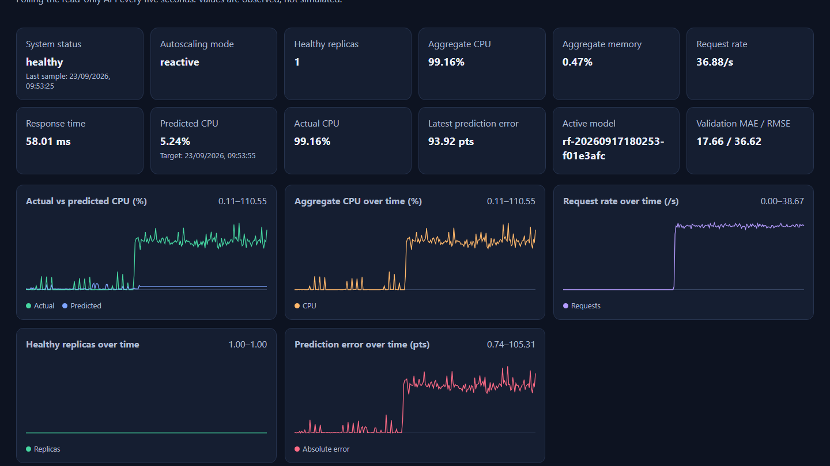
CURRENT IMPLEMENTATION
Live local evidence captured from the running project environment
Docker Compose service status
Service | State
Application replica | Healthy
MongoDB | Healthy
Backend API | Running
Frontend dashboard | Running
Nginx | Running
Membership controller | Running
Implementation evidence
• FastAPI application replicas expose /health and /work
• Nginx routes traffic only to healthy labelled replicas
• Backend records observations and read-only APIs
• React dashboard polls the API every five seconds
• Repository is organised into app, backend, nginx, load-tests, config, docs, results
Live control-loop dashboard: observed status, CPU, predictions, model version, and validation metrics
No pre-existing Locust or terminal screenshots were stored in the repository. This slide therefore uses the verified live dashboard and live Compose service state rather than stock or recreated images.

Slide 7
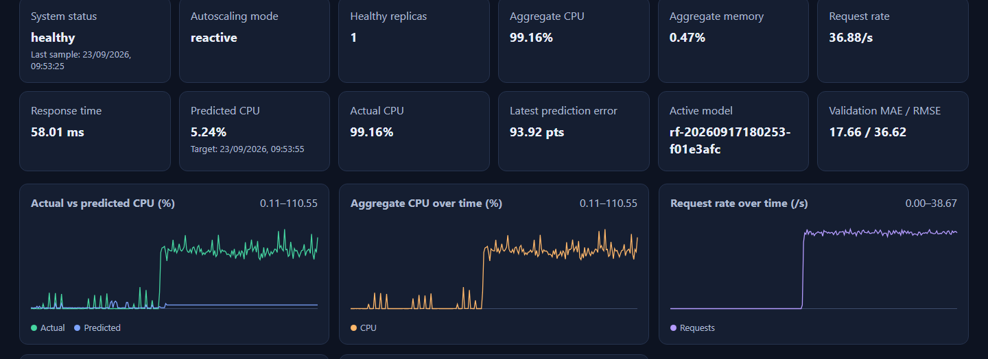
PRELIMINARY RESULTS & TESTING
Recorded final evaluation matrix: 15 valid policy–workload trials; fixed traces did not trigger scaling
Policy | Trials | MAE range | Response-time range | Scaling events | Adaptation attempts
Reactive | 5 | 7.919–15.531 | 116.073–175.784 ms | 0 | 0
Predictive | 5 | 7.147–15.933 | 115.709–118.278 ms | 0 | 0
Adaptive predictive | 5 | 11.073–16.161 | 114.434–117.595 ms | 0 | 1
Reporting note
All chart and table values come from results/final-evaluation-valid-matrix.csv and .json. The 15 fixed evaluation traces recorded zero scaling events. Separate controlled validation verified scaling and adaptive candidate handling. No performance improvement is claimed from this matrix.
Live dashboard view of observed metrics and prediction feedback
Model version recorded for every final-matrix trial: rf-20260917180253-f01e3afc
Notes:
Sources: results/final-evaluation-valid-matrix.csv and results/final-evaluation-valid-matrix.json. Values are recorded observations; no comparative inference is made.

Slide 8
HURDLES & MITIGATION
Hurdle | Mitigation
Docker / WSL environment setup | Used a reproducible Docker Compose environment and project-scoped labels to keep application control separate from unrelated containers.
Dynamic Nginx replica management | Membership controller discovers only healthy labelled replicas, generates an upstream, validates Nginx, then reloads gracefully.
Prediction and target-time alignment | Locked the 30-second horizon and five-second sampling interval; dataset and feedback use chronological target matching.
Persistent prediction errors | Adaptive service requires threshold breaches across consecutive evaluated predictions before candidate retraining.
Candidate model replacement | Candidate model must pass chronological validation before activation; rejected and superseded versions remain recorded.
Windows command-length limitation | Experiment recorder accepts encoded input through standard input, avoiding oversized command-line payloads.
All mitigations describe implemented behaviour or recorded integration issues. They do not claim production-cloud readiness.

Slide 9
FUTURE WORK & TIMELINE
Remaining delivery work and possible technical extensions
REMAINING DELIVERY WORK
W1
W2
W3
W4
W5
W6
Final result analysis
Final report / documentation
Demo refinement
Presentation preparation
Viva preparation
Final validation
POSSIBLE TECHNICAL EXTENSIONS
Integrate Locust controls into the dashboard
Timeline interpretation
Run longer and higher-intensity workload experiments
The timeline sequences final analysis, documentation, demonstration, presentation, viva preparation, and final validation. Week labels are planning markers, not completed milestones.
Compare additional prediction models
Improve dashboard visualisation and experiment controls
Explore cloud or Kubernetes deployment as future work

