Slide 1
Economic Development and CO2 Emission
Peter H. Schuld

Slide 2
Abstract
Early stage economic development depends on increasing CO2 emission-per-capita unless cheap and reliable alternatives to fossil fuel energy sources like coal are widely available. China’s produces 2/3 of its electricity with coal and her strong economic growth since the mid-1960’s is accompanied by accelerating CO2-per-capita growth up to levels of advanced European economies. France has shown a similar fossil fuel growth dependence in the 1960’s until she switched to nuclear power generation in the 1970’s and 1980’s. Since that change to alternative (i.e. non-fossil) energy sources for electricity generation her impressive economic growth decoupled from the reliance on ever increasing CO2-emissions. The example of France shows that access to cheap and reliable electric energy is the key ingredient for economic growth. Technological advancements in renewable energy sources like wind and solar should enable other developed economies and emerging economies to achieve sustainable economic growth while reducing CO2-emissions.

Slide 3
Motivation
Since the start of the industrial revolution in the mid-1700’s labour-productivity growth is thought to be strongly correlated with substituting manual labour with machines powered by hydro-carbons. Rising total-factor productivity in an economy (i.e. labour productivity) is highly desirable because it leads to rising living standards (i.e. higher GDP per capita).
Therefore, emerging economies like China and some developed economies like the USA are reluctant to commit to binding reductions in greenhouse gas emissions. Nevertheless, while gasoline is typically used of transport and is difficult to substitute most other hydro-carbons like coal and gas are predominantly used for heating and electricity production.
Sustainable economic growth can be achieved by switching to alternative energy sources like solar, wind, hydropower and nuclear to generate electricity.

Slide 4
Dataset(s)
- World Development Indicators Dataset The World Development Indicators from the World Bank contain over a thousand annual indicators of economic development from hundreds of countries around the world. https://www.kaggle.com/worldbank/world-development-indicators/home

Slide 5
Data Preparation and Cleaning
The time-series data for France and PR China was only available until 2011 and German data could not be used since the time-series for Germany starts only in 1990 (German unification). Former GDR (East Germany) data is unreliable.
The annual World Bank time-series are already adjusted for inflation (2005 US dollars) and both GDP and CO2-emission data is provided on a per-capita level.

Slide 6
Research Question(s)
Can economic growth and a reduction in CO2 emissions be achieved simultaneously? This research paper analyses the correlation of GDP-per-capita and CO2-emission-per-capita for representative emerging economies and developed countries.
Do emerging economies like China rely more on fossil fuels to achieve GDP-per-capita growth than developed economies like the USA. For several decades France has generated most of its electricity supply from nuclear fuels and French CO2 emissions have fallen well below the levels of economies with similar GDP-per-capita (e.g. Germany).

Slide 7
Methods
Histograms to show the distribution of data.
The correlation of annual GDP-per-capita and CO2-emission-per-capita was calculated to determine a growth dependence of fossil-fuel for early stage economic growth

Slide 8
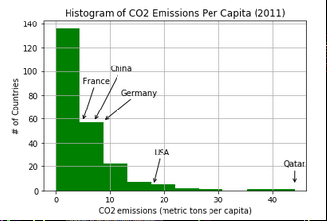
Findings 1
The current level of CO2 emission-per-capita (2011) depends on the level of economic development and the energy mix used in power generation.
Oil and gas producing countries like Qatar and the USA rely heavily on fossil fuels and produce high levels of CO2 emission (40 tonnes and 17 tonnes-per-capita, respectively).
At a similar level of economic development, energy importing European countries like Germany show lower CO2 emission levels around 9 tonnes-per-capita.
The biggest emerging economy China heavily relies on Coal for electricity generation and produces similar CO2 emissions than Germany, albeit at a much lower level of economic development.
In contrast, France shows significantly lower CO2 emission levels than equally wealthy Germany.
.

Slide 9
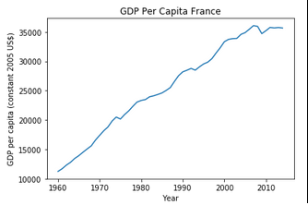
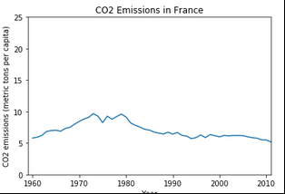
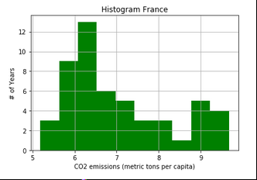
Findings 2
French CO2 emissions have peaked in the 1970s at approx. 10 tonnes per capita and have fallen to 5.2 t in 2011.
Currently, France derives about 75% of its electricity from nuclear energy, due to a long-standing policy based on energy security (source: http://www.world-nuclear.org).

Slide 10
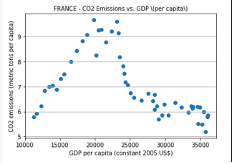

Findings 3
In 1960-2011 French CO2 emissions and GDP-per-capita show a negative correlation. ( correlation 1960-2011: -0.51 )
Until the Oil-price shock of the 1970s the correlation was positive, but since the 1980’s the relationship has broken. Before the 1980’s France relied predominantly on fossil fuels like gas and coal for electricity generation.

Slide 11
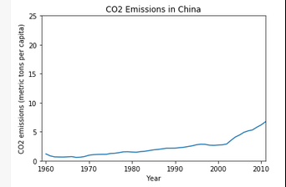
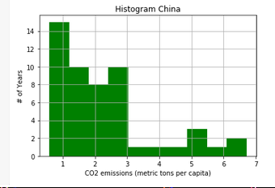
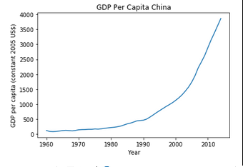
Findings 4
Chinese CO2 emissions have bottomed in the 1960’s and have constantly grown until the 1995. The accelerating economic growth since 2002 is accompanied by a strong increase in CO2 emissions-per-capita.
China's electric power industry is the world's largest electricity producer, passing the USA in 2011 after rapid growth since the early 1990s. Most of the electricity in China comes from coal, which accounted for 66% of the electricity generation mix in 2016 (Source: Wikipedia).

Slide 12
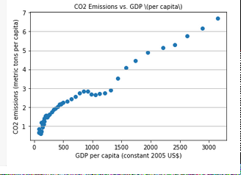

Findings 5
Chinese CO2 emissions show a strong positive correlation with economic development ( correlation 1960-2011: +0.98 ).
Nevertheless, The rise of electricity and of renewables are closely interlinked as China diversifies and cleans up its power mix – the share of coal in total generation is forecasted to fall from two-thirds today to less than 40% in 2040 as a result (International Energy Agency https://www.iea.org/weo/china/ )

Slide 13
Limitations
The analysis uses China as a proxy for emerging economies and ignores the different energy-mix in EM countries like Brazil, which heavily relies on renewable energy.
Nevertheless, several large EM countries like Indonesia and South Africa share China ‘s reliance on coal for electric energy generation. Therefore, the findings for China (biggest EM country and biggest electric energy producer in the world) hold for many other EM countries.
France heavy reliance on nuclear energy is no raw model for developing countries. Instead, EM countries should explore renewable energy sources like biofuel, wind and solar.

Slide 14
Conclusions
Countries in an early stage of economic development show a strong positive correlation between GDP-per-capita growth and CO2-emission-per-capita. China heavily relies on coal for electric energy generation and its strong economic grows since the 1960’s is accompanied by an increase in CO2-emission. France has shown a similar pattern of fossil fuel GDP growth dependence until she switched to non-fossil fuel (i.e. nuclear) electric power generation in the 1970’s and 1980’s.
Nuclear fission technology has several safety and environmental concerns. Nevertheless, technical advancements in renewable energy sources like wind and solar offer both emerging economies and developed markets sustainable economic growth with significantly reduced CO2 emission.

Slide 15

Acknowledgements
Annual time-series data from the world bank
Lecture videos and Jypiter notebooks from the Python4DS class.
Python Pandas for calculations and matplotlib for data visualization.
World Bank

Slide 16
References
U.S. Environmental Protection Agency. 2016.
Climate change indicators in the United States, 2016. Fourth edition.
EPA 430-R-16-004.
www.epa.gov/climate-indicators

