Slide 2
GIT - Versionsverwaltung
Git, GitHub und GitHub Desktop

Slide 3
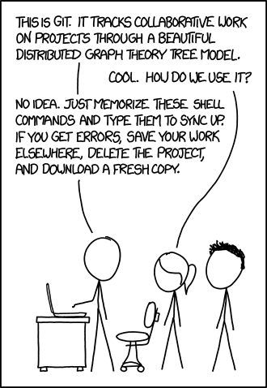

Slide 4
Agenda
Git
Was ist Git
Geschichte
Funktionsweise
Tutorials & Lernunterlagen
Demo?
GitHub
Was ist GitHub
Geschichte
Funktionsweise

Slide 5
Geschichte
2002 Benütze das Linux Kenrel Projekt einen DVCS mit dem Namen BitKeeper

Slide 6
Geschichte
− In 2002 the Linux kernel project began using a proprietary DVCS called BitKeeper.
− In 2005, the relationship between the community that developed the Linux kernel and
the commercial company that developed BitKeeper broke down, and the tool’s free-of-
charge status was revoked.
− This prompted the Linux development community (and in particular Linus Torvalds, the
creator of Linux) to develop their own tool based on some of the lessons they learned while using BitKeeper. Some of the goals of the new system were as follows:
> Abletohandlelargeprojects(e.g.theLinuxKernel)efficiently(speedanddata size)
> Strongsupportfornon-lineardevelopment(thousandsofparallelbranches)
> Fullydistributed
> Speed
> Simpledesign

Slide 7
Was ist Git
Distributed Version Control Software
Distributed
> An order of magnitude faster than other tools
> Strong support for non-linear development
> Free and Open Source
Vorteile von Git
Integrity (Alles wird mit check-summen abedeckt , SHA-1 Hash)
Anwendungsbreite

Slide 8
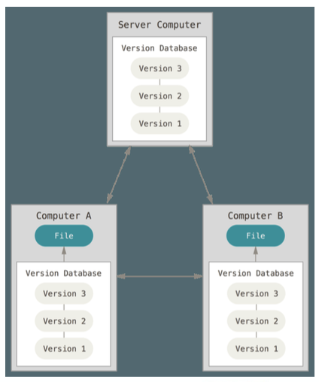
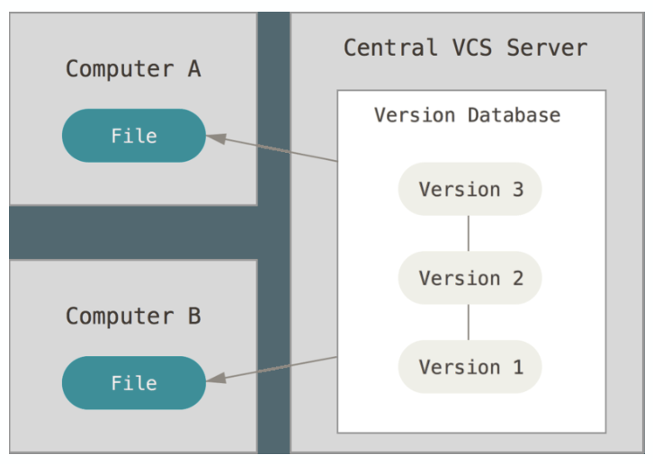
Centralized vs Distributed

Slide 9
The three Stages

Slide 10
Push Pull Merges…

Slide 11
Git - Tutorials
Interactives Webtool mit Visualisierung
Learn Git Branching
https://learngitbranching.js.org

Slide 12
GitHub
Remotes
Single Shared Repository
Shared repository
developer
developer
developer

Slide 13
Shared repository
developer
developer
developer

