Slide 1
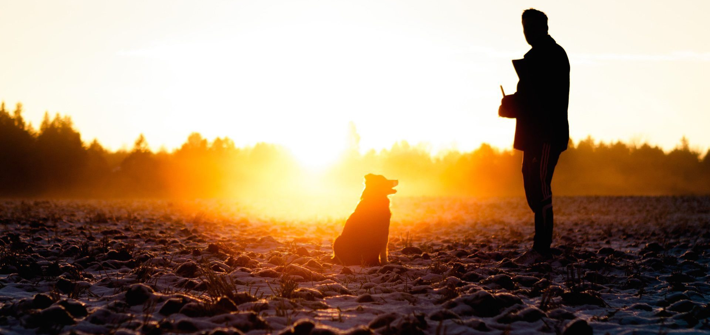
Index.html Landing Page
My best friend is a dog
Main Page
Fun and Fitness
Nutrition and Health
History of Dogs
Our Preferred Partners
Past Articles
Sign Up for our Newsletter
Main Content
Panel
SOCIAL MEDIA AND CONTESTS

