Slide 1
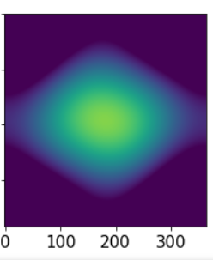
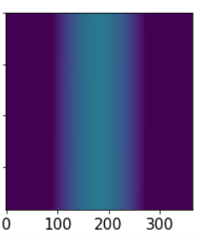
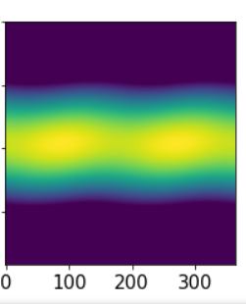
Amount and strength of sun through out the year for 3 places on Earth
BATH
North Pole
EQUATOR
Morning
Morning
Morning
Noon
12 O’Clock
Noon
12 O’Clock
Noon
12 O’Clock
Evening
Evening
Evening

