Slide 1
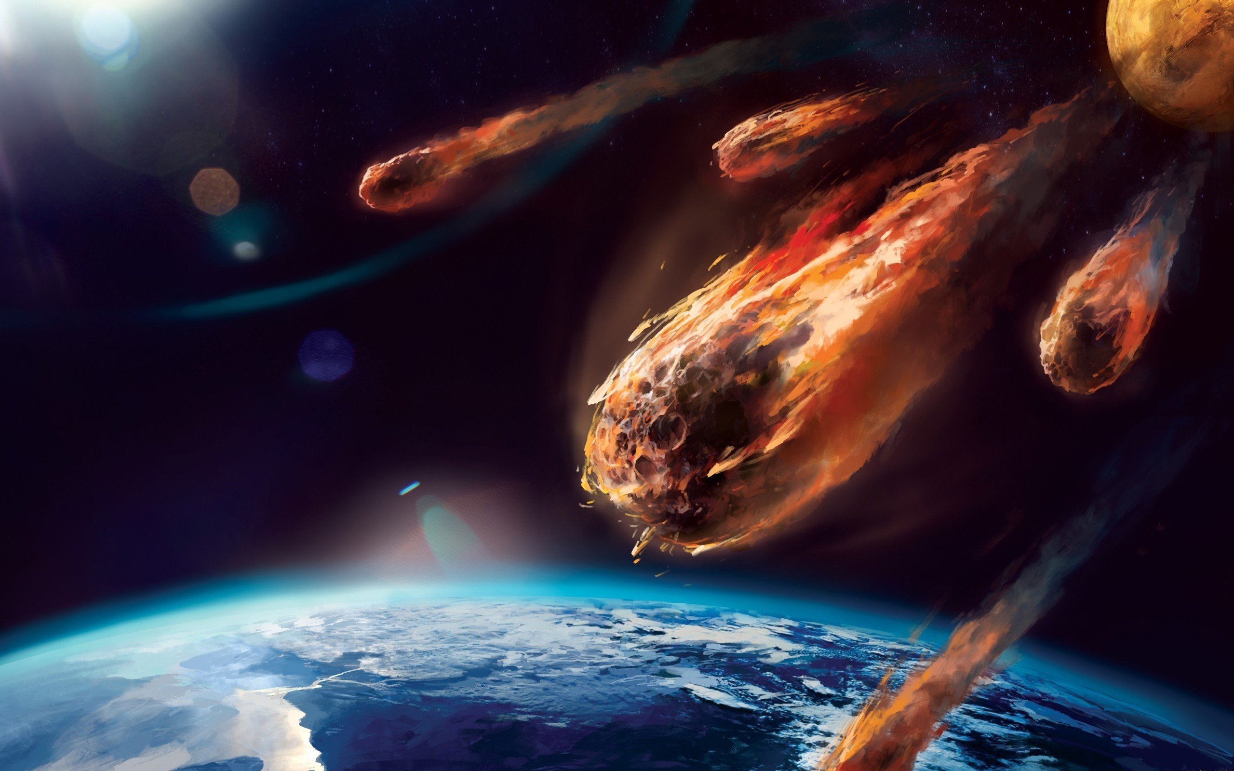


Slide 2

Planetary Defender
Player operates turret on planet Earth
Asteroids sent by Aliens on a collision path to Earth
Player must destroy all Asteroids
Physics based projectiles
Arcade style play
High tempo music

Slide 3
Design Decisions
Changed enemies to asteroids (from aliens)
Reduced survival time (from 120s)
Spawn Power Ups randomly (instead of w/ Roids)
Changed to having just one ‘scene’ for levels
Asteroids not splitting into smaller ones

Slide 4
Challenges Faced (and overcome)
Working out how to signal from scene to scene
Getting collision to report type of object colliding
Working out how to spawn bullet at front of turret
Working out how to get a vector to a point

