Slide 1
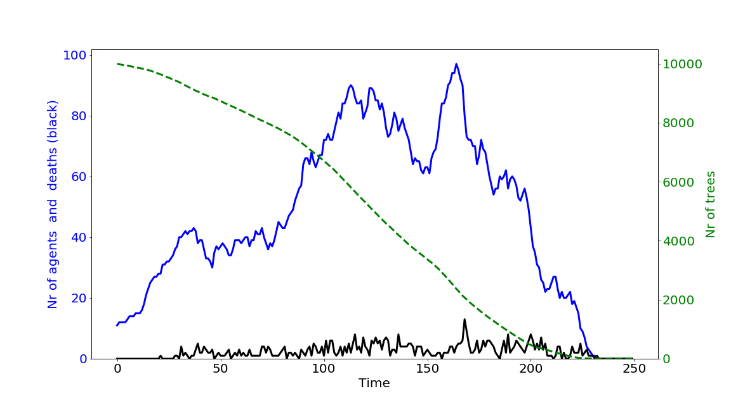
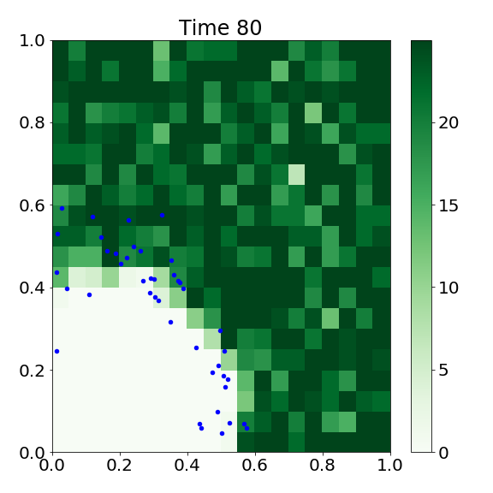
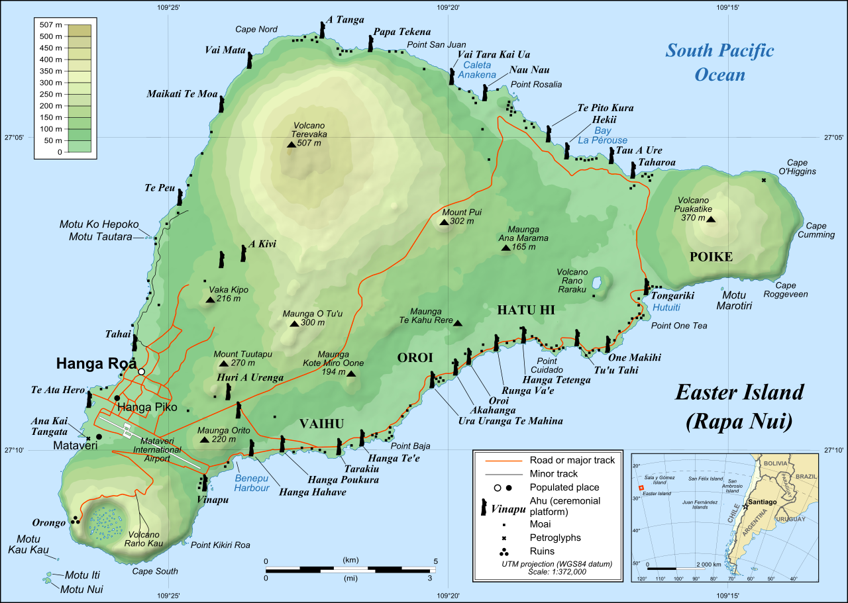
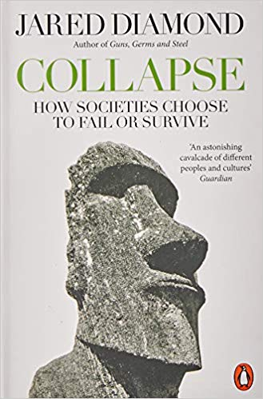
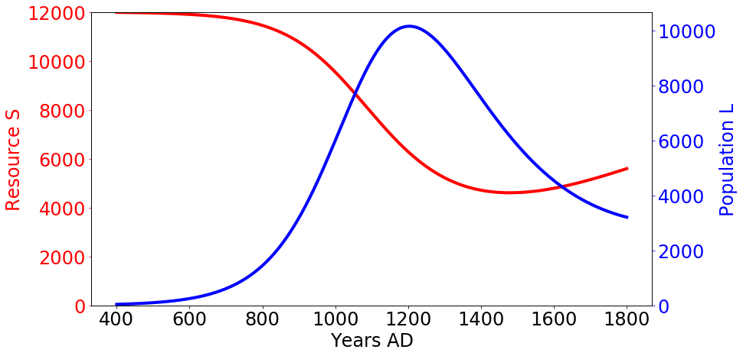
Development of an
Agent-Based Model (ABM)
of human-resource
interactions on
Easter Island
based on real geography
Notes:
Talking about:
Modelling ancient society and their human-resource interalcions,
in particular, the one on Easter Island
Through an Agent Based Model
Allows us to assess the impact of the actual geographical constraints

Slide 2
“Why should I postpone my nap today?”
- 2 approaches to mathematically model an ecological system
- approaching an ancient history riddle
- find the hidden Trump quote → earn a high-five

Slide 3
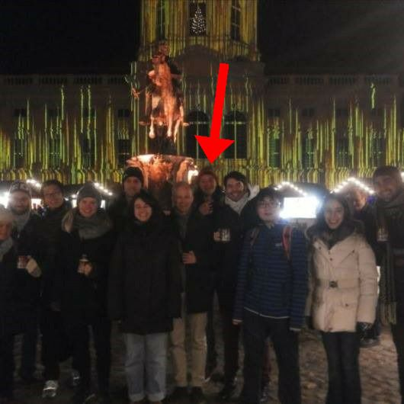
Me
Bachelor in Physics (Erlangen, Germany)
Master in (Climate) Physics (Potsdam, Germany)
COSSE Year 2018 (Berlin, Stockholm)
now: Master’s thesis in Bremen, Germany

Slide 4
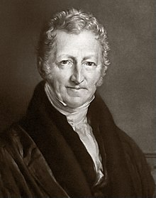
Malthusian Catastrophe
Thomas Malthus, 1798.
An Essay on the Principle of Population, Chapter II.
https://en.wikipedia.org/wiki/File:Thomas_Robert_Malthus.jpg
1a

Slide 5

Malthusian Catastrophe
Food Production rises as more land is cultivated
→ Population grows
Agri-
culture
Food Production
Population
t
1b
Notes:
Rise in per capita resource extraction leads to precreation in PRE-MODERN societies (Reuveny, 2012)

Slide 6
Malthusian Catastrophe
Population > Food Production
→ prices rise
→ per capita consumption
decline
→ conflict
→ collapse
Food Production rises as more land is cultivated
→ Population grows
Agri-
culture
Food Production
t
Population
1c

Slide 7
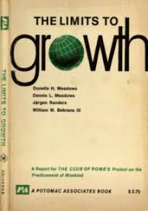
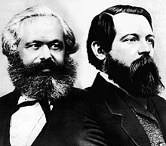

Malthusian Catastrophe
:
:
Agri-
culture
Technological advances
de.wikipedia.org/wiki/Wissenschaftlicher_Sozialismus
Clubofrome.org
Food Production
t
Population
1d
Notes:
Malthus Theory failed
Neo-classical economists: through free markets, human ingenuity → technological advances
e.g. Marx/Engels heavily critizised
Indeed, human consumption per capita increased eve since
BUT: environmental damage since the 1960s??
Club of Rome: Limits of Growth

Slide 8
Collapse of Easter Island population?
Diamond, 2005
https://www.amazon.de/Collapse-Societies-Choose-Fail-Survive/dp/0241958687
Diamond, J. (2005). Collapse: How States Choose to Fail or Succeed. In Penguin Group.
2
Notes:
Easter Island
- History:
- dense plam tree forest
- first settlers 400 to 1200 (unsure)
- apparently advanced culture (statues heavy, tools required)
- also found very advanced technologies agains soil erosion.
- Europeans arrive 1722:
barren island, not that many people
- next contact 1780ies:
no trees, only very, very few people. Statues all collapsed

Slide 9
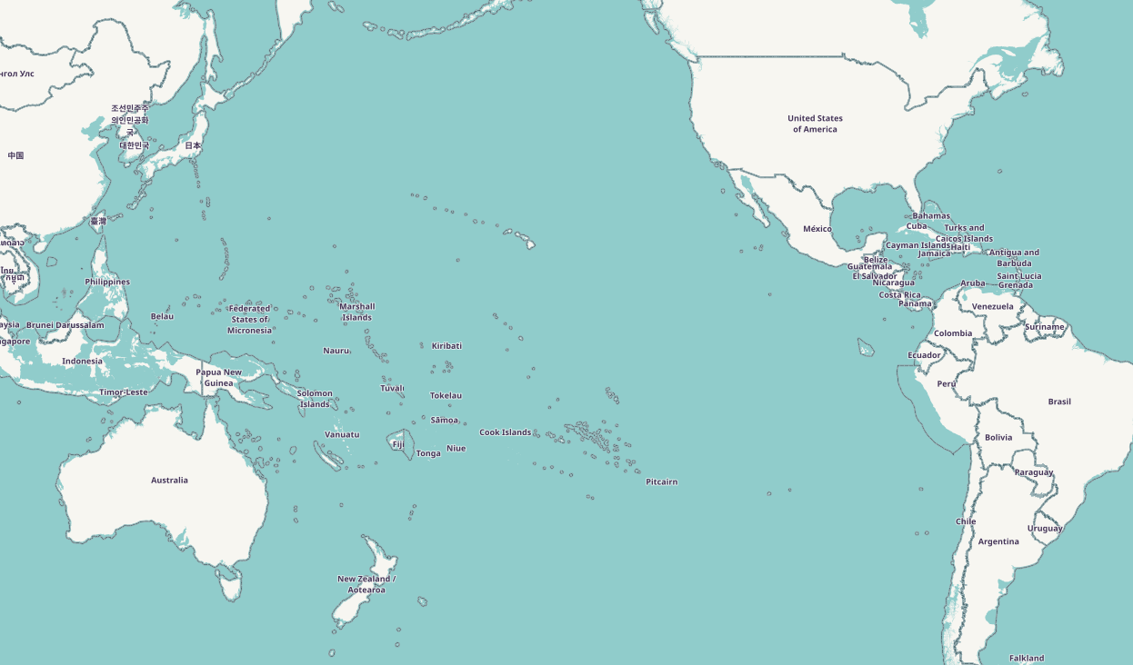
Easter Island – Overview
https://en.wikipedia.org/wiki/Moai#/media/File:Easter_Island_map-en.svg
3
Notes:
Island as “natural laboratory”

Slide 10


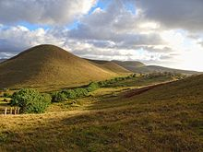
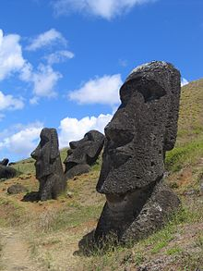
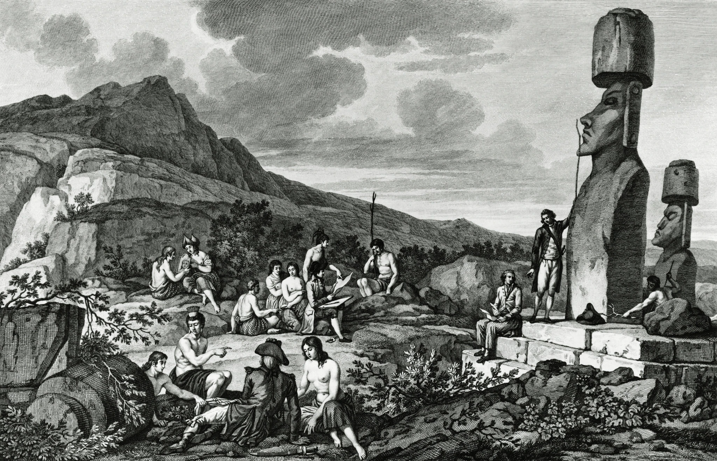
Easter Island – The Facts
feeds on palm tree seeds
Polynesian/Pacific
Rat
(1)
(4)
(1)
https://en.wikipedia.org/wiki/Easter_Island
Deforestation by humans (ca. from 1200)
https://en.wikipedia.org/wiki/Polynesian_rat
(2)
Advanced culture
(1250-1500)
(3)
Europeans arrive in 1722+x
bring diseases and slave trade
https://www.nytimes.com/2017/10/12/science/easter-island-dna-south-america.html
Hunt, T. (2006). Rethinking the Fall of Easter Island. American Scientist.
Brandt, G., & Merico, A. (2015). The slow demise of Easter Island: Insights from a modeling investigation. Frontiers in Ecology and Evolution.
4d

Slide 11
SUMMARY
The Problem:
How did turn from via to ?
Is it an example of a Malthusian Collapse?
Food Production
Population

Slide 12
Modelling Ancient Societies
(1) (simple) Macroscopic System Models
- coupled differential equations (highly non-linear)
- for the Population Size
- for the Resource Stock (here: Trees)
(- for other invasive species)
- modelled as simple predator (humans) vs. prey (resource) model
(`Lotka-Volterra-Model’)
- decision makers (humans) maximise their utility
(here: through harvest and manufactured goods)
- control variable
(here: consumption rate, i.e. resource extraction rate)
Reuveny, R. (2012). Taking Stock of Malthus: Modeling the Collapse of Historical Civilizations. Annual Review of Resource Economics.
5

Slide 13
The First Model: Brander and Taylor (1998)
Variables
L = Population size
S = Resource Stock = Nr of trees
Parameters
b = birth rate
d = death rate
= relation between
fertility and consumption
H(L,S) = harvest rate of population
G(S) = logistic growth rate
of resource
Exponential growth/decay
The more harvest the more population growth
Logistic growth
Harvest
Brander, J. A., & Taylor, M. S. (1998). The Simple Economics of Easter Island: A Ricardo-Malthus Model of Renewable Resource Use. American Economic Review.
6
\frac{dL}{dt} = L \cdot (b - d) + \phi \cdot H(L, S)
\frac{dS}{dt} = S\cdot G(S) – H(L,S)
Notes:
2 Equations for Pop Size and Resource Stock
1st: exponential growth with birth rate and decay through death rate.
Additional Dependency: If Harvest of the population is good, then more births
Explicit coupling between the resource and population size
2nd Equ: Logistic Growth rate (draw on board) S over t, and reduced by harvest
That’s how you write a paper in 1998 with >500 citations (google scholar)

Slide 14
The First Model: Brander and Taylor (1998)
“ Boom and Bust”
7
Notes:
Red = Resource S starting at Carrying Capacity and being reduced through Harvest,
Blue = Population, first exponential growth, then declining
They call it Boom and Bust.
And basically here it is: The Malthusian colllapse
End of Story?

Slide 15
Extensions to Brander and Taylor (1998)
Agriculture
Far-sightedness vs. short-sightedness of the population
Social/Organisational Responses:
- positive
+ institutions i.e. social planning
+ technological advances
- negative
+ war, rivalry
How could we improve this model?
e.g.
Reuveny, R. (2012). Taking Stock of Malthus: Modeling the Collapse of Historical Civilizations. Annual Review of Resource Economics.
8
Notes:
Obviously Model is very simplified
Much room for improvement. Several more models suggested that include parts of that

Slide 16
Hunt (2006): Role of the Pacific Rat
New Archaeological Evidence:
- Pacific rat responsible for ecological catastrophe
New Narrative about population collapse:
- Not an example of an `ecocide’.
- “Consequence of European contacts, with Old World diseases and slave-trading”
→ genocide
Hunt, T. (2006). Rethinking the Fall of Easter Island. American Scientist.
9
Notes:
And more!
Enter, the polynesian rat
Hunt finds that Pacific Rat is crucial factor on other islands if the vegetation remained or not.
Then find bones in archaeological data
Concludes: Not Ecocide, but the rat, which they brought along initially responsible for nature collapse
Population collapse because of contact with europeans and infectious diseases

Slide 17
Adjusted Model
- 3 instead of 2 variables and differential equations
(Basener, 2008):
Human Population (L)
Resource Stock (S)
Rat Population (R)
- Include a Diseases Spread Model after European Contact
(Brandt and Merico, 2015)
Brandt, G., & Merico, A. (2015). The slow demise of Easter Island: Insights from a modeling investigation. Frontiers in Ecology and Evolution.
Basener, W., Brooks, B., Radin, M., & Wiandt, T. (2008). Rat instigated human population collapse on Easter Island. Nonlinear Dynamics, Psychology, and Life Sciences.
10
Notes:
A few people picked up this evidence and
Naturally introduced a new predator variable, that also feeds on the trees or the resource
Later, a disease spreading Model after the european contact

Slide 18
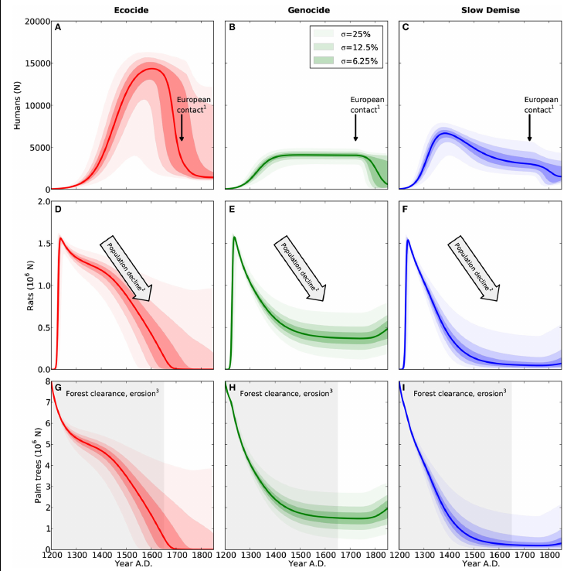

So which theory is the right one now?
Brandt, G., & Merico, A. (2015). The slow demise of Easter Island: Insights from a modeling investigation. Frontiers in Ecology and Evolution.
11
Notes:
SAME Model
But different Parameter settings
Left: Ecocide / Collapse Narrative: Population overshoots, trees collapse, pop collapses and the Europeans give it the rest.
Middle: Population grows, but so do rats! Decline forest, stable population, but then genocide by Europeans
Right: Third/new theory: Fast Start, Then slow demise until final collapse by Europeans
BUT WHICH ONE IS CORRECT? Don’t know.

Slide 19
SUMMARY
The Problem:
How did turn from via to ?
Is it an example of a Malthusian Collapse?
Modelling Approaches:
(1) Macroscopic System Models
Food Production
Population
(2) Microscopic Agent Based Modelling (ABM)

Slide 20

Now: ABM, but why?
- Agents are unique and heterogeneous
- Agents act in response to local environment/context
- System Models assume a fixed relationship between Environment and Behaviour
(except for global change of an equation; no bottom-up emergence)
Benefits of Agent Based Model (ABM):
- can capture emergent phenomena
- explicit space dependency of microscopic behaviour
- natural description of a social system
- very flexible
https://www.amazon.de/End-Theory-Financial-Economics-Interaction-ebook/dp/B01M2BVG7M
Bousquet, F., & Le Page, C. (2004). Multi-agent simulations and ecosystem management: A review. Ecological Modelling.
Bonabeau, E. (2002). Agent-based modeling: Methods and techniques for simulating human systems. Proceedings of the National Academy of Sciences of the USA.
12
Notes:
Def: “Agent-based models in archeology and
anthropology are computer programs emulating behaviors of many heterogeneous agents
to reproduce detailed archeological data from certain landscapes while the historical environment is coded in detail on a digitized map.” (Reuveny 2012)

Slide 21
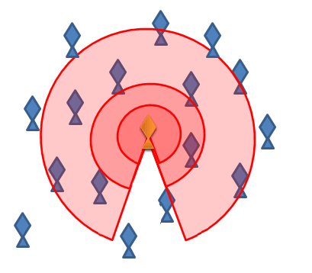
What exactly is an ABM?
Agents | discrete, independent, heterogeneous entities placed in a dynamic, spatial environment rule-based interactions with the environment and each other given the local context
Environment/Resource | (dynamic) map that influences the agents’ behaviour responds to agents’ actions
Update | select agents randomly and update them autonomously
e.g. modelling
Swarm behaviour
Rules
https://en.wikipedia.org/wiki/Swarm_behaviour
13

Slide 22
Comparison to simple System Model
Agents | discrete, independent, heterogeneous entities placed in a dynamic, spatial environment rule-based interactions with the environment and each other given the local context
Environment/Resource | (dynamic) map that influences the agents’ behaviour responds to agents’ actions
Update | select agents randomly and update them autonomously
A “representative” agent with 1 set of global parameters
Interested in aggregate Variables
Dynamic aggregate Variables
Following Trajectory given by Differential Equation
14

Slide 23
A first Easter Island ABM
.ipynb

Slide 24
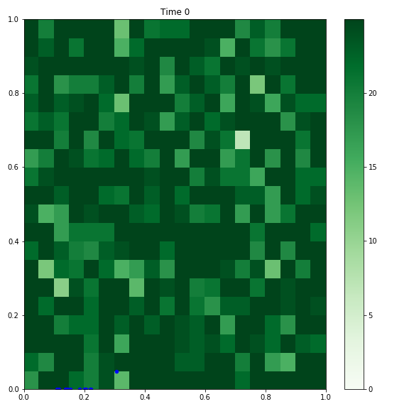
A first Easter Island ABM (here or .ipynb)
- Map is a homogeneous square filled with trees
- Agents are initialised (1) at an edge or (2) equally distributed
- Environment (Trees) are harvested (can’t regrow or die otherwise) (passive agents)
- Agents eat one tree per time step in circle with fixed radius (parameter 1)
IF they found a tree and cut it, they reproduce (i.e. copy themselves) with fixed probability (parameter 2)
ELSE they
(1) move to a random spot within a fixed radius (parameter 3) and get hungry or
(2) die if they have been hungry already
15

Slide 25
A first Easter Island ABM
16a

Slide 26
A first Easter Island ABM
.gif

Slide 27
A first Easter Island ABM
16b

Slide 28
My Master’s Thesis
Experiments:
- Are there limits to the scenarios introduced by the spatial constraints?
- Impact of fresh water availability on movement of settlements?
- Drying of a lake in 1450?
17

Slide 29
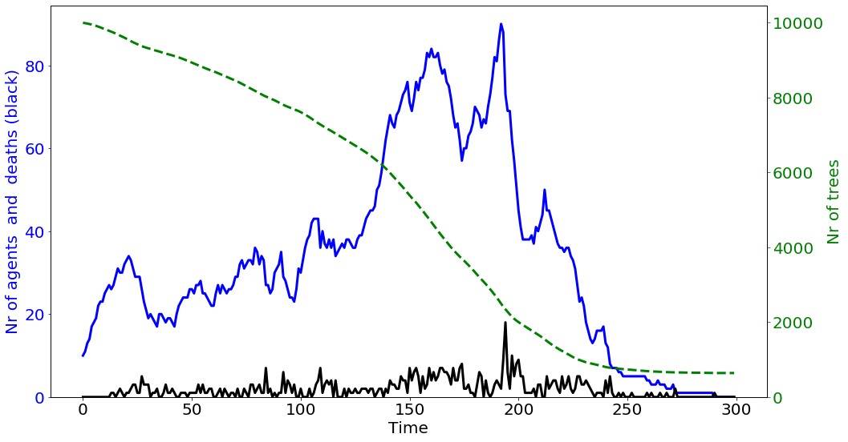
SUMMARY
The Problem:
How did turn from via to ?
Is it an example of a Malthusian Collapse?
Modelling Approaches:
(1) Macroscopic System Models (2) Microscopic Agent Based Modelling (ABM)
Food Production
Population
Rules
(t)
Thanks for your interest!

Slide 30
Backup and Old Versions

Slide 31
Brander et al. (1998)
Parameters
b = birth rate
d = death rate
= relation between fertility and consumption
= resource exploitation rate
= how much we value harvest over manufactured goods (e.g. leisure)
K = resource carrying capacity
r = resource growth rate
Variables
L = Population size
S = Resource Stock
\frac{dL}{dt} = L \cdot (b - d + \phi \cdot \alpha \cdot \beta \cdot S)
\frac{dS}{dt} = r\cdot S\cdot \left(1-\frac{S}{K}\right) \, - \, \alpha\cdot \beta \cdot L \cdot S

Slide 32
Good and Reuveny (2012):
A far-sighted social planner tries to maximise utility not instantaneously but over a certain, discounted timespan, then he/she tells everyone how much they should harvest
Result:
Even with optimal planning, collapse can’t be averted

Slide 33
Good and Reuveny (2012):
A far-sighted social planner tries to maximise utility not instantaneously but over a certain, discounted timespan, then he/she tells everyone how much they should harvest
Result:
Even with optimal planning, collapse can’t be averted

Slide 34
What exactly is an ABM?
 |  | Python
Agents | Independent, heterogeneous entities that are placed in a dynamic, spatial environment Rule-based interactions with the Env and each other given the local context | objects of class `agent’ with different params/attributes Class functions
Environment/Resource | (dynamic) map that influences the agents’ behaviour Environment responds to agents’ actions | Here: list of objects of class `tree’ located on map
Update | Each agent updates autonomously | Select random agent, Update given the local, current environment
13

Slide 35
Comparison to simple System Model
What | Description | Python
Agents | Independent, heterogeneous entities that are placed in a dynamic, spatial environment Rule-based interactions with the Env and each other given the local context | objects of class `agent’ with different params/attributes Class functions
Environment/Resource | (dynamic) map that influences the agents’ behaviour Environment responds to agents’ actions | Here: list of objects of class `tree’ located on map
Update | Each agent updates autonomously | Select random agent, Update given the local, current environment
1 “representative” agent
Interested in 1 aggregate variable
Fixed parameters,
1 Variable
1 Variable and DiffEqu
1 Variable and DiffEqu
Following Trajectory from DiffEqus
Solve DiffEqu
14

