Slide 1
1.Title slide: project title, presenter name, and date
Introduction: project’s overview and goals, explanation of the problem being investigated
Background: previous research and findings related to lead exposure and crime rates, explanation of how lead exposure can affect behavior
Data collection and analysis: explain data sources, data cleaning and preparation process, also statistical methods used for analysis
Results: results of the analysis, graphs and charts
Discussion: the relationship between lead exposure and crime rates, explain the observed correlations
Limitations: any limitations of the study
Conclusion: summarize project findings
References
Questions and answers

Slide 2

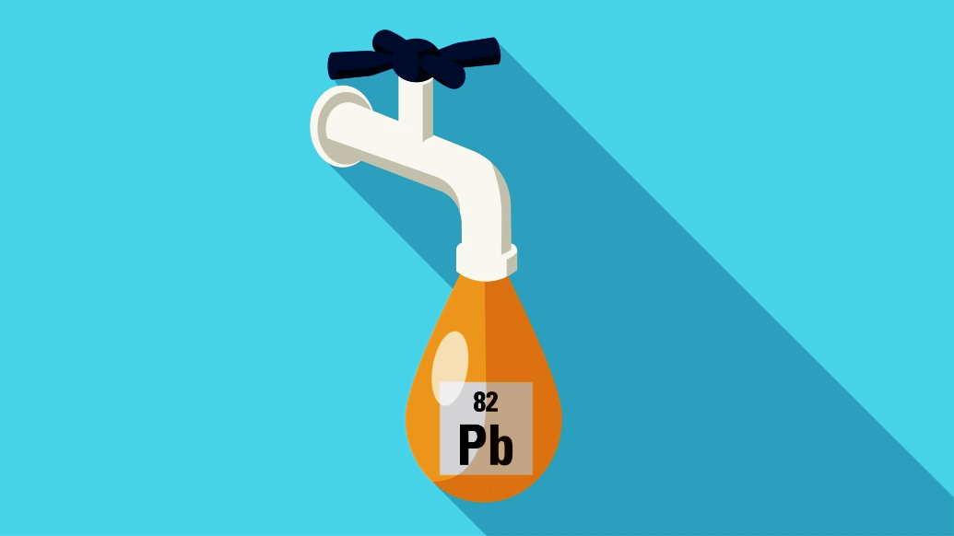
IS OUR WATER safe ?
ANALYSIS OF LEAD EXPOSURE vs CRIME RATES IN THE US
GROUP 5

Slide 3
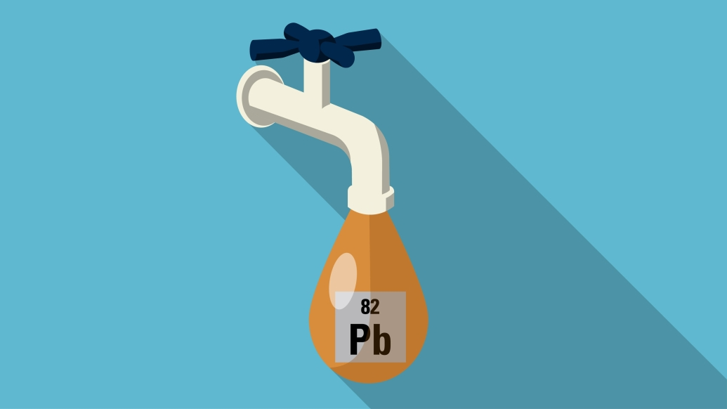

Outline
Sources of lead exposure and its health effects
Discuss the statistical significance of the correlation
Call to action
Background
Results
Conclusion
1
3
5
2
4
6
Goal
Data Analysis
Limitations
Correlation between crime rates and the level of toxins
Crime rate data vs water quality data
Potential confounding variables

Slide 4

GOALS
INVESTIGATE
SOLUTIONS
How lead exposure from lead pipes can potential link to criminal behavior
Address the issue of lead exposure to prevent potential negative outcomes
EXPLORE
ANALYZE
The relationship between lead exposure and crime rates in different states of the U.S
Crime rates in areas with known lead pipe infrastructure

Slide 5
DATA SOURCE AND CLEANING
LEAD SERVICE LINE DATA
CHELATON DOCTORS
From the Natural Resources Defense Council (NRDC): https://www.nrdc.org/resources/lead-pipes-are-widespread-and-used-every-state. We cleaned, processed data to extract info on lead pipes and their locations
Make a big impact wi
HEALTH PROBLEMS RELATED TO LEAD EXPOSURE
FBI VIOLENCE DATA
From Uniform Crime Reporting (UCR) program: https://ucr.fbi.gov/crime-in-the-u.s/2016/crime-in-the-u.s.-2016/topic-pages/tables/table-3. We cleaned, processed data to extract info on violent crimes and their locations
SOURCES OF DATA
Make a big impact with professional slides, charts, infographics and more.
MISSOURI CORRELATION DATA
BASIC LEAD IN DRINKING WATER
Make a big impact with professional slides, charts, infographics and more.
From the Environmental Protection Agency (EPA)

