Slide 1
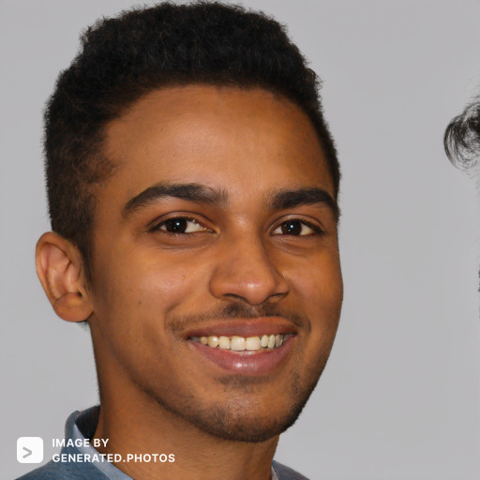
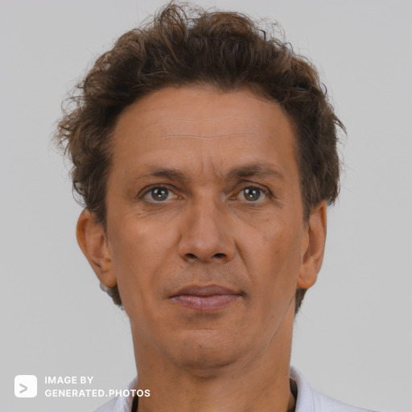

Slide 2
Sean Spears
Age: 23
Occupation: Student
Sean wants to buy his first car. He doesn’t know a good place to find cars.

Slide 3
Bob Perkins
Age: 44
Occupation: Car garage owner
Bob owns a car garage, and he wants to start selling cars. He doesn’t know a good platform to sell his cars.

