Slide 1
Virtual Memory

Slide 2
Outline
Multilevel page tables
Pentium/Linux Memory System
Core i7
Linux Virtual Memory System
Memory Mapping
Suggested reading: 9.7, 9.8

Slide 3
Multi-Level Page Tables
Given:
  X86: 32-bit address space
  4KB (2¹²) page size, 4-byte PTE
  X86-64: 48-bit address space
  4KB (2¹²) page size, 8-byte PTE
Problem:
  X86: Would need a 4 MB page table!
    2²⁰ *4 bytes (20bit = 32bit – 12bit)
  X86-64: Would need a 512 GB page table!
    2³⁶ *8 bytes (36bit = 48bit – 12bit)

Slide 4
Multi-Level Page Tables
Common solution
  multi-level page tables
  e.g., 2-level page table
    Level 1 table: 1024 entries, each of which points to a Level 2 page table.
    Level 2 table: 1024 entries, each of which points to a page
Level 2
Tables
Level 1
Table
...

Slide 5
Multi-Level Page Tables
Level 1
page table
Level 2
page tables
Virtual memory
VP 0
0
PTE 0
...
PTE 0
...
VP 1023
2K allocated VM pages
for code and data
PTE 1
PTE 1023
VP 1024
PTE 2 (null)
...
PTE 3 (null)
VP 2047
PTE 4 (null)
PTE 0
Gap
PTE 5 (null)
...
PTE 6 (null)
PTE 1023
PTE 7 (null)
6K unallocated VM pages
PTE 8
1023 null
PTEs
(1K - 9)
null PTEs
PTE 1023
1023
unallocated
pages
1023 unallocated pages
32 bit addresses, 4KB pages, 4-byte PTEs
VP 9215
1 allocated VM page
for the stack
...

Slide 6
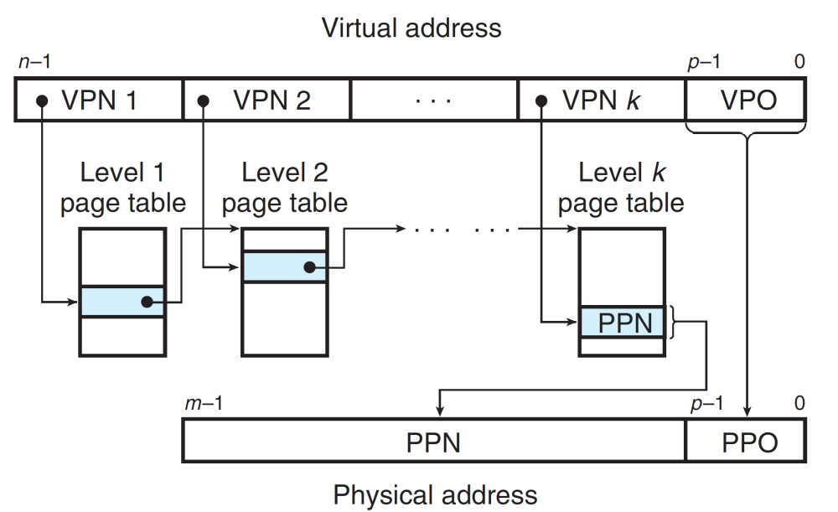
Multi-Level Page Tables

Slide 7
P6 Memory System
DRAM
32 bit address space
4 KB page size
L1, L2, and TLBs
  4-way set associative
inst TLB
  32 entries
  8 sets
data TLB
  64 entries
  16 sets
L1 i-cache and d-cache
  16 KB
  32 B line size
  128 sets
L2 cache
  unified
  128 KB -- 2 MB
  32 B line size
external system bus (e.g. PCI)
L2
cache
cache bus
bus interface unit
inst
TLB
data
TLB
instruction
fetch unit
L1
i-cache
L1
d-cache
processor package

Slide 8
Review of Address Translation
n–1
p
p–1
0
virtual page number
page offset
virtual address
TLB tag
TLB index
address translation
m–1
p
p–1
0
physical page number
page offset
physical address
Cache tag
Cache index
Cache offset

Slide 9
Review of Address Translation
Components of the virtual address (VA)
  VPO: Virtual page offset
  VPN: Virtual page number
  TLBI: TLB index
  TLBT: TLB tag
Components of the physical address (PA)
  PPO: Physical page offset (same as VPO)
  PPN: Physical page number
  CO: Byte offset within cache line
  CI: Cache index
  CT: Cache tag

Slide 10
Core i7 Summary
Core i7
  The 64-bit Nehalem microarchitecture
  Current support 48-bit (256 TB) virtual address space and 52-bit (4 PB) physical address space
  Compatibility mode support 32-bit (4 GB) virtual and physical address spaces

Slide 11
Core i7 Memory System (Haswell)
Registers
Instruction fetch
MMU
(addr translation)
L1 d-cache 32 KB,8-way
L1 i-cache
32 KB,8-way
L1 d-TLB
64 entries, 4-way
L1 i-TLB
64 entries, 4-way
Processor package
L2 unified TLB
1024 entries, 8-way
L2 unified cache
256 KB, 8-way
QuickPath interconnect
4 links @ 25.6 GB/s
102.4 GB/s total
To other
cores
To I/O
bridge
L3 unified cache
8 MB, 16-way
(shared by all cores)
DDR3 memory controller
3 x 64 bit @ 10.66 GB/s
32 GB/s total (shared by all cores)
Core x 4
Main memory

Slide 12
Core i7 Memory System (Skylake)
Registers
Instruction fetch
MMU
(addr translation)
L1 d-cache 32 KB,8-way
L1 i-cache
32 KB,8-way
L1 d-TLB
64 entries, 4-way
L1 i-TLB
64 entries, 4-way
Processor package
L2 unified TLB
1536 entries, 12-way
L2 unified cache
256 KB, 8-way
QuickPath interconnect
4 links @ 25.6 GB/s
102.4 GB/s total
To other
cores
To I/O
bridge
L3 unified cache
8 MB, 16-way
(shared by all cores)
DDR3 memory controller
3 x 64 bit @ 10.66 GB/s
32 GB/s total (shared by all cores)
Core x 4
Main memory

Slide 13
Core i7 Address Translation
CPU
32/64
L2, L3, and
main memory
result
Virtual address (VA)
36
12
VPN
VPO
L1 hit
L1 miss
32
4
TLBT
TLBI
L1 d-cache
(64 sets, 8 lines/set)
TLB
hit
TLBmiss
...
...
L1 TLB (16 sets, 4 entries/set)
9
9
9
9
VPN1
VPN2
VPN3
VPN4
40
12
40
6
6
PPN
PPO
CT
CI
CO
CR3
physical
address
(PA)
PTE
PTE
PTE
PTE
Page Tables

Slide 14
Core i7 Address Translation
CPU
32/64
L2, L3, and
main memory
result
Virtual address (VA)
36
12
VPN
VPO
L1 hit
L1 miss
32
4
TLBT
TLBI
L1 d-cache
(64 sets, 8 lines/set)
TLB
hit
TLBmiss
...
...
L1 TLB (16 sets, 4 entries/set)
9
9
9
9
VPN1
VPN2
VPN3
VPN4
40
12
40
6
6
PPN
PPO
CT
CI
CO
CR3
physical
address
(PA)
PTE
PTE
PTE
PTE
Page Tables

Slide 15
Core i7 Address Translation
CPU
32/64
L2, L3, and
main memory
result
Virtual address (VA)
36
12
VPN
VPO
L1 hit
L1 miss
32
4
TLBT
TLBI
L1 d-cache
(64 sets, 8 lines/set)
TLB
hit
TLBmiss
...
...
L1 TLB (16 sets, 4 entries/set)
9
9
9
9
VPN1
VPN2
VPN3
VPN4
40
12
40
6
6
PPN
PPO
CT
CI
CO
CR3
physical
address
(PA)
PTE
PTE
PTE
PTE
Page Tables

Slide 16
Level 1, Level 2 and Level 3 Page Table Entry
63
62
52
51
12
11
9
8
7
6
5
4
3
2
1
0
XD
Unused
Page table physical base addr
Unused
G
PS
A
CD
WT
U/S
R/W
P=1
Available for OS (page table location in secondary storage)
P=0
XD Disable or enable instruction fetches
Base addr 40 most significant bits of base address of child page
table (forces page tables to be 4KB aligned)
G global page (don’t evict from TLB on task switch)
PS Page size either 4K or 2M or 1G(may set to 1 only for
Level 2 or level 3 PTEs)
A Reference bit (set by MMU on reads and writes, cleared
by software)
CD Cache disabled(1) or enabled(0) for child page table
WT Write-through or write-back cache policy
U/S User or supervisor(kernel) mode access permission
R/W Read-only or read-write access permissiom
P Child page table present in memory(1) or not(0)

Slide 17
Level 4 Page Table Entry
63
62
52
51
12
11
9
8
7
6
5
4
3
2
1
0
XD
Unused
Page table physical base addr
Unused
G
D
A
CD
WT
U/S
R/W
P=1
Available for OS (page table location in secondary storage)
P=0
XD Disable or enable instruction fetches
Base addr 40 most significant bits of base address of child page
table (forces page tables to be 4KB aligned)
G global page (don’t evict from TLB on task switch)
D Dirty bit (Set by MMU on writes, cleared by software)
A Reference bit (set by MMU on reads and writes, cleared
by software)
CD Cache disabled(1) or enabled(0) for child page table
WT Write-through or write-back cache policy
U/S User or supervisor(kernel) mode access permission
R/W Read-only or read-write access permissiom
P Child page table present in memory(1) or not(0)

Slide 18
Page tables Translation
9
9
9
9
12
VPN 1
VPN 2
VPN 3
VPN 4
VPO
L1 PT
Page global
directory
L2 PT
Page upper
directory
L3 PT
Page middle
directory
L4 PT
Page
directory
Virtual address
9
9
9
9
CR3
Physical
address
of L1 PT
40
40
40
40
Offset into
physical and
virtual page
L1 PTE
L1 PTE
L1 PTE
L1 PTE
physical
address
of page
12
512 GB
region
per entry
1 GB
region
per entry
2 MB
region
per entry
4 KB
region
per entry
40
40
12
Physical address
PPO
PPO

Slide 19
Cute Trick for Speeding Up L1 Access
CT
Tag Check
36
6
6
Physical
address
(PA)
CT
CI
CO
PPN
PPO
Address
Translation
No
Change
Virtual
address
(VA)
CI
VPN
VPO
L1 Cache
Observation
  Bits that determine CI identical in virtual and physical address
  Can index into cache while address translation taking place
  Generally we hit in TLB, so PPN bits (CT bits) available next
  “Virtually indexed, physically tagged”
  Cache carefully sized to make this possible
36
12

Slide 20
Linux Virtual Memory System
Process-specific data structures
(e.g. task and mm structs,
page tables, kernel stack)
Different for
each process
Kernel
virtual
memory
Physical memory
Identical for
each process
Kernel code and data
User stack
%esp
Memory mapped region
for shared libraries
Process
virtual
memory
brk
Run-time heap (via malloc)
Uninitialized data (.bss)
Initialized data (.data)
Program text (.text)
x08048000 (32)
x40000000 (64)

Slide 21
Linux Virtual Memory System

Slide 22
Linux Virtual Memory System
Process-specific data structures
(e.g. task and mm structs,
page tables, kernel stack)
Different for
each process
Kernel
virtual
memory
Physical memory
Identical for
each process
Kernel code and data
User stack
%esp
Memory mapped region
for shared libraries
Process
virtual
memory
brk
Run-time heap (via malloc)
Uninitialized data (.bss)
Initialized data (.data)
Program text (.text)
x08048000 (32)
x40000000 (64)

Slide 23
Linux organizes VM as a collection of “areas”
vm_area_struct
process virtual memory
task_struct
mm_struct
vm_end
mm
pgd
vm_start
vm_prot
mmap
vm_flags
shared libraries
vm_next
0x4000000
pgd:
  page directory address (will be loaded to CR3)
mmap:
  A list of allocated virtual memory arears
vm_end
vm_start
data
vm_prot
vm_flags
0x600000
vm_next
text
vm_end
vm_start
0x400000
vm_prot
vm_flags
vm_next
0

Slide 24
Linux organizes VM as a collection of “areas”
task_struct
vm_area_struct
process virtual memory
mm_struct
mm
pgd
vm_end
vm_start
mmap
vm_prot
vm_flags
shared libraries
vm_next
0x4000000
vm_prot:
  read/write permissions for this area
vm_flags
  shared with other processes or private to this process
vm_end
vm_start
data
vm_prot
vm_flags
0x600000
vm_next
text
vm_end
vm_start
0x400000
vm_prot
vm_flags
vm_next
0

Slide 25
Linux page fault handling
process virtual memory
Is the VA legal?
  i.e. is it in an area defined by a vm_area_struct?
  if not then signal segmentation violation (e.g. (1))
vm_area_struct
vm_end
vm_start
r/o
shared libraries
vm_next
1
read
vm_end
vm_start
data
3
r/w
read
vm_next
2
text
write
vm_end
vm_start
r/o
vm_next
0

Slide 26
Linux page fault handling
process virtual memory
Is the operation legal?
  i.e., can the process read/write this area?
  if not then signal protection violation (e.g., (2))
If OK, handle fault
  e.g., (3)
vm_area_struct
vm_end
vm_start
r/o
shared libraries
vm_next
1
read
vm_end
vm_start
data
3
r/w
read
vm_next
2
text
write
vm_end
vm_start
r/o
vm_next
0

Slide 27
Memory mapping
Memory mapping
  Linux initializes the contents of a VM area by associating it with an object on disk
  A VM area can get its initial values from the object

Slide 28
Memory mapping
Area can be backed by
  regular file on disk (e.g., an executable object file)
    initial page bytes come from a section of a file
  anonymous file (e.g. nothing)
    First fault will allocate a physical page full of 0’s (demand-zero page)
    Once the page is written to (dirtied), it is like any other page

Slide 29
Memory mapping
Dirty pages are copied back and forth between memory and a swap file.
Swap file
  Maintained by the kernel
  Also known as swap space or the swap area
  Bounds the total amount of virtual pages that can be allocated by the currently running processes

Slide 30
Demand Paging
Key point: no virtual pages are copied into physical memory until they are referenced!
  known as “demand paging”
  crucial for time and space efficiency

Slide 31
Exec() revisited
process-specific data
structures
(page tables,
task and mm structs
Kernal stack)
To run a new program p in the current process using exec():
  Free all vm_area_structs and page tables for old areas.
physical memory
same for each process
kernel code/data
kernel
VM
0xc0000000
demand-zero
%esp
stack
process
VM
Memory mapped region
for shared libraries
.data
.text
libc.so
brk
runtime heap (via malloc)
uninitialized data (.bss)
demand-zero
initialized data (.data)
.data
program text (.text)
.text
forbidden
p
0

Slide 32
Exec() revisited
process-specific data
structures
(page tables,
task and mm structs
Kernal stack)
To run a new program p in the current process using exec():
  create new vm_area_structs and page tables for new areas.
    stack, bss, data, text, shared libs.
physical memory
same for each process
kernel code/data
kernel
VM
0xc0000000
demand-zero
%esp
stack
process
VM
Memory mapped region
for shared libraries
.data
.text
libc.so
brk
runtime heap (via malloc)
uninitialized data (.bss)
demand-zero
initialized data (.data)
.data
program text (.text)
.text
forbidden
p
0

Slide 33
Exec() revisited
process-specific data
structures
(page tables,
task and mm structs
Kernal stack)
To run a new program p
in the current process using exec():
  create new vm_area_structs
  and page tables for
  new areas.
    text and data backed by ELF executable object file.
    bss and stack initialized to zero.
physical memory
same for each process
kernel code/data
kernel
VM
0xc0000000
demand-zero
%esp
stack
process
VM
Memory mapped region
for shared libraries
.data
.text
libc.so
brk
runtime heap (via malloc)
uninitialized data (.bss)
demand-zero
initialized data (.data)
.data
program text (.text)
.text
forbidden
p
0

Slide 34
Exec() revisited
process-specific data
structures
(page tables,
task and mm structs
Kernal stack)
To run a new program p
in the current process using exec():
  create new vm_area_structs
  and page tables for
  new areas.
    text, data, bss and stack area are private areas
    Shard libs are shared areas.
physical memory
same for each process
kernel code/data
kernel
VM
0xc0000000
demand-zero
%esp
stack
process
VM
Memory mapped region
for shared libraries
.data
.text
libc.so
brk
runtime heap (via malloc)
uninitialized data (.bss)
demand-zero
initialized data (.data)
.data
program text (.text)
.text
forbidden
p
0

Slide 35
Exec() revisited
process-specific data
structures
(page tables,
task and mm structs
Kernal stack)
To run a new program p in the current process using exec():
  set PC to entry point in .text
    Linux will do paging for code and data pages as needed.
physical memory
same for each process
kernel code/data
kernel
VM
0xc0000000
demand-zero
%esp
stack
process
VM
Memory mapped region
for shared libraries
.data
.text
libc.so
brk
runtime heap (via malloc)
uninitialized data (.bss)
demand-zero
initialized data (.data)
.data
program text (.text)
.text
forbidden
p
0

Slide 36
Example
A 32-bit machine with 2-level page table of 10-10-12 structure
What is the skeleton of the page table for a process that has
  a code segment of 48K starting at address 0x1000000,
  a data segment of 600K starting at address 0x80000000
  and a stack segment of 64K starting at address 0xf0000000 and growing upward (towards higher addresses)?

Slide 37
Example
1 000 000
00 0000 0100 | 00 0000 0000 | 0000 0000 0000
80 000 000
10 0000 0000 | 00 0000 0000 | 0000 0000 0000
f0 000 000
11 1100 0000 | 00 0000 0000 | 0000 0000 0000
48K=4K*12, 600K=4K*150, 64K=4K*16
3ff
…
f
…
0
3ff
…
3c0
…
200
…
4
…
0
3ff
…
95
…
…
0
3ff
…
b
…
0

Slide 38
User-level memory mapping
void *mmap(void *start, int len, int prot,
int flags, int fd, int offset)
Map len bytes starting at offset offset of the
file specified by file description fd, preferably at address start (usually 0 for don’t care).
  prot: MAP_READ, MAP_WRITE
  flags: MAP_PRIVATE, MAP_SHARED
Return a pointer to the mapped area

Slide 39
User-level memory mapping
void *mmap(void *start, int len,
int prot, int flags, int fd, int offset)
len bytes
start
len bytes
(or address
chosen by kernel)
offset
(bytes)
0
0
Process virtual memory
Disk file specified by
file descriptor fd

Slide 40
VMA changes
vm_area_struct
vm_end
vm_start
vm_prot
process virtual memory
vm_flags
process virtual memory
vm_area_struct
vm_end
vm_next
vm_start
vm_end
vm_prot
shared libraries
vm_start
shared libraries
vm_flags
vm_prot
vm_flags
vm_next
vm_next
mmapped
vm_end
vm_end
vm_start
data
vm_start
data
vm_prot
vm_prot
vm_flags
vm_flags
vm_next
text
vm_next
text
vm_end
vm_end
vm_start
vm_start
vm_prot
vm_prot
vm_flags
vm_flags
vm_next
0
vm_next
0

Slide 41
User-level memory mapping
Example: fast file copy
  Useful for applications like Web servers that need to quickly copy files.
  mmap allows file transfers without copying into user space.

Slide 42
mmap() example: fast file copy
/*
* mmapcopy - uses mmap to copy file fd to stdout
*/
void mmapcopy(int fd, int size)
{
char *bufp;
/* map the file to a new VM area */
bufp = mmap(0, size, PROT_READ,
MAP_PRIVATE, fd, 0);
/* write the VM area to stdout */
write(1, bufp, size);
return ;
}

Slide 43
mmap() example: fast file copy
int main(int argc, char **argv)
{
struct stat stat;
/* check for required command line argument */
if ( argc != 2 ) {
printf(“usage: %s <filename>\n”, argv[0]);
exit(0) ;
}
/* open the file and get its size*/
fd = open(argv[1], O_RDONLY, 0);
fstat(fd, &stat);
mmapcopy(fd, stat.st_size);
}

Slide 44
Example
下列程序运行在Pentium/Linux存储系统下
#define PAGE_SIZE 4 * 1024
int main(void) {
char *p = NULL;
int i;
A: p = mmap(0, 128 * PAGE_SIZE, PROT_READ |
PROT_WRITE, MAP_PRIVATE | MAP_ANON, 0, 0);
printf("buffer start: %p\n", p);
for(i = 0; i < BUF_SIZE; i += PAGE_SIZE)
p[i] = 1;
B: munmap(p, BUF_SIZE);
return;
}

Slide 45
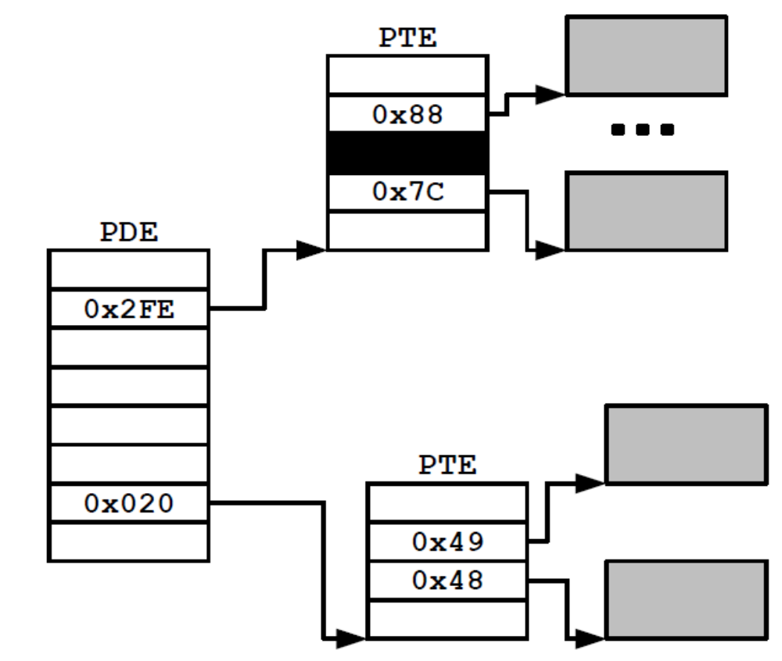
Example

Slide 46
Example
当程序到达标号A时，页表如下。块中的数字表示PDE/PTE的偏移值。函数printf的输出值是 “buffer start: 0xb7bdf000”。
请画出程序到达标号B时页表的形状。
  注意: 没有数字的白色块意味着空的PDE/PTE，填写了数字的白色块表示PDE/PTE被使用，黑色块表示连续多个PDE/PTEs被使用，灰色块表示一个有数据/代码的页）
0xb7bdf000 1011011110 1111011111 000000000000
2de 3df

Slide 47
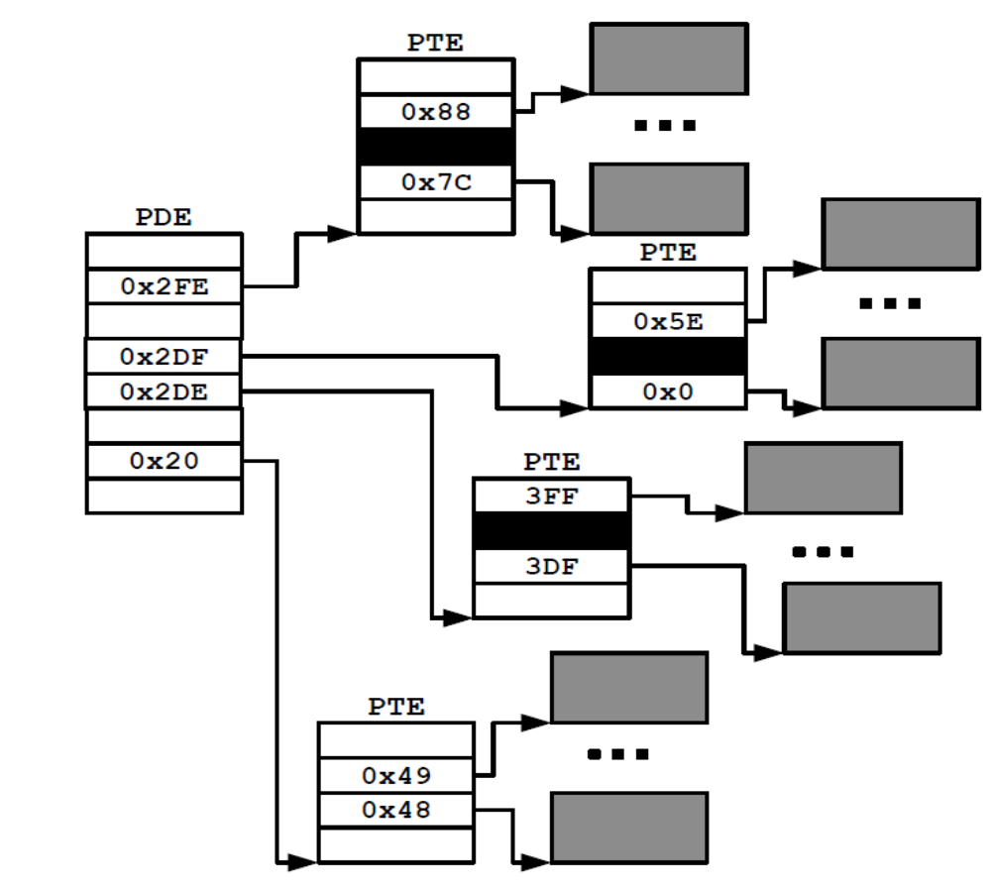
A sample from exam papers

Slide 48
Fork() revisted
To create a new process using fork:
  make copies of the old process’s mm_struct, vm_area_struct, and page tables
    Two processes are sharing all of their pages
    (At this point)
    How to get separate spaces without copying all the virtual pages from one space to another?
      “Copy On Write” (COW) technique.

Slide 49
Shared Object
Shared Object
  An object which is mapped into an area of virtual memory of a process
  Any writes that the process makes to that area are visible to any other processes that have also mapped the shared object into their virtual memory
  The changes are also reflected in the original object on disk
Shared Area
  A virtual memory area that a shared object is mapped

Slide 50
Sharing a Shared Object
Process 1
virtual memory
Physical
memory
Process 2
virtual memory
Process 1 maps the shared object
Shared
object

Slide 51
Sharing a Shared Object
Process 1
virtual memory
Physical
memory
Process 2
virtual memory
Process 2 maps the shared object
Notice how the virtual addresses can be different
Shared
object

Slide 52
Private object
Private Object
  As oppose to shared object
  Changes made to an area mapped to a private object are not visible to other processes
  Any writes that the process makes to the area are not reflected back to the object on disk.
Private Area
  Similar to shared area

Slide 53
Copy-on-Write
A private object begins life in exactly the same way as a shared object, with only one copy of the private object stored in physical memory.

Slide 54
Sharing a Private COW Object
Process 1
virtual memory
Physical
memory
Process 2
virtual memory
Private
copy-on-write
area
Private
copy-on-write object

Slide 55
Fork() revisted
To create a new process using fork
  Copy-On-Write
    make pages of writeable areas read-only
    flag vm_area_struct for these areas as private “copy-on-write”.

Slide 56
Copy-on-Write
For each process that maps the private object
  The page table entries for the corresponding private area are flagged as read-only
  The area struct is flagged as private copy-on-write
  So long as neither process attempts to write to its respective private area, they continue to share a single copy of the object in physical memory.

Slide 57
Copy-on-Write
For each process that maps the private object
  As soon as a process attempts to write to some page in the private area, the write triggers a protection fault
  The fault handler notices that the protection exception was caused by the process trying to write to a page in a private copy-on-write area

Slide 58
Copy-on-Write
For each process that maps the private object
  The fault handler
    Creates a new copy of the page in physical memory
    Updates the page table entry to point to the new copy
    Restores write permissions to the page

Slide 59
Sharing Revisited: Private COW Objects
Process 1
virtual memory
Physical
memory
Process 2
virtual memory
Copy-on-write
Write to private
copy-on-write
page
Private
copy-on-write object

Slide 60
Fork() revisted
To create a new process using fork:
  Net result:
    copies are deferred until absolutely necessary
    (i.e., when one of the processes tries to modify a shared page).

