Slide 1
Replacement Policy

Slide 2
Outline
The Optimal Replacement Policy
The FIFO Policy
The Random Policy
The LRU Policy
Workload Studies
Implementation Issues
Suggested reading: 22

Slide 3
The Optimal Replacement Policy
The best possible replacement policy
  developed by Belady many years ago
  replacing the page that will be accessed furthest in the future
  hard to implement
  incredibly useful as a comparison point in simulation or other studies

Slide 4
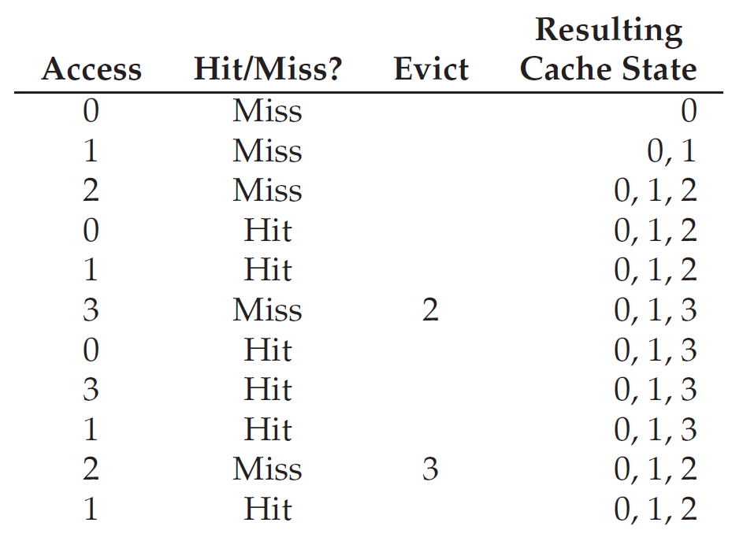
Example
Trace:0, 1, 2, 0, 1, 3, 0, 3, 1, 2, 1
  Hit rate = 6/11 = 54.5%

Slide 5
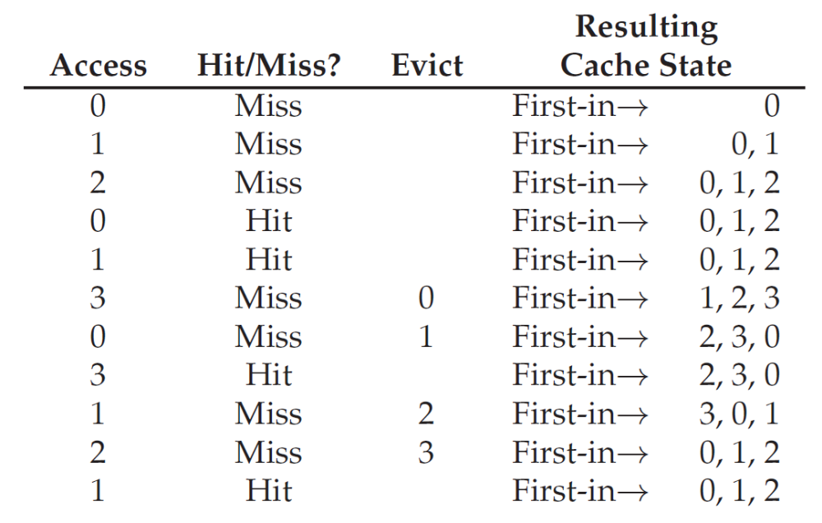
First-In, First-Out Replacement Policy
Hate rate = 4/11 =36.4%

Slide 6
Belady’s Anomaly
The reference trace is 0,1,2,3,0,1,4,0,1,2,3,4
Time | 1 | 2 | 3 | 4 | 5 | 6 | 7 | 8 | 9 | 10 | 11 | 12
reference string | 0 | 1 | 2 | 3 | 0 | 1 | 4 | 0 | 1 | 2 | 3 | 4
primary device contents | - - - | 0 - - | 0 1 - | 0 1 2 | 1 2 3 | 2 3 0 | 3 0 1 | 0 1 4 | 0 1 4 | 0 1 4 | 1 4 2 | 4 2 3 | pages brought in
remove | - | - | - | 0 | 1 | 2 | 3 | - | - | 0 | 1 | -
bring in | 0 | 1 | 2 | 3 | 0 | 1 | 4 | - | - | 2 | 3 | - | 9

Slide 7
Belady’s Anomaly
The reference trace is 0,1,2,3,0,1,4,0,1,2,3,4
Time | 1 | 2 | 3 | 4 | 5 | 6 | 7 | 8 | 9 | 10 | 11 | 12
reference string | 0 | 1 | 2 | 3 | 0 | 1 | 4 | 0 | 1 | 2 | 3 | 4
primary device contents | - - - - | 0 - - - | 0 1 - - | 0 1 2 3 | 0 1 2 3 | 0 1 2 3 | 0 1 2 3 | 1 2 3 4 | 2 3 4 0 | 3 4 0 1 | 4 0 1 2 | 0 1 2 3 | pages brought in
remove | - | - | - | - | - | - | 0 | 1 | 2 | 3 | 4 | 0
bring in | 0 | 1 | 2 | 3 | - | - | 4 | 0 | 1 | 2 | 3 | 4 | 10

Slide 8
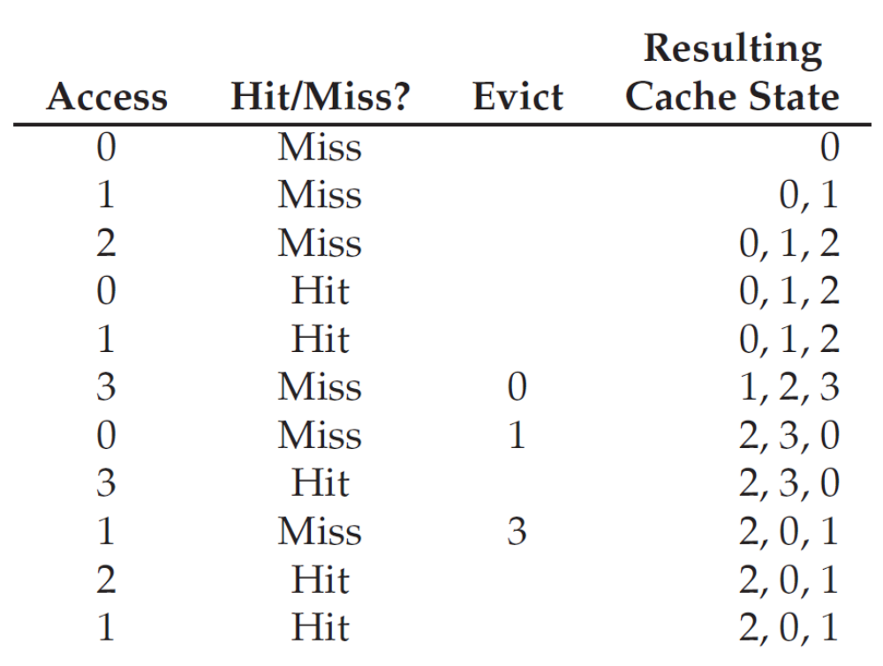
Random Replacement Policy
Hate rate = 5/11 =45.5%

Slide 9
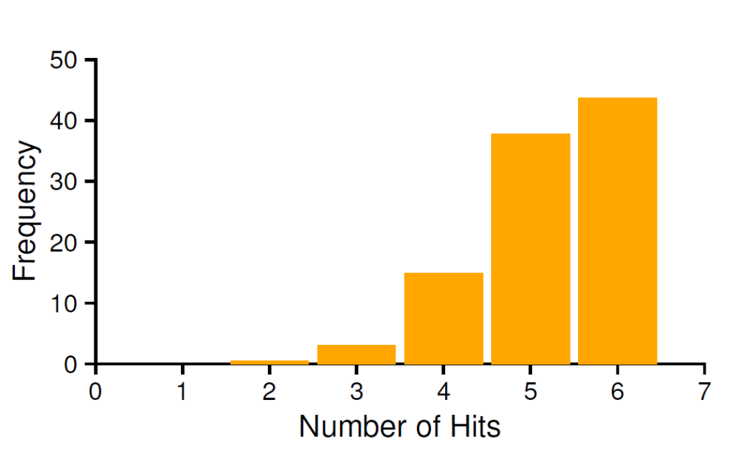
Random Replacement Policy
How many hits Random achieves
  over 10,000 trials
  each with a different random seed
  over 40% of the time Random is as good as optimal

Slide 10
LRU Replacement Policy
Lean on the past and use history as our guide
  Frequency
    if a page has been accessed many times, perhaps it should not be replaced as it clearly has some value
    Least-Frequently-Used (LFU)
      Replace the least-frequently used page
  Recency of access
    the more recently a page has been accessed, perhaps the more likely it will be accessed again
    Least-Recently-Used (LRU)
      Replace the least-recently-used page

Slide 11
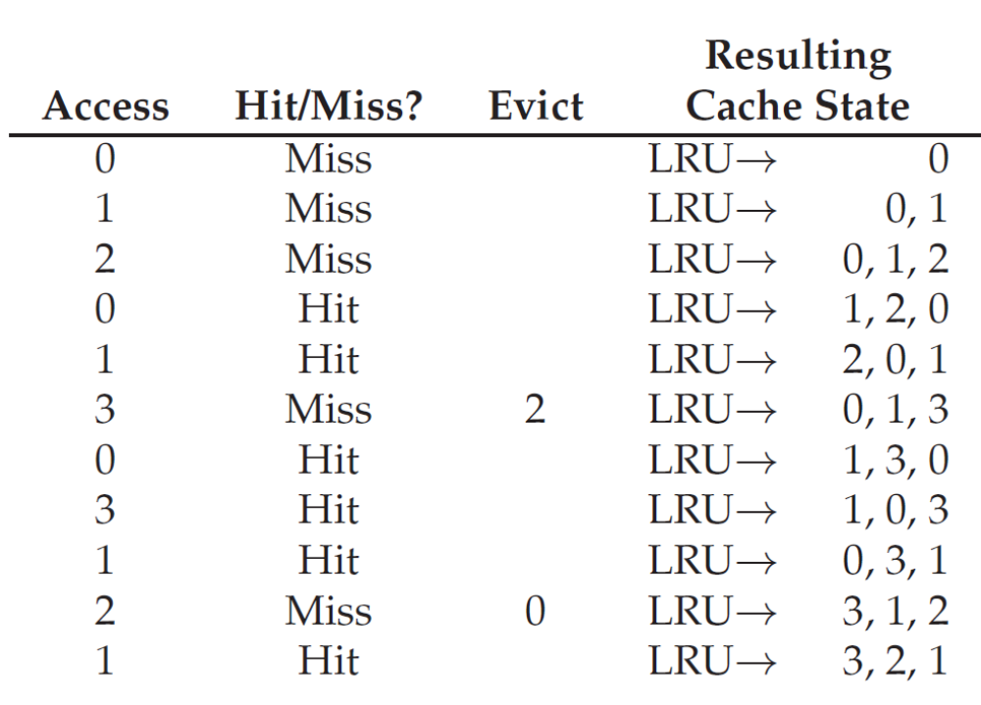
LRU Replacement Policy
Hate rate = 6/11 =54.5%

Slide 12
Stack Algorithms
Subset property
  For the optimal policy, at all times
  the pages it keeps in the 3-page memory
  is a subset of that it keeps in the 4-page memory
No Belady’s anomaly if subset property holds
  At all times and
  For every possible capacity of primary device
  It creates a total ordering for pages at a given time

Slide 13
Stack Algorithms for LRU
Time | 1 | 2 | 3 | 4 | 5 | 6 | 7 | 8 | 9 | 10 | 11 | 12
reference string | 0 | 1 | 2 | 3 | 0 | 1 | 4 | 0 | 1 | 2 | 3 | 4
stack contents after reference | 0 - - - - | 1 0 - - - | 2 1 0 - - | 3 2 1 0 - | 0 3 2 1 - | 1 0 3 2 - | 4 1 0 3 2 | 0 4 1 3 2 | 1 0 4 3 2 | 2 1 0 4 3 | 3 2 1 0 4 | 4 3 2 1 0 | number of moves in
size 1 in/out | 0/- | 1/0 | 2/1 | 3/2 | 0/3 | 1/0 | 4/1 | 0/4 | 1/0 | 2/1 | 3/2 | 4/3 | 12
size 2 in/out | 0/- | 1/- | 2/0 | 3/1 | 0/2 | 1/3 | 4/0 | 0/1 | 1/4 | 2/0 | 3/1 | 4/2 | 12
size 3 in/out | 0/- | 1/- | 2/- | 3/0 | 0/1 | 1/2 | 4/3 | -/- | -/- | 2/4 | 3/0 | 4/1 | 10
size 4 in/out | 0/- | 1/- | 2/- | 3/- | -/- | -/- | 4/2 | -/- | -/- | 2/3 | 3/4 | 4/0 | 8
size 5 in/out | 0/- | 1/- | 2/- | 3/- | -/- | -/- | 4/2 | -/- | -/- | -/- | -/- | -/- | 5

Slide 14
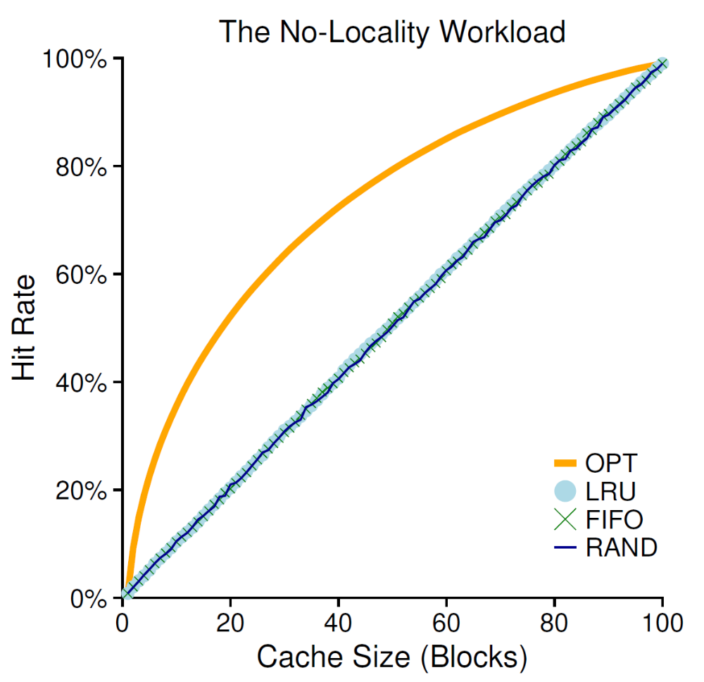
Random Access Workload
the workload
  accesses 100 unique pages over time
  choosing the next page to refer to at random
  overall 10,000 pages are accessed

Slide 15
Random Access Workload
It doesn’t matter much which realistic policy you are using
  LRU, FIFO, and Random all perform the same
  the hit rate exactly determined by the size of the cache
When the cache is large enough to fit the entire workload
  it also doesn’t matter which policy you use
  all policies (even Random) converge to a 100% hit rate when all the referenced blocks fit in cache

Slide 16
Random Access Workload
Optimal performs noticeably better than the realistic policies
  peeking into the future if it were possible
  does a much better job of replacement

Slide 17
“80-20” Workload
Hot pages
  80% of the references
  is about to 20% of the pages
Cold pages
  the remaining 20% of the references
  is about the remaining 80% of the pages
Example
  there are a total 100 unique pages
  “hot” pages are referred to most of the time
  “cold” pages the remainder.

Slide 18
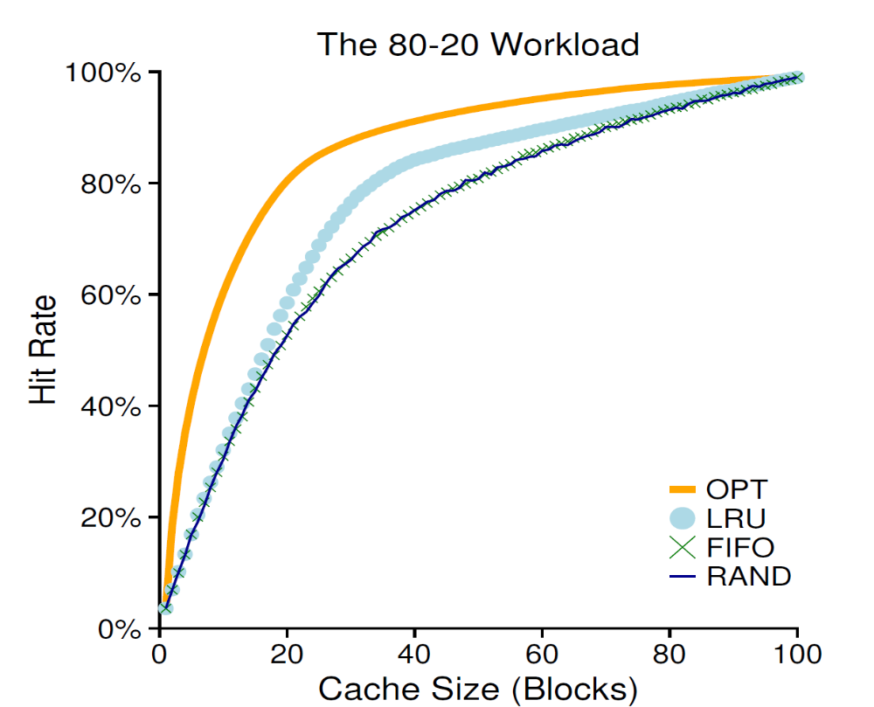
“80-20” Workload

Slide 19
“80-20” Workload
both random and FIFO do reasonably well
LRU does better
  it is more likely to hold onto the hot pages
  those pages have been referred to frequently in the past
  they are likely to be referred to again in the near future
Optimal does best
  showing that LRU’s historical information is not perfect
Does LRU do better than random or FIFO?
  It depends

Slide 20
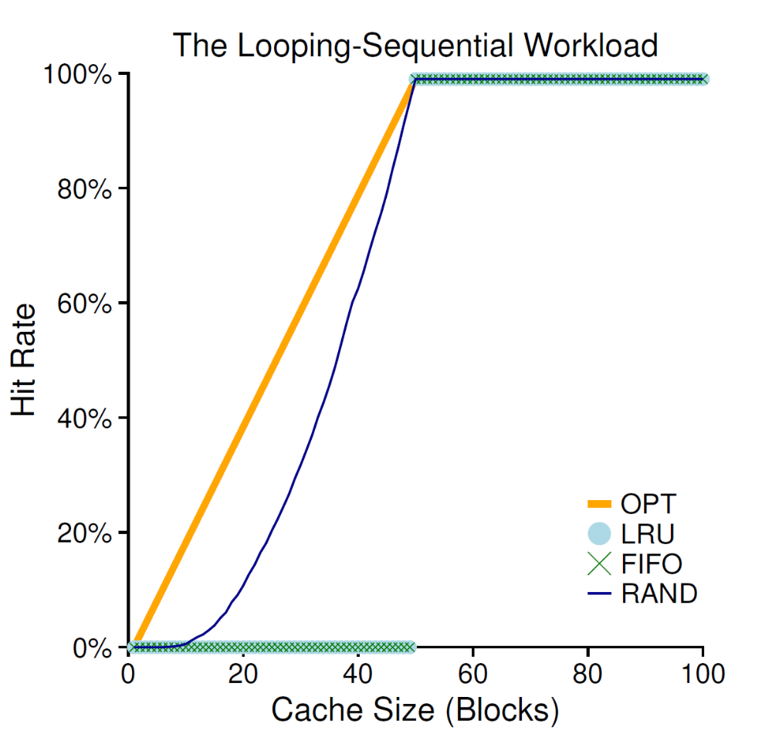
“Looping Sequential” Workload
Refer to 50 pages in sequence
  start at 0, then 1, ..., up to page 49,
  repeat those accesses
  for a total of 10,000 accesses to 50 unique pages

Slide 21
“Looping Sequential” Workload
Common in many applications such as databases
A worst case for both LRU and FIFO
  kick out older pages
  these older pages are going to be accessed sooner than the pages that the policies prefer to keep in cache
  even with a cache of size 49, hit rate remains 0%
Random fares notably better
  not quite approaching optimal, but at least achieving a non-zero hit rate
  not having weird corner-case behaviors
  used as TLB replacement policy

Slide 22
How to implement LRU?
Hardware should put a time stamp on each physical page whenever it is accessed
When evicting, it should sort the pages by their time stamps
It may be too many pages to be sorted
  One million pages for 4GB memory with 4KB page-size

Slide 23
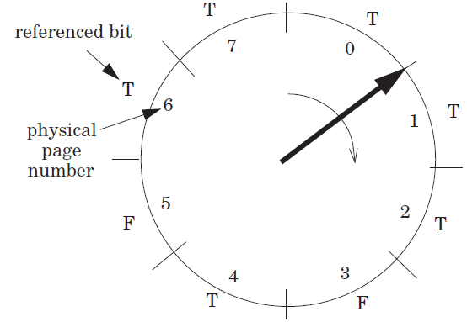
Clock Algorithm
Access bit
  a hardware bit for each page
  Set to true when accessed
  Pages are organized as a clock
Start from a position
  Move clockwise and checks the bit page-wise
  If T, clear to F
  Otherwise, choose as the victim and stop

Slide 24
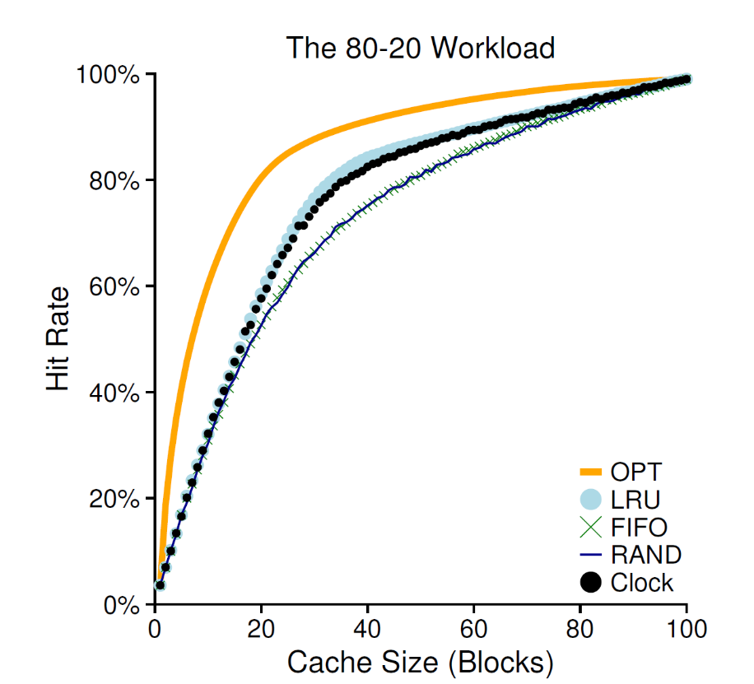
Clock Algorithm
It doesn’t do quite as well as perfect LRU
It does better than approaches that don’t consider history at all
It can use dirty bit to reduce disk writing furthur

Slide 25
Page Selection Policies
When to bring pages into memory?
  Demand paging
  Prefetching
    the OS could
      guess a page is about to be used
      and bring it in ahead of time
  Clustering (grouping)
    Set two numbers as low/high water mark
      when available page number is less than the low water mark,
      OS begins to evict pages
      until the number of available pages reaches the high water mark

Slide 26
Control Thrashing
admission control
  not to run some processes
  hope to reduce working sets (the pages that they are using actively) to fit in memory
out-of-memory killer
  A daemon
  choose a memory intensive process and kill it
  thus reducing memory
  it kills the X server and thus renders any applications requiring the display unusable

Slide 27
Level 1, Level 2 and Level 3 Page Table Entry
63
62
52
51
12
11
9
8
7
6
5
4
3
2
1
0
XD
Unused
Page table physical base addr
Unused
G
PS
A
CD
WT
U/S
R/W
P=1
Available for OS (page table location in secondary storage)
P=0
XD Disable or enable instruction fetches
Base addr 40 most significant bits of base address of child page
table (forces page tables to be 4KB aligned)
G global page (don’t evict from TLB on task switch)
PS Page size either 4K or 2M or 1G(may set to 1 only for
Level 2 or level 3 PTEs)
A Reference bit (set by MMU on reads and writes, cleared
by software)
CD Cache disabled(1) or enabled(0) for child page table
WT Write-through or write-back cache policy
U/S User or supervisor(kernel) mode access permission
R/W Read-only or read-write access permissiom
P Child page table present in memory(1) or not(0)

Slide 28
Level 4 Page Table Entry
63
62
52
51
12
11
9
8
7
6
5
4
3
2
1
0
XD
Unused
Page table physical base addr
Unused
G
D
A
CD
WT
U/S
R/W
P=1
Available for OS (page table location in secondary storage)
P=0
XD Disable or enable instruction fetches
Base addr 40 most significant bits of base address of child page
table (forces page tables to be 4KB aligned)
G global page (don’t evict from TLB on task switch)
D Dirty bit (Set by MMU on writes, cleared by software)
A Reference bit (set by MMU on reads and writes, cleared
by software)
CD Cache disabled(1) or enabled(0) for child page table
WT Write-through or write-back cache policy
U/S User or supervisor(kernel) mode access permission
R/W Read-only or read-write access permissiom
P Child page table present in memory(1) or not(0)

Slide 29
Level 2 and Level 3 Page Table Entry
63
62
52
51
12
11
9
8
7
6
5
4
3
2
1
0
XD
Unused
Page table physical base addr
Unused
G
D
A
CD
WT
U/S
R/W
P=1
Available for OS (page table location in secondary storage)
P=0
XD Disable or enable instruction fetches
Base addr 40 most significant bits of base address of child page
table (forces page tables to be 4KB aligned)
G global page (don’t evict from TLB on task switch)
D Dirty bit (used in Level 2 or level 3 PTEs for page
size 2M or 1G respectively)
A Reference bit (set by MMU on reads and writes, cleared
by software)
CD Cache disabled(1) or enabled(0) for child page table
WT Write-through or write-back cache policy
U/S User or supervisor(kernel) mode access permission
R/W Read-only or read-write access permissiom
P Child page table present in memory(1) or not(0)

Slide 30
Linux Virtual Memory System
Process-specific data structures
(e.g. task and mm structs,
page tables, kernel stack)
Different for
each process
Kernel
virtual
memory
Physical memory
Identical for
each process
Kernel code and data
User stack
%esp
Memory mapped region
for shared libraries
Process
virtual
memory
brk
Run-time heap (via malloc)
Uninitialized data (.bss)
Initialized data (.data)
Program text (.text)
x08048000 (32)
x40000000 (64)

Slide 31
How to Evict Page Table
20
12
It is physical address accessed
Each physical address has a virtual counter part
VPN
VPO
VPN1
VPN2
Mem
PDE
p=0
PDBR
Page directory
Disk
PTE
p=0
data
Page table
Data page

Slide 32
Questions
How does the clock algorithm get the reference bit for Physical Pages?
  MMU only sets the access bit in VP.
DMA does not set the A bit, how does the clock algorithm handle these Physical Pages?

