Slide 1
Concurrent Programming

Slide 2
Outline
Topics:
  Producer-consumer problem
  Readers-writers problem
  Concurrent Server Based on Pthreading
  Concurrent Issues
Suggested reading:
  12.5~12.7

Slide 3
Using Semaphores to Schedule Access to Shared Resources
Basic idea: Thread uses a semaphore operation to notify another thread that some condition has become true
  Use counting semaphores to keep track of resource state.
  Use binary semaphores to notify other threads.
Two classic examples:
  The Producer-Consumer Problem
  The Readers-Writers Problem

Slide 4
Signaling with semaphores
producer
thread
consumer
thread
shared
buffer
Common synchronization pattern:
  Producer waits for empty slot, inserts item in buffer, and notifies consumer
  Consumer waits for item, removes it from buffer, and notifies producer

Slide 5
Producer-Consumer on 1-element Buffer
#define NITERS 5
struct {
int buf;
sem_t full;
sem_t empty;
} shared;
int main() {
pthread_t tid_producer;
pthread_t tid_consumer;
/* Initialize the semaphores */
Sem_init(&shared.empty, 0, 1);
Sem_init(&shared.full, 0, 0);
/* Create threads and wait */
Pthread_create(&tid_producer, NULL, producer, NULL);
Pthread_create(&tid_consumer, NULL, consumer, NULL);
Pthread_join(tid_producer, NULL);
Pthread_join(tid_consumer, NULL);
exit(0);
}

Slide 6
Producer-Consumer on 1-element Buffer
Initially: empty==1, full==0
Producer Thread
Consumer Thread
void *producer(void *arg) {
int i, item;
for (i=0; i<NITERS; i++) {
/* Produce item */
item = i;
printf("produced %d\n", item);
/* Write item to buf */
P(&shared.empty);
shared.buf = item;
V(&shared.full);
}
return NULL;
}
void *consumer(void *arg) {
int i, item;
for (i=0; i<NITERS; i++) {
/* Read item from buf */
P(&shared.full);
item = shared.buf;
V(&shared.empty);
/* Consume item */
printf("consumed %d\n“, item);
}
return NULL;
}

Slide 7
Producer-Consumer on an n-element Buffer
Requires a mutex and two counting semaphores
  mutex: enforces mutually exclusive access to the the buffer
  slots: counts the available slots in the buffer
  items: counts the available items in the buffer
Implemented using a shared buffer package called sbuf.

Slide 8
sbuf Package - Declarations
struct {
int *buf; /* Buffer array */
int n; /* Maximum number of slots */
int front; /* buf[(front+1)%n] is the first item */
int rear; /* buf[rear%n] is the last item */
sem_t mutex; /* protects accesses to buf */
sem_t slots; /* Counts available slots */
sem_t items; /* Counts available items */
} sbuf_t;

Slide 9
sbuf Package - Implementation
void sbuf_init(sbuf_t *sp, int n)
{
sp->buf = Calloc(n, sizeof(int));
/* Buffer holds max of n items */
sp->n = n;
/* Empty buffer iff front == rear */
sp->front = sp->rear = 0;
/* Binary semaphore for locking */
Sem_init(&sp->mutex, 0, 1);
/* Initially, buf has n empty slots */
Sem_init(&sp->slots, 0, n);
/* Initially, buf has zero data items */
Sem_init(&sp->items, 0, 0);
}

Slide 10
sbuf Package - Implementation
void sbuf_insert(sbuf_t *sp, int item)
{
/* Wait for available slot */
P(&sp->slots);
/*Lock the buffer */
P(&sp->mutex);
/*Insert the item */
sp->buf[(++sp->rear)%(sp->n)] = item;
/* Unlock the buffer */
V(&sp->mutex);
/* Announce available items*/
V(&sp->items);
}

Slide 11
sbuf Package - Implementation
void sbuf_remove(sbuf_t *sp)
{
int item;
/* Wait for available item */
P(&sp->items);
/*Lock the buffer */
P(&sp->mutex);
/*Remove the item */
item = sp->buf[(++sp->front)%(sp->n)];
/* Unlock the buffer */
V(&sp->mutex);
/* Announce available slot*/
V(&sp->slots);
return item;
}

Slide 12
Readers-Writers Problem
Generalization of the mutual exclusion problem
Problem statement:
  Reader threads only read the object
  Writer threads modify the object
  Writers must have exclusive access to the object
  Unlimited number of readers can access the object

Slide 13
Readers-Writers Problem
Occurs frequently in real systems, e.g.,
  Online airline reservation system
  Multithreaded caching Web proxy

Slide 14
Variants of Readers-Writers
First readers-writers problem
(favors readers)
  No reader should be kept waiting unless a writer
  has already been granted permission to use the object.
  A reader that arrives after a waiting writer gets priority over the writer.

Slide 15
Variants of Readers-Writers
Second readers-writers problem
(favors writers)
  Once a writer is ready to write, it performs its write as soon as possible
  A reader that arrives after a writer must wait, even if the writer is also waiting.
Starvation (where a thread waits indefinitely) is possible in both cases.

Slide 16
Solution to First Readers-Writers Problem
Readers:
Writers:
int readcnt; /* Initially 0 */
sem_t mutex, w; /* Both initially 1 */
void reader(void) {
while (1) {
P(&mutex);
readcnt++;
if (readcnt == 1) /* First in */
P(&w);
V(&mutex);
/* Reading happens here */
P(&mutex);
readcnt--;
if (readcnt == 0) /* Last out */
V(&w);
V(&mutex);
}
}
void writer(void) {
while (1) {
P(&w);
/* Writing here */
V(&w);
}
}

Slide 17
Case Study: Prethreaded Concurrent Server
Pool of
worker
threads
Client
Service client
Worker
thread
Insert
descriptors
Accept
connections
Master
thread
Remove
descriptors
...
Buffer
...
Client
Worker
thread
Service client

Slide 18
Prethreading
#include “csapp.h”
#include “sbuf.h”
#define NTHREADS 4
#define SBUFSIZE 16
sbuf_t sbuf ; /* shared buffer of connected descriptors */
int main(int argc, char **argv)
{
int i, listenfd, connfd;
sockelen_t clientlen ;
struct sockaddr_storage clientaddr;
pthread_t tid;
if (argc != 2) {
fprintf(stderr, “usage: %s <port>\n”, argv[0]) ;
exit(0);
}
listenfd = open_listenfd(argv[1]);

Slide 19
Prethreading
sbuf_init(&sbuf, SBUFSIZE);
for (i = 0; i < NTHREADS; i++) /* Create worker threads */
Pthread_create(&tid, NULL, thread, NULL);
while (1) {
clientlen = sizeof(struct sockaddr_storage);
connfd = Accept (listenfd, (SA *)&clientaddr, &clientlen);
sbuf_insert(&sbuf, connfd); /* Insert connfd in buffer */
}
}
void *thread(void *vargp)
{
Pthread_detach(pthread_self());
while (1) {
int connfd = sbuf_remove(&sbuf); /* Remove connfd from buffer */
echo_cnt(connfd); /* Service client */
Close(connfd);
}
}

Slide 20
Prethreading
#include “csapp.h”
static int byte_cnt; /* byte counter */
static sem_t mutex; /* and the mutex that protects it */
static void init_echo_cnt(void)
{
Sem_init(&mutex, 0, 1);
byte_cnt = 0;
}
void echo_cnt(int connfd)
{
int n;
char buf[MAXLINE];
rio_t rio;
static pthread_once_t once = PTHREAD_ONCE_INIT;
Pthread_once(&once, init_echo_cnt);

Slide 21
Prethreading
Rio_readinitb(&rio, connfd);
while((n = Rio_readlineb(&rio, buf, MAXLINE)) != 0) {
P(&mutex);
byte_cnt += n;
printf(“server received %d(%d) byte on fd %d\n”, n,byte_cnt, connfd);
V(&mutex);
Rio_writen(confd, buf, n);
}
}

Slide 22
Using Threads for Parallelism
All programs
Concurrent programs
Sequential Programs
Parallel
Programs

Slide 23
Using Threads for Parallelism
1 #include "csapp.h"
2 #define MAXTHREADS 32
3
4 void *sum_mutex(void *vargp); /* Thread routine */
5
6 /* Global shared variables */
7 long gsum; /* Global sum */
8 long nelems_per_thread; /* Number of elements summed by each thread */
9 sem_t mutex ; /* Mutex to protect global sum */
10
11 int main(int argc, char **argv)
12 {
13 long i, nelems, log_nelems, nthreads, myid[MAXTHREADS];
14 pthread_t tid[MAXTHREADS];
15
16 /* Get input arguments */
17 if (argc != 3) {
18 printf("Usage: %s <nthreads> <log_nelems>\n", argv[0]);
19 exit(0);
}

Slide 24
Using Threads for Parallelism
21 nthreads = atoi(argv[1]);
22 log_nelems = atoi(argv[2]);
23 nelems = (1L << log_nelems);
24 nelems_per_thread = nelems / nthreads;
25 sem_init(&mutex, 0, 1);
26
27 /* Create peer threads and wait for them to finish */
28 for (i = 0; i < nthreads; i++) {
29 myid[i] = i;
30 Pthread_create(&tid[i], NULL, sum_mutex, &myid[i]);
31 }
32 for (i = 0; i < nthreads; i++)
33 Pthread_join(tid[i], NULL);
34
35 /* Check final answer */
36 if (gsum != (nelems * (nelems-1))/2)
37 printf("Error: result=%ld\n", gsum);
38
39 exit(0);
40 }

Slide 25
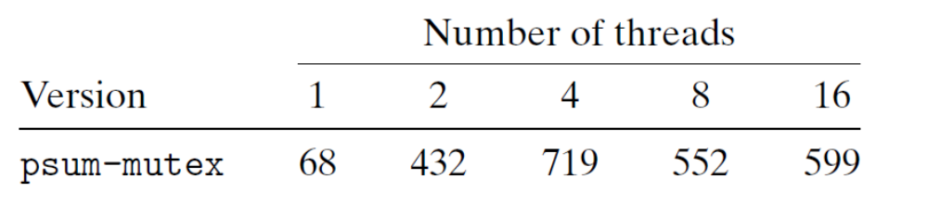
Using Threads for Parallelism
1 /* Thread routine for psum-mutex.c */
2 void *sum_mutex(void *vargp)
3 {
4 int myid = *((int *)vargp); /* Extract the thread ID */
5 long start = myid * nelems_per_thread; /* Start element index */
6 long end = start + nelems_per_thread; /* End element index */
7 long i;
8
9 for (i = start; i < end; i++) {
10 p(&mutex) ;
11 gsum += i;
12 V(&mutex);
13 }
14 return NULL;
15 }
Run the code on four cores
Synchronization overhead is expensive and should be avoided if possible.
If it cannot be avoided, the overhead should be amortized by as much useful computation as possible.

Slide 26
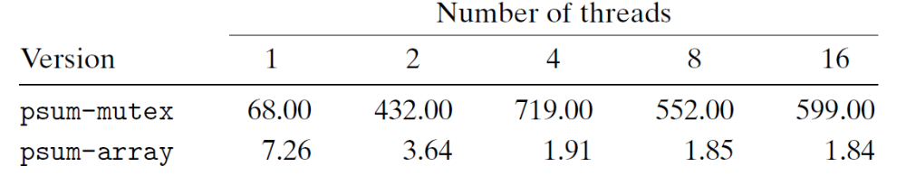
Using Threads for Parallelism
1 /* Thread routine for psum-array.c*/
2 void *sum_array(void *vargp)
3 {
4 int myid = *((int *)vargp); /* Extract the thread ID */
5 long start = myid * nelems_per_thread; /* Start element index */
6 long end = start + nelems_per_thread; /* End element index */
7 long i;
8
9 for (i = start; i < end; i++) {
psum[myid] + = i ;
}
12 return NULL;
13 }
The main thread (not shown) defines a global array called psum.
Each peer thread accumulates its partial sum in psum[i].
After the peer threads have terminated, the main thread sums up the elements of the psum vector.

Slide 27
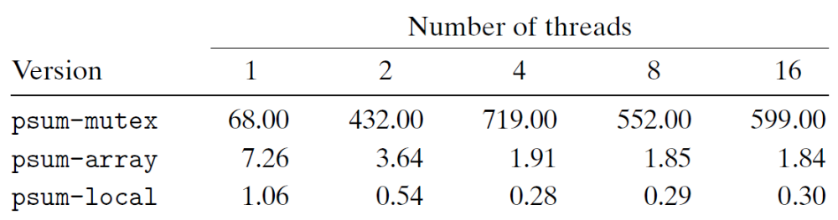
Using Threads for Parallelism
1 /* Thread routine for psum-local.c*/
2 void *sum_array(void *vargp)
3 {
4 int myid = *((int *)vargp); /* Extract the thread ID */
5 long start = myid * nelems_per_thread; /* Start element index */
6 long end = start + nelems_per_thread; /* End element index */
7 long i, sum = 0;
8
9 for (i = start; i < end; i++) {
sum += i;
}
psum[myid] = sum ;
13 return NULL;
14 }/

Slide 28
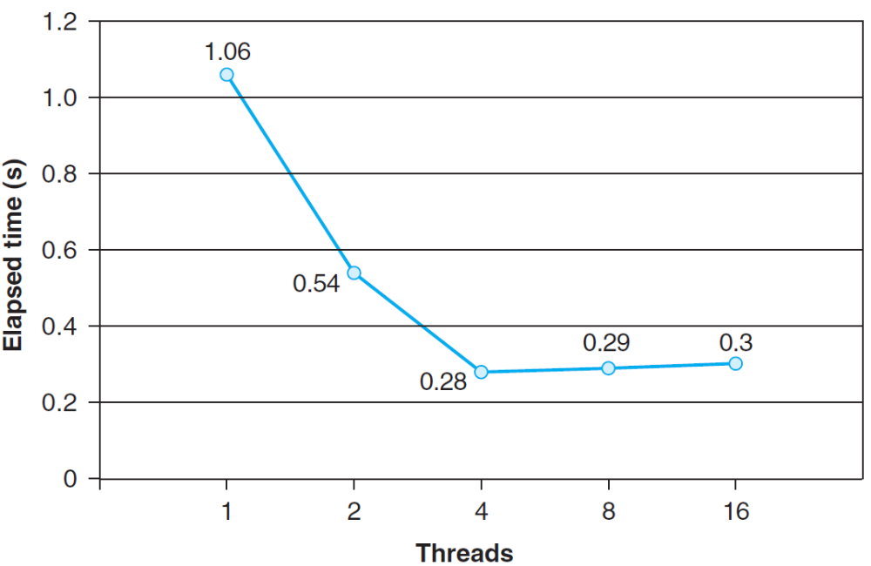
Using Threads for Parallelism
log_nelems=31

Slide 29
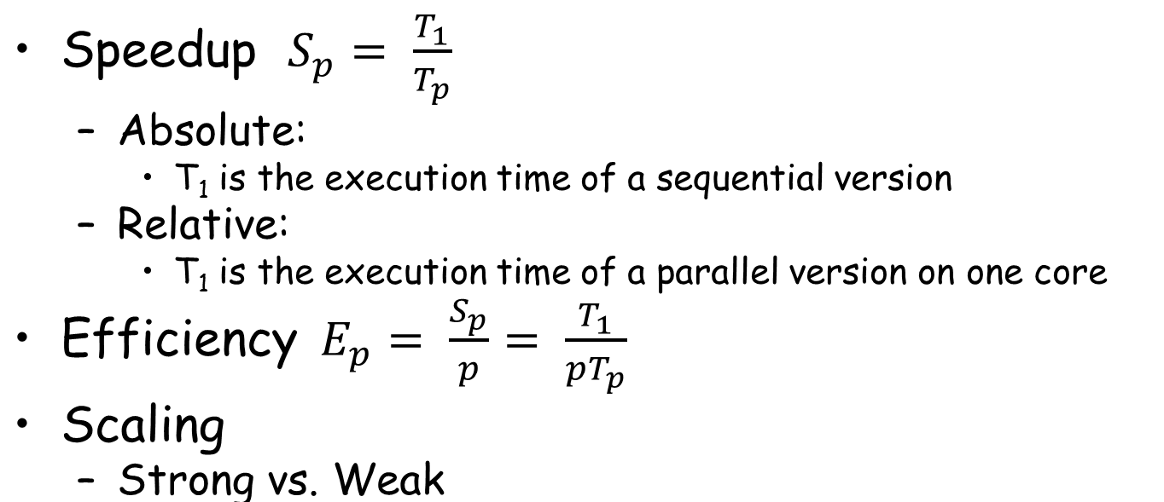
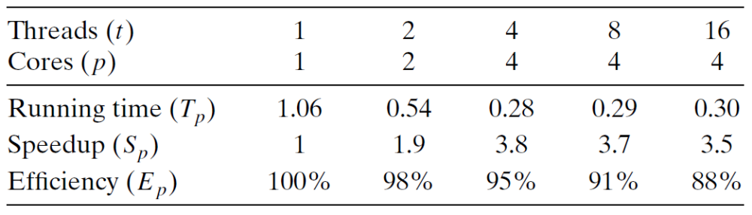
Using Threads for Parallelism

Slide 30
Thread-safe functions
Functions called from a thread must be thread-safe
Definition: A function is thread-safe iff it will always produce correct results when called repeatedly from multiple concurrent threads.

Slide 31
Thread-safe functions
We identify four (non-disjoint) classes of thread-unsafe functions:
  Class 1: Failing to protect shared variables.
  Class 2: Relying on persistent state across invocations.
  Class 3: Returning a pointer to a static variable.
  Class 4: Calling thread-unsafe functions.

Slide 32
Thread-unsafe functions
Class 1: Failing to protect shared variables.
  Fix: use Pthreads P/V operations.
  Do not need to modify the calling code
  Issue: synchronization operations will slow down code.

Slide 33
Thread-unsafe functions (case 2)
Class 2: Relying on persistent state across invocations
unsigned int next = 1;
/* rand – return pseudo-random int on 0..32767 */
int rand(void)
{
next = next * 110351524 + 12345 ;
return (unsigned int)((next/65536) % 32768);
}
/* srand – set seed for rand() */
void srand(unsigned int seed)
{
next = seed;
}

Slide 34
Thread-unsafe functions (case 2)
Pass state as part of argument
  and, thereby, eliminate static state
/* rand_r – return pseudo-random int on 0..32767 */
int rand_r(int *nextp)
{
*nextp = *nextp * 110351524 + 12345 ;
return (unsigned int)((*nextp/65536) % 32768);
}

Slide 35
Thread-safe functions
Class 3: Returning a pointer to a static variable
char *ctime(const time_t *timep)
{
static char *p;
<get current time and converted to string>
return &p;
}

Slide 36
Thread-safe functions
Class 3: (Fixes)
  Rewrite so caller passes pointer to struct
    Issue: Requires changes in callee
  “Lock-and-copy”
privatep = Malloc(...);
ctime_ts(&t, privatep);
char *ctime_ts (const time_t timep, char *privatep)
{
char *sharedp;
P(&mutex);
sharedp = ctime(timep);
strcpy(privatep, sharedp) ;
V(&mutex);
return privatep;
}

Slide 37
Thread-safe functions
Class 4: Calling thread-unsafe functions.
  Calling one thread-unsafe function makes the entire function that calls it thread-unsafe
  Fix: Modify the function so it calls only thread-safe functions ☺

Slide 38
Reentrant functions
A function is reentrant iff it accesses NO shared variables when called from multiple threads.
  Reentrant functions are an important subset of thread-safe functions.
  Require no synchronization operations.

Slide 39
Reentrant functions
All functions
Thread-safe
functions
Thread-unsafe
functions
Reentrant
functions
  NOTE: The fixes to Class 2 thread-unsafe
  functions require modifying the function to
  make it reentrant

Slide 40
Thread-safe library functions
All functions in the Standard C Library
(at the back of your K&R text) are thread-safe.
Most Unix system calls are thread-safe,
with a few exceptions:
Thread-unsafe function Class Reentrant version
rand 2 rand_r
Strtok 2 strtok_r
asctime 3 asctime_r
ctime 3 ctime_r
gethostbyaddr 3 gethostbyaddr_r
gethostbyname 3 gethostbyname_r
inet_ntoa 3 (none)
localtime 3 localtime_r

Slide 41
Thread local storage：an example
int main() {
i=0;
std::thread t1(threadfunc,1);
std::thread t2(threadfunc,2);
std::thread t3(threadfunc,3);
t1.join();
t2.join();
t3.join();
std::cout<<i<<std::endl;
}
thread_local int i=0;
void f(int newval) {
i=newval;
}
void g() {
std::cout<<i;
}
void threadfunc(int id) {
f(id);
++i;
g();
}
"2340", "3240", "4230", "4320", "2430" or "3420"
Notes:
This code will output "2340", "3240", "4230", "4320", "2430" or "3420", but never anything else. Each thread has its own copy of i, which is assigned to, incremented and then printed. The thread running main also has its own copy, which is assigned to at the beginning and then left unchanged. These copies are entirely independent, and each has a different address.

Slide 42
TLS: Thread local storage
Aka., TSS (Thread Specific Storage)
  A variable can be declared thread_local as of C++11
  Lifetime is the lifetime of the thread
Useful for data that are logically global to the thread
  Good for avoiding passing references to it up and down call stack
  E.g., if data are made extern, or static, or put in a namespace, etc.

Slide 43
TLS: Thread local storage
Good fences make good neighbors
  Not visible to other threads (unless a pointer/reference is given away)
What if there are many different thread-specific data?
  If all threads use instances of all the same types all the time, can put them in a struct and make instances of the struct thread local

Slide 44
Example-1 of TLS: Random number generator
If your seed was a local variable within the random function
  it would be initialized every time you called it, giving you the same number each time
  If it was a global, threads would interfere with each other's sequences
Using TLS
  Each thread gets its own random number sequence, independent of other threads.

Slide 45
Example-2: Errno
How is errno maintained?
  A global variable
  Modified by the library after some error happens
What if another thread has an error at the same time?
  Must avoid change the global errno
  Solution: use TLS to save errno

Slide 46
Issues: Races
Correctness of a program depends on
  one thread reaching point x in its control before another thread reaches point y

Slide 47
Issues: Races
/*thread routine */
void *thread(void *vargp)
{
int myid = *((int *)vargp) ;
printf(“Hello from th. %d\n”, myid);
return NULL ;
}
#define N 4
int main()
{
pthread_t tid[N];
int i ;
for ( i=0 ; i<N ; i++ )
pthread_create(&tid[i], NULL, thread, &i);
for ( i=0 ; i<N ; i++ )
pthread_joint(tid[i], NULL) ;
exit(0) ;
}

Slide 48
Issues: Races
int main()
{
pthread_t tid[N];
int i, *ptr ;
for ( i=0 ; i<N ; i++ ) {
ptr = malloc(sizeof)int));
*ptr = i ;
pthread_create(&tid[i], NULL, thread, ptr);
}
for ( i=0 ; i<N ; i++ )
pthread_joint(tid[i], NULL) ;
exit(0) ;
}

Slide 49
Issues: Deadlock
int main()
{
pthread_t tid[2];
Sem_init(&mutex[0], 0, 1); /* mutex[0] = 1 */
Sem_init(&mutex[1], 0, 1); /* mutex[1] = 1 */
Pthread_create(&tid[0], NULL, count, (void*)0);
Pthread_create(&tid[1], NULL, count, (void*)1);
Pthread_join(tid[0], NULL);
Pthread_join(tid[1], NULL);
printf("cnt=%d\n", cnt);
exit(0);
}

Slide 50
Issues: Deadlock
Thread0
Thread1
Tid[0]:
P(s₀);
P(s₁);
cnt++;
V(s₀);
V(s₁);
Tid[1]:
P(s₁);
P(s₀);
cnt++;
V(s₁);
V(s₀);
void *count(void *vargp)
{
int i;
int id = (int) vargp;
for (i = 0; i < NITERS; i++) {
P(&mutex[id]); P(&mutex[1-id]);
cnt++;
V(&mutex[id]); V(&mutex[1-id]);
}
return NULL;
}

Slide 51
Issues: Deadlock
Thread 2
Locking introduces the
potential for deadlock:
waiting for a condition that
will never be true.
Any trajectory that enters
the deadlock region will
eventually reach the
deadlock state, waiting for either s or t to become nonzero.
Other trajectories luck out and skirt the deadlock region.
V(s0)
deadlock
state
forbidden
region for s0
V(s1)
P(s0)
deadlock
region
forbidden
region for s1
P(s1)
P(s0)
P(s1)
V(s0)
V(s1)
Thread 1
Initially, s=t=1

Slide 52
Threads Summary
Threads provide another mechanism for writing concurrent programs
Threads are growing in popularity
  Somewhat cheaper than processes
  Easy to share data between threads
However, the ease of sharing has a cost:
  Easy to introduce subtle synchronization errors
  Tread carefully with threads!
For more info:
  D. Butenhof, “Programming with Posix Threads”,
  Addison-Wesley, 1997

