Slide 1
Lock-based Concurrent
Data Structures

Slide 2
Basic Idea & Posix Library
Lock (variable)
  Two states: available (unlocked) or acquired (locked)
  Unlocked: no thread holds the lock
  Locked: exactly one thread holds the lock
The POSIX library provides mutual exclusion between threads
  Also known as mutex
pthread_mutex_t lock = PTHREAD_MUTEX_INITIALIZER;
pthread_mutex_lock(&lock);
balance = balance + 1;
pthread_mutex_unlock(&lock);

Slide 3
Lock-based Concurrent Data Structure
Concurrent Data Structure
  Enabling many threads to access the structure
  Thread safe
  High performance
How to add locks to data structures?
  Counter
  Linked List
  Queue
  Hash Table

Slide 4
A Simple Counter
typedef struct __conter_t {
int value;
} counter_t
void init(counter *c) { c->value=0; }
void increment(counter_t *c) { c->value++; }
void decrement(counter_t *c) { c->value--; }
int get(counter_t *c) { return c->value; }

Slide 5
Thread Unsafe
c->value
v = 0
[thread-1]
v += 1;
[thread-2]
v += 1;
v = ?

Slide 6
Thread Unsafe
v = 0 (memory)
T1 reads 0 to %reg
T1 increments %reg to 1
T1 stores %reg to v (v = 1)
T2 reads 1 to %reg
T2 increments %reg to 2
T2 stores %reg to v (v = 2)
v = 2; (memory)
v = 0
[thread-1]
%reg = v;
%reg++;
v = %reg;
[thread-2]
%reg = v;
%reg++;
v = %reg;
v = ?

Slide 7
Thread Unsafe
v = 0 (memory)
T1 reads 0 to %reg
T2 reads 0 to %reg
T1 increments %reg to 1
T2 increments %reg to 1
T1 stores %reg to v (v = 1)
T2 stores %reg to v (v = 1)
v = 1; (memory)
v = 0
[thread-1]
%reg = v;
%reg++;
v = %reg;
[thread-2]
%reg = v;
%reg++;
v = %reg;
v = ?

Slide 8
Lock-based Approach
Locks support a concurrent programming style based on mutual exclusion
  Only one thread at a time executes the critical section
  Acquire lock
  . . . // Critical sections
  Release lock

Slide 9
A Lock-based Counter
typedef struct __conter_t {
int value;
pthread_mutex_t lock;
} counter_t
void init(counter *c) {
c->value=0;
pthread_mutex_init(&c->lock, NULL);
}
void increment(counter_t *c) {
Pthread_mutex_lock(&c->lock);
c->value++;
Pthread_mutex_unlock(&c->lock);
}

Slide 10
A Lock-based Counter
void decrement(counter_t *c) {
Pthread_mutex_lock(&c->lock);
c->value--;
Pthread_mutex_unlock(&c->lock);
}
int get(counter_t *c) {
Pthread_mutex_lock(&c->lock);
rc = c->value;
Pthread_mutex_unlock(&c->lock);
return rc
}

Slide 11
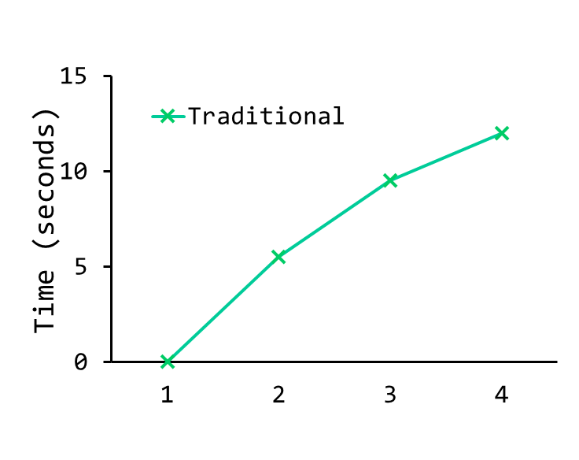
Performance
Traditional Lock-based Counter
  Simple
  Works correctly
  Poor performance
Note that if the data structure is not too slow, you are done!
No need to do something fancy if something simple will work.
Perfect Scaling

Slide 12
Scalable Counting
Sloppy Counter
  Represent a single logical counter via numerous local physical counters (one per CPU core), as well as a single global counter
Example:
A machine with 4 CPUs - 4 local counter (L1-4)
- 1 global counter (G)
Time | L1 | L2 | L3 | L4 | G

Slide 13
Sloppy Counter
Scalable Write (increment/decrement)
  Each local counter is synchronized via the corresponding local lock
  Each thread always increases local counter on the same CPU core
Scalable Read (get)
  Local values are periodically transferred to the global counter (local counter is reset to zero)
  Global counter is synchronized via the global lock

Slide 14
Sloppy Counter
Sloppiness (S)
  The frequency of local-to-global transfer
  Smaller S: more precise and more non-scalable
  Bigger S: more imprecise and more scalable
Exact (non-scalable) Read
  Acquire all the local locks and the global lock

Slide 15
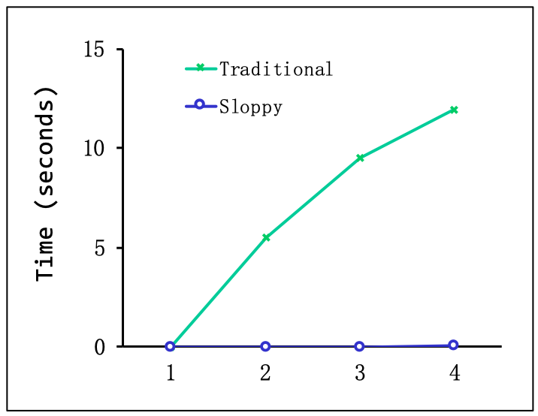
Example
A machine with 4 CPUs
  S = 5
Time | L1 | L2 | L3 | L4 | G
0 | 0 | 0 | 0 | 0 | 0
1 | 0 | 0 | 1 | 1 | 0
2 | 1 | 0 | 2 | 1 | 0
3 | 2 | 0 | 3 | 1 | 0
4 | 3 | 0 | 3 | 2 | 0
5 | 4 | 1 | 3 | 3 | 0
6 | 5->0 | 1 | 3 | 4 | 5 (from L1)
7 | 0 | 2 | 4 | 5->0 | 10 (from L4)

Slide 16
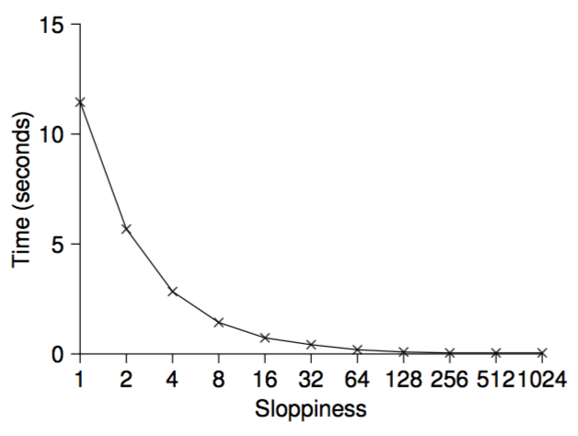
Example
A machine with 4 CPUs
  Each thread adds the counter 1 million times

Slide 17
Sloppy Counter
typedef struct __counter_t {
int global // global count
pthread_mutex_t glock; // global lock
int local[NCPUS]; // local counter (per cpu)
pthread_mutex_t llock[NCPUS]; // ... and locks
int threshold; // update frequency
} counter_t;

Slide 18
Sloppy Counter
// init: record threshold, init locks, init values
// if all local counts and global count
void init (counter_t *c, int threshold) {
c->threshold = threshold;
c->global = 0;
pthread_mutex_init(&c->glock, NULL);
int i;
for (i = 0; I < NCPUS; i++) {
c->local[i] = 0;
pthread_mutex_init(c->llock[i], NULL);
}
}

Slide 19
Sloppy Counter
// update: usually, just grab local lock and update local
// amount once local count has risen by ‘threshold’,
// grab global lock and transfer local values to it
void update (counter_t *c, int threadID, int amt) {
int cpu = threadID % NCPUS;
pthread_mutex_lock(&c->llock[cpu]);
c->local[cpu] += amt; // assumes amt > 0
if (c->local[cpu] >= c->threshold) { // transfer
pthread_mutex_lock(&c->glock);
c->global += c->local[cpu];
pthread_mutex_unlock(&c->glock);
c->local[cpu] = 0;
}
pthread_mutex_unlock(&c->llock[cpu]);
}

Slide 20
Sloppy Counter
// get: just return global amount (which may not be perfect)
int get (counter_t *c) {
pthread_mutex_lock(&c->glock);
int val = c->global;
pthread_mutex_unlock(&c->glock);
return val; // only approximate!
}

Slide 21
Concurrent Linked Lists
Simple Concurrent Linked List
  Use lock to synchronize the whole insert and lookup function
  Don’t forget to release the lock for exceptional control flow (error prone)
A recent study of Linux kernel patches found that a huge fraction of bugs (nearly 40%) are found on such rarely-taken code paths

Slide 22
Simple Linked List
typedef struct __node_t { // basic node structure
int key;
struct __node_t *next;
} node_t;
typedef struct __list_t { // basic list structure
node_t *head;
pthread_mutex_t lock;
} list_t
void List_Init(list_t *L) {
L->head = NULL;
pthread_mutex_init(&L->lock, NULL);
}

Slide 23
Simple Linked List
int List_Insert(list *L, int key) {
pthread_mutex_lock(&L->lock);
node_t *new = malloc(sizeof(node_t));
if (new == NULL) {
perror(“malloc”);
pthread_mutex_unlock(&L->lock);
return -1; // fail
}
new->key = key;
new->next = L->head;
L->head = new;
pthread_mutex_unlock(&L->lock);
return 0; // success
}
exceptional control flow

Slide 24
Simple Linked List
int List_Lookup(list *L, int key) {
pthread_mutex_lock(&L->lock);
node_t *curr = L->head;
while (curr) {
if (curr->key == key) {
pthread_mutex_unlock(&L->lock);
return 0; // success
}
curr = curr->next;
}
pthread_mutex_unlock(&L->lock);
return -1; // failure
}
exceptional control flow

Slide 25
Concurrent Linked Lists
Can we avoid calling unlock in the failure path?
  List_Insert(): malloc() itself is thread-safe
  List_Lookup(): a common exit path

Slide 26
Simple Linked List
void List_Insert(list *L, int key) {
// synchronization not needed
node_t *new = malloc(sizeof(node_t));
if (new == NULL) {
perror(“malloc”);
return;
}
new->key = key;
// just lock critical section
pthread_mutex_lock(&L->lock);
new->next = L->head;
L->head = new;
pthread_mutex_unlock(&L->lock);
}

Slide 27
Simple Linked List
int List_Lookup(list *L, int key) {
int rv = -1;
pthread_mutex_lock(&L->lock);
node_t *curr = L->head;
while (curr) {
if (curr->key == key) {
rv = 0;
break;
}
curr = curr->next;
}
pthread_mutex_unlock(&L->lock);
return rv;
}

Slide 28
Scaling Linked Lists
Hand-over-hand locking (a.k.a. lock coupling)
  Use a lock per node of the list, rather than a single lock for the entire list
  Grab the next node’s lock before releasing the current node’s lock
  The overheads of acquiring and releasing locks for each node make it impractical
MORE CONCURRENCY ISN’T NECESSARILY FASTER

Slide 29
Concurrent Queues
Simple (always work) Solution
  Add a big lock (leave it as homework)
Michael and Scott Concurrent Queues
  Add two locks, one for head, and one for tail
  Queue_Enqueue always uses tail lock
  Queue_Dequeue always uses head lock
  A dummy node enables the separation of head and tail operations

Slide 30
Michael and Scott Concurrent Queue
typedef struct __node_t {
int key;
struct __node_t *next;
} node_t;
typedef struct __queue_t {
node_t *head;
node_t *tail;
pthread_mutex_t head_lock;
pthread_mutex_t tail_lock;
} queue_t

Slide 31
Michael and Scott Concurrent Queue
void Queue_Init(queue_t *q) {
node_t *tmp = malloc(sizeof(node_t));
tmp->next = NULL;
q->head = q->tail = temp;
pthread_mutex_init(&q->head_lock, NULL);
pthread_mutex_init(&q->tail_lock, NULL);
}

Slide 32
Michael and Scott Concurrent Queue
void Queue_Enqueu(queue_t *q, int value) {
node_t *tmp = malloc(sizeof(node_t));
assert(tmp != NULL);
tmp->value = value;
tmp->next = NULL;
pthread_mutex_lock(&q->tail_lock);
q->tail->next = tmp;
q->tail = tmp;
pthread_mutex_unlock(&->tail_lock);
}

Slide 33
Michael and Scott Concurrent Queue
void Queue_Dequeu(queue_t *q, int value) {
pthread_mutex_lock(&q->head_lock);
node_t *tmp = q->head;
node_t *new_head = tmp->next;
if (new_head == NULL) {
phtread_mutex_unlock(&q->head_lock);
return -1; // queue was empty
}
*value = new_head->value;
q->head = new_head;
pthread_mutex_unlock(&->head_lock);
free(tmp);
return 0;
}

Slide 34
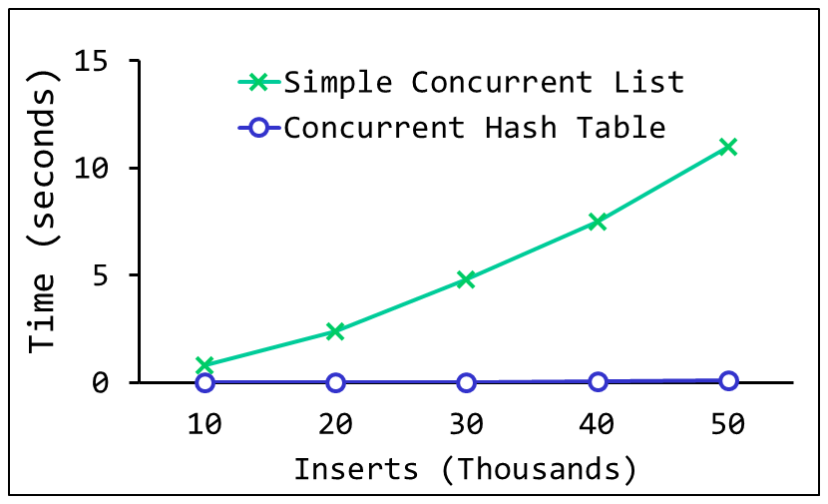
Concurrent Hash Tables
Scaling Concurrent Hash Tables
  Based on concurrent lists
  Each bucket is represented by a list
  A lock per hash bucket

Slide 35
Concurrent Hash Table
#define BUCKETS (101)
typedef struct __hash_t {
list_t lists[BUCKETS];
} hash_t
void Hash_Init(hash_t *H) {
int I;
for (I = 0; I < BUCKETS; i++) {
List_Init(&H->lists[i]);
}
}

Slide 36
Concurrent Hash Table
void Hash_Insert(hash_t *H, int key) {
int bucket = key % BUCKETS;
return List_Insert(&H->lists[bucket], key);
}
void Hash_Lookup(hash_t *H, int key) {
int bucket = key % BUCKETS;
return List_Lookup(&H->lists[bucket], key);
}

