Slide 1
Process Scheduling
Introduction

Slide 2
Outline
Workload Assumption
Turnaround time
FIFO, SJF, STCF
Response time
Round Robin
Incorporating I/O
Suggested reading: 7

Slide 3
From Mechanism to Policy
Mechanisms
  Low-level methods or protocols
    that implement a needed piece of functionality
  Examples
    context switch (time-sharing)
    Paging
Policies
  Intelligence resides on top of the mechanisms
  algorithms for making some kind of decision
  Examples
    Scheduling policy (decide to run which process)
    Replacement policy(decide which page to be replaced)

Slide 4
Workload Assumptions
Each job runs for the same amount of time
All jobs arrive at the same time
Once started, each job runs to completion
All jobs only use the CPU
  i.e., they perform no I/O
The run-time of each job is known
Above assumptions are unrealistic
  Will be relaxed one by one

Slide 5
Turnaround time
Metric
  is just something we use to measure something
Scheduling metrics
  there are a number of different metrics that make sense in scheduling
The turnaround time
  the time at which the job completes minus the time at which the job arrived in the system
  T_{turnaround} = T_{completion} − T_{arrival}
  Because for now T_{arrival} = 0 and hence T_{turnaround} = T_{completion}

Slide 6
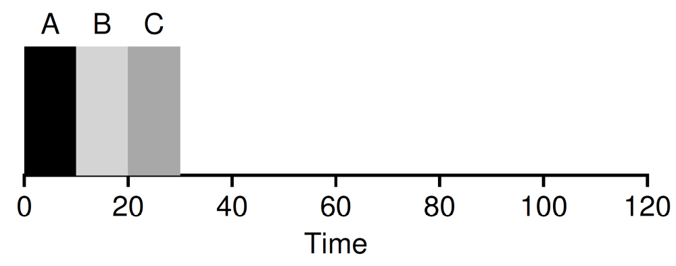
First In, First Out (FIFO)
Also known as First Come, First Served (FCFS)
It is clearly simple and thus easy to implement
Examples
  Jobs A, B, C. Each runs for 10s
  Turnaround time is (10+20+30)/3=20

Slide 7
Workload Assumptions
×
Each job runs for the same amount of time
All jobs arrive at the same time
Once started, each job runs to completion
All jobs only use the CPU
  i.e., they perform no I/O
The run-time of each job is known
Above assumptions are unrealistic
  Will be relaxed one by one

Slide 8
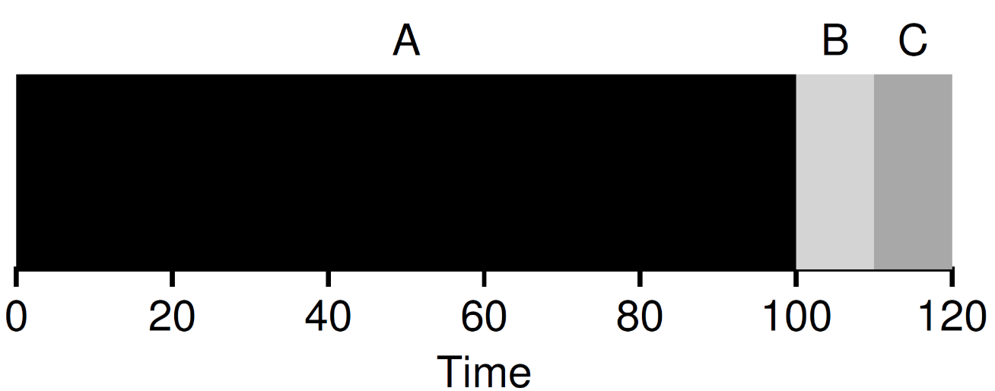
First In, First Out (FIFO)
Job A runs for 100s. Job B and C run for 10s
  Turnaround time is (100+110+120)/3=110
Convey Effect
  a number of relatively-short potential consumers of a resource get queued behind a heavyweight resource consumer

Slide 9
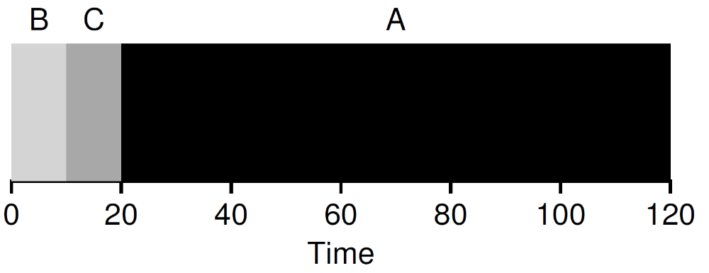
Shortest Job First (SJF)
Runs the shortest job first
  then the next shortest, and so on
  optimal
Examples
  Job A runs for 100s. Job B and C run for 10s
  Turnaround time is (10+20+120)/3=50

Slide 10
Workload Assumptions
×
Each job runs for the same amount of time
All jobs arrive at the same time
Once started, each job runs to completion
All jobs only use the CPU
  i.e., they perform no I/O
The run-time of each job is known
Above assumptions are unrealistic
  Will be relaxed one by one
×

Slide 11
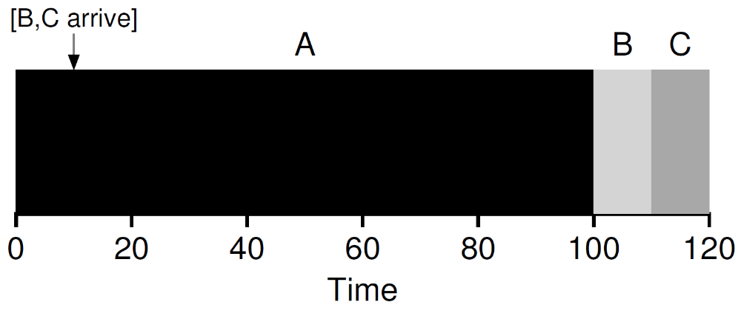
Shortest Job First (SJF)
Assume A arrives at t = 0 and needs to run for 100 seconds, whereas B and C arrive at t = 10 and each need to run for 10 seconds
Turnaround time (100+100+110)/3=103.33s

Slide 12
Workload Assumptions
×
Each job runs for the same amount of time
All jobs arrive at the same time
Once started, each job runs to completion
All jobs only use the CPU
  i.e., they perform no I/O
The run-time of each job is known
Above assumptions are unrealistic
  Will be relaxed one by one
×
×

Slide 13
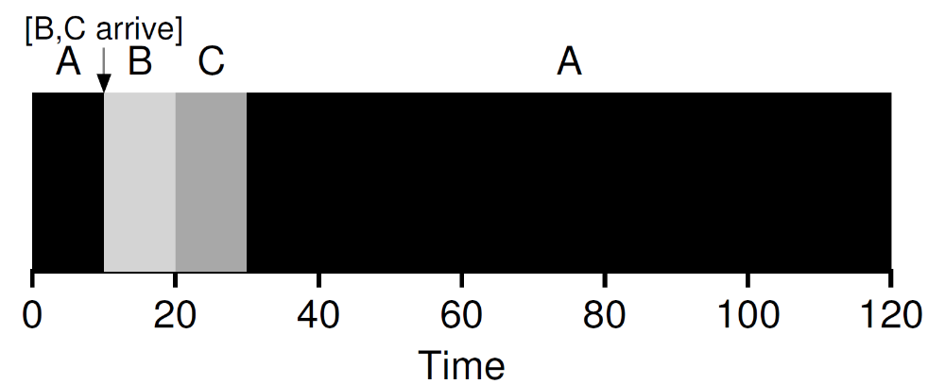
Shortest Time-to-Completion First (STCF)
STCF
  Any time a new job enters the system
  the STCF scheduler determines
    which of the remaining jobs (including the new job) has the least time left, and schedules that one
Preempt A when B and C arrived
  Turnaround time is (10+20+120)/3=50

Slide 14
Response time
In the time sharing systems
  Many users are interactive with computers
  Each user does not want to wait too long
Response time
  the time from when the job arrives in a system to the first time it is scheduled
  T_{response} = T_{firstturn} − T_{arrival}
Example
  T_{response} = (0+0+10)/3=3.33

Slide 15
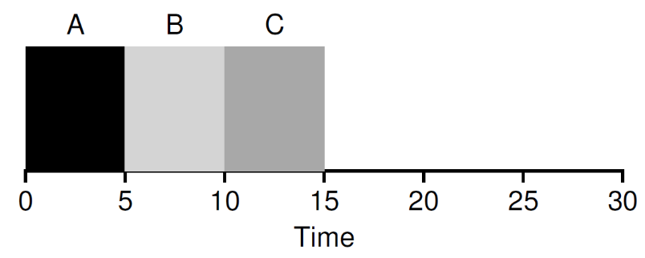
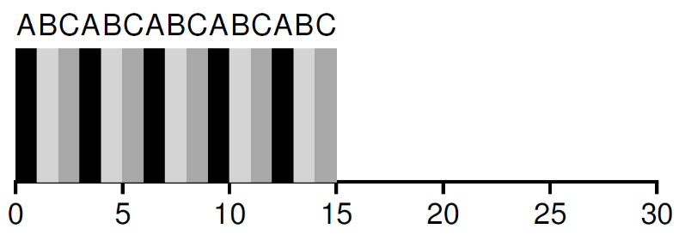
Round Rabin
Mechanism
  Run a job for a time slice
  Switch to the next job in the run queue
  Repeat until the jobs are finished
Time slice
      scheduling quantum
      a multiple of the timer-interrupt period (10ms)

Slide 16
Round Rabin
Switching cost
  Save and restore context
  Flushing TLB
  Flushing the hardware pipelines ( or out of order execution states)
Amortization
  Do not switch too shortly
  May increase the response time
  Must do some trade-off

Slide 17
Round Rabin vs. SJF
SJF
  Best for turnaround time
    (5+10+15)/3=10
  Worse for response time
    (0+5+10)/3=5
Round Rabin
  Worse for turnaround time
    (13+14+15)/3=14
  Better for response time
    (0+1+2)/3=1
Must some trade-off

Slide 18
Workload Assumptions
×
Each job runs for the same amount of time
All jobs arrive at the same time
Once started, each job runs to completion
All jobs only use the CPU
  i.e., they perform no I/O
The run-time of each job is known
Above assumptions are unrealistic
  Will be relaxed one by one
×
×
×

Slide 19
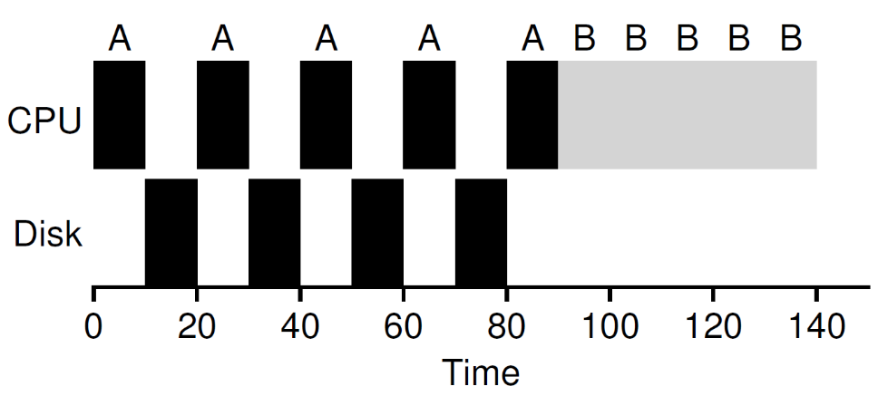
Incorporating I/O
Example
  Job A and B run on CPU for 50s each
  Job A does 4 I/O operations (10s each)
  The poor schedule does as follows

Slide 20
Incorporating I/O
When a job initiates an I/O request
  A system call is invoked
  The job is blocked (by kernel)
  Another job is scheduled to CPU
When a job completes an I/O request
  An interrupt is sent to CPU
  The job becomes ready to run
  The schedule determines which job to be scheduled
Overlap I/O and CPU
  Maximize the utilization of systems

Slide 21
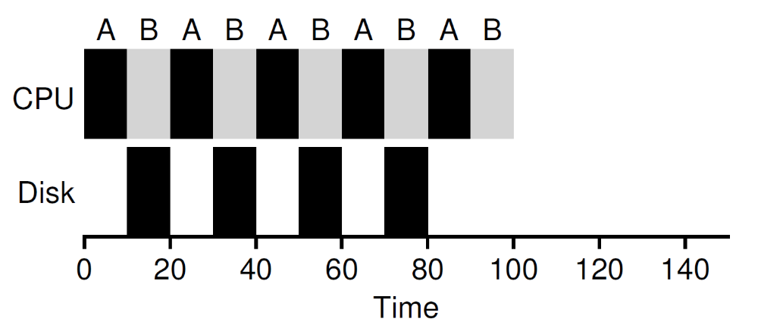
Incorporating I/O
How should the scheduler treat each job?
  Treat each CPU burst as a job
Example
  Treat each 10-ms sub-job of A as an independent job
  Doing overlap better

Slide 22
Workload Assumptions
×
Each job runs for the same amount of time
All jobs arrive at the same time
Once started, each job runs to completion
All jobs only use the CPU
  i.e., they perform no I/O
The run-time of each job is known
When the last assumption is relaxed
  what can we do?
×
×
×

Slide 23
Outline
Multi-Level Feedback Queue Scheduler
Suggested reading: 8

Slide 24
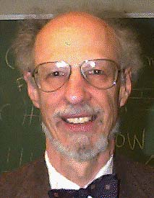
Introduction
Corbato
  introduced it with others in 1962 in a system known as the Compatible Time-Sharing System (CTSS)
  Won the ACM Turing Award in 1990
    because of CTSS and the later work on Multics

Slide 25
Primary Goal of the MLFQ
MLFQ would like to both
  optimize the turnaround time without a priori knowledge of job length
  minimize the response time
How to schedule without perfect knowledge
  The scheduler can learn the characteristics of the jobs it is running as the system runs,
  and thus make better scheduling decisions

Slide 26
Learning from History
Systems that learn from the past to predict the future
  The multi-level feedback queue
  hardware branch predictors
  caching algorithms
Such approaches work when jobs have phases of behavior and are thus predictable
Must be careful with such techniques
  they can easily be wrong and drive a system to make worse decisions than they would have with no knowledge at all

Slide 27
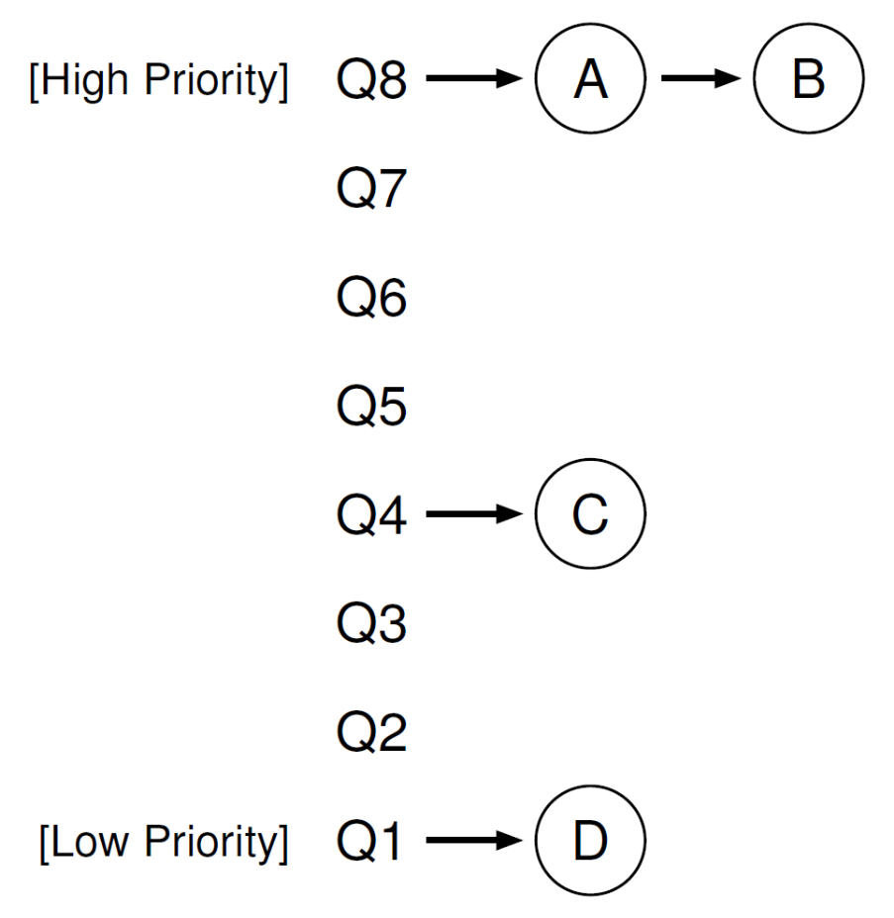
Basic Rules
A number of distinct queues
  each assigned a different priority level
A job that is ready to run is on a single queue
Rule 1: If Priority(A) > Priority(B), A runs (B doesn’t)
Rule 2: If Priority(A) = Priority(B), A & B run in RR

Slide 28
How to Change Priority
Our workload is a mix of
  interactive jobs that are short-running
    and may frequently relinquish the CPU
  and some longer-running “CPU-bound” jobs
    need a lot of CPU time
    response time isn’t important
Rule 3: When a job enters the system, it is placed at the highest priority
Rule 4a: If a job uses up an entire time slice while running, its priority is reduced
Rule 4b: If a job gives up the CPU before the time slice is up, it stays at the same priority level.

Slide 29
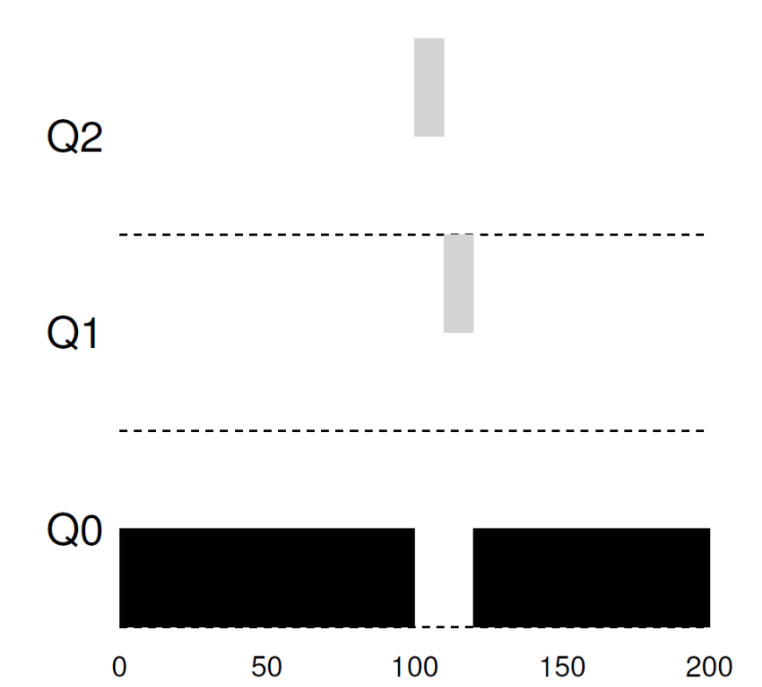
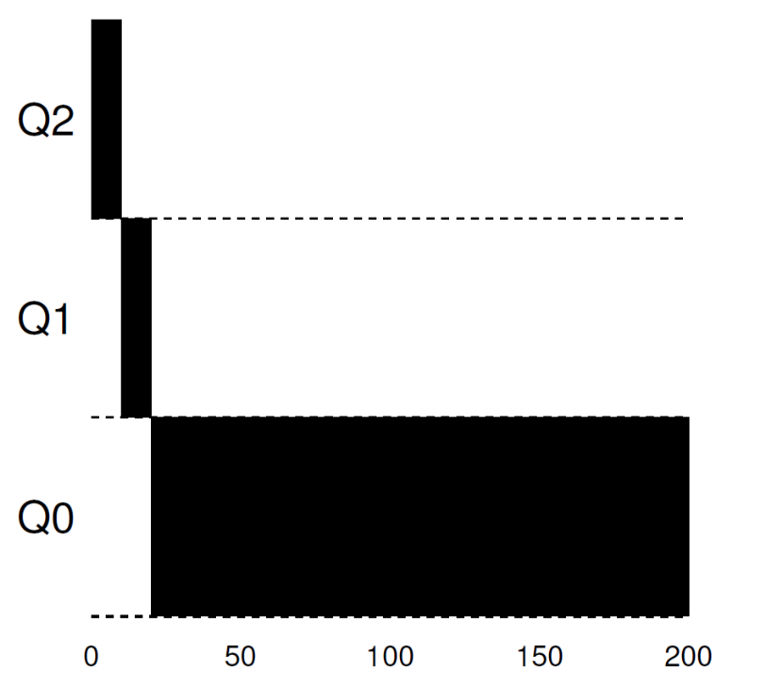
Examples
1. A single long running job
2. Along Came A Short Job

Slide 30
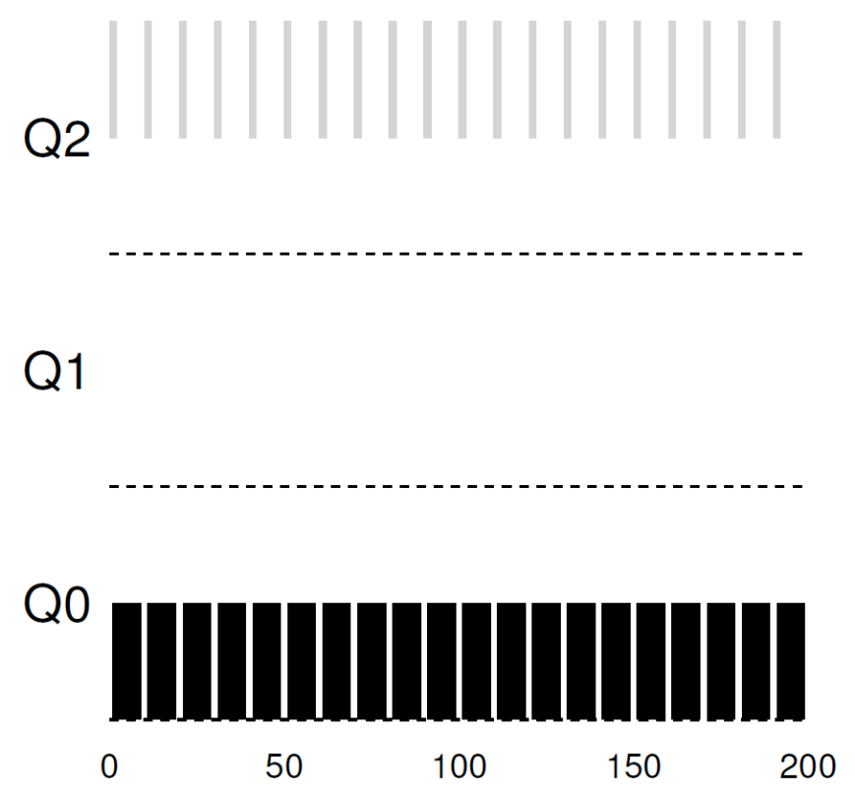
Examples
3. A mixed I/O-intensive and CPU-intensive workload

Slide 31
Notes
When a job arrives, the MLFQ
  first assumes it might be a short job
    Thus giving the job high priority
If it actually is a short job
  it will run quickly and complete
If it is not a short job
  it will slowly move down the queues
  soon prove itself to be a long-running process
If it is an interactive job doing a lot of I/O
  it will relinquish the CPU before its time slice is complete
  simply keep it at the same level without penalizing

Slide 32
Problems
starvation
  If there are “too many” interactive jobs in the system, they will combine to consume all CPU time
  long-running jobs will never receive any CPU time
Gaming scheduler attack
  before the time slice is over, issue an I/O operation and thus relinquish the CPU
  the job remains in the same queue, and thus gain a higher percentage of CPU time.
  This may lead to nearly monopolize the CPU
programs may change its behavior over time
  what were CPU bound may transit to a phase of interactivity

Slide 33
Priority Boost
Rule 5: After some time period S, move all the jobs in the system to the topmost queue
Processes are guaranteed not to starve
  sitting in the top queue, a job will eventually receive service
  because it shares the CPU with other high-priority jobs in a round-robin fashion
If a CPU-bound job has become interactive
  the scheduler treats it properly
  once it has received the priority boost

Slide 34
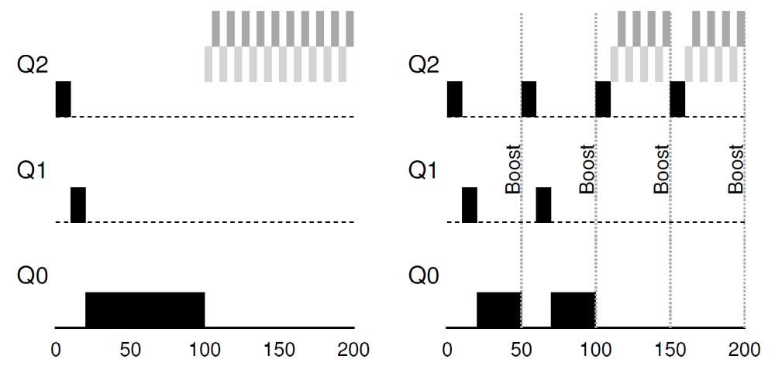
Priority Boost

Slide 35
Better Accounting
How to prevent gaming of our scheduler?
Rule 4: Once a job uses up its time allotment at a given level (regardless of how many times it has given up the CPU), its priority is reduced
The scheduler
  keeps track of the percentage of the time slice a process used at a given level
  once a process has used its allotment, it is demoted to the next priority queue

Slide 36
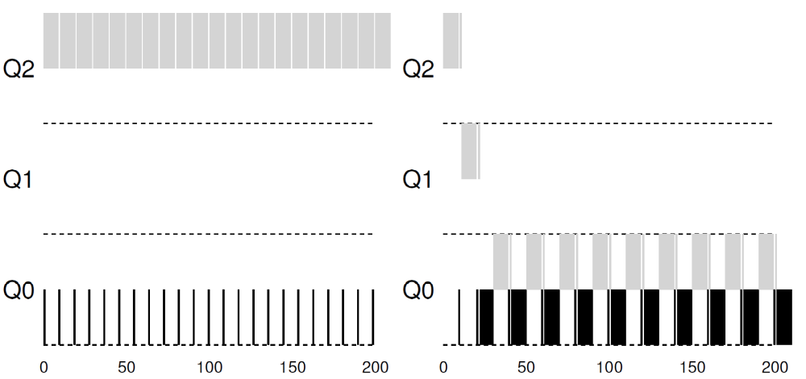
Better Accounting

Slide 37
Tuning MLFQ
How to parameterize a MLFQ scheduler
  how many queues should there be?
  How big should the time slice be per queue?
  How often should priority be boosted in order to avoid starvation and account for changes in behavior?
Tuning the scheduler
  only doing experience with typical workloads
  will lead to a satisfactory balance

Slide 38
Tuning MLFQ
Most MLFQ variants allow for varying time-slice length across different queues
The high-priority queues are given short time slices
  They are comprised of interactive jobs after all
  Quickly alternating between them makes sense
The low-priority queues are given longer time slices
  They contain long-running jobs that are CPU-bound
  Longer time slice works well

Slide 39
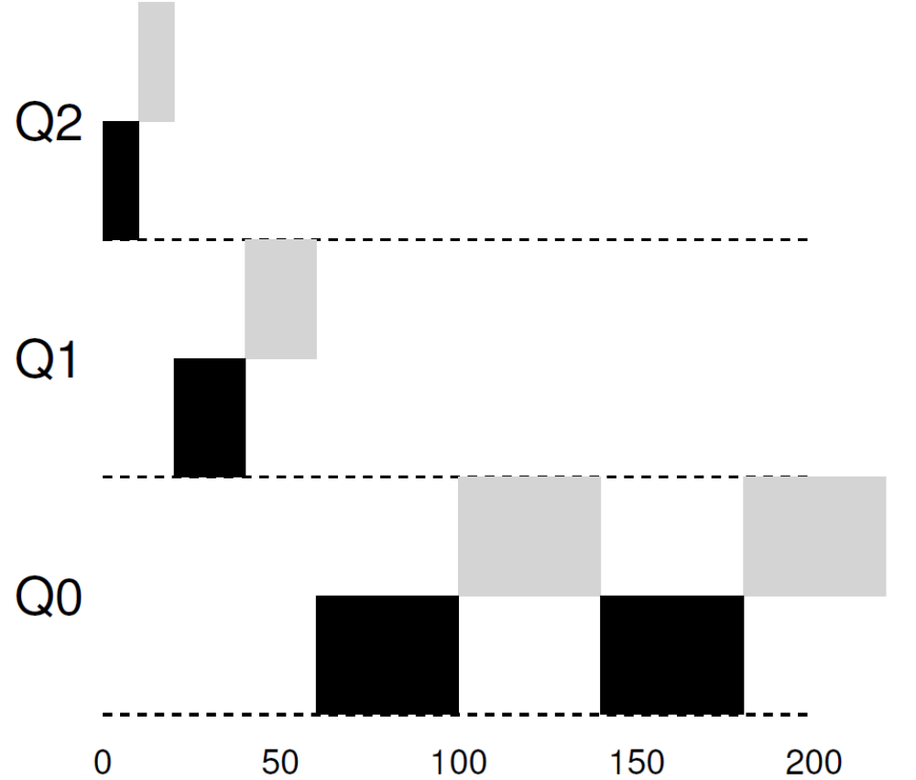
Lower Priority, Longer Quanta

Slide 40
OUSTERHOUT’S LAW
VOO-DOO CONSTANTS
  require some form of black magic to set them correctly
Avoiding voo-doo constants is a good idea whenever possible
  Unfortunately, it is often difficult
  One could try to make the system learn a good value
    but that too is not straightforward
The frequent result:
  a configuration file filled with default parameter values
  a seasoned administrator can tweak when something isn’t quite working correctly
    And is left unchanged

Slide 41
Solaris MLFQ implementation
The Time-Sharing scheduling class (TS)
Particularly easy to configure
  provides a set of tables that determine exactly how the priority of a process is altered throughout its lifetime
    how long each time slice is, and how often to boost the priority of a job
    an administrator can muck with this table in order to make the scheduler behave in different ways

Slide 42
Solaris MLFQ implementation
Default values for the table are
  60 queues
  slowly increasing time-slice lengths
    from 20 milliseconds (highest priority)
    to a few hundred milliseconds (lowest)
  priorities boosted around every 1 second or so.

Slide 43
Other implementations
Decay-usage
  the FreeBSD scheduler (version 4.3)
  uses a formula to calculate the current priority level of a job
    basing on how much CPU the process has used
  usage is decayed over time
  providing the desired priority boost in a different manner than described herein.

Slide 44
Other implementations
Some schedulers
  reserve the highest priority levels for operating system work
  typical user jobs can never obtain the highest levels of priority in the system
Some systems
  allow some user advice to help set priorities;
  for example, using the command-line utility nice
    you can increase or decrease the priority of a job
    and thus increase or decrease its chances of running at any given time

Slide 45
Summary
Rule 1: If Priority(A) > Priority(B), A runs (B doesn’t).
Rule 2: If Priority(A) = Priority(B), A & B run in RR.
Rule 3: When a job enters the system, it is placed at the highest priority (the topmost queue).
Rule 4: Once a job uses up its time allotment at a given level (regardless of how many times it has given up the CPU), its priority is reduced (i.e., it moves down one queue).
Rule 5: After some time period S, move all the jobs in the system to the topmost queue.

Slide 46
Summary
MLFQ
  Observes the execution of a job and prioritizes it accordingly
    instead of demanding a priori knowledge of the nature of a job
  Manages to achieve the best of both worlds
    it can deliver excellent overall performance similar to SJF/STCF) for short-running interactive jobs
    it is fair and makes progress for long-running CPU-intensive workloads
Many systems use a form of MLFQ as their base scheduler
  BSD, Solaris, Windows NT and subsequent Windows operating systems

