Slide 1


Instructor
臧斌宇
Email: byzang@sjtu.edu.cn
Office phone: 13917124245
Office hour: make an appointment
Room: 1312 software Bld.
陈榕
Email: rongchen@sjtu.edu.cn
Office phone: 13616861826

Slide 2
Teaching Assistants
胡凎森、同睿哲、李浩、蔡忠玮
  软件楼4号楼4层（3-403）
周三（地点待定）
  习题：18:00～20:00
  Quiz
  期中考试

Slide 3
Text Books & Web Site
Randy Bryant and David O’Hallaron,
  Computer Systems: A Programmer’s Perspective
  3rd Edition
  Prentice Hall, 2016.
http://ipads.se.sjtu.edu.cn/courses/ics/

Slide 4
Grading
Exams(70%)
  Middle Exam (32%)
  Final Exam (32%)
  Quiz (6%, 2% each)
  All exams are open books/open notes.
Labs (30%)
  Five labs

Slide 5
Introducing to Y86

Slide 6
Topics
Y86 instruction set architecture
Why do we need to study CPU design
RISC vs. CISC
Suggested Reading: 4.1

Slide 7
Goal
Understanding the instruction encodings
Preparing for designing your
  simulator
  assembler
  computer

Slide 8
Y86 Processor State
Program Registers
  Same 15 as with IA64. Each 64 bits
Program Counter
  Indicates address of instruction
Program Registers
%rax
%rsi
%r8
%r12
%rcx
%rdi
%r9
%r13
%rdx
%rsp
%r10
%r14
%rbx
%rbp
%r11
PC

Slide 9
Y86 Processor State
Condition Codes
  Single-bit flags set by arithmetic or logical instructions
    OF: Overflow ZF: Zero SF: Negative
Status code
  Program is running normally
  Or some special event has occured
Memory
  Byte-addressable storage array
  Words stored in little-endian byte order
Condition codes
OF
ZF
SF
Program status
Memory

Slide 10
Y86 Instructions
12 classes instructions
  Each accesses and modifies some part(s) of the program state
halt
nop
rrmovq rA, rB
cmovXX rA, rB
irmovq V, rB
rmmovq rA, D(rB)
mrmovq D(rB), rA
opq rA, rB
jXX Dest
call Dest
ret
pushq rA
popq rA

Slide 11
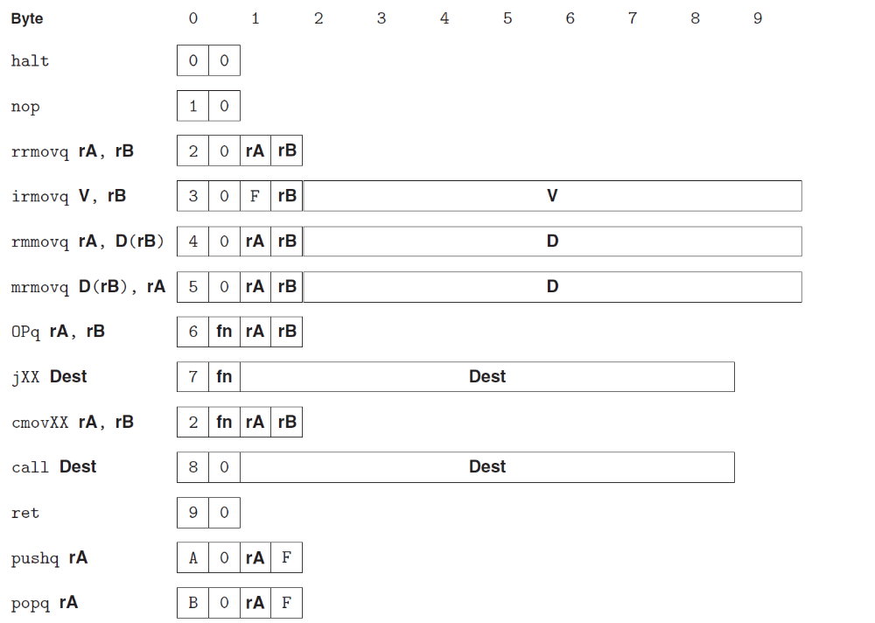
Y86 Instructions

Slide 12
Y86 Instructions
Format
  1--10 bytes of information read from memory
    Can determine instruction length from first byte
    Not as many instruction types, and simpler encoding than with IA64

Slide 13
Encoding Registers
1
Each register has 4-bit ID
  Same encoding as in IA64, except %r15
Register ID F indicates “no register”
  Will use this in our hardware design in multiple places
%rax
0
%rsi
6
%r8
8
%r12
C
%rcx
1
%rdi
7
%r9
9
%r13
D
%rdx
2
%rsp
4
%r10
A
%r14
E
%rbx
3
%rbp
5
%r11
B
None
F

Slide 14
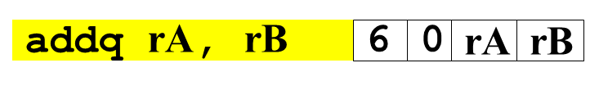
Instruction Example
Addition Instruction
  Add value in register rA to that in register rB
    Store result in register rB
    Note that Y86 only allows addition to be applied to register data
  Set condition codes based on result
Generic Form
Encoded Representation

Slide 15
Instruction Example
Addition Instruction
  e.g., addq %rax,%rsi Encoding: 60 06
  Two-byte encoding
    First indicates instruction type
    Second gives source and destination registers
Generic Form
Encoded Representation

Slide 16
Arithmetic and Logical Operations
Instruction Code
Function Code
Add
  Refer to generically as “OPl”
  Encodings differ only by “function code”
    Low-order 4 bites in first instruction word
  Set condition codes as side effect
  Notice: no multiply or divide operation
addq rA, rB
6
0
rA
rB
Subtract (rA from rB)
subq rA, rB
6
1
rA
rB
And
andq rA, rB
6
2
rA
rB
Exclusive-Or
xorq rA, rB
6
3
rA
rB

Slide 17
Move Operations
rrmovq rA, rB
2
0
rA
rB
Register --> Register
irmovq V, rB
3
0
F
rB
V
Immediate --> Register
rmmovq rA, D(rB)
4
0
rA
rB
D
Register --> Memory
mrmovq D(rB), rA
5
0
rA
rB
D
Memory --> Register
Like the IA64 movl instruction
Simpler format for memory addresses
Give different names to keep them distinct

Slide 18
Move Instruction Examples
IA64
Y86
movq $0xabcd, %rdx
irmovq $0xabcd, %rdx
movq %rsp, %rbx
rrmovq %rsp, %rbx
movq -12(%rbp),%rcx
mrmovq -12(%rbp),%rcx
movq %rsp,0x12345(%rdx)
rmmovq %rsp,0x12345c(%rdx)
movq $0xabcd, (%rax)
—
movl %rax, 12(%rax,%rdx)
—
movl (%rbp,%rax,8),%rcx
—

Slide 19
Move Instruction Examples
Y86
Encoding
irmovq $0xabcd, %rdx
30 F2 cd ab 00 00 00 00 00 00
rrmovq %rsp, %rbx
20 43
mrmovq -12(%rbp),%rcx
50 15 f4 ff ff ff ff ff ff ff
rmmovq %rsp,0x12345(%rdx)
40 42 45 23 01 00 00 00 00 00

Slide 20
Conditional Move Operations
Refer to generically as “cmovXX”
  Share the same “instruction code” with rrmovl
Encodings differ only by “function code”
cmovle rA, rB
2
1
rA
rB
cmovl rA, rB
2
2
rA
rB
cmove rA, rB
2
3
rA
rB
cmovne rA, rB
2
4
rA
rB
cmovge rA, rB
2
5
rA
rB
cmovg rA, rB
2
6
rA
rB
Based on values of condition codes
Same as IA64 counterparts

Slide 21
Jump Instructions
Jump Unconditionally
  Refer to generically as “jXX”
  Encodings differ only by “function code”
  Based on values of condition codes
  Same as IA64 counterparts
  Encode full destination address
    Unlike PC-relative addressing seen in IA64
jmp Dest
7
0
Dest
Jump When Less or Equal
jle Dest
7
1
Dest
Jump When Less
jl Dest
7
2
Dest
Jump When Equal
je Dest
7
3
Dest
Jump When Not Equal
jne Dest
7
4
Dest
Jump When Greater or Equal
jge Dest
7
5
Dest
Jump When Greater
jg Dest
7
6
Dest

Slide 22
Y86 Program Stack
Stack Bottom
Region of memory holding program data
Used in Y86 (and IA64) for supporting procedure calls
Stack top indicated by %rsp
  Address of top stack element
Stack grows toward lower addresses
  Top element is at lowest address in the stack
•
•
•
Increasing
Addresses
%rsp
Stack Top

Slide 23
Stack Operations
pushq rA
a
0
rA
F
Decrement %rsp by 8
Store word from rA to memory at %rsp
Like IA64 (pushq %rsp → save old %rsp)
Read word from memory at %rsp
Save in rA
Increment %rsp by 8
Like IA64 (popq %rsp → movq (%rsp) %rsp)
popq rA
b
0
rA
F

Slide 24
Subroutine Call and Return
call Dest
8
0
Dest
Push address of next instruction onto stack
Start executing instructions at Dest
Like IA64
Pop value from stack
Use as address for next instruction
Like IA64
ret
9
0

Slide 25
Miscellaneous Instructions
nop
1
0
Don’t do anything
Stop executing instructions
IA64 has comparable instruction, but can’t execute it in user mode
We will use it to stop the simulator
halt
0
0

Slide 26
Y86 Instructions

Slide 27
Y86 Programs
int Sum(int *Start, int Count)
{
int sum = 0;
while (Count) {
sum += *Start;
Start++;
Count--;
}
return sum;
}

Slide 28
Y86 Assembly
IA64 code
1 sum:
2 movl $0, %eax
3 jmp .L2
4 .L3:
5 addq (%rdi), %rax
6 addq $8, %rdi
7 subq $1, %rsi
8 .L2:
9 testq %rsi, %rsi
10 jne .L3
11 rep; ret
Y86 code
int Sum(int *Start, int Count)
1 sum:
2 irmovq $8,%r8
3 irmovq $1,%r9
4 xorq %rax,%rax
5 andq %rsi,%rsi
6 jmp test
7 loop:
8 mrmovq (%rdi),%r10
9 addq %r10,%rax
10 addq %r8,%rdi
11 subq %r9,%rsi
12 test:
13 jne loop
14 ret

Slide 29
Y86 Object Program
1 # Execution begins at address 0
2 .pos 0
3 irmovq stack, %rsp # Set up stack pointer
4 call main # Execute main program
5 halt # Terminate program
6
Init part of program generated automatically
Assembler directives
  .pos 0, .pos 0x200
  .align
Symbolic Name

Slide 30
Y86 Object Program
7 # Array of 4 elements
8 .align 8
9 array:
10 .quad 0x000d000d000d
11 .quad 0x00c000c000c0
12 .quad 0x0b000b000b00
13 .quad 0xa000a000a000
14
Data area
  array denotes the start of an array
  Aligned on 8-byte boundary

Slide 31
Y86 Object Program
15 main:
16 irmovq array,%rdi
17 irmovq $4,%rsi
18 call sum # sum(array, 4)
19 ret
20

Slide 32
Y86 Object Program
21 # long sum(long *start, long count)
22 # start in %rdi, count in %rsi
23 sum:
24 irmovq $8,%r8 # Constant 8
25 irmovq $1,%r9 # Constant 1
26 xorq %rax,%rax # sum = 0
27 andq %rsi,%rsi # Set CC
28 jmp test # Goto test

Slide 33
Y86 Object Program
29 loop:
30 mrmovq (%rdi),%r10 # Get *start
31 addq %r10,%rax # Add to sum
32 addq %r8,%rdi # start++
33 subq %r9,%rsi # count--. Set CC
34 test:
35 jne loop # Stop when 0
36 ret # Return
37
38 # Stack starts here and grows to lower addresses
39 .pos 0x200
40 stack:

Slide 34
Y86 Object Program
38 # Stack starts here and grows to lower addresses
39 .pos 0x200
40 stack:
Programmers must write assembly codes themselves
  including manage the memory
    such as allocate memory for array and stack
    as well as avoid the memory overwritting
Symbolic Name

Slide 35
Assembling Y86 Program
  unix> yas eg.ys
Generates “object code” file eg.yo
  Actually looks like disassembler output

Slide 36
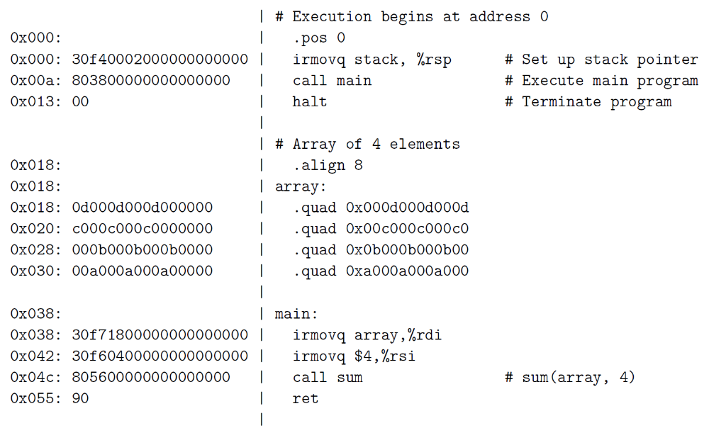

Slide 37
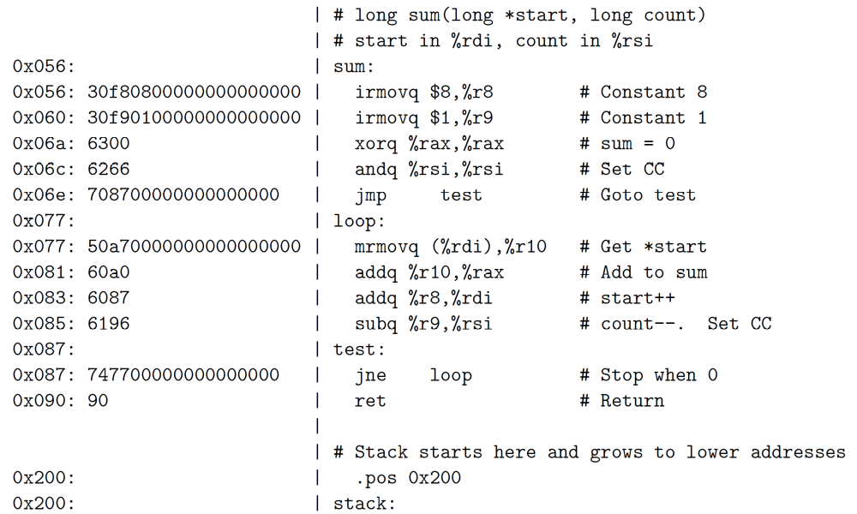

Slide 38
Simulating Y86 Program
  unix> yis eg.yo
Instruction set simulator
  Computes effect of each instruction on processor state
  Prints changes in state from original

Slide 39
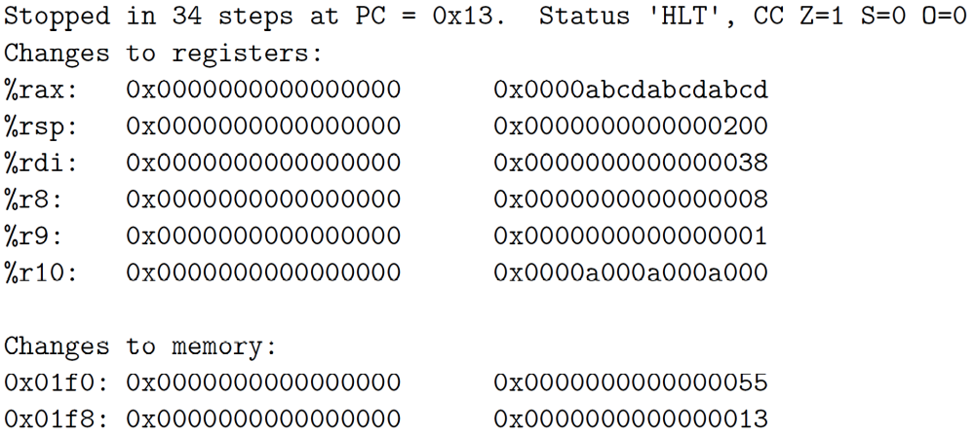
Simulating Y86 Program

Slide 40
Why do We Study the CPU Design?
Understand basic computer organization
  Instruction set architecture
Deeply explore the CPU working mechanism
  How the instruction is executed
Help you programming
  Fully understand how computer is organized and works will help you write more stable and efficient code

Slide 41
Instruction Set Architecture #1
What is ISA ?
  Assemble Language Abstraction
    assembly supported by a processor
  Machine Language Abstraction
    Byte-level representation
What does it provide?
  An abstraction of the real computer, hide the details of implementation
    The syntax of computer instructions
    The semantics of instructions
    The execution model
    Programmer-visible computer status

Slide 42
Instruction Set Architecture #2
Assembly Language View
  Processor state
    Registers, memory, …
  Instructions
    addq, movq, leaq, …
    How instructions are encoded as bytes
Layer of Abstraction
  Above: how to program machine
    Processor executes instructions in a sequence
  Below: what needs to be built
    Use tricks to make it run fast
    E.g., execute multiple instructions simultaneously
Application
Program
Compiler
OS
ISA
CPU
Design
Circuit
Design
Chip
Layout

Slide 43
Instruction Set Architecture #3
ISA defines the processor family
  Two main kind: RISC and CISC
    RISC: SPARC, MIPS, PowerPC, ARM
    CISC: X86 (or called IA32)
Under same ISA, there are many different processors
  From different manufacturers
    X86 from Intel, AMD and VIA
  Different models
    8086, 80386, Pentium, atom, core i7
Notes:
This is the modern division. There are other kinds besides superscalar, VLIW and EPIC, e.g. vector machine, stack machine (example is X87)
We will cover some of these topics in the last lesson of cpu design.

Slide 44
RISC vs. CISC
ISA
  Instruction set architecture
    Instructions supported by a particular processor
    Their byte-level encodings
CISC
  Complex instruction set computer
RISC
  Reduced instruction set computer

Slide 45
CISC
Involved from the earliest computers
Mainframe and Minicomputers
  By the early 1980s
  their instruction sets had grown quite large
    Manipulating circular buffers
    performing decimal arithmetic
    evaluating polynomials
Microcomputer
  Appeared in 1970s, had limited instruction sets
    constrained by number of transistors on a single chip
  By the early 1980s, followed the path to increase their instruction sets

Slide 46
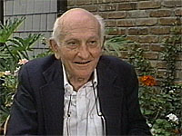


RISC
Developed in the early 1980s
  philosophy
    One are able to generate efficient code for a simpler form of instruction set
    Complex instructions are hard to generated with a compiler and seldom used
John Cocke (1925-2002)
  1987 ACM Turing Award
David Patterson(UC Berkeley), John Hennessy (Stanford U)
  2017 ACM Turing Award

Slide 47
RISC
IBM | Power
IBM and Motorola | PowerPC
Sun Microsystems | SPARC
Digital Equipment Corporation | Alpha
Hewlett Pack | Pa-risc
MIPS Technologies | MIPS
Acorn Computers Ltd | ARM(Acorn RISC Machine)

Slide 48
RISC vs. CISC
CICS | Early RISC
A large number of instructions | Many fewer instructions (<100)
Some instructions with long execution times | No instruction with a long execution time
Variable-length encodings. (x86-64 1~15 bytes) | Fixed-length encodings
Multiple formats for specifying operands | Simple addressing formats
Arithmetic and logical operations can be applied to both memory and register operands | Arithmetic and logical operations only use register operands. load/store Architecture

Slide 49
RISC vs. CISC
CICS | Early RISC
Implementation artifacts hidden from machine level programs | Implementation artifacts exposed to machine level programs
Condition codes | explicit test instructions store the test results in normal registers for use in conditional evaluation
Stack-intensive procedure linkage | Registers are used for procedure arguments and return addresses

Slide 50
RISC
Cons for early RISC
  More instructions
  Not multiple cycles
  Exposing implementation artifacts to machine level programs
Pros for RISC
  Well suited for pipeline (high efficient implementation)

Slide 51
Y86-64
The Y86-64 instruction set
  Includes attributes of both CISC and RISC
  Can be viewed as taking a CISC instruction set (x86-64) and simplifying it by applying some of the principles of RISC
On the CISC side
  condition codes, variable-length instructions
  uses the stack to store return addresses.
On the RISC side,
  a load/store architecture
  a regular instruction encoding
  passes procedure arguments through registers

Slide 52
RISC vs. CISC
In the early 1990s, the debate diminished
  neither RISC nor CISC in their purest forms are better than designs that incorporated the best ideas of both

Slide 53
RISC
Evolved and introduced more instructions
  many of which take multiple cycles to execute
  Have hundreds of instructions
Exposing implementation artifacts to machine-level programs
  proved to be shortsighted
  As new processor models were developed
    using more advanced hardware structures,
    many of these artifacts became irrelevant,
    but they still remained part of the instruction set

Slide 54
CISC
The core of RISC design
  is well suited to execution on a pipelined machine
X86 incorporates RISC features
  Dynamic translating CISC instructions to RISC-like ops and taking pipeline architectures
  X86-64 introduces more RISC features

Slide 55
CISC
Marketing issues determine the success of the ISAs
  X86 wins in high-end server, desktop, laptop machines
  RISC win in market of embedded processors and the smart phones

Slide 56
CISC
Intel made it easy to keep moving from one generation of processor to the next
  By maintaining compatibility with its existing processors
As integrated-circuit technology improved
  x86 processor manufacturers could overcome the inefficiencies created by the original 8086 instruction set design
  using RISC techniques to produce performance comparable to the best RISC machines.

Slide 57
CISC
RISC processors have done very well in the market for embedded processors
In these applications, saving on cost and power is more important than maintaining backward compatibility
  In terms of the number of processors sold
this is a very large and growing market

