Slide 1
Modern Processors

Slide 2
Outline
Understanding Memory Performance
Suggested reading
  5.12

Slide 3
Instruction Control
Fetch
Control
Address
Instruction
Cache
Retirement
Unit
Instruction
Decode
Instructions
Register
File
Operations
Register Updates
Register renaming
Reorder
buffer
Prediction OK?
Dispatch
Execution
Functional
Units
Branch
Arithmetic
operations
Arithmetic
operations
Load
Store
Operation Results
Addr.
Addr.
Data
Data
Data
Cache

Slide 4
Load Performance
load unit can only initiate one load operation every clock cycle (Issue=1.0)
typedef struct ELE {
struct ELE *next ;
int data ;
} list_ele, *list_ptr ;
long list_len(list_ptr ls) {
long len = 0 ;
while (ls) {
len++ ;
ls = ls->next;
}
return len ;
}
len in %rax, ls in %rdi
.L3:
addq $1, %rax
movq (%rdi), %rdi
testq %rdi, %rdi
jne .L3
Function CPE
list_len 4.0
load latency 4.0

Slide 5
Store Performance
store unit can only initiate one store operation every clock cycle (Issue=1.0)
void array_clear(int *dest, int n)
{
int i;
int limit = n-3;
for (i = 0; i < limit; i++)
dest[i] = 0;
}
Function CPE
array_clear 1.0

Slide 6
Store Performance
void write_read(long *src,
long *dest, long n)
{
long cnt = n;
long val = 0;
while (cnt) {
*dest = val;
val = (*src)+1;
cnt--;
}
}
Example A: write_read(&a[0],&a[1],3)
initial
Iter.1
Iter.2
Iter.3
cnt
3
2
1
0
a
-10
17
-10
0
-10
-9
-10
-9
val
0
-9
-9
-9
Example B: write_read(&a[0],&a[0],3)
initial
Iter.1
Iter.2
Iter.3
cnt
3
2
1
0
a
-10
17
0
17
1
17
2
17
Function CPE
Example A 1.3
Example B 7.3
val
0
1
2
3

Slide 7
Instruction Control Unit
Retirement Unit
  Keep track of the ongoing processing
  Obey the sequential semantics of the machine-level program (misprediction & exception)
Instruction Control
Fetch
Control
Address
Instruction
Cache
Retirement
Unit
Instruction
Decode
Instructions
Register
File
Operations
Register Updates
Prediction OK?

Slide 8
Instruction Control Unit
Instruction Retired/Flushed
  Place instructions into a first-in, first-out queue
  Retired: any updates to the memory being made
    Operations of the instruction have completed
    Any branch prediction to the instruction are confirmed correctly
  Flushed: discard any results have been computed
    Some branch prediction was mispredicted
    Mispredictions can’t alter the program state

Slide 9
Store Units
Store Unit
Store buffer
address
data
Address
Data
Data Cache

Slide 10
Multi-functional Units
Multiple Instructions Can Execute in Parallel
  Haswell CPU (Core i7)
      0. Integer arithmetic, FP multiplication, integer and FP division, branches
      1. Integer arithmetic, FP addition, integer multiplication, FP multiplication
      2. Load, address computation
      3. Load, address computation
      4. Store
      5. Integer arithmetic(basic operations)
      6. Integer arithmetic, branches
      7. Store address computation
Integer arithmetic: addition, bitwise operations, shifting

Slide 11
Load and Store Units
Load
Unit
Store Unit
Store buffer
address
data
address
Matching
addresses
Data
Address
Data
Address
Data
Data Cache

Slide 12
Graphical Representation
%rax
%rdi
%rsi
%rdx
s_addr
movq %rax,(%rsi)
s_data
load
movq (%rdi), %rax
add
addq $1,%rax
sub
subq $1,%rdx
jne
jne loop
%rax
%rdi
%rsi
%rdx
//inner-loop
while (cnt) {
*dest = val;
val = (*src)+1;
cnt--;
}

Slide 13
Graphical Representation
%rax
%rdi
%rsi
%rdx
%rax
%rdx
1
s_addr
s_data
s_data
2
load
3
load
sub
add
sub
add
jg
%rax
%rdx
%rax
%rdx

Slide 14
Graphical Representation
Example A
Example B
Critical Path
s_data
s_data
load
load
add
sub
add
sub
Function bounds
Example A 1
Example B 7
s_data
s_data
load
load
add
sub
add
sub
Notes:
Dependence on addresses of store and load

Slide 15
Getting High Performance
Good compiler and flags
Look carefully at innermost loops
  Write compiler-friendly code
    Watch out for optimization blockers:
      procedure calls & memory references
  Tune code for machine
    Exploit instruction-level parallelism
    Avoid unpredictable branches
    Make code cache friendly

Slide 16
Performance Tuning

Slide 17
Outline
Tuning Performance
Suggested reading
  5.14

Slide 18
Program Example
Task
  Analyzing the n-gram statistics of a text document
    an n-gram is a sequence of n words occurring in a document
  reads a text file,
  creates a table of unique n-grams
    specifying how many times each one occurs
  sorts the n-grams in descending order of occurrence

Slide 19
Program Example
Steps
  Convert strings to lowercase
  Apply hash function
  Read n-grams and insert into hash table
    Mostly list operations
    Maintain counter for each unique n-gram
  Sort results
Data Set
  Collected works of Shakespeare
  965,028 total words, 23,706 unique
  N=2, called bigrams
  363,039 unique bigrams

Slide 20
Amdahl’s Law
S = T_{old} / T_{new} = 1/[(1-α) + α/k]
S∞ = 1/(1-α)
T_{old} = 209.0
α = T_{part} / T_{old} = 203.7 / 209.0 = 0.974
S∞ = 1/(1-α) = 39.0
T_{old} / T_{new} = 209.0 / 5.4 = 38.5
Try to optimize
    the most time consuming part of a program
    hottest part

Slide 21
Identify the hottest part
Using a very useful method profiling
  Compile the program correctly
  Run it with typical input data
  Collect information from the result
  Analysis the result
    How much time did execution of a function take?
    How many times was a particular function called?

Slide 22
Using GPROF
Step 1: Instrument the program
$gcc -Og –pg prog.c –o prog
  Adds profiling code to prog, that is ”Instruments” prog.c
Step 2: Run the program
$./prog file.txt
  Creates file gmon.out containing statistics
Step 3: Create a report
$gprof prog > myreport
  Uses prog and gmon.out to create textual report
Step 4: Examine the report
$cat myreport

Slide 23
Examples
Each line describes one function
  name: name of the function
  %time: percentage of time spent executing this function
  cumulative seconds: [skipping, as this isn’t all that useful]
  self seconds: time spent executing this function
  calls: number of times function was called (excluding recursive)
  self s/call: average time per execution (excluding descendents)
  total s/call: average time per execution (including descendents)
By default, the timings for library functions are not shown
% cumulative self self total
time seconds seconds calls s/call s/call name
97.58 203.66 203.66 1 203.66 203.66 sort_words
2.32 208.50 4.85 965027 0.00 0.00 find_ele_rec
0.14 208.81 0.30 12511031 0.00 0.00 Strlen
Notes:
-pg let gcc do instrumentation.
What is s/call. What spent on each call.
Self: Called by itself ,
Total: called by itself and others.

Slide 24
How does gprof work?
Essentially, by randomly sampling the code as it runs
… and seeing what line is running, & what function it’s in
Interval counting
  Maintain a counter for each function
    Record the time spent executing this function
  Interrupted at regular time (1ms~10ms)
    Check which function is executing when interrupt occurs
    Increment the counter for this function
The calling information is quite reliable

Slide 25
Example
calling history in the report
Ratio : 158655725/965027 = 164.4
The average length of a list in one hash bucket is 164
index % time self called name
158655725 find_ele_rec [5]
4.85 0.10 965027/965027 insert_string [4]
[5] 2.4 4.85 0.10 965027+158655725 find_ele_rec [5]
0.08 0.01 363039/363039 save_string [8]
0.00 0.01 363039/363039 new_ele [12]
158655725 find_ele_rec [5]

Slide 26
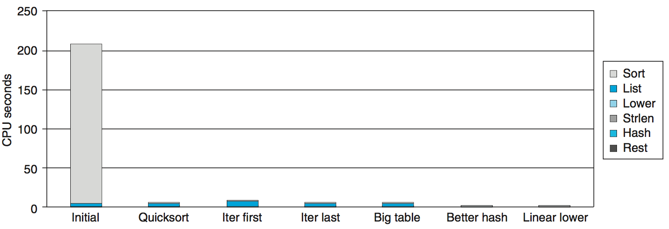
Performance Tuning
Steps to improve execution (time) efficiency:
  (1) Do timing studies
  (2) Identify hot spots
  (3) Use a better algorithm or data structure
  (4) Tune the code

Slide 27
Use a Better Algorithm
First step: Use more efficient sorting function
Library function qsort

Slide 28
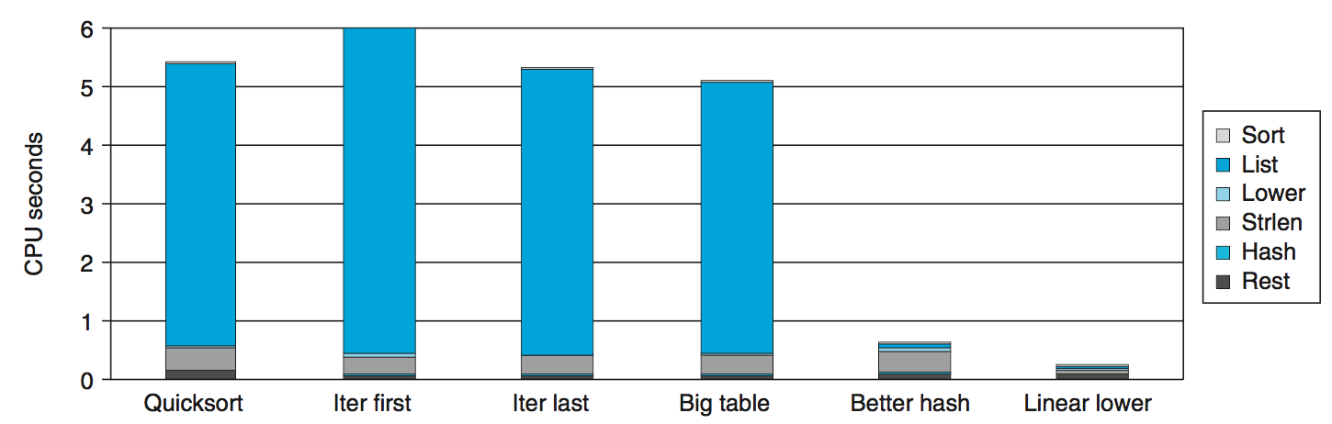
Try Code Optimizations
Replace recursive call to iterative
    Insert elements in linked list

Slide 29
Try Code Optimizations
Causes code to slow down
Reason:
  Iter first: insert a new element at the beginning of the list
  Most common n-grams tend to appear at the end of the list which results the searching time

Slide 30
Try Code Optimizations
Iter last:
  iterative function, places new entry at end of the list
  Tend to place most common words at front of list

Slide 31
Try Code Optimizations
Initial version: only 1021 buckets.
There are 363039/1021 = 355.6 bigrams in each bucket
Big table: Increase it to 199,999

Slide 32
Try Code Optimizations
Only improves 0.3s
Reason
  Hash key is summing character codes for a string
    The maximum code is 3371
      for “honorificabilitudinitatibus thou”
    Cannot differentiate “rat” and “tar”
  Most buckets are not used

Slide 33
Try Code Optimizations
Better hash:
  Use more sophisticated hash function (Shift and Xor)
Time drops to 0.4 seconds

Slide 34
Optimizaitons
Better hash: Use more sophisticated hash function
  Shift and Xor
  Time drops to 0.4 seconds
Linear lower: Move strlen out of loop
  Time drops to 0.2 seconds

Slide 35
Further Optimizations
Linear lower:
  Move strlen out of loop
Time drops to 0.2 seconds

Slide 36
Code Motion
1 /* Convert string to lowercase: slow */
2 void lower1(char *s)
3 {
4 int i;
5
6 for (i = 0; i < strlen(s); i++)
7 if (s[i] >= ’A’ && s[i] <= ’Z’)
8 s[i] -= (’A’ - ’a’);
9 }
10

Slide 37
Code Motion
11 /* Convert string to lowercase: faster */
12 void lower2(char *s)
13 {
14 int i;
15 int len = strlen(s);
16
17 for (i = 0; i < len; i++)
18 if (s[i] >= ’A’ && s[i] <= ’Z’)
19 s[i] -= (’A’ - ’a’);
20 }
21

Slide 38
Code Motion
22 /* Sample implementation of library function strlen */
23 /* Compute length of string */
24 size_t strlen(const char *s)
25 {
26 int length = 0;
27 while (*s != ’\0’) {
28 s++;
29 length++;
30 }
31 return length;
32 }

Slide 39
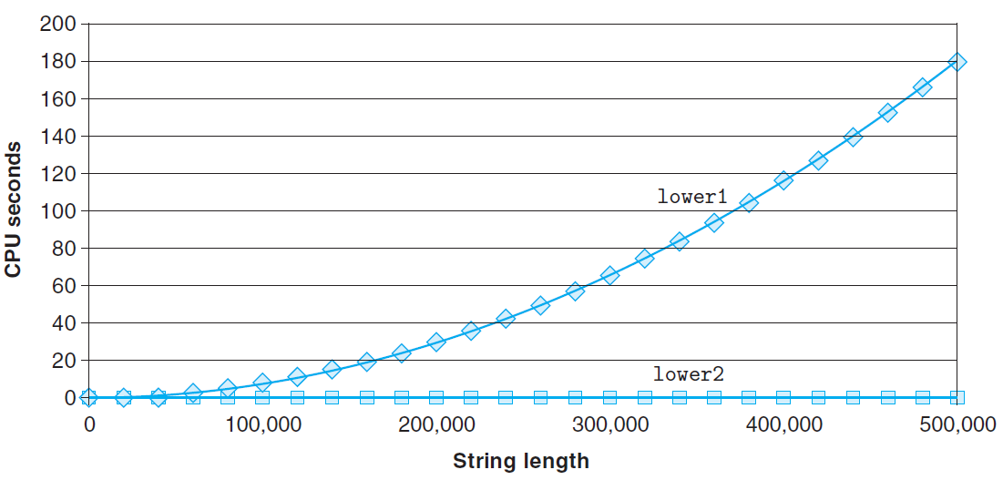
Code Motion

Slide 40
Performance Tuning
Benefits
  Helps identify performance bottlenecks
  Especially useful when have complex system with many components
Limitations, only shows performance for data tested
  if we had run the original function on data consisting of a smaller number of longer strings, we would have found that the lowercase conversion routine was the major performance bottleneck.
  Even worse, if it only profiled documents with short words, quadratic inefficiency of lower1 could remain lurking in code
  Timing mechanism fairly crude
    Only works for programs that run for > 1 seconds

