Slide 1
Linking

Slide 2
Outline
What is linking and why linking
Complier driver
Input & output for the Static linking
Suggested reading: 7.1~7.4

Slide 3
Monolithic source file
main.c
ASCII source file
Translator
binary executable object file
(memory image on disk)
p
Problems:
  efficiency: small change requires complete recompilation
  modularity: hard to share common functions (e.g. printf)

Slide 4
main.c | swap.c
/*main.c */ void swap() ; int buf[2] = {1, 2}; int main() { swap() ; return 0 ; } | /*swap.c */ extern int buf[]; int *bufp0 = &buf[0] int *bufp1 ; void swap() { int temp ; bufp1 = &buf[1]; temp = *bufp0 ; *bufp0 = *bufp1 ; *bufp1 = temp ; }

Slide 5
Separate Compilation
main.c
swap.c
Translators
Translators
separately compiled relocatable object files
main.o
swap.o
Linker (ld)
executable object file
(contains code and data for all functions defined in main.c and swap.c)
prog

Slide 6
What is linker
Linking is the process of
  collecting and combining various pieces of code and data into a single executable file
Executable file
  Can be loaded (copied) into memory and executed.

Slide 7
What is linker
Linking can be performed
  at compile time, when the source code is translated into machine code by the linker
  at load time, when the program is loaded into memory and executed by the loader
  at run time, by application programs.

Slide 8
Compiler Drivers
Coordinates all steps in the translation and linking process
  Typically included with each compilation system (e.g., gcc)
  Invokes
    preprocessor (cpp)
    compiler (cc1)
    assembler (as),
    linker (ld).
  Passes command line args to appropriate phases

Slide 9
Example
unix> gcc -Og -o prog main.c swap.c
cpp [other args] main.c /tmp/main.i
cc1 /tmp/main.i main.c -Og [other args] -o /tmp/main.s
as [other args] -o /tmp/main.o /tmp/main.s
<similar process for swap.c>
ld -o prog [system obj files] /tmp/main.o /tmp/swap.o
unix>

Slide 10
main.c | swap.c
/*main.c */ void swap() ; int buf[2] = {1, 2}; int main() { swap() ; return 0 ; } | /*swap.c */ extern int buf[] ; int *bufp0 = &buf[0] ; int *bufp1 ; void swap() { int temp ; bufp1 = &buf[1] ; temp = *bufp0 ; *bufp0 = *bufp1; *bufp1 = temp; }

Slide 11
Example
Two functions
  main() and swap()
Three global variables
  buf, bufp0 which are initialized explicitly
  bufp1 implicitly initialized to 0

Slide 12
Example
.file "swap.c"
.globl bufp0
.data
.align 8
.type bufp0, @object
.size bufp0, 8
bufp0:
.quad buf
.comm bufp1,8,8
.text
.globl swap
.type swap, @function
define
reference

Slide 13
Example
swap:
pushq %rbp
movq %rsp, %rbp
movq $buf+4, bufp1(%rip)
movq bufp0(%rip), %rax
movl (%rax), %eax
movl %eax, -4(%rbp)
movq bufp0(%rip), %rax
movq bufp1(%rip), %rdx
movl (%rdx), %edx
movl %edx, (%rax)
movq bufp1(%rip), %rax
movl -4(%rbp), %edx
movl %edx, (%rax)
nop
popq %rbp
ret
define
reference

Slide 14
Static linking
Input
  A relocatable object files and command line arguments
Output
  Fully linked executable object file that can be loaded and run

Slide 15
Example
unix> gcc -Og -o prog main.c swap.c
cpp [other args] main.c /tmp/main.i
cc1 /tmp/main.i main.c -Og [other args] -o /tmp/main.s
as [other args] -o /tmp/main.o /tmp/main.s
<similar process for swap.c>
ld -o prog [system obj files] /tmp/main.o /tmp/swap.o
unix>

Slide 16
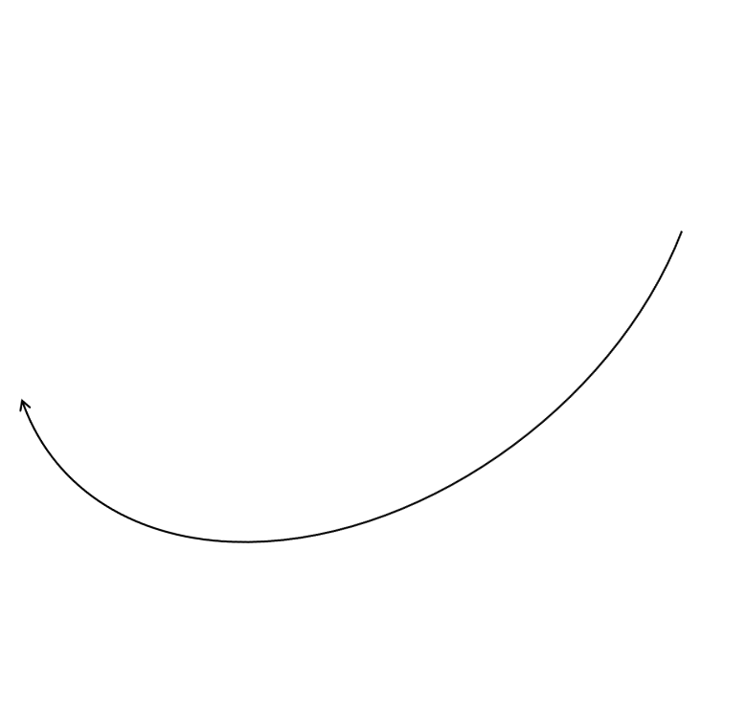
Relocatable Object Files(main.o)
Define (main)
00<main>:
00: 55 push %rbp
01: 48 89 e5 mov %rsp,%rbp
04: b8 00 00 00 00 mov $0x0,%eax
09: e8 00 00 00 00 callq e <main+0xe>
0e: b8 00 00 00 00 mov $0x0,%eax
13: 5d pop %rbp
14: c3 retq
Reference
(swap)

Slide 17
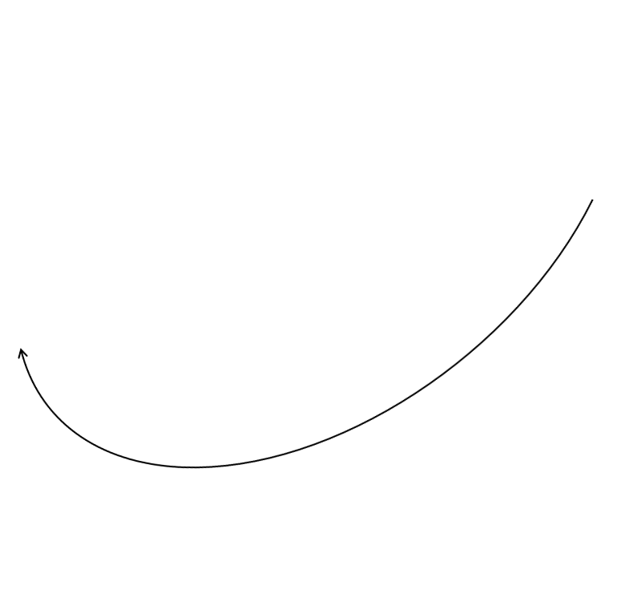
Relocatable Object Files(main.o)
Define (buf)
00 <buf>:
00: 01 00 00 00 02 00 00 00

Slide 18

Relocatable Object Files(swap.o)
bufp1
References
buf[1]
00<swap>:
00: 55 push %rbp
01: 48 89 e5 mov %rsp,%rbp
04: 48 c7 05 00 00 00 00 movq $0x0,0x0(%rip)
0b: 00 00 00 00 bufp1= &buf[1]
0f: 48 8b 05 00 00 00 00 mov 0x0(%rip),%rax get bufp0
16: 8b 00 mov (%rax),%eax
18: 89 45 fc mov %eax,-0x4(%rbp)
1b: 48 8b 05 00 00 00 00 mov 0x0(%rip),%rax get bufp0
22: 48 8b 15 00 00 00 00 mov 0x0(%rip),%rdx get bufp1
29: 8b 12 mov (%rdx),%edx
2b: 89 10 mov %edx,(%rax) *bufp0 = *bufp1
2d: 48 8b 05 00 00 00 00 mov 0x0(%rip),%rax get bufp1
34: 8b 55 fc mov -0x4(%rbp),%edx
37: 89 10 mov %edx,(%rax)

Slide 19
Relocatable Object Files(swap.o)
Define (buf)
39: 90 nop
3a: 5d pop %rbp
3b: c3 retq
00<bufp0>:
00: 00 00 00 00 00 00 00 00
00<bufp1>:
Reference
(buf)

Slide 20
Relocatable Object Files
Relocatable object file
  Contain binary code and data in a form that can be combined with other relocatable object files to create an executable file
Sections
  Various code and data sections
  Instructions are in one section
  Initialized global variables are in one section
  Uninitialized global variables are in one section

Slide 21
Linking (Symbol resolution)
External reference:
  Reference to a symbol defined in another object file
  The external references are value 0 in the relocatable object files in the previous example
Symbol resolution
  Resolves external references

Slide 22
Executable object file
Contains binary code and data in a form that can be copied directly into memory and executed

Slide 23
Executable Object Files
4004d6 <main>:
4004d6: 55 push %rbp
4004d7: 48 89 e5 mov %rsp,%rbp
4004da: b8 00 00 00 00 mov $0x0,%eax
4004df: e8 07 00 00 00 callq 4004eb <swap>
4004e4: b8 00 00 00 00 mov $0x0,%eax
4004e9: 5d pop %rbp
4004ea: c3 retq

Slide 24
Executable Object Files
00000000004004eb <swap>:
4004eb: 55 push %rbp
4004ec: 48 89 e5 mov %rsp,%rbp
4004ef: 48 c7 05 4e 0b 20 00 movq $0x601034,0x200b4e(%rip)
4004f6: 34 10 60 00 bufp1= &buf[1]
4004fa: 48 8b 05 37 0b 20 00 mov 0x200b37(%rip),%rax get bufp0
400501: 8b 00 mov (%rax),%eax
400503: 89 45 fc mov %eax,-0x4(%rbp)
400506: 48 8b 05 2b 0b 20 00 mov 0x200b2b(%rip),%rax get bufp0
40050d: 48 8b 15 34 0b 20 00 mov 0x200b34(%rip),%rdx get bufp1
400514: 8b 12 mov (%rdx),%edx
400516: 89 10 mov %edx,(%rax) *bufp0 = *bufp1
400518: 48 8b 05 29 0b 20 00 mov 0x200b29(%rip),%rax get bufp0
40051f: 8b 55 fc mov -0x4(%rbp),%edx
400522: 89 10 mov %edx,(%rax)

Slide 25
Executable Object Files
400524: 90 nop
400525: 5d pop %rbp
400526: c3 retq
601030<buf>:
601030: 01 00 00 00 02 00 00 00
601038<bufp0>:
601038: 30 10 60 00 00 00 00 00
601048<bufp1>:

Slide 26
Relocation
Relocates symbols
  from their relative locations in the .o files
  to new absolute positions in the executable
    main in the 0 pos of the .txt section in main.o to 4004d6 in prog
    buf in the 0 pos of the .data section in main.o to 601030 in prog
    swap in the 0 pos of the .txt section in swap.o to 4004eb in prog
    bufp0 in the 0 pos of the .data section in swap.o to 601038 in prog
    bufp1 in the 0 pos of the .bss section in swap.o to 601048 in prog

Slide 27
Relocation
Updates all references to these symbols to reflect their new positions
  e8 00 00 00 00 → e8 07 00 00 00 call 4004eb <swap>
  (%rip= 4004e4)
  48 8b 05 00 00 00 00 → 48 8b 05 37 0b 20 00
  mov 0x200b37(%rip),%rax (%rip= 400501)
  00<bufp0>:
  00: 00 00 00 00 00 00 00 00
  ↓
  601038<bufp0>:
  601038: 30 10 60 00 00 00 00 00

Slide 28
Object files
Relocatable object file
Executable object file
Shared object file
  A special type of relocatable object file that can be loaded into memory and linked dynamically, at either load time or run time

Slide 29
Executable and Linkable Format (ELF)
Standard binary format for object files
Derives from AT&T System V Unix
  later adopted by BSD Unix variants and Linux
One unified format for relocatable object files (.o), executable object files, and shared object files (.so)
  generic name: ELF binaries
Better support for shared libraries than old a.out formats.

Slide 30
ELF relocatable object file format
ELF header
.text
.rodata
.data
.bss
.symtab
Sections
.rel.txt
.rel.data
.debug
.line
Describes
object file
Sections
.strtab
Section header table

Slide 31
ELF Header
For files
  The first part is very important
  It is used to store meta data usually
    magic number,
    type (.o, exec, .so),
    machine,
    byte ordering,
    Beginning of the section header table (as well as the program header table)
    etc

Slide 32
ELF Header
typedef struct{
unsigned char e_ident[16]; /* ELF identification */
Elf64_Half e_type; /* Object file type */
Elf64_Half e_machine; /* Machine type */
Elf64_Word e_version; /* Object file version */
Elf64_Addr e_entry; /* Entry point address */
Elf64_Off e_phoff; /* Program header offset */
Elf64_Off e_shoff; /* Section header offset */
Elf64_Word e_flags; /* Processor-specific flags */
Elf64_Half e_ehsize; /* ELF header size */
Elf64_Half e_phentsize; /* Size of program header entry */
Elf64_Half e_phnum; /* Number of program header entries */
Elf64_Half e_shentsize; /* Size of section header entry */
Elf64_Half e_shnum; /* Number of section header entries */
Elf64_Half e_shstrndx; /* Section name string table index */
} Elf64_Ehdr;

Slide 33
ELF Header
/*
* ELF definitions common to all 64-bit architectures.
*/
typedef uint64_t Elf64_Addr;
typedef uint16_t Elf64_Half;
typedef uint64_t Elf64_Off;
typedef int32_t Elf64_Sword;
typedef int64_t Elf64_Sxword;
typedef uint32_t Elf64_Word;
typedef uint64_t Elf64_Lword;
typedef uint64_t Elf64_Xword;

Slide 34
ELF Header
e_type ET_REL(1)、ET_EXEC(2)、ET_DYN(3)(shared)
e_machine EM_386(3)、EM_IA_64(50)
e _shoff
e _shentsize
e _shnum
e_ident[0-3] ‘0x7f’ ‘E’ ‘L’ ‘F’ magic number
e_ident[4] 1(32-bit) / 2(64-bit)
e_ident[5] 1(little) / 2(big)
e_ident[15] size of e_ident[]

Slide 35
ELF relocatable object file format
ELF header
.text
.rodata
.data
.bss
.symtab
Sections
.rel.txt
.rel.data
.debug
.line
Describes
object file
Sections
.strtab
Section header table

Slide 36
ELF Section Header Table
Sections contain all information in an object file
  except the ELF header, the program header table, and the section header table
Every section in an object file has exactly one section header describing it
  Section headers may exist that do not have a section
Each section occupies one contiguous (possibly empty) sequence of bytes within a file

Slide 37
ELF Section Header Table
Sections in a file may not overlap
  No byte in a file resides in more than one section
An object file may have inactive space
  The various headers and the sections might not ‘‘cover’’ every byte in an object file
  The contents of the inactive data are unspecified.

Slide 38
ELF Section Header Table
typedef struct {
Elf64_Word sh_name; /* Section name (index into the
section header string table). */
Elf64_Word sh_type; /* Section type. */
Elf64_Xword sh_flags; /* Section flags. */
Elf64_Addr sh_addr; /* Address in memory image. */
Elf64_Off sh_offset; /* Offset in file. */
Elf64_Xword sh_size; /* Size in bytes. */
Elf64_Word sh_link; /* Index of a related section. */
Elf64_Word sh_info; /* Depends on section type. */
Elf64_Xword sh_addralign; /* Alignment in bytes. */
Elf64_Xword sh_entsize; /* Size of each entry in section. */
} Elf64_Shdr;

Slide 39
ELF Section Header Table
sh_name
  index to strtab
sh_type
  SHT_PROGBITS、SHT_SYMTAB 、SHT_STRTAB、SHT_REL、SHT_NOBITS
sh_addr
  If the section will be copied into the memory to execute, this member gives the address at which the section’s first byte should reside

Slide 40
ELF Section Header Table
sh_offset
  the byte offset from the beginning of the file to the first byte in the section
sh_size
  the section’s size in bytes
sh_addralign
  address alignment constraints
sh_entsize
  Some sections hold a table of fixed-size entries
  this member gives the size in bytes of each entry

Slide 41
ELF relocatable object file format
ELF header
.text
.rodata
.data
.bss
.symtab
Sections
.rel.txt
.rel.data
.debug
.line
Describes
object file
Sections
.strtab
Section header table

Slide 42
ELF StringTable
Hold null-terminated character sequences (strings)
The object file uses these strings to represent symbol and section names
One references a string as an index into the string table section

Slide 43
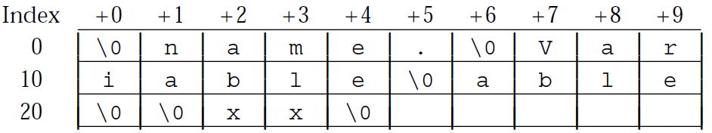
ELF StringTable
The first byte and last byte
  are defined to hold a null character
e_shstrndx
  In the ELF header
  Index to the Section Header Table

Slide 44
Other Sections in the ELF object file
.debug section
  debugging symbol table, local variables and typedefs, global variables, original C source file (gcc -g)
.line:
  Mapping between line numbers in the original C source program and machine code instructions in the .text section.
These sections are for debugging

Slide 45
ELF relocatable object file format
ELF header
.text
.rodata
.data
.bss
.symtab
Sections
.rel.txt
.rel.data
.debug
.line
Describes
object file
Sections
.strtab
Section header table

Slide 46
Sections in the ELF object file
.text section
  code
.rodata section
  Read-only data
.data section
  initialized global and static C variables
  .bss section (“Block Started by Symbol” or “Better Save Space”)
  uninitialized global and static C variables, along with any global or static variables that are initialized to zero
  has section header but occupies no disk space
  at run time, these variables are allocated in memory with initial value zero

