Slide 1
Relocation and Loading

Slide 2
Outline
Relocation
Executable Object Files
Loading
Suggested reading: 7.7, 7.8, 7.9

Slide 3
ELF relocatable object file format
ELF header
.text
.rodata
.data
.bss
.symtab
Sections
.rel.txt
.rel.data
.debug
.line
Describes
object file
Sections
.strtab
Section header table

Slide 4
Relocation
For each reference to an object with unknown location
  Assembler generates a relocation entry
  Relocation entries for code are placed in .rel.text
  Relocation entries for data are placed in .rel.data

Slide 5
Relocation
In main.o
00<main>:
00: 55 push %rbp
01: 48 89 e5 mov %rsp,%rbp
04: b8 00 00 00 00 mov $0x0,%eax
09: e8 00 00 00 00 callq e <main+0xe>
A swap R_X86_64_PC32 -4
0e: b8 00 00 00 00 mov $0x0,%eax
13: 5d pop %rbp
14: c3 retq

Slide 6
Relocation
In swap.o
00<bufp0>:
00: 00 00 00 00 00 00 00 00
0 buf R_X86_64_64 0
00<bufp1>:

Slide 7
Sections in the ELF object file
.rel.text section
  relocation info for .text section
  addresses of instructions that will need to be modified in the executable
.rel.data section
  relocation info for .data section
  addresses of pointer data that will need to be modified in the merged executable

Slide 8
Relocation
Relocation Entry
  typedef struct {
  long offset ;
  long type:32,
  symbol:32 ;
  long addend;
  } Elf64_Rela ;

Slide 9
Relocation
9 e8 00 00 00 00 callq e<main+0xe> swap();
There is a relocation entry in rel.text
offset symbol type addend
a swap R_X86_64_PC32 -4
Why PC32?
  gcc default mode is the X86_64 small code model which assumes that the total size of the code and data in the executable object file is smaller than 2GB and thus can be accessed at run-time using 32-bit PC-relative addresses

Slide 10
Relocation
int *bufp0 = &buf[0] ;
00000000 <bufp0>:
0: 00 00 00 00 00 00 00 00
There is a relocation entry in rel.data
offset symbol type addend
0 buf R_X86_64_64 0

Slide 11
Relocation
Relocation
  Merge the input modules
  Assign runtime address to each symbol
Two steps
  Relocating sections and symbol definitions
  Relocating symbol references within sections

Slide 12
Relocation
9 e8 00 00 00 00 callq e<main+0xe> swap();
a: R_X86_64_PC32 swap relocation entry
r.offest = 0xa
r.symbol = swap
r.type = R_X86_64_PC32
r.addend = -4
ADDR(main)=ADDR(.text) = 0x4004d6
ADDR(swap)=0x4004eb
refaddr = ADDR(main)+r.offset = 0x4004e0
ADDR(r.symbol)=ADDR(swap)=0x4004eb
*refptr = (unsigned) (ADDR(r.symbol) + r.addend – refaddr)
= (unsigned) (0x4004eb + (-4) – 0x4004e0)
= (unsigned) 0x7
PC-relative

Slide 13
Relocation
00000000 <bufp0>:
0: 00 00 00 00 00 00 00 00 int *bufp0 = &buf[0];
0: R_X86_64_64 buf relocation entry
r.offest = 0x0
r.symbol = buf
r.type = R_X86_64_64
r.addend = 0
ADDR(r.symbol) = ADDR(buf) = 0x601030
*refptr = (unsigned) (ADDR(r.symbol)+ r.addend)
= (unsigned) (0x601030)
0x601038 <bufp0>:
0x601038: 30 10 60 00 00 00 00 00

Slide 14
Relocation
foreach section s {
foreach relocation entry r {
refptr = s + r.offset ; /* ptr to reference to be relocated */
/* relocate a PC-relative reference */
if (r.type == R_X86_64_PC32) {
refaddr = ADDR(s) + r.offset ; /* ref’s runtime address */
*refptr=(unsigned) (ADDR(r.symbol)+r.addend–refaddr) ;
}
/* relocate an absolute reference */
if ( r.type == R_X86_64_64 || r.type == R_X86_64_32||…)
*refptr = (unsigned) (ADDR(r.symbol) + r.addend) ;
}
}

Slide 15
Relocation
601030<buf>:
601030: 01 00 00 00 02 00 00 00
601038<bufp0>:
601038: 30 10 60 00 00 00 00 00
601048<bufp1>:

Slide 16
Relocatable Object Files(swap.o)
00<swap>:
00: 55 push %rbp
01: 48 89 e5 mov %rsp,%rbp
04: 48 c7 05 00 00 00 00 movq $0x0,0x0(%rip) get bufp1
7: R_X86_64_PC32 bufp1 -8
0b: 00 00 00 00 get &buf[1]
b: R_X86_64_32S buf +4
0f: 48 8b 05 00 00 00 00 mov 0x0(%rip),%rax get bufp0
12: R_X86_64_PC32 bufp0 -4
16: 8b 00 mov (%rax),%eax
18: 89 45 fc mov %eax,-0x4(%rbp)
1b: 48 8b 05 00 00 00 00 mov 0x0(%rip),%rax get bufp0
1e: R_X86_64_PC32 bufp0 -4

Slide 17
Relocatable Object Files(swap.o)
22: 48 8b 15 00 00 00 00 mov 0x0(%rip),%rdx get bufp1
25: R_X86_64_PC32 bufp1 -4
29: 8b 12 mov (%rdx),%edx
2b: 89 10 mov %edx,(%rax)
2d: 48 8b 05 00 00 00 00 mov 0x0(%rip),%rax get bufp1
30: R_X86_64_PC32 bufp1 -4
34: 8b 55 fc mov -0x4(%rbp),%edx
37: 89 10 mov %edx,(%rax)
39: 90 nop
3a: 5d pop %rbp
3b: c3 retq

Slide 18
Example (Relocation)
.rel.text
7: R_X86_64_PC32 bufp1 -8
b: R_X86_64_32S buf + 4
12: R_X86_64_PC32 bufp0 -4
1e: R_X86_64_PC32 bufp0 -4
25: R_X86_64_PC32 bufp1 -4
30: R_X86_64_PC32 bufp1 -4
ADDR(swap)=0x4004eb ADDR(buf) = 0x601030
ADDR(bufp0)=0x601038 ADDR(bufp1)=0x601048

Slide 19
Executable Object Files
00000000004004eb <swap>:
4004eb: 55 push %rbp
4004ec: 48 89 e5 mov %rsp,%rbp
4004ef: 48 c7 05 4e 0b 20 00 movq $0x601034,0x200b4e(%rip)
4004f6: 34 10 60 00 bufp1= &buf[1]
4004fa: 48 8b 05 37 0b 20 00 mov 0x200b37(%rip),%rax get bufp0
400501: 8b 00 mov (%rax),%eax
400503: 89 45 fc mov %eax,-0x4(%rbp)
400506: 48 8b 05 2b 0b 20 00 mov 0x200b2b(%rip),%rax get bufp0
40050d: 48 8b 15 34 0b 20 00 mov 0x200b34(%rip),%rdx get bufp1
400514: 8b 12 mov (%rdx),%edx
400516: 89 10 mov %edx,(%rax)
400518: 48 8b 05 29 0b 20 00 mov 0x200b29(%rip),%rax get bufp0
40051f: 8b 55 fc mov -0x4(%rbp),%edx
400522: 89 10 mov %edx,(%rax)

Slide 20
Executable Object Files
400524: 90 nop
400525: 5d pop %rbp
400526: c3 retq
601030<buf>:
601030: 01 00 00 00 02 00 00 00
601038<bufp0>:
601038: 30 10 60 00 00 00 00 00
601048<bufp1>:

Slide 21
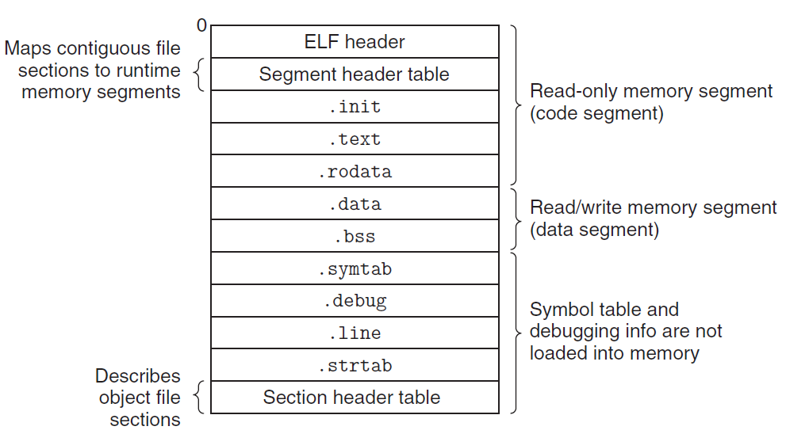
Executable Object Files

Slide 22
ELF Header
typedef struct{
unsigned char e_ident[16]; /* ELF identification */
Elf64_Half e_type; /* Object file type */
Elf64_Half e_machine; /* Machine type */
Elf64_Word e_version; /* Object file version */
Elf64_Addr e_entry; /* Entry point address */
Elf64_Off e_phoff; /* Program header offset */
Elf64_Off e_shoff; /* Section header offset */
Elf64_Word e_flags; /* Processor-specific flags */
Elf64_Half e_ehsize; /* ELF header size */
Elf64_Half e_phentsize; /* Size of program header entry */
Elf64_Half e_phnum; /* Number of program header entries */
Elf64_Half e_shentsize; /* Size of section header entry */
Elf64_Half e_shnum; /* Number of section header entries */
Elf64_Half e_shstrndx; /* Section name string table index */
} Elf64_Ehdr;

Slide 23
Executable Object File Header
ELF header
  Overall information
  Entry point
  Program (Segment) header table information
    Starting point
    Size
    Size of each entry
    Number of entries

Slide 24
Executable Object File Segment Header Table
typedef struct {
Elf64_Word p_type; /* Entry type. */
Elf64_Word p_flags; /* Access permission flags. */
Elf64_Off p_offset; /* File offset of contents. */
Elf64_Addr p_vaddr; /* Virtual address in memory image. */
Elf64_Addr p_paddr; /* Physical address (not used). */
Elf64_Xword p_filesz; /* Size of contents in file. */
Elf64_Xword p_memsz; /* Size of contents in memory. */
Elf64_Xword p_align; /* Alignment in memory and file. */
} Elf64_Phdr;

Slide 25
Executable Object File Segment Header Table
p_type
  PT_LOAD (1): loadable segment
p_offset
  Offset from the beginning of the file to the first byte in the segment
p_vaddr
  The virtual address of the first byte in the segment
p_paddr
  Not very useful

Slide 26
Executable Object File Segment Header Table
p_filesz
  Segment size in the object file (≤p_memsz)
p_memsz
  Segment size in the memory (≥p_filesz)
p_flags
  Run time permissions (rwx)
p_align
  Alignment requirement for the beginning address of the segment
  Usually 2**12 or 2**21(2M)

Slide 27
Executable Object Files

Slide 28
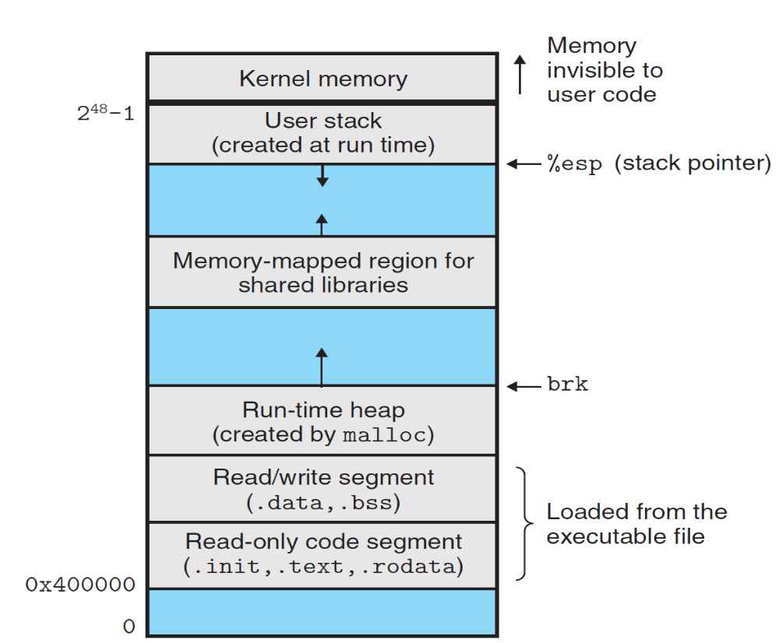
2⁴⁷-1
%rsp

Slide 29
ELF format
Read only code segment
LOAD off 0x0000000000000000 vaddr 0x0000000000400000
paddr 0x0000000000400000 align 2**21
filesz 0x000000000000069c memsz 0x000000000000069c
flags r-x
Read/write data segment
LOAD off 0x0000000000000df8 vaddr 0x0000000000600df8
paddr 0x0000000000000df8 align 2**21
filesz 0x0000000000000228 memsz 0x0000000000000230
flags rw
Difference between filesz and memsz means the uninitialized data in .bss
.init section contains a small function _init called by program’s initialization code

Slide 30
Startup code
_start
  the entry point of the program
  Defined in the crt1.o
  Same for all C program
  Calls
    system startup function
    __libc_start_main
      Defined in libc.so
      Initializes the execution environment
      Calls the main function
      Handles return value
      Returns control to OS (if necessary)

Slide 31
Loading
Unix> ./p
Loader
  Memory-resident operating system code
  Invoked by call the execve function
  Copy the code and data in the executable object file from disk into memory
  Jump to the entry point
  Run the program

