Slide 1
Principles of Pipeline

Slide 2
Outline
General Principles of Pipelining
  Goal
  Difficulties
Suggested Reading 4.4

Slide 3



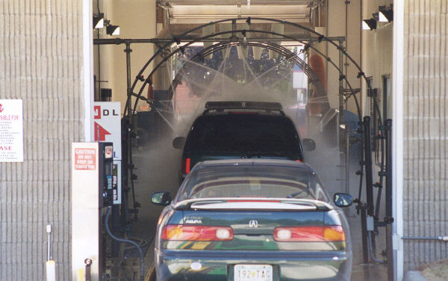
Real-World Pipelines: Car Washes
Sequential
Parallel
Idea
  Divide process into independent stages
  Move objects through stages in sequence
  At any given times, multiple objects being processed
Pipelined

Slide 4
Computational Example
300 ps
20 ps
Combinational
logic
R
e
g
Delay = 320 ps
Throughput = 3.12 GOPS
Clock
System
  Computation requires total of 300 picoseconds
  Additional 20 picoseconds to save result in register
  Must have clock cycle of at least 320 ps
Notes:
Clock Cycle是320ps

Slide 5
3-Way Pipelined Version
100 ps
20 ps
100 ps
20 ps
100 ps
20 ps
Comb.
logic
A
R
e
g
Comb.
logic
B
R
e
g
Comb.
logic
C
R
e
g
Delay = 360 ps
Throughput =
8.33 GOPS
Clock
System
  Divide combinational logic into 3 blocks of 100 ps each
  Can begin new operation as soon as previous one passes through stage A.
    Begin new operation every 120 ps
  Overall latency increases
    360 ps from start to finish
Notes:
Clock Cycle是120ps。
之所以要增加阶段寄存器是因为B要用A的结果，原来B和A执行的是同一条指令，所以内容都是属于同一条指令的。
现在B和A在一个clock cycle里执行的是两条指令的内容，而B所需要的A的内容是上个周期中A产生的。所以必须保留下来给B用。所以要增加阶段间的寄存器。用以存放中间结果。

Slide 6
Pipeline Diagrams
Unpipelined
  Cannot start new operation until previous one completes
3-Way Pipelined
  Up to 3 operations in process simultaneously
OP1
OP2
OP3
Time
OP1
A
B
C
OP2
A
B
C
OP3
A
B
C
Time
Notes:
这就是时空图。
OP表示一条指令。
原来Unpipelined时候一条指令执行完了，才能执行另外一条指令。现在几条指令可以overlap。

Slide 7
I1
A
B
C
I2
A
B
C
I3
A
B
C
Time
120
240
360
Time=239
100 ps
20 ps
100 ps
20 ps
100 ps
20 ps
Comb.
logic
A
R
e
g
Comb.
logic
B
R
e
g
Comb.
logic
C
R
e
g
Clock
Time=241
100 ps
20 ps
100 ps
20 ps
100 ps
20 ps
Comb.
logic
A
R
e
g
Comb.
logic
B
R
e
g
Comb.
logic
C
R
e
g
Clock

Slide 8
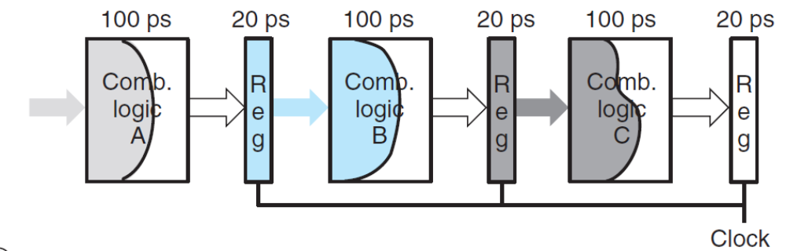
I1
A
B
C
I2
A
B
C
I3
A
B
C
Time
120
240
360
Time=300
Time=359
100 ps
20 ps
100 ps
20 ps
100 ps
20 ps
Comb.
logic
A
R
e
g
Comb.
logic
B
R
e
g
Comb.
logic
C
R
e
g
Clock

Slide 9
Limitations: Nonuniform Delays
50 ps
20 ps
150 ps
20 ps
100 ps
20 ps
Comb.
logic
A
R
e
g
Comb.
logic
B
R
e
g
Comb.
logic
C
R
e
g
Delay = 510 ps
Throughput
= 5.88 GOPS
Clock
OP1
A
B
C
OP2
A
B
C
OP3
A
B
C
Time
Notes:
Clock cycle是170ps

Slide 10
Limitations: Nonuniform Delays
Throughput limited by slowest stage
Other stages sit idle for much of the time
Challenging to partition system into balanced stages

Slide 11
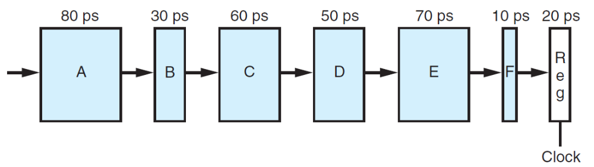
Practice Problem
Creating pipelined versions of this design by inserting pipeline registers between pairs of these blocks.
1. By inserting a single, two, three register(s). Where should the register be inserted to maximize throughput? What would be the throughput and latency?
2. What is the minimum number of stages that would yield a design with the maximum achievable throughput?

Slide 12
Limitations: Register Overhead
50 ps
20 ps
50 ps
20 ps
50 ps
20 ps
50 ps
20 ps
50 ps
20 ps
50 ps
20 ps
Comb.
logic
R
e
g
Comb.
logic
R
e
g
Comb.
logic
R
e
g
Comb.
logic
R
e
g
Comb.
logic
R
e
g
Comb.
logic
R
e
g
Clock
Delay = 420 ps,
Throughput = 14.29 GOPS
Notes:
时钟周期70ps。

Slide 13
Limitations: Register Overhead
As try to deepen pipeline, overhead of loading registers becomes more significant
Percentage of clock cycle spent loading register:
  1-stage pipeline: 6.25%
  3-stage pipeline: 16.67%
  6-stage pipeline: 28.57%
High speeds of modern processor designs obtained through very deep pipelining
Notes:
时钟周期70ps。

Slide 14
Data Dependency
By far, we have considered only systems in which the objects passing through the pipeline—whether cars, people, or instructions—are completely independent of one another.
For a system that executes machine programs such as x86-64 or Y86-64, however, there are potential dependencies between successive instructions
1 irmovq $50, %rax
2 addq %rax , %rbx
3 mrmovq 100(%rbx),%rdx

Slide 15
Data Dependencies
Combinational
logic
R
e
g
Clock
OP1
OP2
OP3
Time
System
  Each operation depends on result from preceding one

Slide 16
Data Hazards
Comb.
logic
A
R
e
g
Comb.
logic
B
R
e
g
Comb.
logic
C
R
e
g
OP1
A
B
C
Clock
OP2
A
B
C
OP3
A
B
C
OP4
A
B
C
Time
In attempting to speed up the system via pipelining, we have changed the system behavior

Slide 17
Control Dependence
  loop:
  subq %rdx, %rbx
  jne targ
  irmovq $10, %rdx
  jmp loop
  targ:
  halt
The jne instruction create a control dependency
  Which instruction will be executed?
Notes:
这种dependency在SEQ和SEQ+中也是不存在的。道理和前面data dependency的道理相通。

Slide 18
Pipeline Implemetation

Slide 19
Outline
SEQ+ Implementations
Naïve PIPE Implementation
Pipeline Feedback
Suggested Reading 4.5.1 ~ 4.5.4

Slide 20
SEQ Hardware vs. SEQ+ Hardware
SEQ Hardware
  Stages occur in sequence
  One operation in process at a time
SEQ+ Hardware
  Still sequential implementation
  Reorder PC stage to put at beginning

Slide 21
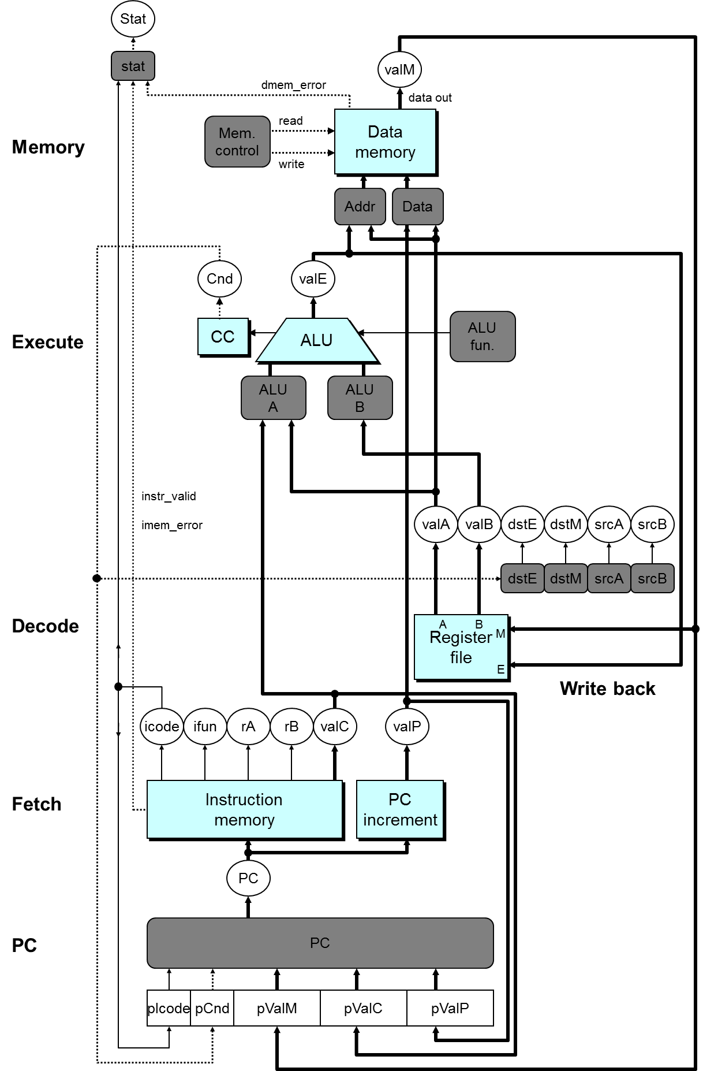

Slide 22
SEQ+ Hardware
PC Stage
  Task is to select PC for current instruction
  Based on results computed by previous instruction
Processor State
  PC is no longer stored in register
  But, can determine PC based on other stored information
Notes:
可能初看上去非常古怪。明明计算下条指令地址PC应该是在本指令快结束时才能进行的。为什么放到了指令的开始呢。
因为我们把计算下条指令地址变成了计算本条指令地址。也就是说算出来的PC(圆圈中的那个)不是下条指令的地址，而是本条指令的地址。
相当于对时序进行切分时向前移动了一点。
在这种情况下，虽然lSA说存在一个PC寄存器。但实际上并不存在这个寄存器。相反，存在其他几个寄存器pIcode, pBch, pValM, pValC, pValP。（但程序员不可见）
另外，这种变换也没有引起问题。例如相对跳转(PC-relative寻址)(虽然Y86不存在这种寻址方式)，这种寻址方式实际上是在Execute阶段将valP的值+偏移量。所以没有使用PC的值，即使用了在Fetch之前新的PC也已经有了，所以对于其后的各个阶段来说PC和SEQ中的是一样的。
这种变换的主要目的是要说明ISA和实现之间并不需要一一对应，只要语义一致就可以了。
这种变换也方便了我们下面要实现的PIPE。因为PIPE的地址预测是在fetch阶段就做的。

Slide 23
PC Computation
int pc= [
picode == ICALL : pValC;
picode == IJXX && pCnd : pValC;
picode == IRET : pValM;
1 : pValP;
];

Slide 25
Pipeline Stages
Fetch
  Select current PC
  Read instruction
  Compute incremented PC
Decode
  Read program registers
Execute
  Operate ALU
Memory
  Read or write data memory
Write Back
  Update register file
Notes:
我们希望能够设计一个每条指令只用一个周期完成的Pipleline CPU

Slide 26
PIPE- Hardware
Pipeline registers hold intermediate values from instruction execution
Notes:
整个硬件框图。实际上大部分内容与SEQ+相比，是相当类似或者说相同的。
变化有：
信号的重新组织与命名。在原有输入信号前面加上流水线寄存器名称（大写）以区分各自用到的信号。因为例如icode就在Decode、Execute、Memory和Write back阶段都存在，而且这些信号的内容还不同(因为属于不同的指令)，所以用流水线寄存器来加以区分。D_icode, E_icode, M_icode, and W_icode.
如果这些信号是某一阶段产生的，则以小写字母作前缀。例如valE是由Execute阶段产生的，所以在Execute阶段，他的名字叫e_valE.
2. 在Fetch阶段增加了Predict PC部件来预测下一条指令的地址。
3. 将valP和valA在Decode阶段合并为一个信号，所以多了一个Select A部件。书上P321。主要用处是减少控制信号和寄存器的数目。因为只有call指令会在memory阶段用到valP，
只有jump指令会在execute阶段用到valP。这两种指令都不需要用到寄存器A。所以我们可以将这两个控制信号合并。这样，SEQ中的data部件就不需要了。
因为在Fetch阶段本身就有Predict PC部件。这样valP在其他场合也不需要传播到Fetch阶段之外的场合去。

Slide 27
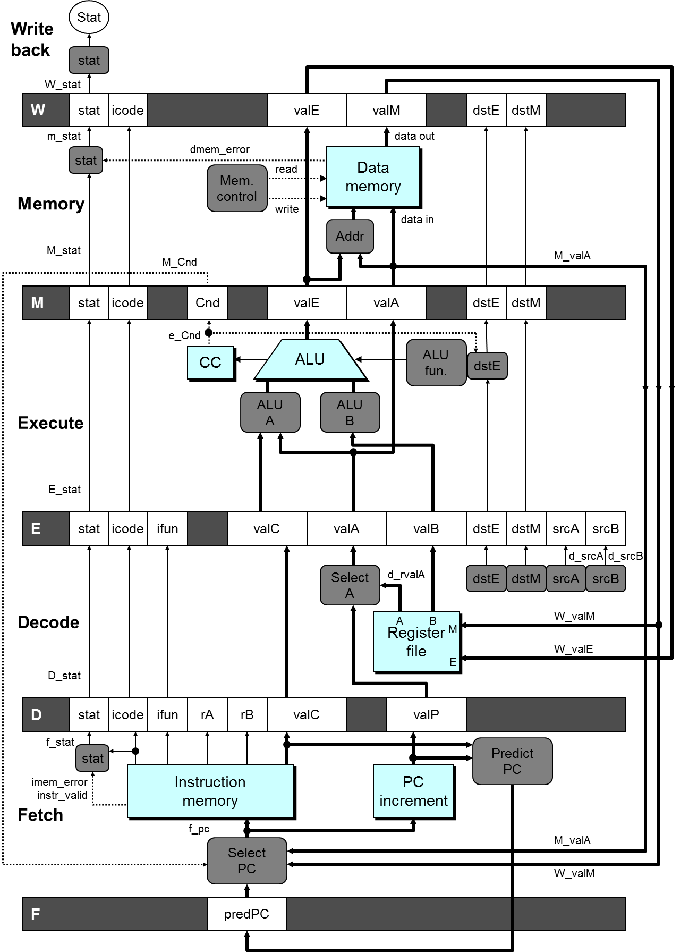

Slide 28
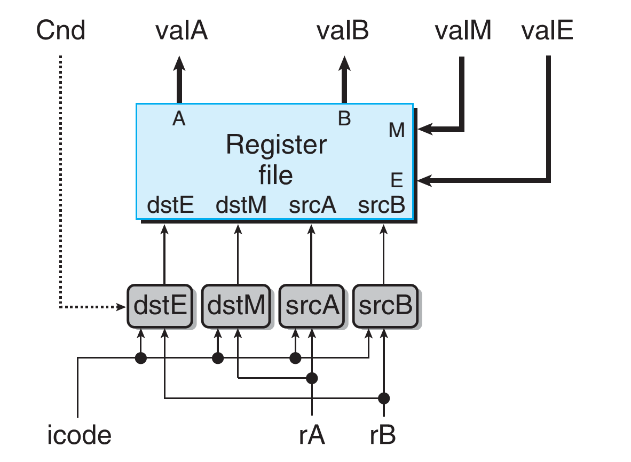
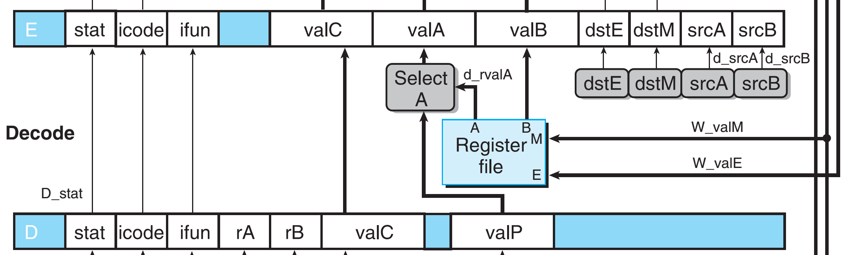
Generate Signals

Slide 29
Generate Signals
#code from SEQ
int srcA = [
icode in {IRRMOVL, IRMMOVL,
IOPL, IPUSHL} : rA;
icode in {IPOPL, IRET} : RRSP;
1: RNONE; #Don’t need register
];
#code from PIPE
int d_srcA = [
D_icode in {IRRMOVL, IRMMOVL,
IOPL, IPUSHL} : D_rA;
D_icode in {IPOPL, IRET} : RRSP;
1: RNONE; #Don’t need register
];

Slide 30
PIPE- Hardware
Forward (Upward) Paths
  Values passed from one stage to next
  Cannot jump past stages
    e.g., valC passes through decode
Notes:
整个硬件框图。实际上大部分内容与SEQ+相比，是相当类似或者说相同的。
变化有：
信号的重新组织与命名。在原有输入信号前面加上流水线寄存器名称（大写）以区分各自用到的信号。因为例如icode就在Decode、Execute、Memory和Write back阶段都存在，而且这些信号的内容还不同(因为属于不同的指令)，所以用流水线寄存器来加以区分。D_icode, E_icode, M_icode, and W_icode.
如果这些信号是某一阶段产生的，则以小写字母作前缀。例如valE是由Execute阶段产生的，所以在Execute阶段，他的名字叫e_valE.
2. 在Fetch阶段增加了Predict PC部件来预测下一条指令的地址。
3. 将valP和valA在Decode阶段合并为一个信号，所以多了一个Select A部件。书上P321。主要用处是减少控制信号和寄存器的数目。因为只有call指令会在memory阶段用到valP，
只有jump指令会在execute阶段用到valP。这两种指令都不需要用到寄存器A。所以我们可以将这两个控制信号合并。这样，SEQ中的data部件就不需要了。
因为在Fetch阶段本身就有Predict PC部件。这样valP在其他场合也不需要传播到Fetch阶段之外的场合去。

Slide 31
Notes:
整个硬件框图。实际上大部分内容与SEQ+相比，是相当类似或者说相同的。
变化有：
信号的重新组织与命名。在原有输入信号前面加上流水线寄存器名称（大写）以区分各自用到的信号。因为例如icode就在Decode、Execute、Memory和Write back阶段都存在，而且这些信号的内容还不同(因为属于不同的指令)，所以用流水线寄存器来加以区分。D_icode, E_icode, M_icode, and W_icode.
如果这些信号是某一阶段产生的，则以小写字母作前缀。例如valE是由Execute阶段产生的，所以在Execute阶段，他的名字叫e_valE.
2. 在Fetch阶段增加了Predict PC部件来预测下一条指令的地址。
3. 将valP和valA在Decode阶段合并为一个信号，所以多了一个Select A部件。书上P321。主要用处是减少控制信号和寄存器的数目。因为只有call指令会在memory阶段用到valP，
只有jump指令会在execute阶段用到valP。这两种指令都不需要用到寄存器A。所以我们可以将这两个控制信号合并。这样，SEQ中的data部件就不需要了。
因为在Fetch阶段本身就有Predict PC部件。这样valP在其他场合也不需要传播到Fetch阶段之外的场合去。

Slide 32
Feedback Paths (Hazards)
PC Updates
  Determine the value of next PC
    Next Instruction for most cases (valP)
    Call destination (valC)
    Branch information
      Jump taken/ Fall-through (not-taken)
    Return point
      Read from memory
Register updates
    To register file write ports

Slide 34
Predicting the PC
Start fetch of new instruction after current one has completed fetch stage
  Not enough time to reliably determine next instruction
Guess which instruction will follow
  Recover if prediction was incorrect

Slide 35
Our Prediction Strategy
Instructions that Don’t Transfer Control
  Predict next PC to be valP
  Always reliable
Call and Unconditional Jumps
  Predict next PC to be valC (destination)
  Always reliable

Slide 36
Our Prediction Strategy
Conditional Jumps
  Predict next PC to be valC (destination)
  Only correct if branch is taken
    Typically right 60% of time
    Recovery: M_Cnd and M_valA (valP: next PC)
Return Instruction
  Don’t try to predict

Slide 37
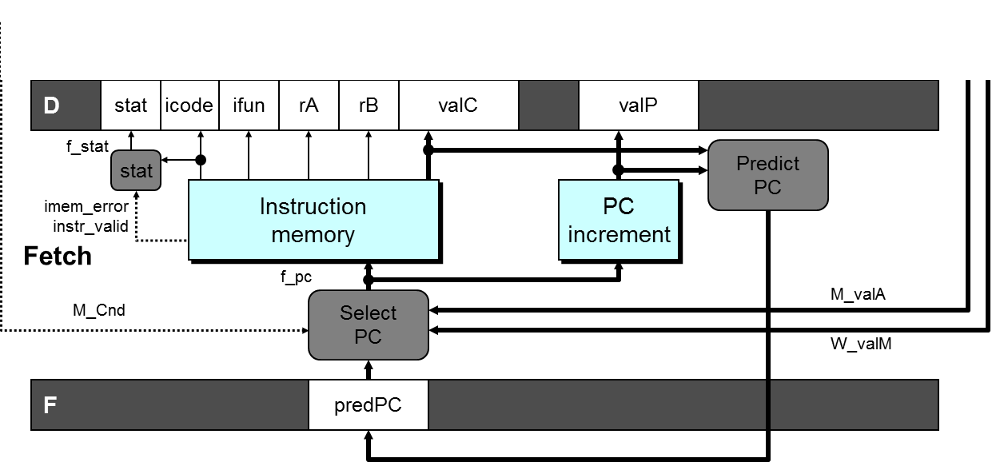
Select PC
Int F_predPC = [
f_icode in {IJXX, ICALL} : f_valC;
1: f_valP;
];

Slide 38
Recovering from PC Misprediction
Mispredicted Jump
  Will see branch flag once instruction reaches Memory stage
  Can get fall-through PC from valA (valP)
Return Instruction
  Will get return PC when ret reaches write-back stage

Slide 39
Recovering the PC
M_valP
M_icode

Slide 40
Recovering the PC
W_icode

Slide 41
Select PC
int f_PC = [
#mispredicted branch. Fetch at incremented PC
M_icode == IJXX && !M_Cnd : M_valA;
#completion of RET instruciton
W_icode == IRET : W_valM;
#default: Use predicted value of PC
1: F_predPC
];

Slide 42
Pipeline Demonstration
1
2
3
4
5
6
7
8
9
irmovq $1,%rax #I1
irmovq $2,%rcx #I2
irmovq $3,%rdx #I3
irmovq $4,%rbx #I4
halt #I5
F
D
E
M
W
F
D
E
M
W
F
D
E
M
W
F
D
E
M
W
F
D
E
M
W
Cycle 5
W
I1
M
I2
E
I3
D
I4
F
I5

