Slide 1
Outline
PIPE Stages Implementations
Suggested Reading 4.5.7

Slide 2
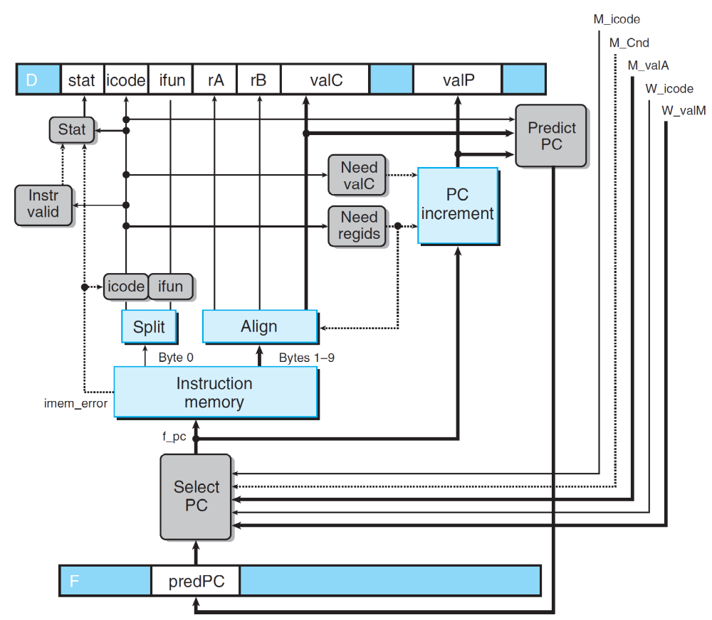
Fetch
Notes:
因为原来valA是通过选择Select valP和srcA对应的值来的。现在srcA对应的值通过forward模块进行选择到底从那里得到。所以valA必须经过select和forward两个模块。所以简写为
Sel+Fwd A.

Slide 3
Fetch
int F_predPC = [
f_icode in {IJXX, ICALL} : f_valC;
1: f_valP;
];
int f_PC = [
M_icode == IJXX && !M_Cnd : M_valA;
W_icode == IRET : W_valM;
1: F_predPC
];
int f_stat = [
imem_error: SADR;
!instr_valid: SINS;
f_icode == IHALT: SHLT;
1: SAOK;
];
Notes:
注意：五个forward条件之间的顺序不能更换。
因为首先在pipeline中阶段越前的指令越靠近目标指令，所以如果两个不同阶段的指令写同一个寄存器，显然应该保留阶段较前的那个。
其次，同一阶段dstE可能和dstM相同，这发生在 popq %rsp上。根据语义，%rsp的内容应该是内存的值，而不是计算得到的值。

Slide 4
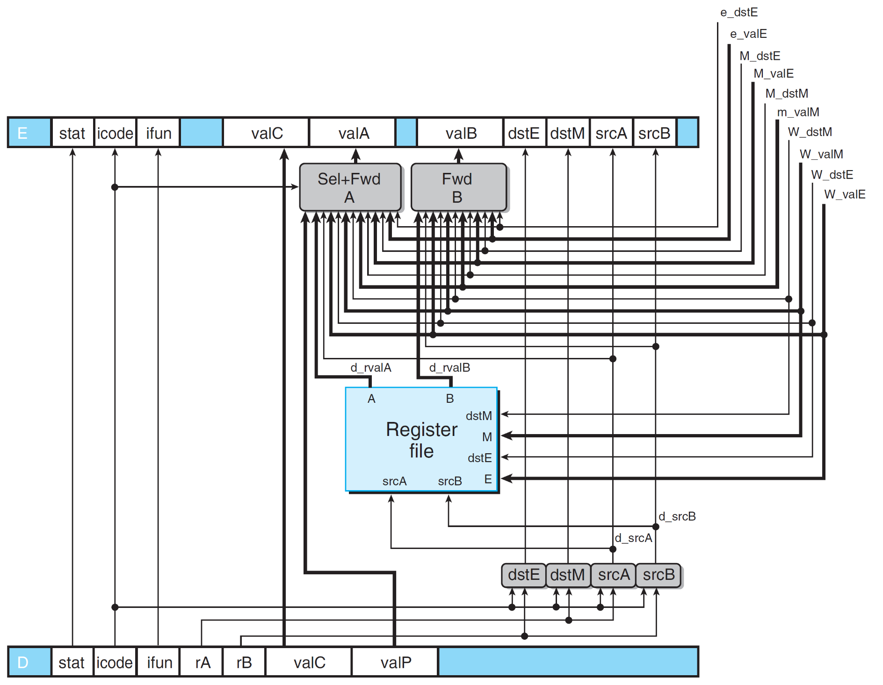
Decode & Write back
Notes:
因为原来valA是通过选择Select valP和srcA对应的值来的。现在srcA对应的值通过forward模块进行选择到底从那里得到。所以valA必须经过select和forward两个模块。所以简写为
Sel+Fwd A.

Slide 5
Decode & Write back
dstE
W
icode
valE
valM
dstM
Mem
read
m_valM
.
Data Memory
Memory
control
write
M_Cnd
Addr
data in
M_valA
M
icode
Cnd
valE
valA
dstE
dstM
e_Cnd
e_valE
CC
ALU
ALU fun
ALUA
ALUB
Execute
valC
srcA
E
icode
srcB
ifun
valA
valB
dstE
dstM
d_rvalA
d_srcA
d_srcB
Select A
srcA
dstM
srcB
dstE
A
B
Decode
M
W_valM
E
Register File
W_valE
D
icode
valC
valP
ifun
rA
rB
Predict PC
Instruction Memory
PC
Instruction
PC
increment
Fetch
f_PC
M_valA
Select PC
W_valM
F
predPC

Slide 6
Implementing Forwarding
## What should be the A value?
int d_valA = [
# Use incremented PC
D_icode in { ICALL, IJXX } : D_valP;
# Forward valE from execute
d_srcA == E_dstE : e_valE;
# Forward valM from memory
d_srcA == M_dstM : m_valM;
# Forward valE from memory
d_srcA == M_dstE : M_valE;
# Forward valM from write back
d_srcA == W_dstM : W_valM;
# Forward valE from write back
d_srcA == W_dstE : W_valE;
# Use value read from register file
1 : d_rvalA;
];
Notes:
注意：五个forward条件之间的顺序不能更换。
因为首先在pipeline中阶段越前的指令越靠近目标指令，所以如果两个不同阶段的指令写同一个寄存器，显然应该保留阶段较前的那个。
其次，同一阶段dstE可能和dstM相同，这发生在 popq %rsp上。根据语义，%rsp的内容应该是内存的值，而不是计算得到的值。

Slide 7
The Order Matters
1
2
3
4
5
6
7
8
F
D
E
M
W
# demo.ys
0x000:irmovq $10,%rdx
0x00a:irmovq $3,%rdx
0x014:rrmove %rdx,%rax
0x016:halt
F
D
E
M
W
F
D
E
M
W
F
D
E
M
W
Cycle 4
Memory
W_dstE=%rdx
W_valE=10
## What should be the A value?
int d_valA = [
# Use incremented PC
D_icode in { ICALL, IJXX } : D_valP;
# Forward valE from execute
d_srcA == E_dstE : e_valE;
# Forward valM from memory
d_srcA == M_dstM : m_valM;
# Forward valE from memory
d_srcA == M_dstE : M_valE;
# Forward valM from write back
d_srcA == W_dstM : W_valM;
# Forward valE from write back
d_srcA == W_dstE : W_valE;
# Use value read from register file
1 : d_rvalA;
];
Execute
x
W_dstE=%rdx
W_valE=3
•
•
•
•
Decode
srcA=%rdx
valA
Notes:
因为读和写寄存器都发生在Cycle 6的末尾，两者基本上同时发生，读稍微要早那么一点点，因为写有延迟。

Slide 8
The Order does Matter
## What should be the A value?
int d_valA = [
# Use incremented PC
D_icode in { ICALL, IJXX } : D_valP;
# Forward valE from execute
d_srcA == E_dstE : e_valE;
# Forward valE from memory
d_srcA == M_dstE : M_valE;
# Forward valM from memory
d_srcA == M_dstM : m_valM;
# Forward valM from write back
d_srcA == W_dstM : W_valM;
# Forward valE from write back
d_srcA == W_dstE : W_valE;
# Use value read from register file
1 : d_rvalA;
];
We reversed the order as the left.
Describe the resulting behavior of the last instruction
irmovq $5, %rdx
irmovq $0x100, %rdx
rmmovq %rdx, 0(%rsp)
popq %rsp
rrmovq %rsp, %rax
Notes:
注意：五个forward条件之间的顺序不能更换。
因为首先在pipeline中阶段越前的指令越靠近目标指令，所以如果两个不同阶段的指令写同一个寄存器，显然应该保留阶段较前的那个。
其次，同一阶段dstE可能和dstM相同，这发生在 popq %rsp上。根据语义，%rsp的内容应该是内存的值，而不是计算得到的值。

Slide 9
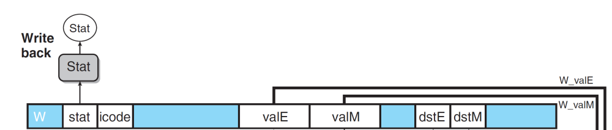
Write Back
int Stat = [
# SBUB in earlier stages indicates bubble
W_stat == SBUB : SAOK;
1 : W_stat;
];
Notes:
注意：五个forward条件之间的顺序不能更换。
因为首先在pipeline中阶段越前的指令越靠近目标指令，所以如果两个不同阶段的指令写同一个寄存器，显然应该保留阶段较前的那个。
其次，同一阶段dstE可能和dstM相同，这发生在 popq %rsp上。根据语义，%rsp的内容应该是内存的值，而不是计算得到的值。

Slide 10
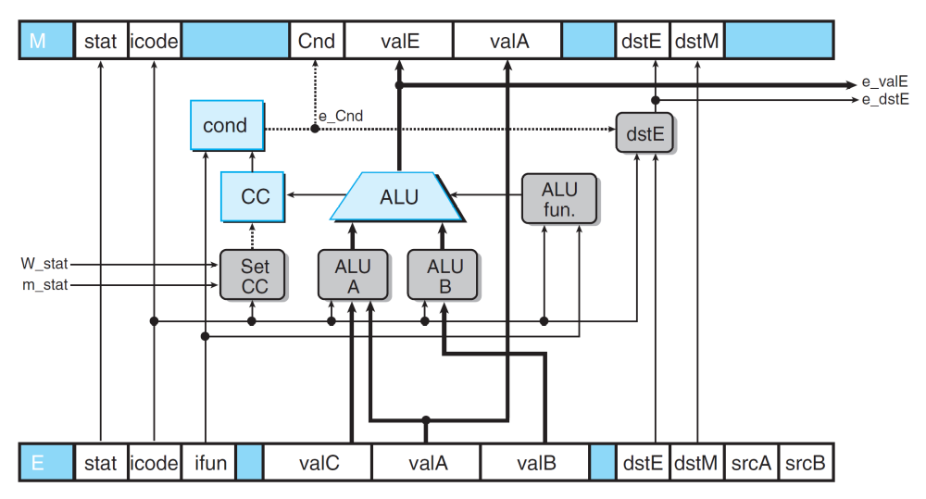
Execute
# Should the condition codes be updated?
bool set_cc = (E_icode == IOPL)
# State changes only during normal operation
&& !m_stat in { SADR, SINS, SHLT }
&& !W_stat in { SADR, SINS, SHLT };
Notes:
因为原来valA是通过选择Select valP和srcA对应的值来的。现在srcA对应的值通过forward模块进行选择到底从那里得到。所以valA必须经过select和forward两个模块。所以简写为
Sel+Fwd A.

Slide 11
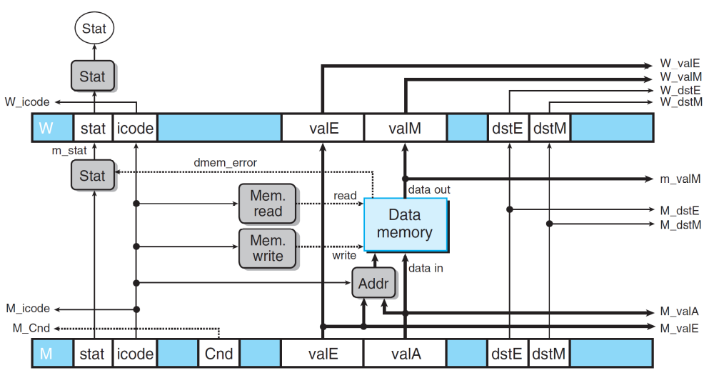
Memory
int m_stat = [
dmem_error : SADR;
1 : M_stat;
];
Notes:
因为原来valA是通过选择Select valP和srcA对应的值来的。现在srcA对应的值通过forward模块进行选择到底从那里得到。所以valA必须经过select和forward两个模块。所以简写为
Sel+Fwd A.

Slide 12
Outline
Pipeline Control Logic
Suggested Reading 4.5.8

Slide 13
Example of Load/Use Hazard
#demo-luh.ys
0x000: irmovq $128, %rdx
0x00a: irmovq $3, %rcx
0x014: rmmovq %ecx, 0(%rdx)
0x01e: irmovq $10, %rbx
#Load %rax
0x028: mrmovq 0(%rdx), %rax
#Use %rax
0x032: addq %rbx, %rax
0x034: halt
Notes:
在最后一个stall之后，必须有一个bubble，不然原来的指令还是会被组合电路传递到下一个阶段去，这样一条指令就执行了两次。

Slide 14
Detecting Load/Use Hazard
Condition | Trigger
Load/Use Hazard | E_icode in { IMRMOVQ, IPOPQ } && E_dstM in { d_srcA, d_srcB }
e_Bch
e_
ALU
ALU
valE
CC
ALU
CC
fun.
ALU
ALU
Execute
A
B
E
icode
ifun
valC
valA
valB
dstE
dstM
srcA
srcB
d_srcA
d_srcB
dstE
dstM
srcA
srcB
Sel
Fwd
+Fwd
A
B
W_
Decode
valM
A
M
B
Register
Register
W_
file
valE
file
E
D
icode
ifun
rA
rB
valC
valP
Notes:
这里必须判断E_icode，而前面的d_valA的HCL中不需要严格判断icode
如果冲突的指令没有实际写寄存器，那么dstM和dstE就应该是F，如果这是==说明d_rA也是F（F==F），当前decode阶段的指令不需要使用d_valA，也就无所谓设置成什么值了。
但这里trigger成立的话会插入bubble，所以必须进行严格的判断，不允许F==F的情况下插入bubble

Slide 15
Control for Load/Use Hazard
1
2
3
4
5
6
7
8
9
10
11
12
F
F
D
D
E
E
M
M
W
W
#demo-luh.ys
0x000: irmovq $128, %rdx
0x00a: irmovq $3, %rcx
0x014: rmmovq %ecx, 0(%rdx)
0x01e: irmovq $10, %rbx
#Load %rax
0x028: mrmovq 0(%rdx), %rax
#Use %rax
0x032: addq %rbx, %rax
0x034: halt
Stall instructions in fetch and decode stages
Inject bubble into execute stage
F
F
D
D
E
E
M
M
W
W
F
F
D
D
E
E
M
M
W
W
F
F
D
D
E
E
M
M
W
W
F
F
F
D
D
D
E
E
E
M
M
M
W
W
W
E
M
W
F
D
D
E
M
W
F
F
D
E
M
W
Condition | F | D | E | M | W
Load/Use Hazard | stall | stall | bubble | normal | normal
Notes:
在最后一个stall之后，必须有一个bubble，不然原来的指令还是会被组合电路传递到下一个阶段去，这样一条指令就执行了两次。

Slide 16
Pipeline Register Modes
Input = y
Output = x
Normal
x
x
stall
bubble
= 0
= 0
Rising
Rising

clock

Output = y
clock
y
y
Notes:
上图中的stall信号和bubble信号正是作用于这种特殊的寄存器才能起作用。
Bubble和stall同时为1是不允许的。

Slide 17
Pipeline Register Modes
Input = y
Output = x
Stall
x
x
stall
bubble
= 1
= 0
Rising
Rising

clock

Output = x
clock
x
x
Notes:
上图中的stall信号和bubble信号正是作用于这种特殊的寄存器才能起作用。
Bubble和stall同时为1是不允许的。

Slide 18
Pipeline Register Modes
Input = y
Output = x
Bubble
x
x
stall
bubble
= 0
= 1
Rising
Rising

clock

Output =
nop
clock
n
o
p
Notes:
上图中的stall信号和bubble信号正是作用于这种特殊的寄存器才能起作用。
Bubble和stall同时为1是不允许的。

Slide 19
Implementing Pipeline Control
Combinational logic generates pipeline control signals
Action occurs at start of following cycle

Slide 20
W
icode
valE
valM
dstE
dstM
M
icode
Cnd
valE
valA
dstE
dstM
E_
dstM
E_
icode
Pipe
E_bubble
E
icode
ifun
valC
valA
valB
dstE
control
dstM
d_
logic
srcB
d_
srcA
srcB
srcA
D_stall
D
icode
ifun
rA
rB
valC
valP
F_stall
F
predPC

Slide 21
Detecting Mispredicted Branch
M
icode
Cnd
dstE
valE
valA
dstM
e_Cnd
ALU
ALU
CC
ALU
CC
fun.
ALU
ALU
Execute
A
B
E
dstM
icode
srcA
srcB
ifun
valC
valA
valB
dstE
Condition | Trigger
Mispredicted Branch | E_icode = IJXX & !e_Cnd

Slide 22
Control for Misprediction
#demo-j.ys
1: 0x000: xorq %rax, %rax
2: 0x002: jne T #Not Taken
3: 0x016: irmovq $2, %rdx # T
4: bubble
5: 0x020: irmovq $3, %rbx # T+1
6: bubble
7: 0x00b: irmovq $1, %rax # Fall through
8: 0x015: halt
1
2
3
4
5
6
7
8
9
10
F
F
D
D
E
E
M
M
W
W
F
F
D
D
E
E
M
M
W
W
F
D
E
M
W
F
D
E
M
W
F
F
D
D
E
E
M
M
W
W
F
F
D
D
E
E
M
M
W
W
Condition | F | D | E | M | W
Mispredicted Branch | normal | bubble | bubble | normal | normal
Notes:
只是简单的取消已经进入流水线的两条指令（通过在execute和decode阶段插入bubble的方法，这就把这两条指令替换掉了）

Slide 23
W
icode
valE
valM
dstE
dstM
M
icode
Bch
valE
valA
dstE
dstM
e_Cnd
CC
CC
E_
icode
Pipe
E_bubble
E
icode
ifun
valC
valA
valB
dstE
dstM
srcA
control
srcB
logic
D_bubble
D
icode
ifun
rA
rB
valC
valP
F
predPC

Slide 24
Detecting Return
M
icode
Cnd
valE
valA
dstE
dstM
e_Cnd
ALU
ALU
CC
ALU
CC
fun.
ALU
ALU
Execute
A
B
E
icode
ifun
valC
valA
valB
dstE
dstM
d_
srcA
d_
srcB
dstE
dstM
srcA
srcB
Sel
Fwd
+Fwd
A
B
Decode
A
M
B
Register
Register
file
file
E
D
icode
ifun
rA
rB
valC
valP
Notes:
因为原来valA是通过选择Select valP和srcA对应的值来的。现在srcA对应的值通过forward模块进行选择到底从那里得到。所以valA必须经过select和forward两个模块。所以简写为
Sel+Fwd A.

Slide 25
Control for Return
Condition | Trigger
Processing ret | IRET in { D_icode, E_icode, M_icode }
1
2
3
4
5
6
7
8
9
#demo_retb
0x02a: ret
0x02b: irmovq $1, %rax
bubble
0x02b: irmovq $1, %rax
bubble
0x02b: irmovq $1, %rax
bubble
0x013: irmovq $5, %rsi #return
F
D
E
M
W
F
D
E
M
W
F
D
E
M
W
F
D
E
M
W
F
F
D
D
E
E
M
M
W
W
Condition | F | D | E | M | W
Processing ret | stall | bubble | normal | normal | normal
Notes:
通过让fetch stall,就使得fetch总是在fetch ret之后的一条指令，但因为向D中插入bubble，所以这条指令也不被执行。

Slide 26
W
icode
valE
valM
dstE
dstM
M_
icode
M
icode
Cnd
valE
valA
dstE
dstM
E_
icode
Pipe
E
icode
ifun
valC
valA
valB
dstE
dstM
srcA
control
srcB
logic
D_
icode
D_bubble
D
icode
ifun
rA
rB
valC
valP
F_stall
F
predPC

Slide 27
Control Cases
Detection
Condition | Trigger
Processing ret | IRET in { D_icode, E_icode, M_icode }
Load/Use Hazard | E_icode in { IMRMOVL, IPOPL } && E_dstM in { d_srcA, d_srcB }
Mispredicted Branch | E_icode = IJXX & !e_Cnd
Action
Condition | F | D | E | M | W
Processing ret | stall | bubble | normal | normal | normal
Load/Use Hazard | stall | stall | bubble | normal | normal
Mispredicted Branch | normal | bubble | bubble | normal | normal

Slide 28
W
icode
valE
valM
dstE
dstM
M_
icode
M
icode
Cnd
valE
valA
dstE
dstM
e_Cnd
CC
CC
E_
dstM
E_
icode
Pipe
E_bubble
E
icode
ifun
valC
valA
valB
dstE
control
dstM
d_
logic
srcB
d_
srcA
srcB
D_
icode
srcA
D_bubble
D
icode
ifun
rA
rB
valC
valP
D_stall
F_stall
F
predPC

Slide 29
Initial Version of Pipeline Control
bool F_stall =
# Conditions for a load/use hazard
E_icode in { IMRMOVL, IPOPL } &&
E_dstM in { d_srcA, d_srcB } ||
# Stalling at fetch
while ret passes through pipeline
IRET in { D_icode, E_icode, M_icode };
bool D_stall =
# Conditions for a load/use hazard
E_icode in { IMRMOVL, IPOPL } &&
E_dstM in { d_srcA, d_srcB };

Slide 30
Initial Version of Pipeline Control
bool D_bubble =
# Mispredicted branch
(E_icode == IJXX && !e_Bch) ||
# Stalling at fetch
while ret passes through pipeline
IRET in { D_icode, E_icode, M_icode };
bool E_bubble =
# Mispredicted branch
(E_icode == IJXX && !e_Bch) ||
# Load/use hazard
E_icode in { IMRMOVL, IPOPL } &&
E_dstM in { d_srcA, d_srcB};

Slide 31
Control Combinations
1
1
1
2
2
2
3
3
Load/use
Mispredict
3
Mispredict
ret
ret
ret
ret
ret
ret
ret
ret
ret
ret
ret
M
M
ret
M
M
M
M
M
M
M
M
M
M
Load
bubble
bubble
JXX
bubble
JXX
ret
ret
E
E
ret
E
E
E
E
E
E
E
E
E
E
Use
bubble
bubble
bubble
bubble
bubble
ret
bubble
ret
D
D
ret
D
D
D
D
D
D
D
D
D
D
Combination A
Combination B
  Special cases that can arise on same clock cycle
Combination A
  Not-taken branch
  ret instruction at branch target
Combination B
  Instruction that reads from memory to %rsp
  Followed by ret instruction
Notes:
对于ret2，当decode一条ret时，自动会在D中插入bubble,这样当下一cycle时，decode stage中只可能是bubble.

Slide 32
Control Combination A
PC
Instruction
PC
PC
1
memory
increment
1
Mispredict
1
Mispredict
ret
ret
ret
memory
M
M
f_PC
M
M
M
Fetch
M_
valA
JXX
Select
E
JXX
E
E
E
E
PC
W_
ret
valM
ret
D
ret
D
D
D
D
Combination A
F
predPC
Condition | F | D | E | M | W
Processing ret | stall | bubble | normal | normal | normal
Mispredicted Branch | normal | bubble | bubble | normal | normal
Combination | stall | bubble | bubble | normal | normal

Slide 33
Control Combination A
Condition | F | D | E | M | W
Processing ret | stall | bubble | normal | normal | normal
Mispredicted Branch | normal | bubble | bubble | normal | normal
Combination | stall | bubble | bubble | normal | normal
Should handle as mispredicted branch
  Still stalls F pipeline register
  But PC selection logic will be using M_valA anyhow

Slide 34
Control Combination B
Load/use
ret
M
M
M
M
E
Load
E
E
E
Use
ret
ret
D
D
ret
D
D
Combination B
Condition | F | D | E | M | W
Processing ret | stall | bubble | normal | normal | normal
Load/Use Hazard | stall | stall | bubble | normal | normal
Combination | stall | bubble + stall | bubble | normal | normal
Would attempt to bubble and stall pipeline register D
Signaled by processor as pipeline error
Notes:
Ret在D中插入bubble的前提是他自己往前走，而让decode空操作。但现在因为load/use要求ret不能往前走(stall)，这样也就不需要在D中插入bubble.

Slide 35
Handling Control Combination B
Condition | F | D | E | M | W
Processing ret | stall | bubble | normal | normal | normal
Load/Use Hazard | stall | stall | bubble | normal | normal
Combination | stall | stall | bubble | normal | normal
Load/use hazard should get priority
ret instruction should be held in decode stage for additional cycle

Slide 36
Corrected Pipeline Control Logic
bool D_bubble =
# Mispredicted branch
(E_icode == IJXX && !e_Cnd) ||
# Stalling at fetch
while ret passes through pipeline
IRET in { D_icode, E_icode, M_icode }
# but not condition for a load/use hazard
&& !(E_icode in { IMRMOVL, IPOPL }
&& E_dstM in { d_srcA, d_srcB });
Condition | F | D | E | M | W
Processing ret | stall | bubble | normal | normal | normal
Load/Use Hazard | stall | stall | bubble | normal | normal
Combination | stall | stall | bubble | normal | normal
Notes:
书上P352有错，请更正。

Slide 37
Control Combinations
Must analyze carefully
First version had subtle bug
  Only arises with unusual instruction combination

Slide 38
W_stall
W
stat
icode
valE
valM
dstE
dstM
m_stat
stat
dmem_error
M_bubble
M
stat
icode
Cnd
valE
valA
dstE
dstM
Pipe
control
# Start injecting bubbles as soon as exception passes through memory stage
bool M_bubble = m_stat in { SADR, SINS, SHLT }
|| W_stat in { SADR, SINS, SHLT };
# Stall pipeline register W when exception encountered
bool W_stall = W_stat in { SADR, SINS, SHLT };
E
stat
icode
ifun
valC
valA
valB
dstE
dstM
srcA
srcB
logic
D
stat
icode
ifun
rA
rB
valC
valP

Slide 39
Outline
Performance Analysis
Suggested Reading 4.5.9

Slide 40
Performance Metrics
Clock rate
  Measured in Gigahertz
  Function of stage partitioning and circuit design
    Keep amount of work per stage small
Rate at which instructions executed
  CPI: cycles per instruction
  On average, how many clock cycles does each instruction require?
  Function of pipeline design and benchmark programs
    E.g., how frequently are branches mispredicted?
Notes:
Stage设计的基本原则：每个stage的工作量尽可能少。Stage的大小尽可能平均。

Slide 41
CPI for PIPE
CPI ≈ 1.0
  Fetch instruction each clock cycle
  Effectively process new instruction almost every cycle (throughput)
  Although each individual instruction has latency of 5 cycles (latency)
CPI > 1.0
  Sometimes must stall or cancel branches
Notes:
我们的设计目标是CPI=1

Slide 42
CPI for PIPE
Computing CPI
  C: clock cycles
  I: instructions executed to completion
  B: bubbles injected (C = I + B)
  CPI = C/I = (I+B)/I = 1.0 + B/I
  Factor B/I represents average penalty due to bubbles
Notes:
我们的设计目标是CPI=1

Slide 43
CPI for PIPE (Cont.)
LP: Penalty due to load/use hazard stalling
  Fraction of instructions that are loads 0.25
  Fraction of load instructions requiring stall 0.20
  Number of bubbles injected each time 1
  ⇒ LP = 0.25 * 0.20 * 1 = 0.05
MP: Penalty due to mispredicted branches
  Fraction of instructions that are cond. jumps 0.20
  Fraction of cond. jumps mispredicted 0.40
  Number of bubbles injected each time 2
  ⇒ MP = 0.20 * 0.40 * 2 = 0.16
Typical Values
Notes:
要减少CPI，关键是MP。因为它占了最大的比重。

Slide 44
CPI for PIPE (Cont.)
RP: Penalty due to ret instructions
  Fraction of instructions that are returns 0.02
  Number of bubbles injected each time 3
  RP = 0.02 * 3 = 0.06
Net effect of penalties 0.05 + 0.16 + 0.06 = 0.27
  CPI = 1.27 (Not bad!)
  B/I = LP + MP + RP
Typical Values
Notes:
要减少CPI，关键是MP。因为它占了最大的比重。

Slide 45
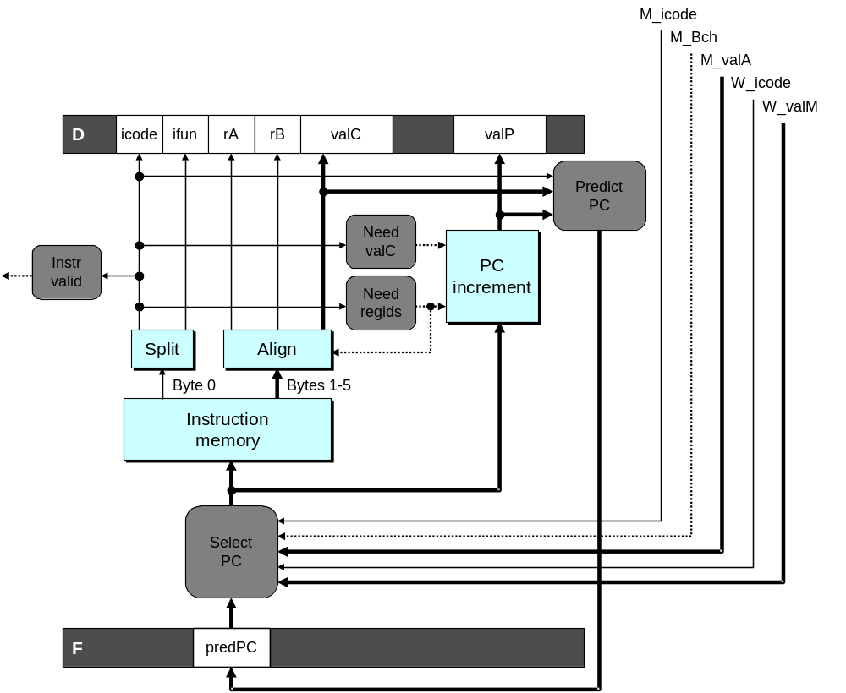
Fetch Logic Revisited
During Fetch Cycle
  Select PC
  Read bytes from instruction memory
  Examine icode to determine instruction length
  Increment PC
Timing
  Steps 2 & 4 require significant amount of time

Slide 46
Standard Fetch Timing
Select PC
need_regids, need_valC
Mem. Read
Increment
1 clock cycle
  Must Perform Everything in Sequence
  Can’t compute incremented PC until know how much to increment it by

Slide 47
A Fast PC Increment Circuit
incrPC
High-order 60 bits
Low-order 4 bits
MUX
carry
0
1
60-bit
incrementer
4-bit adder
Slow
Fast
need_regids
0
High-order 60 bits
need_ValC
Low-order 4 bits
PC
Notes:
因为指令长度为1-6个字节。所以大部分时间只有PC的低3位在变化。而高位很多时候是不变的。
利用这一性质。我们可以只加低3位。如果没有进位，那么高29位就直接输出，如果有进位，再加1。

Slide 48
Modified Fetch Timing
need_regids, need_valC
Select PC
4-bit add
Mem. Read
MUX
Incrementer
Standard cycle
1 clock cycle
60-Bit Incrementer
  Acts as soon as PC selected
  Output not needed until final MUX
  Works in parallel with memory read
Notes:
因为高29位的加一是一直在加的。即使最后没有被选中，它也会加。而且这个加法只依赖于Select PC的结果，不依赖于其他任务（比方说内存读取的完成）。

Slide 49
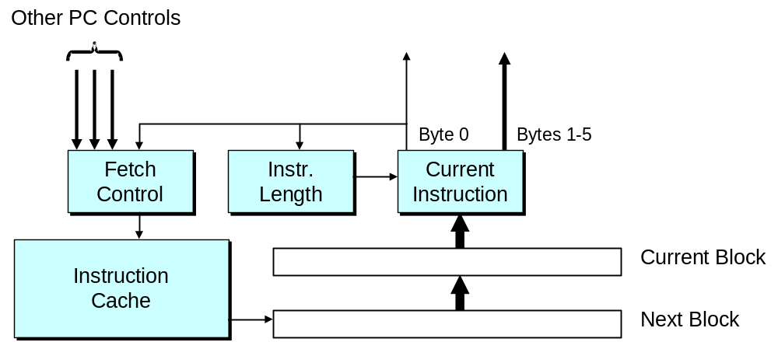
More Realistic Fetch Logic
Fetch Box
  Integrated into instruction cache
  Fetches entire cache block (16 or 32 bytes)
  Selects current instruction from current block
  Works ahead to fetch next block
    As reaches end of current block
    At branch target

