Slide 1
Hazard

Slide 2
Outline
Data Hazard
Control Hazard
Suggested Reading 4.5.5

Slide 3
Outline
Data Hazard
Control Hazard
Suggested Reading 4.5.5

Slide 4
Data Dependencies in Processors
1 irmovq $50, %rax
2 addq %rax , %rbx
3 mrmovq 100(%rbx),%rdx
Result from one instruction used as operand for another
  Read-after-write (RAW) dependency
Very common in actual programs
Must make sure our pipeline handles these properly
  Get correct results
  Minimize performance impact

Slide 5
Data Dependencies
1
2
3
4
5
6
7
8
F
F
D
D
E
E
M
M
W
W
F
F
D
D
E
E
M
M
W
W
F
F
D
D
E
E
M
M
W
W
F
F
D
D
E
E
M
M
W
W
# demo-h0.ys
0x000:irmovq $10,%rdx
0x00a:irmovq $3,%rax
0x014:addq %rdx,%rax
0x016:halt
Cycle 4
Memory
M_valE=10
M_dstE=%rdx
Execute
e_valE←0+3=3
E_dstE=%rax
•
•
Decode
val←R[%rdx]=0
val←R[%rax]=0
Error

Slide 6
Data Dependencies: 3 Nop’s
1
2
3
4
5
6
7
8
9
10
11
F
F
D
D
E
E
M
M
W
W
F
F
D
D
E
E
M
M
W
W
F
F
D
D
E
E
M
M
W
W
F
F
D
D
E
E
M
M
W
W
F
F
D
D
E
E
M
M
W
W
# demo-h3.ys
0x000:irmovq $10,%rdx
0x00a:irmovq $3,%rax
0x014:nop
0x015:nop
0x016:nop
0x017:addq %rdx,%rax
0x019:halt
F
F
D
D
E
E
M
M
W
W
F
F
D
D
E
E
M
M
W
W
Cycle 6
Write Back
R[%rax]←3
Cycle 7
Decode
val←R[%rdx]=10
val←R[%rax]=3

Slide 7
Data Dependencies: 2 Nop
1
2
3
4
5
6
7
8
9
F
F
D
D
E
E
M
M
W
W
F
F
D
D
E
E
M
M
W
W
F
F
D
D
E
E
M
M
W
W
F
F
D
D
E
E
M
M
W
W
F
F
D
D
E
E
M
M
W
W
# demo-h2.ys
0x000:irmovq $10,%rdx
0x00a:irmovq $3,%rax
0x014:nop
0x015:nop
0x016:addq %rdx,%rax
0x018:halt
F
F
D
D
E
E
M
M
W
W
Cycle 6
Write Back
R[%rax]←3
•
•
Decode
val←R[%rdx]=10
val←R[%rax]=0
Error

Slide 8
Data Dependencies: 1 Nop
1
2
3
4
5
6
7
8
9
F
F
D
D
E
E
M
M
W
W
F
F
D
D
E
E
M
M
W
W
F
F
D
D
E
E
M
M
W
W
F
F
D
D
E
E
M
M
W
W
F
F
D
D
E
E
M
M
W
W
# demo-h1.ys
0x000:irmovq $10,%rdx
0x00a:irmovq $3,%rax
0x014:nop
0x015:addq %rdx,%rax
0x017:halt
Cycle 5
Write Back
R[%rdx]←10
Memory
M_valE=3
M_dstE=%rax
•
•
Decode
val←R[%rdx]=0
val←R[%rax]=0
Error

Slide 9
Data Dependencies: 2 Nop’s
1
2
3
4
5
6
7
8
9
10
11
F
D
E
M
W
F
D
E
M
W
F
D
E
M
W
F
D
E
M
W
# demo-h2.ys
0x000:irmovq $10,%rdx
0x00a:irmovq $3,%rax
0x014:nop
0x015:nop
0x016:addq %rdx,%rax
0x018:halt
F
D
D
E
M
W
F
F
D
E
M
W
Cycle 6
Write Back
W_dstE=%rax
W_valE=3
•
•
•
•
Decode
srcA=%rdx
srcB=%rax

Slide 10
Stalling
1
2
3
4
5
6
7
8
9
10
11
# demo-h2.ys
0x000:irmovq $10,%rdx
0x00a:irmovq $3,%rax
0x014:nop
0x015:nop
bubble
0x016:addq %rdx,%rax
0x018:halt
F
D
E
M
W
F
D
E
M
W
F
D
E
M
W
F
D
E
M
W
E
M
W
F
D
D
E
M
W
F
F
D
E
M
W
If instruction follows too closely after one that writes register, slow it down
Hold instruction in decode
Dynamically inject nop into execute stage

Slide 11
Stalling X3
1
2
3
4
5
6
7
8
9
10
11
F
D
E
M
W
F
D
E
M
W
# demo-h0.ys
0x000:irmovq $10,%rdx
0x00a:irmovq $3,%rax
bubble
bubble
bubble
0x014:addq %rdx,%rax
0x016:halt
E
M
W
E
M
W
E
M
W
F
D
D
D
D
E
M
W
F
F
F
F
D
E
M
W
Cycle 6
Write Back
Cycle 5
W_dstE=%rax
Memory
•
•
•
•
Cycle 4
M_dstE=%rax
Execute
•
•
E_dstE=%rax
Decode
Decode
Decode
srcA=%rdx
srcB=%rax
srcA=%rdx
srcB=%rax
srcA=%rdx
srcB=%rax

Slide 12
Data Forwarding
Observation
  Value generated in execute or memory stage
Trick
  Pass value directly from generating instruction to decode stage
  Needs to be available at end of decode stage

Slide 13
Data Dependencies: 2 Nop’s
1
2
3
4
5
6
7
8
9
10
F
F
D
D
E
E
M
M
W
W
F
F
D
D
E
E
M
M
W
# demo-h2.ys
0x000:irmovq $10,%rdx
0x00a:irmovq $3,%rax
0x014:nop
0x015:nop
0x016:addq %rdx,%rax
0x018:halt
W
F
F
D
D
E
E
M
M
W
W
F
F
D
D
E
E
M
M
W
W
F
F
D
D
E
E
M
M
W
W
F
F
D
D
E
E
M
M
W
W
Cycle 6
Write Back
W_dstE=%rax
W_valE=3
R[%rax]←3
irmovl in W stage
Destination value in W pipeline register
Forward as valB for D stage
•
•
•
•
Decode
srcA=%rdx
srcB=%rax
valA←R[%rdx]=10
valB←W_valE=3

Slide 14
Data Dependencies: 1 Nop
1
2
3
4
5
6
7
8
9
F
F
D
D
E
E
M
M
W
W
F
F
D
D
E
E
M
M
W
W
F
F
D
D
E
E
M
M
W
# demo-h1.ys
0x000:irmovq $10,%rdx
0x00a:irmovq $3,%rax
0x014:nop
0x015:addq %rdx,%rax
0x017:halt
W
F
F
D
D
E
E
M
M
W
W
F
F
D
D
E
E
M
M
W
W
Cycle 5
Write back
W_valE=10
W_dstE=%rdx
Register %rdx
  Generated by ALU during previous cycle
  Forward from M stage as valA
Register %rax
  Value just generated by ALU
  Forward from E stage as valB
Memory
M_valE=3
M_dstE=%rax
•
•
Decode
srcA=%rdx
srcB=%rax
valA←M_valE=10
valB←e_valE=3

Slide 15
Data Dependencies: No Nop
1
2
3
4
5
6
7
8
F
F
D
D
E
E
M
M
W
W
F
F
D
D
E
E
M
M
W
# demo-h0.ys
0x000:irmovq $10,%rdx
0x00a:irmovq $3,%rax
0x014:addq %rdx,%rax
0x016:halt
W
F
F
D
D
E
E
M
M
W
W
F
F
D
D
E
E
M
M
W
W
Cycle 4
Memory
M_valE=10
M_dstE=%rdx
Register %edx
  Generated by ALU during previous cycle
  Forward from M stage as valA
Register %eax
  Value just generated by ALU
  Forward from E stage as valB
Execute
e_valE←0+3=3
E_dstE=%rax
•
•
Decode
srcA=%rdx
srcB=%rax
valA←M_valE=10
valB←e_valE=3

Slide 16
Bypass Paths
Decode Stage
  Forwarding logic selects valA and valB
  Normally from register file
  Forwarding: get valA or valB from later pipeline stage
Forwarding Sources
  Execute: valE
  Memory: valE, valM
  Write back: valE, valM

Slide 17
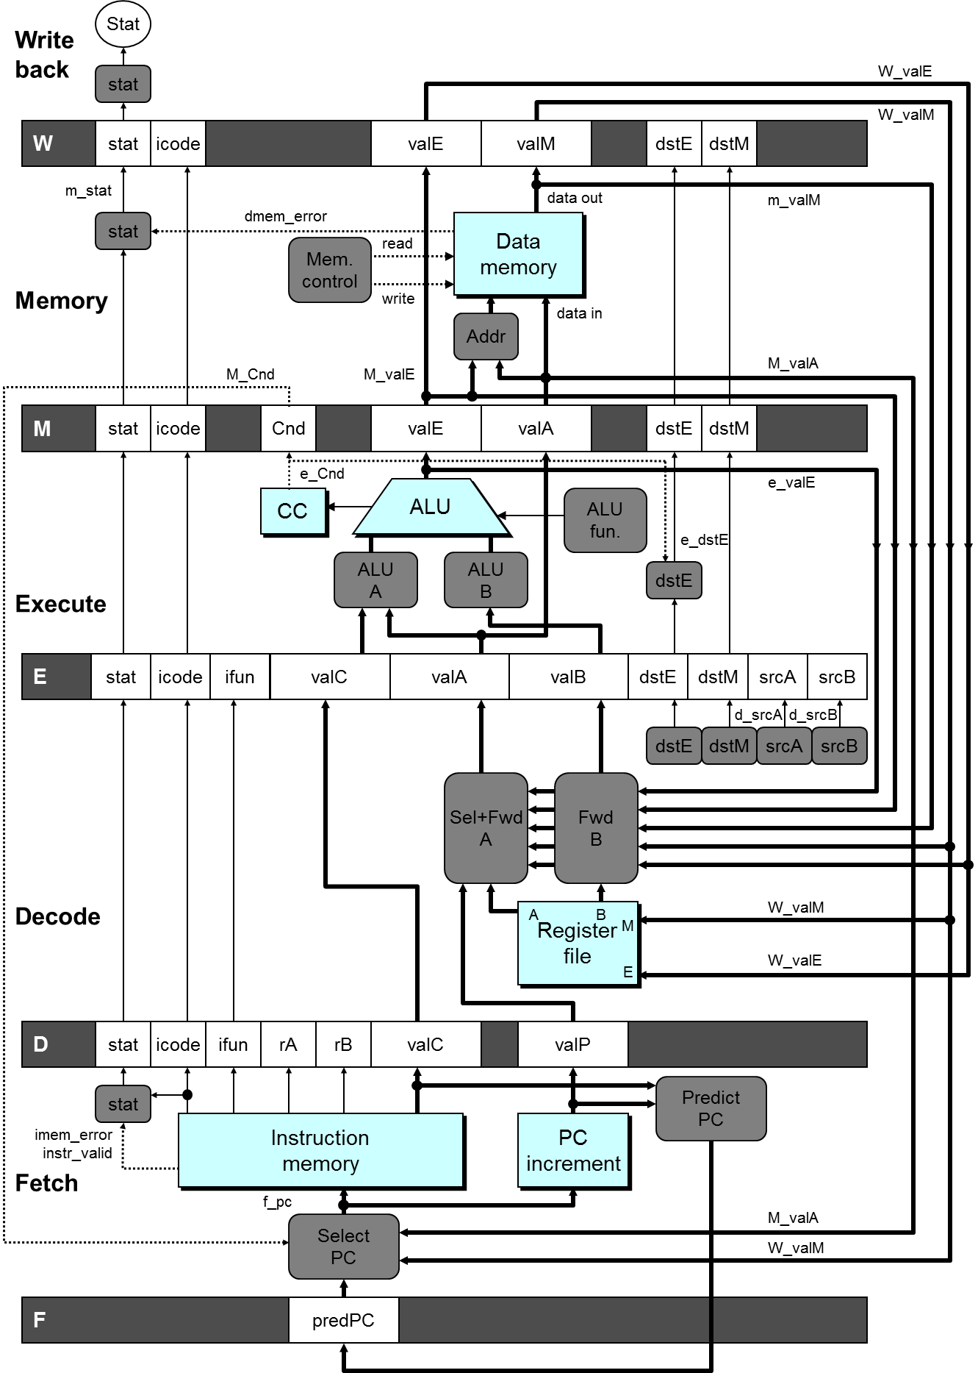

Slide 18
Practice Problem
There is an instruction
  addq %rax, %rbx
What happens if the value needed by %rbx exists at several previous stages?
  irmovq $1, %rbx
  irmovq $2, %rbx
  addq %rax, %rbx

Slide 19
Limitation of Forwarding
1
2
3
4
5
6
7
8
9
10
11
#demo-luh.ys
0x000: irmovq $128, %rdx
0x00a: irmovq $3, %rcx
0x014: rmmovq %rcx, 0(%rdx)
0x01e: irmovq $10, %rbx
#Load %rax
0x028: mrmovq 0(%rdx), %rax
#Use %rax
0x032: addq %rbx, %rax
0x034: halt
Load-use dependency
  Value needed by end of
  D stage in cycle 7
  Value read from memory
  in M stage of cycle 8
F
D
E
M
W
F
D
E
M
W
F
D
E
M
W
F
D
E
M
W
F
F
D
D
E
E
M
M
W
W
F
D
E
M
W
F
D
E
M
W
Cycle 7
Cycle 8
Memory
Memory
M_dstE=%rbx
M_valE=10
M_dstM=%rax
m_valM ← M[128]=3
•
•
Decode
valA←M_valM=10
valB←R[%rax]=0
Error
Notes:
Forward可以解决大部分data dependence问题。对于上面的load/use问题，虽然他属于我们已经给出的五种forward数据的来源之一（寄存器的结果来自于内存），应该用forward技术。但因为memory来得太晚，所以addl指令必须要stall才能正确。
推广开来，如果产生数据的源和目的之间的最小stage>1，那么就必须stall。dstE之所以不引起stall是因为dstE的值由execute stage产生，要使用它的是decode stage。两者之间的stage差为1。

Slide 20
Avoiding Load/Use Hazard
1
2
3
4
5
6
7
8
9
10
11
12
F
F
D
D
E
E
M
M
W
W
#demo-luh.ys
0x000: irmovq $128, %rdx
0x00a: irmovq $3, %rcx
0x014: rmmovq %ecx, 0(%rdx)
0x01e: irmovq $10, %rbx
#Load %rax
0x028: mrmovq 0(%rdx), %rax
#Use %rax
0x032: addq %rbx, %rax
0x034: halt
Stall using instruction for one cycle
Can then pick up loaded value by forwarding from memory
F
F
D
D
E
E
M
M
W
W
F
F
D
D
E
E
M
M
W
W
F
F
D
D
E
E
M
M
W
W
F
F
F
D
D
D
E
E
E
M
M
M
W
W
W
E
M
W
F
D
D
E
M
W
F
F
D
E
M
W
Cycle 8
Write Back
W_dstE=%rbx
W_valE=10
Memory
M_dstM=%rax
m_valM ← M[128]=3
•
Decode
valA←W_valM=10
valB←m_valM=3

Slide 21
Outline
Data Hazard
Control Hazard
Suggested Reading 4.5.5

Slide 22
Control Dependence
Example:
  loop:
  subq %rdx, %rbx
  jne targ
  irmovq $10, %rdx
  jmp loop
  targ:
  halt
The jne instruction create a control dependency
  Which instruction will be executed?

Slide 23
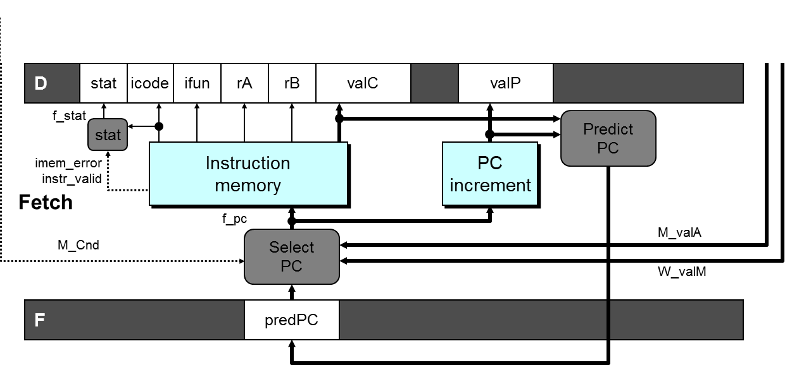
Predict PC
int F_predPC = [
f_icode in {IJXX, ICALL} : f_valC;
1: f_valP;
];

Slide 24
Select PC
int f_PC = [
#mispredicted branch. Fetch at incremented PC
M_icode == IJXX && !M_Cnd : M_valA;
#completion of RET instruciton
W_icode == IRET : W_valM;
#default: Use predicted value of PC
1: F_predPC
];
Notes:
对于mispredicted的情况，因为默认是跳转，所以这时该执行的指令地址是branch指令的下一条指令。这条指令的地址已经被放在valA中传递到了
Memory阶段，所以要从M_valA中恢复。
在实际中要根据预测的方法来确定new_F_predPC和f_PC的计算方法。关键的一点是预测时必须保证另一个出口地址被妥善的保存好。

Slide 25
Practice Problem
Does the order matter?
ret
jg target

Slide 26
Return Example
#demo-retB.ys
0x000: irmovq Stack,%rsp # Intialize stack pointer
0x00a: call p # Procedure call
0x013: irmovq $5,%rsi # Return point
0x01d: halt
0x020: .pos 0x20
0x020: p: irmovq $-1,%rdi # procedure
0x02a: ret
0x02b: irmovq $1,%rax # Should not be executed
0x035: irmovq $2,%rcx # Should not be executed
0x03f: irmovq $3,%rdx # Should not be executed
0x049: irmovq $4,%rbx # Should not be executed
0x100: .pos 0x100
0x100: Stack: # Stack: Stack pointer
  Previously executed three additional instructions

Slide 27
Incorrect Return Example
1
2
3
4
5
6
7
8
9
1: 0x02a: ret
2: 0x02b: irmovq $1,%rax #Oops
3: 0x035: irmovq $2,%rcx #Oops
4: 0x03f: irmovq $3,%rdx #Oops
5: 0x013: irmovq $5,%rsi #Ret point
F
D
E
M
W
F
D
E
M
W
F
D
E
M
W
F
D
E
M
W
F
F
D
D
E
E
M
M
W
W
Cycle 5
Write Back
W_ValM=0x013
Memory
Incorrectly execute 3 instructions following ret
M_valE=1
M_dstE=%rax
Excute
e_valE2
E_dstE=%rcx
Decode
D
D_valC=3
D_dstE=%rdx
Fetch
F
f_valC5
rB%rsi
Notes:
在ret知道正确的返回地址之前，流水线中已经有三条错误的指令被读入了。（因为ret知道返回地址是在memory stage，这时在fetch, decode, execute stage各有一条指令在执行）

Slide 28
Correct Return Example
1
2
3
4
5
6
7
8
9
#demo_retb
1: 0x02a: ret
2: bubble
3: bubble
4: bubble
5: 0x013: irmovq $5, %rsi #return
F
D
E
M
W
F
D
E
M
W
F
D
E
M
W
F
D
E
M
W
F
F
D
D
E
E
M
M
W
W
As ret passes through pipeline, stall at F stage
  While in D, E, and M stage
  fetch the same instruction after ret 3 times.
Inject bubble into D stage
Release stall when reach W stage
Cycle 5
Write Back
W_ValM=0x013
•
•
•
Fetch
F
f_valC5
rB%rsi

Slide 29
Branch Misprediction Example
#demo-j.ys
0x000: xorq %rax,%rax
0x002: jne t # Not taken
0x00b: irmovq $1, %rax # Fall through
0x015: halt
0x016: t: irmovq $2, %rdx # Target (Should not execute)
0x020: irmovq $3, %rbx # Should not execute
0x02a: halt
Should only execute first 4 instructions

Slide 30
Select PC
int f_PC = [
#mispredicted branch. Fetch at incremented PC
M_icode == IJXX && !M_Cnd : M_valA;
#completion of RET instruciton
W_icode == IRET : W_valM;
#default: Use predicted value of PC
1: F_predPC
];
Notes:
对于mispredicted的情况，因为默认是跳转，所以这时该执行的指令地址是branch指令的下一条指令。这条指令的地址已经被放在valA中传递到了
Memory阶段，所以要从M_valA中恢复。
在实际中要根据预测的方法来确定new_F_predPC和f_PC的计算方法。关键的一点是预测时必须保证另一个出口地址被妥善的保存好。

Slide 31
Branch Misprediction Trace
1
2
3
4
5
6
7
8
9
1: 0x000: xorq %rax,%rax
2: 0x002: jne T # Not taken
3: 0x016: irmovq $2, %rdx # T
4: 0x020: irmovq $3, %rbx # T+1
F
D
E
M
W
F
D
E
M
W
F
D
E
M
W
F
D
E
M
W
F
F
D
D
E
E
M
M
W
W
# demo-j.ys
0x000: xorq %rax,%rax
0x002: jne T # Not taken
0x00b: irmovq $1, %rax
0x015: halt
0x016: T:irmovq $2, %rdx
0x020: irmovq $3, %rbx
0x02a: halt
Cycle 5
Memory
M_Cnd=0
M_valA=0x00b
Excute
e_valE2
E_dstE=%rdx
Decode
D
D_valC=3
D_dstE=%rbx
Incorrectly execute two instructions at branch target
Fetch
F
Notes:
在M中的是jne，M_Bch=0表示不跳转，M_valA表示下一条指令地址是0x007。
RISC中规定一条branch指令之后总会执行一条指令就是为了减少这个问题造成的性能损失。
因为在execute阶段可以算出不跳转，这样在下一个阶段会执行正确的指令，但已经执行了两条错误指令了。

Slide 32
Branch Misprediction Trace
1
2
3
4
5
6
7
8
9
1: 0x000: xorq %rax,%rax
2: 0x002: jne T # Not taken
3: 0x016: irmovq $2, %rdx # T
4: 0x020: irmovq $3, %rbx # T+1
5: 0x00b: irmovq $1, %rax # Fall Through
F
D
E
M
W
F
D
E
M
W
F
D
E
M
W
F
D
E
M
W
F
F
D
D
E
E
M
M
W
W
# demo-j.ys
0x000: xorq %rax,%rax
0x002: jne T # Not taken
0x00b: irmovq $1, %rax
0x015: halt
0x016: T:irmovq $2, %rdx
0x020: irmovq $3, %rbx
0x02a: halt
Cycle 5
Memory
M_Cnd=0
M_valA=0x00b
Excute
e_valE2
E_dstE=%rdx
Decode
D
D_valC=3
D_dstE=%rbx
Incorrectly execute two instructions at branch target
Fetch
F
f_valC1
rB%rax
Notes:
在M中的是jne，M_Bch=0表示不跳转，M_valA表示下一条指令地址是0x007。
RISC中规定一条branch指令之后总会执行一条指令就是为了减少这个问题造成的性能损失。
因为在execute阶段可以算出不跳转，这样在下一个阶段会执行正确的指令，但已经执行了两条错误指令了。

Slide 33
Practice Problem
Why do we not use the e_cnd?

Slide 34
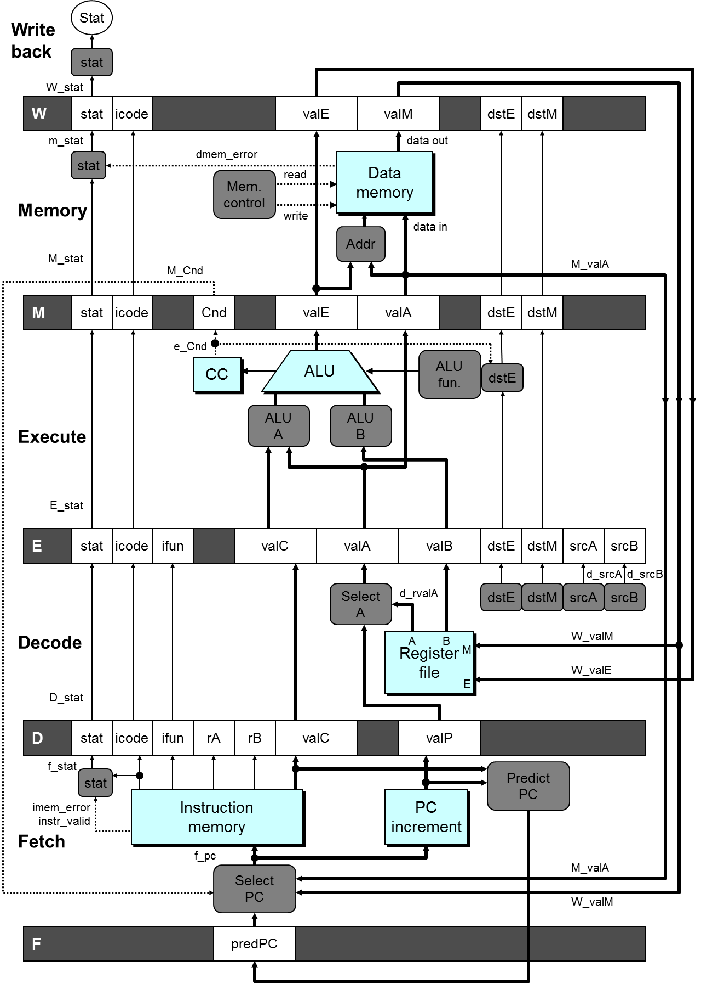

Slide 35
Naïve Method
# demo-j.ys
0x000: xorq %rax,%rax
0x002: jne T # Not taken
0x00b: irmovq $1, %rax
0x015: halt
0x016: T:irmovq $2, %rdx
0x020: irmovq $3, %rbx
0x02a: halt
# demo-j2.ys
0x000: xorq %eax,%eax
0x002: jne T # Not taken
0x00b: irmovq $1, %rax
0x015: halt
0x016: T:nop
0x017: nop
0x018: irmovq $2, %rdx
0x022: irmovq $3, %rbx
0x02c: halt
Notes:
这是control dependency引起问题的一个例子。

Slide 36
Handling Misprediction
#demo-j.ys
1: 0x000: xorq %rax, %rax
2: 0x002: jne T #Not Taken
3: 0x016: irmovq $2, %rdx # T
4: bubble
5: 0x020: irmovq $3, %rbx # T+1
6: bubble
7: 0x00b: irmovq $1, %rax # Fall through
8: 0x015: halt
Predict branch as taken
  Fetch 2 instructions at target
Cancel when mispredicted
  Detect branch not-taken in execute stage
  On following cycle, replace instructions in execute and decode by bubbles
  No side effects have occurred yet
1
2
3
4
5
6
7
8
9
10
F
F
D
D
E
E
M
M
W
W
F
F
D
D
E
E
M
M
W
W
F
D
E
M
W
F
D
E
M
W
F
F
D
D
E
E
M
M
W
W
F
F
D
D
E
E
M
M
W
W
Notes:
只是简单的取消已经进入流水线的两条指令（通过在execute和decode阶段插入bubble的方法，这就把这两条指令替换掉了）

Slide 37
Outline
Exception Handling
Suggested Reading 4.5.6

Slide 38
Exceptions
Condition: instruction encounter an error condition
Deal flow:
  Break the program flow
  Invoke the exception handler provided by OS.
  (Maybe) continue the program flow
    E.g. page fault exception
Notes:
很重要的一点就是在exception发生时，引起exception的语句之前的语句已经全部执行完毕，而在exception之后的语句还没有被执行。
Precise exception包括exception之间的相互关系，exception的类型, exception的位置等等。

Slide 39
Exceptions
  Conditions under which processor cannot continue normal operation
Causes
  Halt instruction (Current)
  Bad address for instruction or data (Previous)
  Invalid instruction (Previous)
Typical Desired Action
  Complete some instructions
    Either current or previous (depends on exception type)
  Discard others
  Call exception handler
    Like an unexpected procedure call
Notes:
完成当前还是前面的指令，主要是说当出现exception时，首先当前指令（引起exception的指令）之前的指令必须已经完成。然后，看语义决定当前指令要不要完成。

Slide 40
Exception Examples
Detect in Fetch Stage
jmp $-1 # Invalid jump target
.byte 0xFF # Invalid instruction code
halt # Halt instruction
Detect in Memory Stage
irmovq $100,%rax
rmmovq %rax,0x10000(%rax) # invalid address

Slide 41
Exceptions in Pipeline Processor #1
# demo-exc1.ys
irmovq $100,%rax
rmmovq %rax,0x10000(%rax) # invalid address
nop
nop
halt # Halt instruction
Exceptions triggered simultaneously.
Which one should be reported?
  The first one

Slide 42
Exceptions in Pipeline Processor #2
# demo-exc2.ys
irmovq $100,%rax
rmmovq %eax,0x10000(%rax) # Invalid address
nop
.byte 0xFF # Invalid instruction code
1
2
3
4
5
0x000: irmovq $100,%rax
F
D
E
M
W
0x00a: rmmovq %rax,0x10000(%rax)
F
D
E
M
0x014: nop
F
D
E
0x015: .byte 0xFF
F
D
Exception detected
Desired Behavior
  rmmovq should cause exception
  Following instructions should have no effect on processor stat
Notes:
假定我们不允许访问地址超过0x10000以上的内存。
上图中出现了两个exception. 显然我们希望在比较后面阶段的那条指令（也就是先执行的那条指令）触发的exception

Slide 43
Exceptions in Pipeline Processor #3
# demo-exc3.ys
0x000: xorq %rax,%rax # Set condition codes
0x002: jne t # Not taken
0x00b: irmovq $1,%rax
0x015: irmovq $2,%rdx
0x01f: halt
0x020: t: .byte 0xFF # Target
1
2
3
4
5
6
7
8
9
0x000: xorl %rax,%rax
F
D
E
M
W
0x002: jne t
F
D
E
M
0x020: t: .byte 0xFF
F
D
E
M
W
0x???: (I’m lost!)
F
D
E
M
W
0x00b: irmovq $1,%rax
F
D
E
M
W
Desired Behavior
  No exception should occur
Exception detected
Notes:
因为misprediction造成的branch错误，使得本来不该执行的指令执行了。这也可能引发exception。

Slide 44
Exceptions in Pipeline Processor #4
# demo-exc4.ys
0x000: irmovq $1,%rax
0x00a: xorq %rsp,%rsp # Set %rsp to 0 & Set CC to 100
0x00c: pushq %rax # attempt to write 0xfffffffffffffff8
0x00e: addq %rax,%rax #(Should not be executed)
# Would set CC to 000
1
2
3
4
5
6
0x000: irmovq $1, %rax
F
D
E
M
W
0x00a: xorq %rsp, %rsp
F
D
E
M
W
0x00c: pushq %rax
F
D
E
M
0x00b: addq %rax,%rax
F
D
E
Exception detected
Desired Behavior
  The fourth instruction should not have side effect
CC set

Slide 45
Maintaining Exception Ordering
W
stat
icode
valE
valM
dstE
dstM
M
stat
icode
Cnd
valE
valA
dstE
dstM
E
stat
icode
ifun
valC
valA
valB
dstE
dstM
srcA
srcB
D
stat
icode
ifun
rA
rB
valC
valP
F
predPC
Add exception status field to pipeline registers
Fetch stage sets to either “AOK”, “ADR” (when bad fetch address), “HTL” (halt instruction) or “INS” (illegal instruction)
Decode & Execute pass values through
Memory either passes through or sets to “ADR”
Exception triggered only when instruction hits Write-back
Notes:
AOK表示合法的指令。其他两种表示错误的指令。
只在Write back阶段才去处理exception，因为指令是顺序流出的，这样exception的先后顺序就保证了。
当某些指令先fetch了，后来又取消了（比如misprediction），那么我们只要简单的将其取消就可以了（连同保存的exception状态）。因为它无法到达Write back阶段，所以也就不会爆出exception.

Slide 46
Avoiding Side Effects
Presence of Exception Should Disable State Update
  Invalid instructions are converted to pipeline bubbles
    Except have stat indicating exception status
  Data memory will not write to invalid address
  Prevent invalid update of condition codes
    Detect exception in memory stage
    Disable condition code setting in execute
    Must happen in same clock cycle

Slide 47
Avoiding Side Effects
Presence of Exception Should Disable State Update
  Handling exception in final stages
    When detect exception in memory stage
      Start injecting bubbles into memory stage on next cycle
    When detect exception in write-back stage
      Stall excepting instruction
  Included in HCL code

Slide 48
Rest of Exception Handling
Calling Exception Handler
  Push PC onto stack
    Either PC of faulting instruction or of next instruction
    Usually pass through pipeline along with exception status
  Jump to handler address
    Usually fixed address
    Defined as part of ISA
Implementation
  Haven’t tried it yet!

