Slide 1
Machine-Independent Optimization

Slide 2
Outline
Machine-Independent Optimization
  Code motion
  Memory optimization
Optimizing Blockers
  Memory alias
  Side effect in function call
Suggested reading
  5.2 ~ 5.6, 5.1

Slide 3
Motivation
Constant factors matter too!
  easily see 10:1 performance range depending on how code is written
  must optimize at multiple levels
    algorithm, data representations, procedures, and loops

Slide 4
Motivation
Understand system to optimize performance
  how programs are compiled and executed
  how to measure program performance and identify bottlenecks
  how to improve performance without destroying code modularity and generality

Slide 5
Time Scales
Absolute Time
  Typically use nanoseconds: 10^{–9} seconds
    Time scale of computer instructions
Clock Cycles
  Typical Range
    100 MHz
      10⁸ cycles per second, clock period = 10ns
    2 GHz
      2 X 10⁹ cycles per second, clock period = 0.5ns

Slide 6
Cycles Per Element
Convenient way to express performance of program that operators on vectors or lists
Length = n
T = CPE*n + Overhead

Slide 7
CPE
1 void psum1(float a[], float p[], long n)
2 {
3 long i;
4
5 p[0] = a[0] ;
6 for (i = 1; i < n; i++)
7 p[i] = p[i-1] + a[i];
8 }
9

Slide 8
CPE
10 void psum2(float a[], float p[]; long n)
11 {
12 long i;
13 p[0] = a[0] ;
14 for (i = 1; i < n-1; i+=2) {
15 float mid_val = p[i-1] + a[i] ;
16 p[i] = mid_val ;
17 p[i+1] = mid_val + a[i+1];
18 }
/* For odd n, finish remaining element */
if ( i < n )
p[i] = p[i-1] + a[i] ;
}

Slide 9
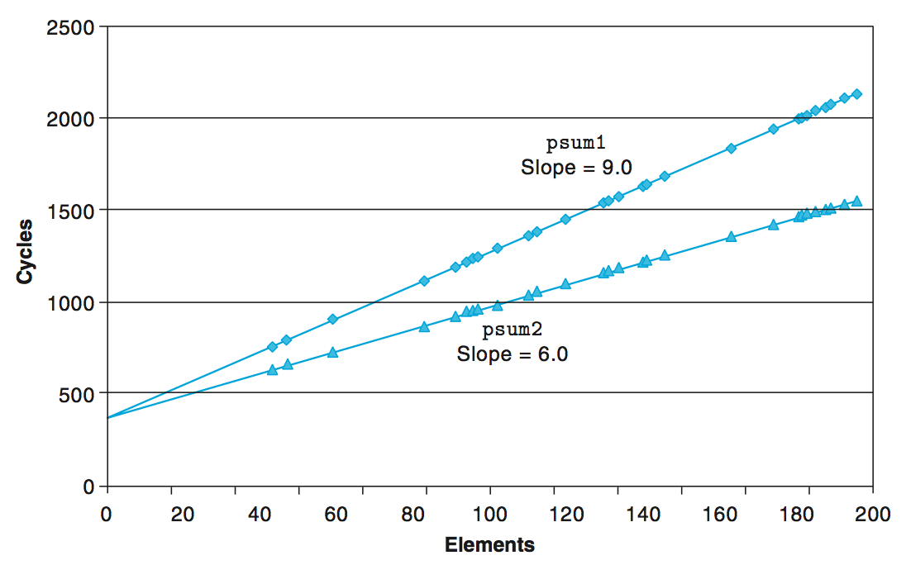
Cycles Per Element

Slide 10
Vector ADT
length
0
1
2
length–1
data
• • •
typedef struct {
long len ;
data_t *data ;
} vec_rec, *vec_ptr ;
typedef long data_t ;

Slide 11
Procedures
vec_ptr new_vec(long len)
  Create vector of specified length
long vec_length(vec_ptr)
  Return length of vector
data_t *get_vec_start(vec_ptr v)
  Return pointer to start of vector data
long get_vec_element(vec_ptr v, long index, int *dest)
  Retrieve vector element, store at *dest
  Return 0 if out of bounds, 1 if successful
Similar to array implementations in Pascal, Java
  E.g., always do bounds checking

Slide 12
Vector ADT
vec_ptr new_vec(long len)
{
/* allocate header structure */
vec_ptr result = (vec_ptr) malloc(sizeof(vec_rec)) ;
data_t *data = NULL;
if ( !result )
return NULL ; /* Couldn’t allocate storage */
result->len = len ;

Slide 13
Vector ADT
/* allocate array */
if ( len > 0 ) {
data = (data_t *)calloc(len, sizeof(data_t)) ;
if ( !data ) {
free( (void *) result ) ;
return NULL ; /* couldn’t allocte stroage */
}
}
/* Data will either be NULL or allocated array */
result->data = data;
return result ;
}

Slide 14
Vector ADT
/*
* Retrieve vector element and store at dest.
* Return 0 (out of bounds) or 1 (successful)
*/
int get_vec_element(vec_ptr v, long index, data_t *dest)
{
if ( index < 0 || index >= v->len)
return 0 ;
*dest = v->data[index] ;
return 1;
}

Slide 15
Vector ADT
/* Return length of vector */
long vec_length(vec_ptr)
{
return v->len ;
}
/* Return pointer to start of vector data */
data_t *get_vec_start(vec_ptr v)
{
return v->data ;
}

Slide 16
Optimization Example
void combine1(vec_ptr v, data_t *dest)
{
long i;
*dest = IDENT;
for (i = 0; i < vec_length(v); i++) {
data_t val;
get_vec_element(v, i, &val);
*dest = *dest OP val;
}
}
Compute sum (product) of all elements of vector
Store result at destination location

Slide 17
Optimization Example
Using different definitions of compile-time constants
#define IDENT 0
#define OP +
#define IDENT 1
#define OP *
typedef long data_t ;
typedef double data_t ;

Slide 18
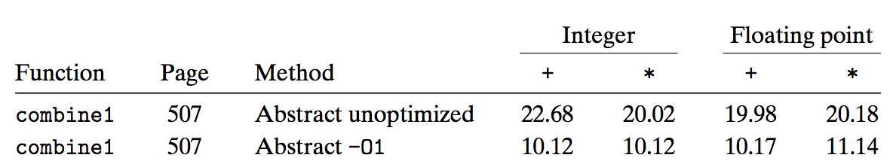
Time Scales

Slide 19
Understanding Loop
void combine1(vec_ptr v, data_t *dest)
{
long i;
*dest = IDENT;
for (i = 0; i < vec_length(v); i++) {
data_t val;
get_vec_element(v, i, &val);
*dest = *dest OP val;
}
}

Slide 20
Understanding Loop
void combine1-goto(vec_ptr v, data_t *dest)
{
long i = 0;
data_t val;
*dest = 0;
if (i >= vec_length(v))
goto done;
loop:
get_vec_element(v, i, &val);
*dest += val;
i++;
if (i < vec_length(v))
goto loop
done:
}
Procedure vec_length called every iteration
Even though result always the same
1 iteration

Slide 21
Code Motion
void combine2(vec_ptr v, data_t *dest)
{
long i;
long length = vec_length(v);
*dest = IDENT;
for (i = 0; i < length; i++) {
data_t val;
get_vec_element(v, i, &val);
*dest = *dest OP val;
}
}

Slide 22
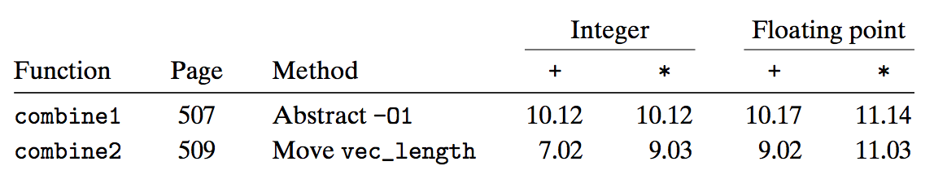
Code Motion
Optimization
  Move call to vec_length out of inner loop
    Value does not change from one iteration to next
    Code motion

Slide 23
Code Motion
1 /* Convert string to lowercase: slow */
2 void lower1(char *s)
3 {
4 long i;
5
6 for (i = 0; i < strlen(s); i++)
7 if (s[i] >= ’A’ && s[i] <= ’Z’)
8 s[i] -= (’A’ - ’a’);
9 }
10

Slide 24
Code Motion
11 /* Convert string to lowercase: faster */
12 void lower2(char *s)
13 {
14 long i;
15 long len = strlen(s);
16
17 for (i = 0; i < len; i++)
18 if (s[i] >= ’A’ && s[i] <= ’Z’)
19 s[i] -= (’A’ - ’a’);
20 }
21

Slide 25
Code Motion
22 /* Sample implementation of library function strlen */
23 /* Compute length of string */
24 size_t strlen(const char *s)
25 {
26 long length = 0;
27 while (*s != ’\0’) {
28 s++;
29 length++;
30 }
31 return length;
32 }

Slide 26
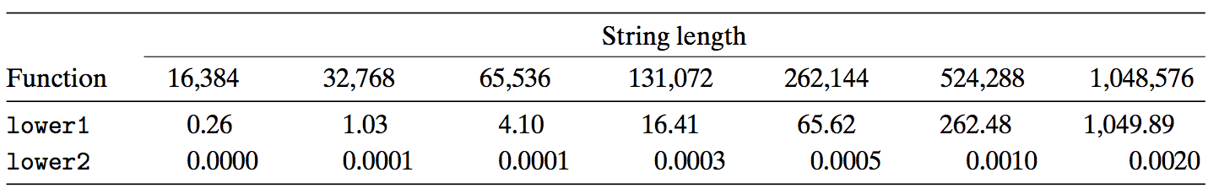
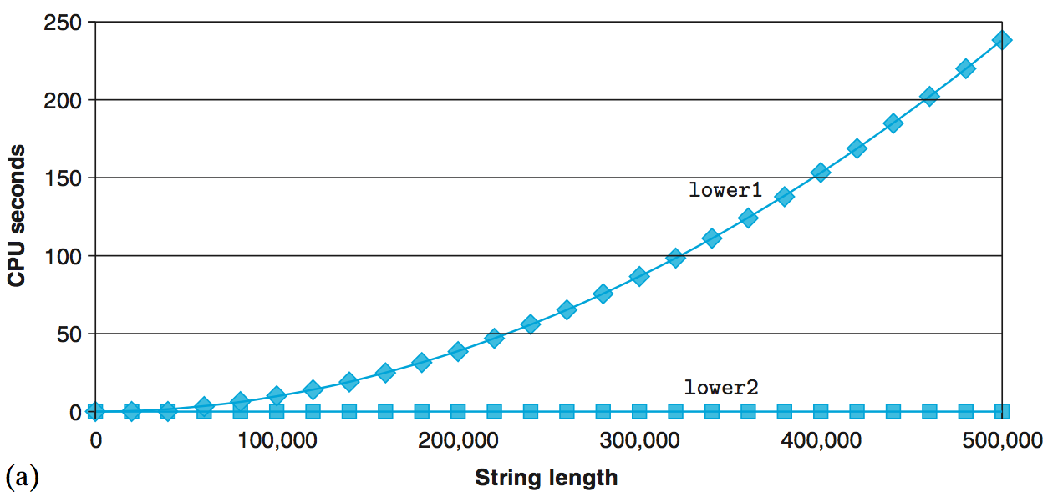
Code Motion

Slide 27
Reduction in Strength
void combine3(vec_ptr v, data_t *dest)
{
long i;
long length = vec_length(v);
data_t *data = get_vec_start(v);
*dest = IDENT;
for ( i = 0 ; i < length ; i++ ) {
*dest = *dest OP data[i] ;
}

Slide 28
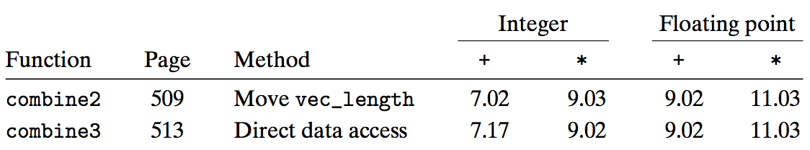
Reduction in Strength
Optimization
  Avoid procedure call to retrieve each vector element
    Get pointer to start of array before loop
    Within loop just do pointer reference
    No apparent performance improvement

Slide 29
Eliminate Unneeded Memory References
combine3: data_t = double, OP = *
data+length in %rax, data+i in %rdx, dest in %rbx
1 .L17: loop:
2 vmovsd (%rbx), %xmm0 Read product from dest
3 vmulsd (%rdx), %xmm0, %xmm0 Multiply product by data[i]
4 vmovsd %xmm0, (%rbx) Store product at dest
5 addq $8, %rdx Increment data+i
6 cmpq %rax, %rdx Compare to data+length
7 jne .L17 If !=, goto loop

Slide 30
Eliminate Unneeded Memory References
void combine4(vec_ptr v, data_t *dest)
{
long i;
long length = vec_length(v);
data_t *data = get_vec_start(v);
data_t acc = IDENT;
for (i = 0; i < length; i++)
acc = acc OP data[i];
*dest = acc;
}

Slide 31
Eliminate Unneeded Memory References
combine4: data_t = double, OP = *
data+length in %rax, data+i in %rdx, limit in %rbp, acc in %xmm0
1 .L25: loop:
2 vmulsd (%rdx), %xmm0, %xmm0 Multiply acc by data[i]
3 addq $8, %rdx Increment data+i
4 cmpq %rax, %rdx Compare to data+length
5 jne .L25 If !=, goto loop

Slide 32
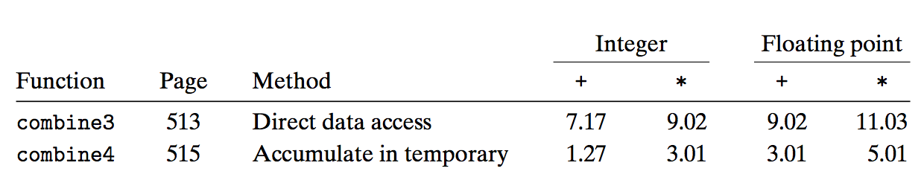
Eliminate Unneeded Memory References
Optimization
  Don’t need to store in destination until end
  Local variable sum held in register
  Avoids 1 memory read, 1 memory write per cycle

Slide 33
Machine Independent Opt. Results
Optimizations
  Reduce function calls and memory references within loop

Slide 34
Optimizing Compilers
Provide efficient mapping of program to machine
  register allocation
  code selection and ordering
  eliminating minor inefficiencies

Slide 35
Optimizing Compilers
Don’t (usually) improve asymptotic efficiency
  up to programmer to select best overall algorithm
  big-O savings are (often) more important than constant factors
    but constant factors also matter
Have difficulty overcoming “optimization blockers”
  potential memory aliasing
  potential procedure side-effects

Slide 36
Optimization Blockers ⎯ Memory aliasing
void twiddle1(int *xp, int *yp)
  {
  *xp += *yp ;
  *xp += *yp ;
  }
  void twiddle2(int *xp, int *yp)
  {
  *xp += 2* *yp ;
  }

Slide 37
Optimization Blockers ⎯ Function call and side effect
int f(int) ;
int func1(x)
{
return f(x)+f(x)+f(x)+f(x) ;
}
int func2(x)
{
return 4*f(x) ;
}

Slide 38
Optimization Blockers ⎯ Function call and side effect
int counter = 0 ;
int f(int x)
{
return counter++ ;
}

Slide 39
Optimization Blocker: Memory Aliasing
Aliasing
  Two different memory references specify single location
Example
  v: [2, 3, 5]
  combine3(v, get_vec_start(v)+2) --> ?
  combine4(v, get_vec_start(v)+2) --> ?
Function | Intial | Before loop | i=0 | i=1 | i=2 | Final
Combine3 | [2,3,5] | [2,3,1] | [2,3,2] | [2,3,6] | [2,3,36] | [2,3,36]
combine4 | [2,3,5] | [2,3,5] | [2,3,5] | [2,3,5] | [2,3,5] | [2,3,30]

Slide 40
Optimization Blocker: Memory Aliasing
Observations
  Easy to have happen in C
    Since allowed to do address arithmetic
    Direct access to storage structures
  Get in habit of introducing local variables
    Accumulating within loops
    Your way of telling compiler not to check for aliasing

Slide 41
Limitations of Optimizing Compilers
Operate Under Fundamental Constraint
  Must not cause any change in program behavior under any possible condition
  Often prevents it from making optimizations when would only affect behavior under pathological conditions.

Slide 42
Limitations of Optimizing Compilers
Behavior that may be obvious to the programmer can be obfuscated by languages and coding styles
  e.g., data ranges may be more limited than variable types suggest
    e.g., using an “int” in C for what could be an enumerated type
When in doubt, the compiler must be conservative

Slide 43
Example
void combine1(vec_ptr v, data_t *dest)
{
long i;
*dest = IDENT;
for (i = 0; i < vec_length(v); i++) {
data_t val;
get_vec_element(v, i, &val);
*dest = *dest OP val;
}
}

Slide 44
Example
void combine2(vec_ptr v, data_t *dest)
{
long i;
long length = vec_length(v);
*dest = IDENT;
for (i = 0; i < length; i++) {
data_t val;
get_vec_element(v, i, &val);
*dest = *dest OP val;
}
}

Slide 45
Example
void combine3(vec_ptr v, data_t *dest)
{
long i;
long length = vec_length(v);
data_t *data = get_vec_start(v);
*dest = IDENT;
for (i = 0; i < length; i++) {
*dest = *dest OP data[i];
}

Slide 46
Example
void combine4(vec_ptr v, data_t *dest)
{
long i;
long length = vec_length(v);
data_t *data = get_vec_start(v);
data_t x = IDENT;
for (i = 0; i < length; i++)
x = x OP data[i];
*dest = x;
}

Slide 47
Effectiveness of the Optimization
 |  |  |  | Integer |  |  | Floating point
Function |  | Method |  | + | * |  | + | *
combine 1 |  | Abstract -O1 |  | 10.12 | 10.12 |  | 10.17 | 11.14
combine 4 |  | Accumulate in temporary |  | 1.27 | 3.01 |  | 3.01 | 5.01

Slide 48
Modern Processors

Slide 49
Outline
Understanding Modern Processor
  Super-scalar
  Out-of –order execution
Suggested reading
  5.7

Slide 50
Modern Processor
Superscalar
  Perform multiple operations on every clock cycle
  Instruction level parallelism
Out-of-order execution
  The order in which the instructions execute need not correspond to their ordering in the assembly program

Slide 51
Instruction Control
Fetch
Control
Address
Instruction
Cache
Retirement
Unit
Instruction
Decode
Instructions
Register
File
Operations
Register Updates
Prediction OK?
dispatch
Execution
Functional
Units
Branch
Arithmetic
operations
Arithmetic
operations
Load
Store
Operation Results
Addr.
Addr.
Data
Data
Data
Cache

Slide 52
Modern Processor
Two main parts
  Instruction Control Unit (ICU)
    Responsible for reading a sequence of instructions from memory
    Generating from above instructions a set of primitive operations to perform on program data
  Execution Unit (EU)
    Execute these operations

Slide 53
Instruction Control Unit
Instruction Cache
  A special, high speed memory containing the most recently accessed instructions.
Instruction Control
Fetch
Control
Address
Instruction
Cache
Retirement
Unit
Register
File
Instruction
Decode
Instructions
Operations
Register Updates
Prediction OK?

Slide 54
Instruction Control Unit
Fetch Control
  Fetches ahead of currently accessed instructions
    enough time to decode instructions and send decoded operations down to the EU
Instruction Control
Fetch
Control
Address
Instruction
Cache
Retirement
Unit
Register
File
Instruction
Decode
Instructions
Operations
Register Updates
Prediction OK?

Slide 55
Fetch Control
Branch Predication
  Branch taken or fall through
  Guess whether branch is taken or not
Speculative Execution
  Fetch, decode and execute only according to the branch prediction
  Before the branch predication has been determined whether or not

Slide 56
Instruction Control Unit
Instruction Decoding Logic
  Take actual program instructions
Instruction Control
Fetch
Control
Address
Instruction
Cache
Retirement
Unit
Register
File
Instruction
Decode
Instructions
Operations
Register Updates
Prediction OK?

Slide 57
Instruction Control Unit
Instruction Decoding Logic
  Take actual program instructions
  Converts them into a set of primitive operations
    An instruction can be decoded into a variable number of operations
  Each primitive operation performs some simple task
    Simple arithmetic, Load, Store
  Register renaming
addq %rax, 8(%rdx)
    load 8(%rdx) → t1
    addq %rax, t1 → t2
    store t2, 8(%rdx)

Slide 58
Instruction Control Unit
  addq $8, %rdx is translated to
  addq $8, %rdx.0 → %rdx.1
Register Renaming
  Values passed directly from producer to consumers
  A tag t is generated to the result of the operation
    e.g. %rcx.0, %rcx.1
  Renaming table
    Maintain the association between program register r and tag t for an operation that will update this register

Slide 59
Translation Example
Example
  combine4 (data_t = float, OP = *)
void combine4(vec_ptr v, data_t *dest)
{
long i;
long length = vec_length(v);
data_t *data = get_vec_start(v);
data_t x = IDENT;
for (i = 0; i < length; i++)
x = x OP data[i];
*dest = x;
}

Slide 60
Translation Example
.L25: # Loop:
vmulsd (%rdx),%xmm0,%xmm0 # t *= data[i]
addq $8, %rdx # Increment data+i
cmpq %rax,%rdp # Comp to data+len
jne .L25 # if !=, goto Loop
load (%rdx.0) ➔ t.1
mulq t.1, %xmm0.0 ➔ %xmm0.1
addq $8, %rdx.0 ➔ %rdx.1
cmpq %rax, %rdx.1 ➔ cc.1
jne-taken cc.1

Slide 61
Understanding Translation Example
vmulsd (%rdx),%xmm0,%xmm0
load (%rdx.0)➔ t.1
mulq t.1, %xmm0.0 ➔ %xmm0.1
Split into two operations
  Load reads from memory to generate temporary result t.1
  Multiply operation just operates on registers

Slide 62
Understanding Translation Example
vmulsd (%rdx),%xmm0,%xmm0
load (%rdx.0)➔ t.1
mulq t.1, %xmm0.0 ➔ %xmm0.1
Operands
  Register %xmm0 changes on every iteration
  Uniquely identify different versions as
    %xmm0.0, %xmm0.1, %xmm0.2, …
  Register renaming
    Values passed directly from producer to consumers

Slide 63
Understanding Translation Example
addq $8, %rdx
addq $8, %rdx.0 ➔ %rdx.1
Register %rdx changes on each iteration
Renamed as %rdx.0, %rdx.1, %rdx.2, …

Slide 64
Understanding Translation Example
cmpq %rax,%rdx
cmpq %rax, %rdx.1 ➔ cc.1
Operands
  Registers %rax does not change in loop
  Values will be retrieved from register file during decoding

Slide 65
Understanding Translation Example
cmpq %rax,%rdx
cmpq %rax, %rdx.1 ➔ cc.1
Condition codes are treated similar to registers
Assign tag to define connection between producer and consumer

Slide 66
Understanding Translation Example
jne .L25
jne-taken cc.1
Execution unit simply checks whether or not prediction was OK
If not, it signals instruction control unit
  Instruction control unit then “invalidates” any operations generated from misfetched instructions
  Begins fetching and decoding instructions at correct target

Slide 67
Execution Unit
Multi-functional Units
  Receive operations from ICU
  Execute a number of operations on each clock cycle
  Handle specific types of operations
Execution
Functional
Units
Branch
Arithmetic
operations
Arithmetic
operations
Load
Store
Operation Results
Addr.
Addr.
Data
Data
Data
Cache

Slide 68
Multi-functional Units
Multiple Instructions Can Execute in Parallel
  Haswell CPU (Core i7)
      0. Integer arithmetic, FP multiplication, integer and FP division, branches
      1. Integer arithmetic, FP addition, integer multiplication, FP multiplication
      2. Load, address computation
      3. Load, address computation
      4. Store
      5. Integer arithmetic(basic operations)
      6. Integer arithmetic, branches
      7. Store address computation
Integer arithmetic: addition, bitwise operations, shifting

Slide 69
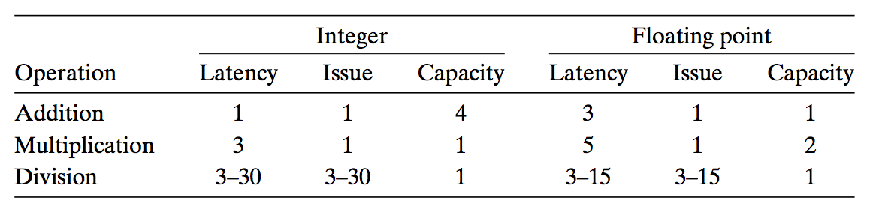
Multi-functional Units
Some Instructions Take > 1 Cycle, but Can be Pipelined
  Haswell (Core i7)

Slide 70
Instruction Control
Fetch
Control
Address
Instruction
Cache
Retirement
Unit
Instruction
Decode
Instructions
Register
File
Operations
Register Updates
Prediction OK?
dispatch
Execution
Functional
Units
Branch
Arithmetic
operations
Arithmetic
operations
Load
Store
Operation Results
Addr.
Addr.
Data
Data
Data
Cache

Slide 71
Execution Unit
Operation is dispatched to one of multi-functional units, whenever
  All the operands of an operation are ready
  Suitable functional units are available
Execution results are passed among functional units
Instruction Control
Fetch
Control
Address
Instruction
Cache
Retirement
Unit
Instruction
Decode
Instructions
Register
File
Operations
Prediction OK?
dispatch

