Slide 1
Weather on the Web
107th OGC Technical Committee
Fort Collins, Colorado USA
Richard Carne (UK Met Office)
6th June 2018

Slide 2
Overview
Proposed Vision statement for Weather on the Web
Thoughts on Best Practice from George Percival
Outline Project plan
Forming the Community
Focus Group and Member commitment
Community Communication
GitHub / slack / Gitter.im / bi-weekly telco

Slide 3

Vision

Slide 4
Weather on the Web Vision
The purpose of Weather* on the Web is to clarify and formalise the weather related standards landscape that enables the development and use of weather based web services.
* Weather meaning any meteorological information that covers past present and future state of the atmosphere including observations and climatological data.
Notes:
Note that by Weather we mean any weather information for any available point in time past, present future thus encompassing historical, present obs and modelling as well as long term climate modelling.
Seeking to follow in the footstep of Spatial Data on the Web in developing

Slide 5
Weather on the Web Vision
to determine how weather information can best be integrated with other data on the Web;
to define a range of access patterns and encoding extensions** that cover a set of core use cases specified;
to identify and assess existing methods and tools;
to drive consensus on weather standards for the web;
and to produce a set of best practice for use of weather information on the web.
** encoding extensions: for example specifying GeoJSON structures for describing weather at a specific location.

Slide 6
Data API vs Product API
Weather on the Web will solely focused on data APIs centered around weather information as opposed to product APIs, in which specific business logic and context of use is required to add further value.
Weather on the Web will not consider Use Cases that require specific business knowledge of the end use.
Do we agree with this focus?

Slide 7


Best Practice

Slide 8
OGC Best Practice in the TC P&P
Documents best practices related to one or more OGC standards.
A best practice is a technique or methodology that, through experience, implementation and research, has proven to reliably lead to a desired result
Must contain “evidence of implementation.
Implementation in commercial product, implementation in open source applications or software, and/or implementation in deployed applications.
Single research related implementation is not proper evidence of implementation.

Slide 9
Approach: Best Practice for weather info on the web
Normative Body of BP
Informative Annexes
Access to weather info using OGC standards
Processing of weather info using OGC standards
Weather information Data models using OGC standards
Operational Weather Information systems, e.g. NMSs implementation, commercial consumers.
Interoperability program Engineering Reports
Compliant Products
Normative Body of BP to contain verifiable requirements
Informative Annexes provides evidence of implementation

Slide 10

Project Plan

Slide 11
Project Plan
Jun 18 – Aug 18 | Sep 18 – Nov 18 | Dec 18 – Feb 19
TC
TC
TC
TC
Finalise Vision
Gather Use Cases
Review / Prioritise
Extract Requirements
Identify Engineering partners
Engineering Activity
Engineering Report
Best Practice Documentation

Slide 12

Forming the Community

Slide 13
Focus Group
Move to set up focus group for weather on the web
Requires commitment from interested members.
Should include engineering partners
Sign up to focus group today
Propose setting up regular Tele/video conference for members of Weather on the Web focus group

Slide 14
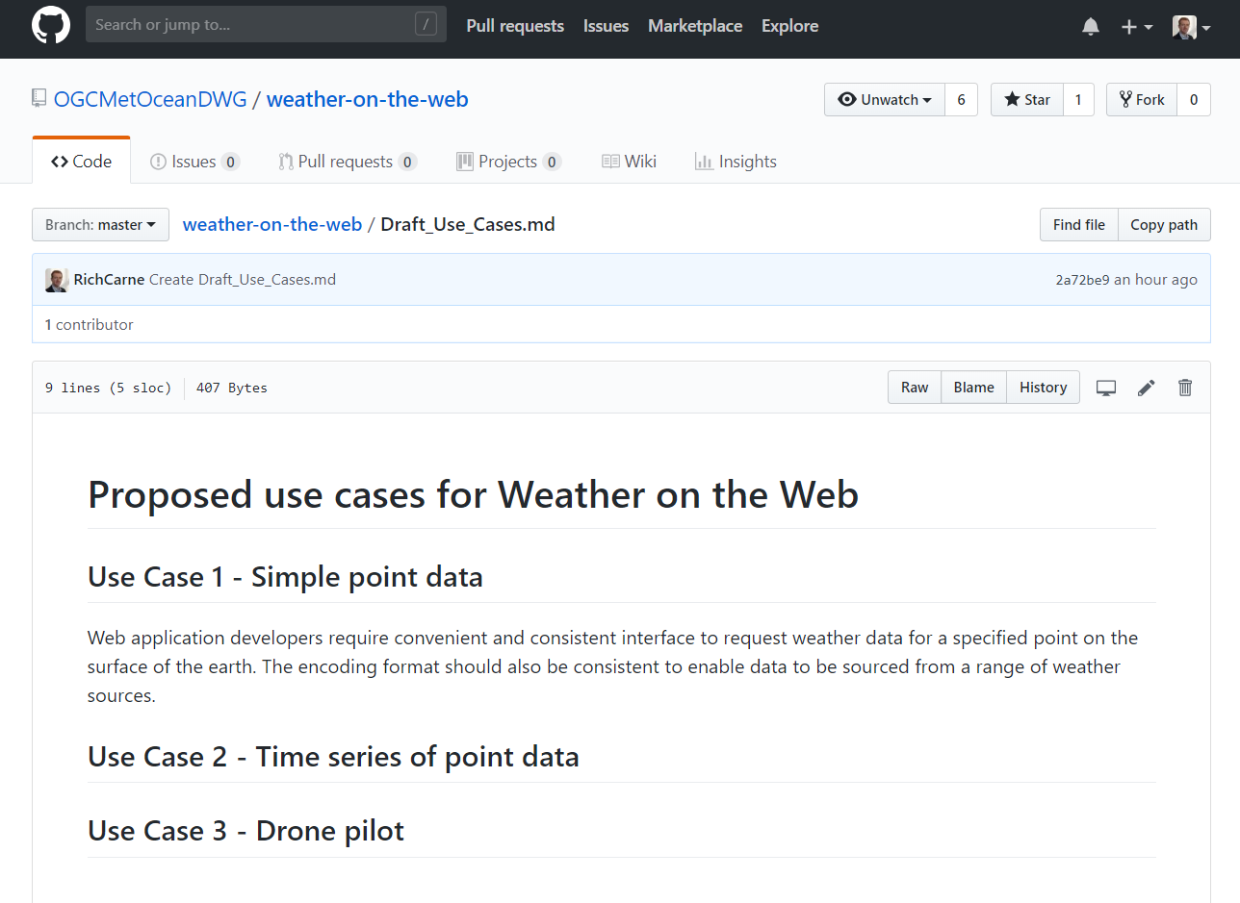
GitHub Repo

Slide 15
DWG Proposal
Propose that DWG agree on the creation of a new repository under the OGC GitHub organisation, named weather-on-the-web And that the repo be made publically accessible.
Vote now!

Slide 16
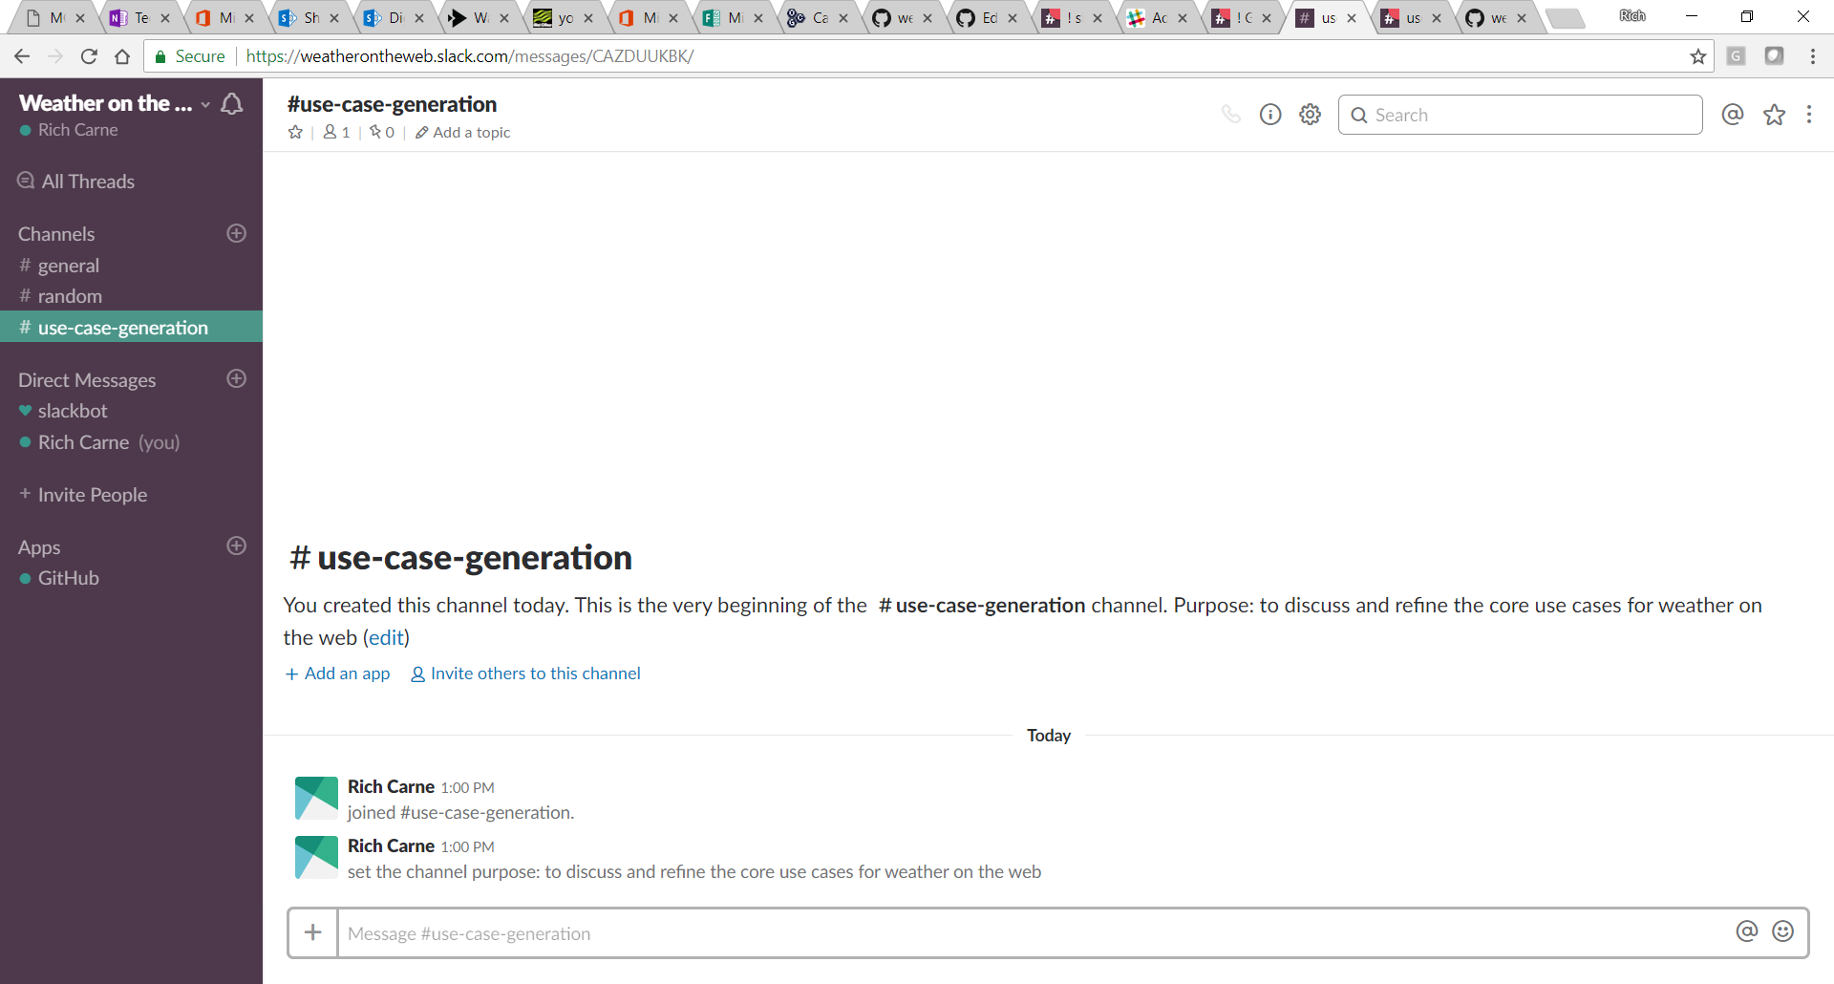
Slack Channel / Gitter.im
Notes:
Met Office restrict access to Gitter.im for staff, Slack is ok for now ☺

Slide 17
Questions

