Slide 1


Conducting experiments with agent-based modelling for social scientists
Dr. J. Kasmire
Research Fellow at Cathie Marsh Institute and UK Data Service
Copyright © 2021 UK Data Service. Created by CSS Training Team, UK Data Service.

Slide 2
Troubleshooting audio problems
Check your speaker/headset is plugged in / volume is on.
Click on audio to change to listening via phone
We are recording this webinar and will post it on YouTube (https://www.youtube.com/user/UKDATASERVICE)

Slide 3
Interaction in this workshop
Use the Zoom chat for technical questions or comments for the workshop facilitator.
Ask or upvote questions for workshop host in the Zoom Q&A.
You can also ask the facilitator to unmute you if you are happy to ask your question out loud.

Slide 4
You might be interested in other UKDS events
Reproducibility: Collaborative working Feb 15 (past event)
ABM guest seminar Mar 9
CSS Drop-ins – Every second Tuesday of the month at 13:00
Geographical data visualisation of UK Census data March 17
https://ukdataservice.ac.uk/news-and-events/events.aspx
https://www.ukdataservice.ac.uk/news-and-events/events/past-events.aspx

Slide 5
Table of contents
Concepts and planning of experiments
Behaviour space – automatically run experiments in NetLogo
Output
Q&A

Slide 6
Development is iterative
Writing code and running the model go together in phases
Initially focused on identifying errors
Experiments
Write Code
Narrow Sweep
Wide Sweep

Slide 7
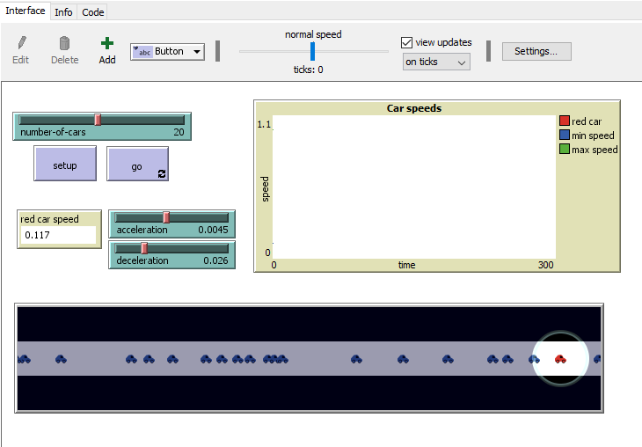
Let’s look at the basic traffic model
Three parameters that can vary
The red car can travel at max speed easily on its own, but has to brake and speed up when there is lots of traffic.
We want to find the breakpoint – the combination(s) of parameters where the red car’s behaviour changes.

Slide 8
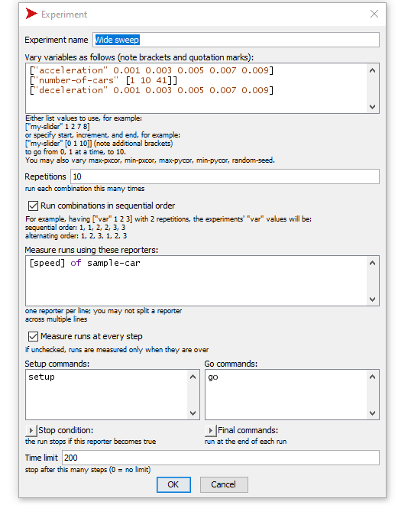
Wide parameter sweeps
Start wide
All parameters vary
Full/wide range
Big increments
Few repetitions
Goal is to find:
Errors not found in basic testing
Broad areas of interesting behaviour
Conceptual problems
Likely to motivate some (major?) code rewrites.

Slide 9
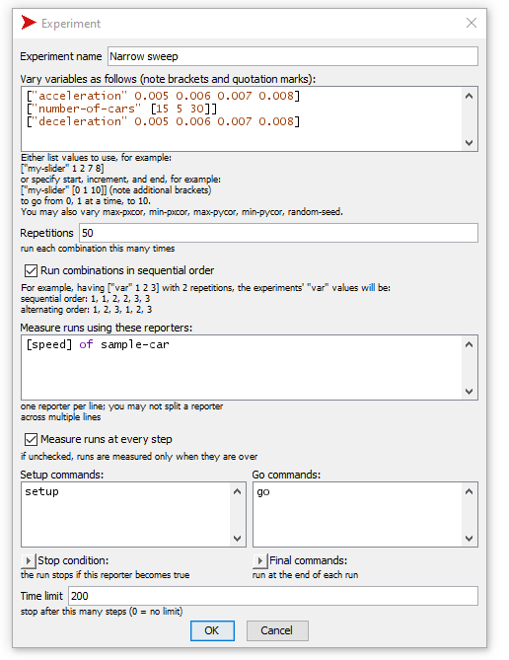
Narrow parameter sweeps
Narrowing in:
Maybe not all parameters
Narrower ranges and/or smaller increments
More repetitions
Goal is to find:
Hopefully no errors
Break points
Delineated critical areas
Code rewrites may be needed.

Slide 10
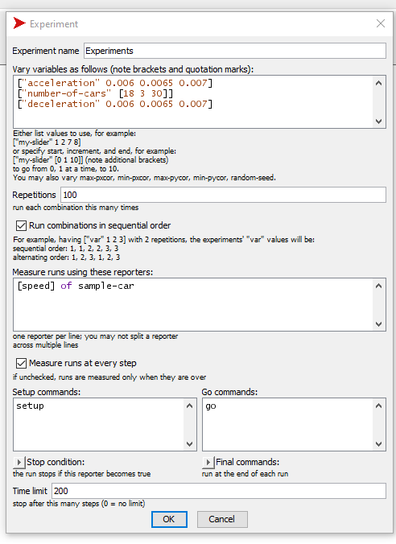
Experiments!
Essentially
MANY repetitions on single/few settings
Goal is to find:
Statistically useful volumes of data on areas that sweeps suggested were important

Slide 11
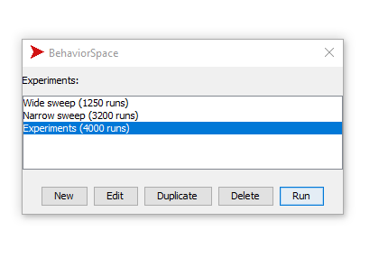
Behaviour Space

Slide 12
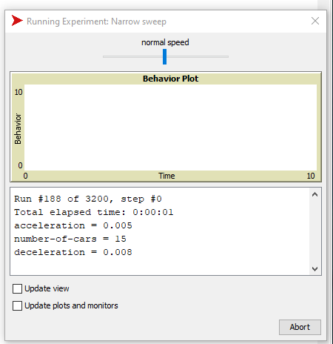
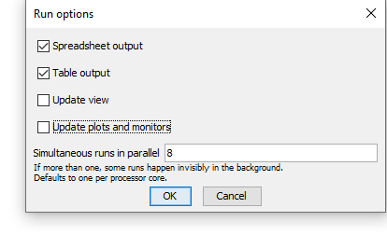
Choose a basic output option if needed

Slide 13
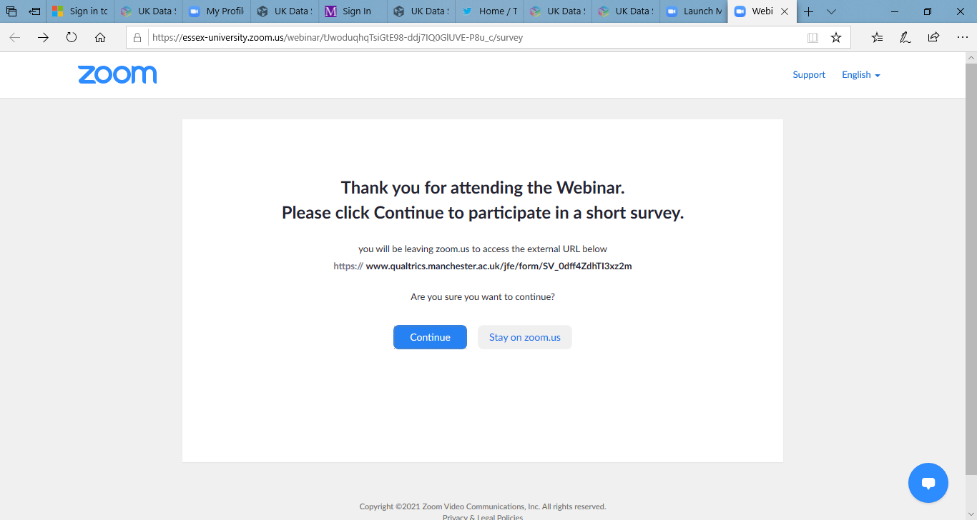
Evaluation
When you leave the webinar, please complete our short survey.
Just click on ‘continue’ to access the survey.

Slide 14


Thank you.
Dr. J. Kasmire
Email to j.kasmire@manchester.ac.uk
@JKasmireComplex on Twitter
@JKasmireComplex on Twitch
UKDS
@UKDataService on Twitter

