Slide 1


Adding real-world data to agent-based modelling for social scientists
Dr. J. Kasmire
Research Fellow at Cathie Marsh Institute and UK Data Service
Copyright © 2021 UK Data Service. Created by CSS Training Team, UK Data Service.

Slide 2
Interaction in this workshop
Zoom chat -> technical questions for facilitator
Zoom Q&A -> content questions for the host, upvote questions of others

Slide 3
Can you hear us?
?

Slide 4
Troubleshooting audio problems
Check your speaker/headset is plugged in / volume is on.
Click on audio to change to listening via phone
We are recording this workshop and will post it on YouTube (also live streaming there now)
(https://www.youtube.com/user/UKDATASERVICE)

Slide 5
You might be interested in other UKDS events
ABM workshop on running experiments - Feb 16
ABM guest researcher seminar - Mar 9
CSS Drop-ins – Every 2nd Tuesday of month at 13:00
https://ukdataservice.ac.uk/news-and-events/events.aspx
https://www.ukdataservice.ac.uk/news-and-events/events/past-events.aspx

Slide 6
Table of contents
Open CSV model in NetLogo
Navigate tabs
Run as random
Write to .csv file
Read from .csv file
Open GIS_commute model in NetLogo
Run as random with various settings
Examine code/folders for data files (.shp, etc.)
Run as GM_LAs with various settings
Questions

Slide 7
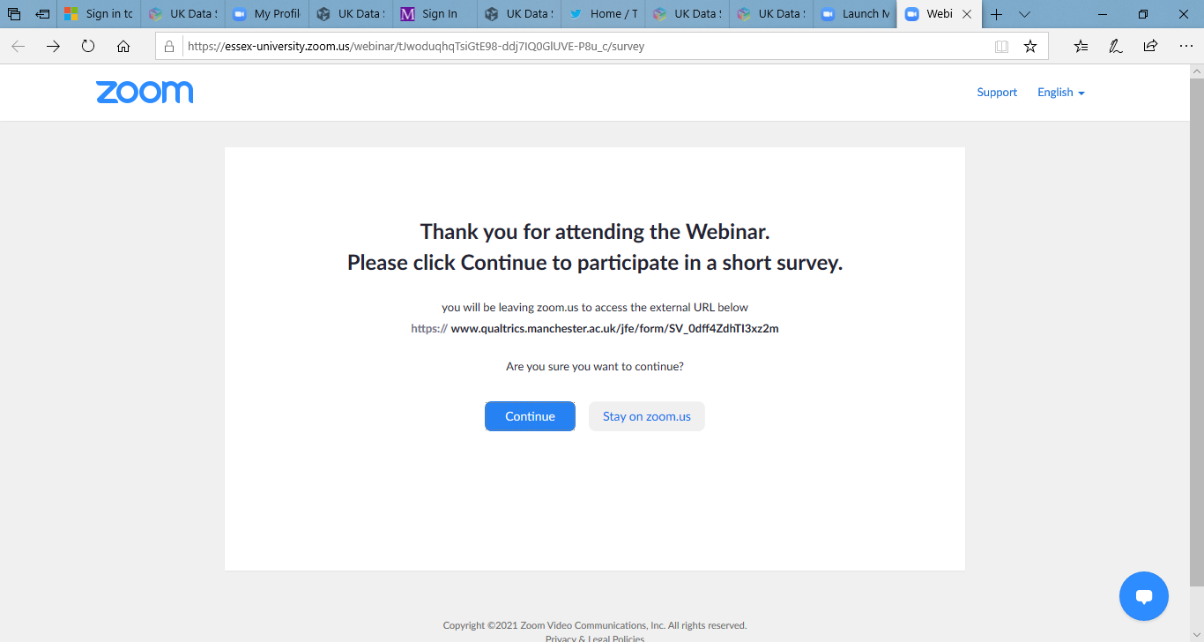
Evaluation
When you leave the webinar, please complete our short survey.
Just click on ‘continue’ to access the survey.

Slide 8


Thank you.
Dr. J. Kasmire
Email to julia.kasmire@manchester.ac.uk
@JKasmireComplex on Twitter
@JKasmireComplex on Twitch
UKDS
@UKDataService on Twitter

