Slide 1

AI runs the world – we don’t know how
I’d like to apply for a loan. Here’s my info
Your application is REJECTED
Why? What can I do to get ACCEPTED?
No idea. That’s just what the machine said
Notes:
Design of panel story inspired by Mike Morrison https://www.youtube.com/watch?v=fQDL8r3r_d4

Slide 2


Approach: Counterfactual explanations suggest changes to instances to avoid negative outcomes
REJECTED
Income | Rent | Savings | Debt
$4,000 | $1,500 | $7,000 | $850
Reject
Accept
ACCEPTED
Income | Rent | Savings | Debt
$6,000 | $1,500 | $7,000 | $850

Slide 3
Challenge 1: A counterfactual explanation may satisfy one user but not another
Unalterable Features
Feature Restrictions
Feature Priorities
My boss won’t give me a raise
Apartments by me cost $2-3k
I’d rather wait and save $$
Explanations must be personalized

Slide 4
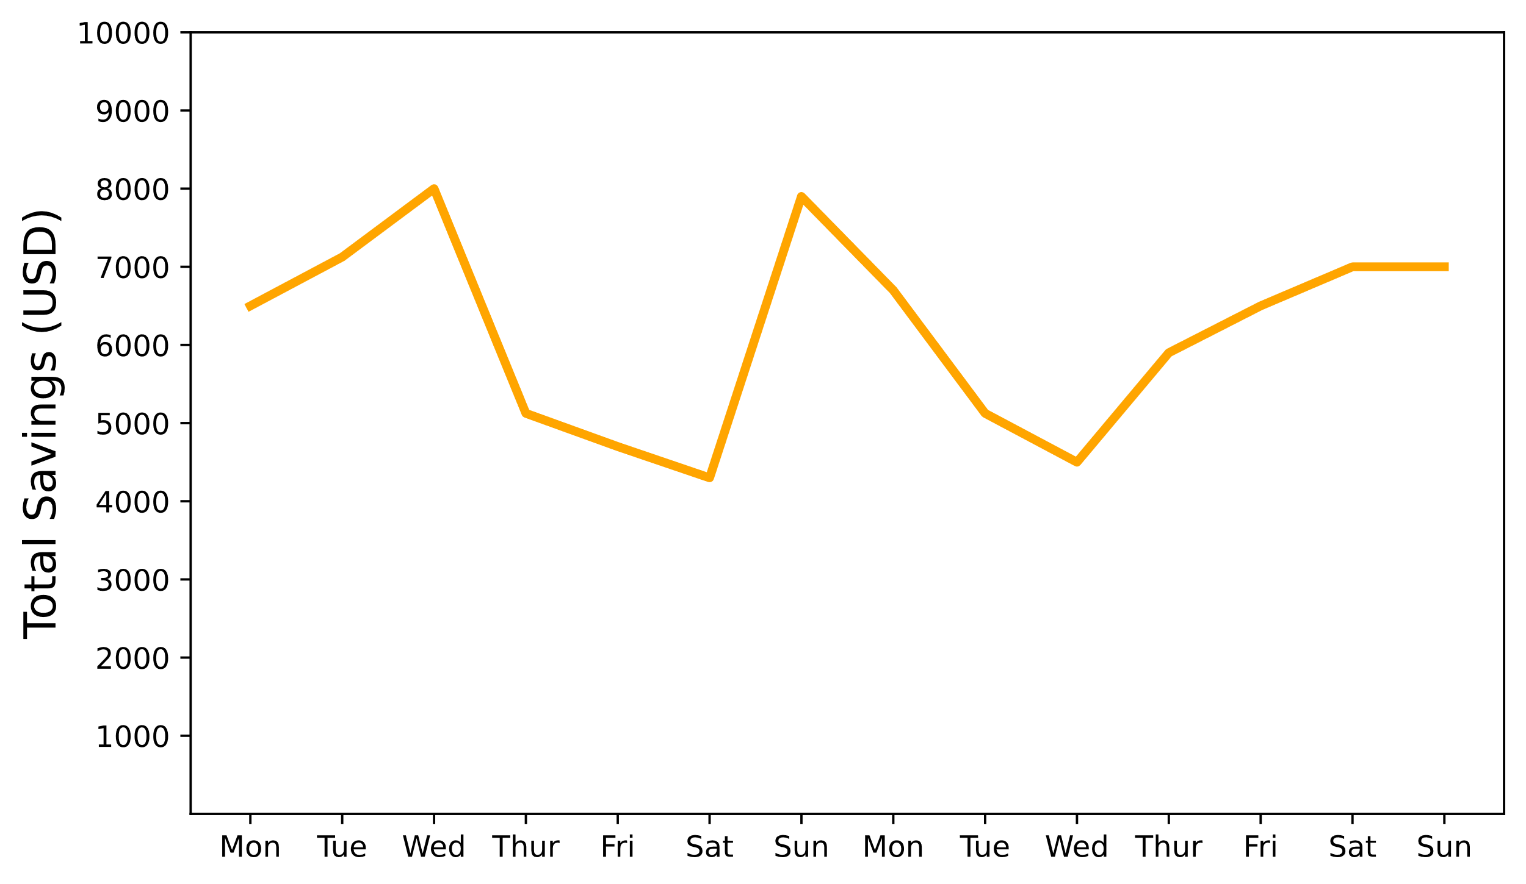
Challenge 2: Users can’t match an explanation exactly, leaving their true outcomes unknown
Total Savings Over Time
$7,001
?
$7,000
$6,999
?
Variations causes uncertainty

Slide 5
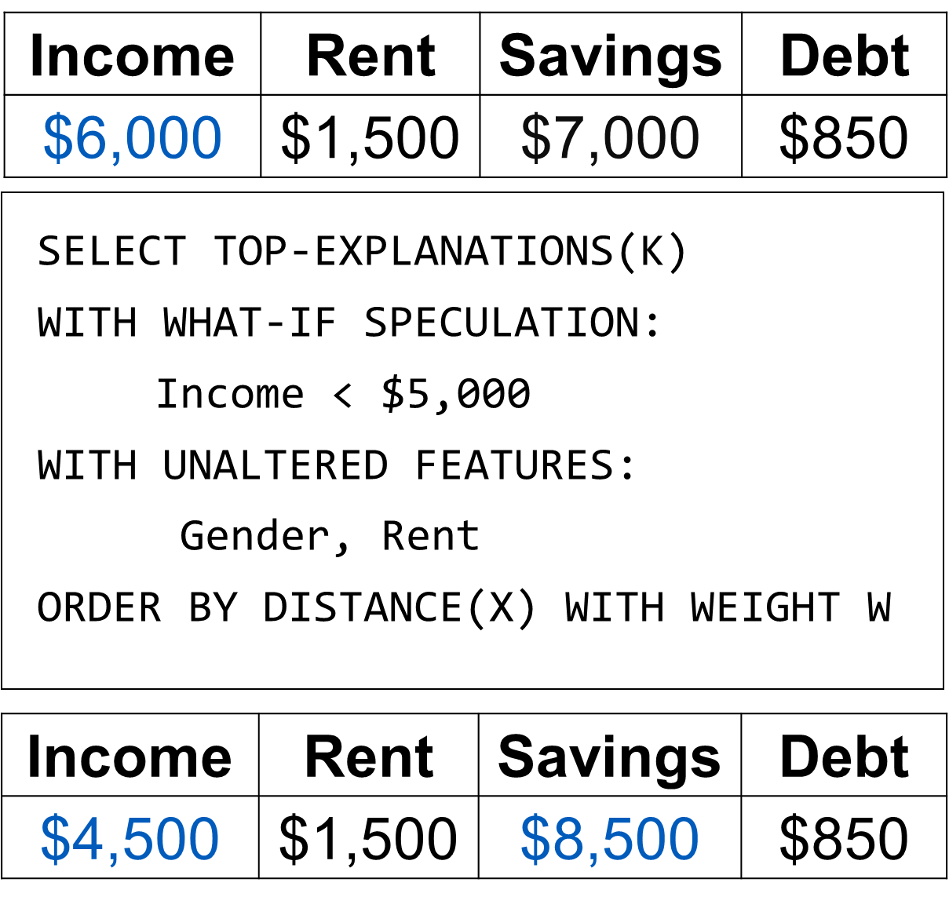
Solution 1: Generate and index a diverse set of explanation candidates
Classifier
XAI System
User Knowledge
Let users explore explanations by querying with actionable criteria

Slide 6
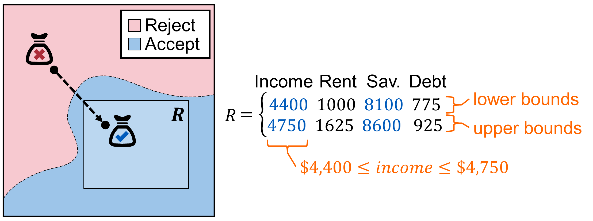
Solution 2: Create Counterfactual Regions that are robust to changes and provide context
Your application would be accepted rather than rejected if
your income was between $4,400 and $4,750 and
your savings was between $8,100 and $8,600

Slide 7

Checkout our paper for results, code and more!
petervannostrand.github.io
FACET: Robust Counterfactual Explanation Analytics
Peter M. VanNostrand, Huayi Zhang, Dennis M. Hofmann, and Elke A. Rundensteiner.
ACM SIGMOD 2023

