Slide 1
Counterfactual Explanation Analytics: Empowering Lay Users to Take Action Against Consequential Automated Decisions
Peter M. VanNostrand, Dennis M. Hofmann, Lei Ma
Belisha Genin, Randy Huang, Elke A. Rundensteiner
VLDB 2024 Demonstration Proposal
Notes:
Hi everyone, my name is Peter VanNostrand and today I’m presenting our proposed demo paper titled “Counterfactual Explanation Analytics: Empowering Lay Users to Take Action Against Consequential Automated Decisions”

Slide 2
Counterfactual Explanation
System Demonstration
Part 1
Part 2
Traditional approach and limitations
Our new approach to explanation
Visual explanation interface
Interactive explanation analytics
Notes:
This talk comes to you in two parts. In part one we’re going to briefly overview counterfactual explanation, traditional approaches and their limitations, and then introduce our new approach to explanation. In part 2 we’re going to do a live system demonstration of our visual explanation interface written in React and showcase out novel approach to counterfactual explanation as an interactive analytics task

Slide 3
Counterfactual Explanation
System Demonstration
Part 1
Part 2
Traditional approach and limitations
Our new approach to explanation
Visual explanation interface
Interactive explanation analytics
Notes:
This talk comes to you in two parts. In part one we’re going to briefly overview counterfactual explanation, traditional approaches and their limitations, and then introduce our new approach to explanation. In part 2 we’re going to do a live system demonstration of our visual explanation interface written in React and showcase out novel approach to counterfactual explanation as an interactive analytics task

Slide 4



85% of banks use ML in lending and investment decisions^{[1]}
rejected
49 States use ML in pre-trial detention and parole decisions^{[2]}
denied
>90% of F500 companies use automated applicant screening^{[3]}
hired
[1] Transforming Paradigms: A Global AI in Financial Services Survey, University of Cambridge, 2020
[2] Liberty at Risk: Pre-trial Risk Assessment Tools in the U.S., Electronic Privacy Information Center, 2022
[3] Hidden Workers: Untapped Talent, 2021 Harvard Business School Survey
Notes:
This is one example of many where consequential decisions about people’s lives are made automatically by machine learning systems. Recent surveys have found that 85% of banks use machine learning in lending and investment decisions, 49 States use machine learning in pre-trial detention and parole decisions, and more than >90% of F500 companies use automated applicant screening in their hiring process. This means that every day millions of people are rejected for loans, denied parole, or denied a job opportunity based on the decision of these machine learning systems

Slide 5
Why?
Notes:
Naturally, when facing these negative outcomes users want to know why. And specifically those questions are often phrased something like this: why was my loan application classified as rejected rather than accepted, why was my parole request denied rather than approved, or why was my resume classified as not-hired rather than hired

Slide 6
Counterfactual Question
Why was my loan application REJECTED rather than ACCEPTED?
Observed Instance
Factual Outcome
(undesired)
Counterfactual Outcome
(desired)
Notes:
Naturally, when facing these negative outcomes users want to know why. And specifically those questions are often phrased something like this: why was my loan application classified as rejected rather than accepted, why was my parole request denied rather than approved, or why was my resume classified as not-hired rather than hired

Slide 7
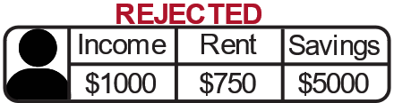


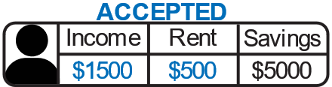

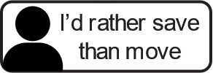
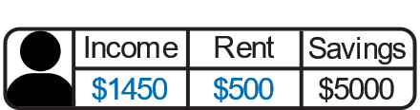





SOTA: Counterfactual Points
$$x$$
$$x$$
$$x′$$
Counterfactual Point
$$x^{′}$$
Minimize $δ\left(x,x^{′}\right)$
Challenge 1: Personalization
Challenge 2: Feature Variations
Reject
Accept
[4] Riccardo Guidotti. 2022. Counterfactual explanations and how to find them: literature review and benchmarking. Data Mining and Knowledge Discovery
Notes:
The traditional way of doing this is via counterfactual point explanations. Given a negative outcome such as this rejected loan applicant, traditional explanation techniques generate a new counterfactual point which represents some hypothetical changes to the instance such that it would be accepted such as “your application would have been accepted if your income was $1500 and your rent was $500.” If we look at the decision surface of the machine learning model this equate to starting from the observed instance x and moving across the decision boundary to some new point x’, and this is often done to minimize the size of this change according to some distance function. This has two main challenges though. The first is explanation personalization. A user could very obviously say “I can’t get a raise” or “I’d rather save money than move” which means that these suggested changes wouldn’t actually be actionable for them. The second challenge is feature variations. If the user is targeting a raise to $1500 but ends up getting a raise to $1450, what happens in this case? In the decision surface we can think about this as the possibility of small pertburbation causing the user to end up at one of these nearby points instead of exactly meeting the suggested x’. This happens because the counterfactual point places very rigid requirements on users who don’t have 100% agency over their feature-values, and is especially pernicious for features like savings which can vary quite a lot over a normal day meaning that whether or not they get accepted is basically up to random chance of exactly when they reapply

Slide 8

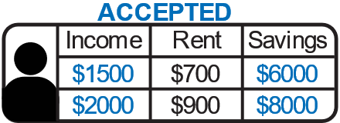


Ours: Counterfactual Regions
$$x$$
$$x$$
Personalized Query
$$R$$
Counterfactual Region
Reject
Accept
[5] Peter M. VanNostrand, Huayi Zhang, Dennis M. Hofmann, and Elke A. Rundensteiner. 2023. FACET: Robust Counterfactual Explanation Analytics. SIGMOD

Slide 9
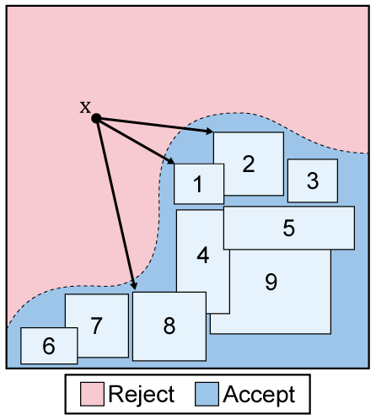
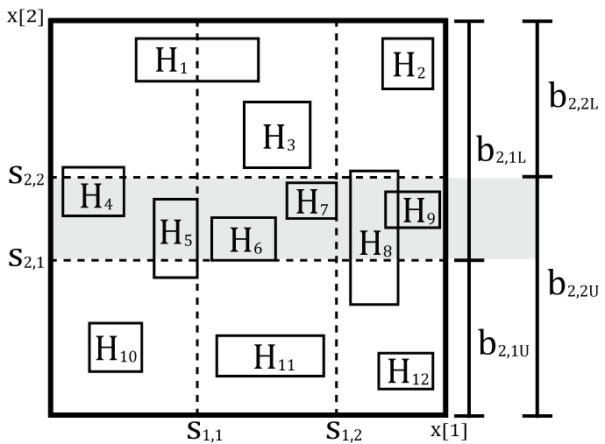
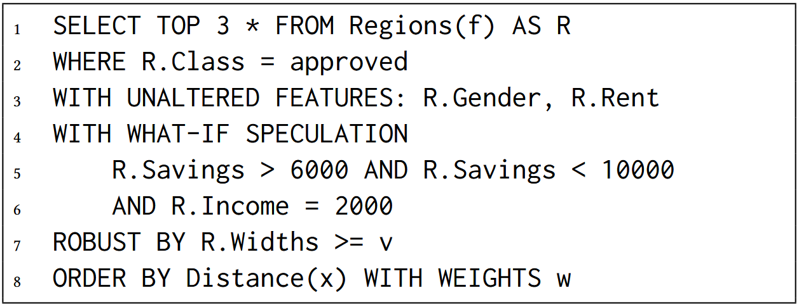
FACET Explanation System
(1) Precompute
(2) Index
(3) Personalized Analytics
FACET transforms the explanation generation process into an interactive analytics task

Slide 10
Counterfactual Explanation
System Demonstration
Part 1
Part 2
What is it?
Traditional techniques and limitations
Our new approach to explanation
React Web Dashboard
Interactive explanation analytics

