Slide 1



Region explanations provide context for users to better understand AI models and avoid negative outcomes
Denied
for loan
$$x$$
Explanation of how to get approved
$$R$$
Notes:
Design of panel story inspired by Mike Morrison https://www.youtube.com/watch?v=fQDL8r3r_d4

Slide 2




AI decisions can have huge impacts on your life
85% Banks
49
States
90% F500
AI lending
AI for parole
AI in hiring
rejected
denied
hired

Slide 3

Counterfactual explanations tell you how a decision was made to help change it’s outcome
rejected
action
accepted
denied
action
approved
hired
action
hired

Slide 4




Competing Notions of counterfactuals give no clear best practices for designers
Point-Based
Region-Based
$$x$$
$$x$$
$$R$$
$$x′$$

Slide 5
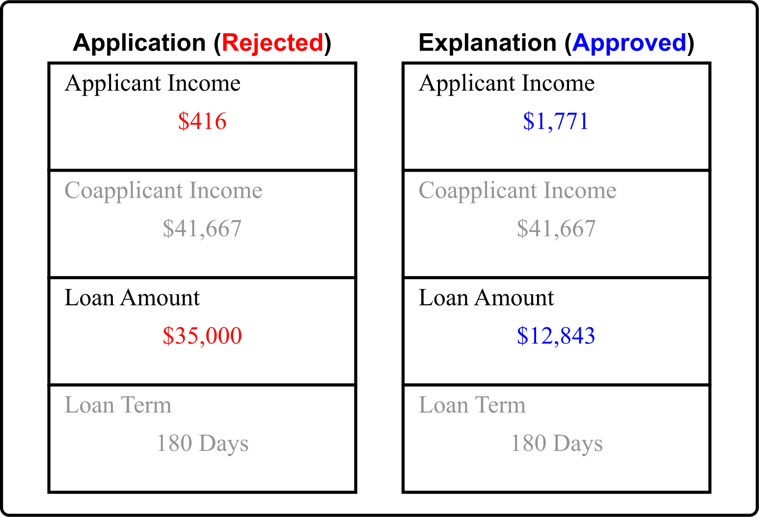
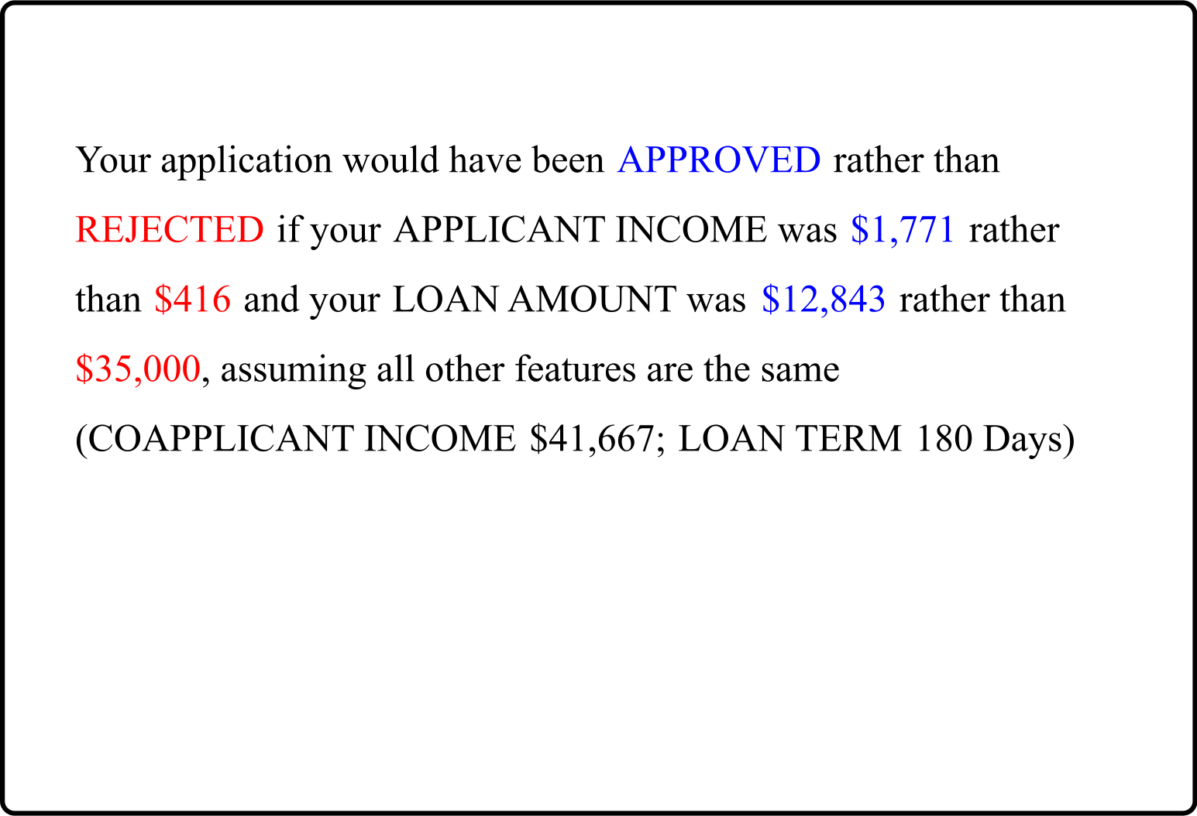
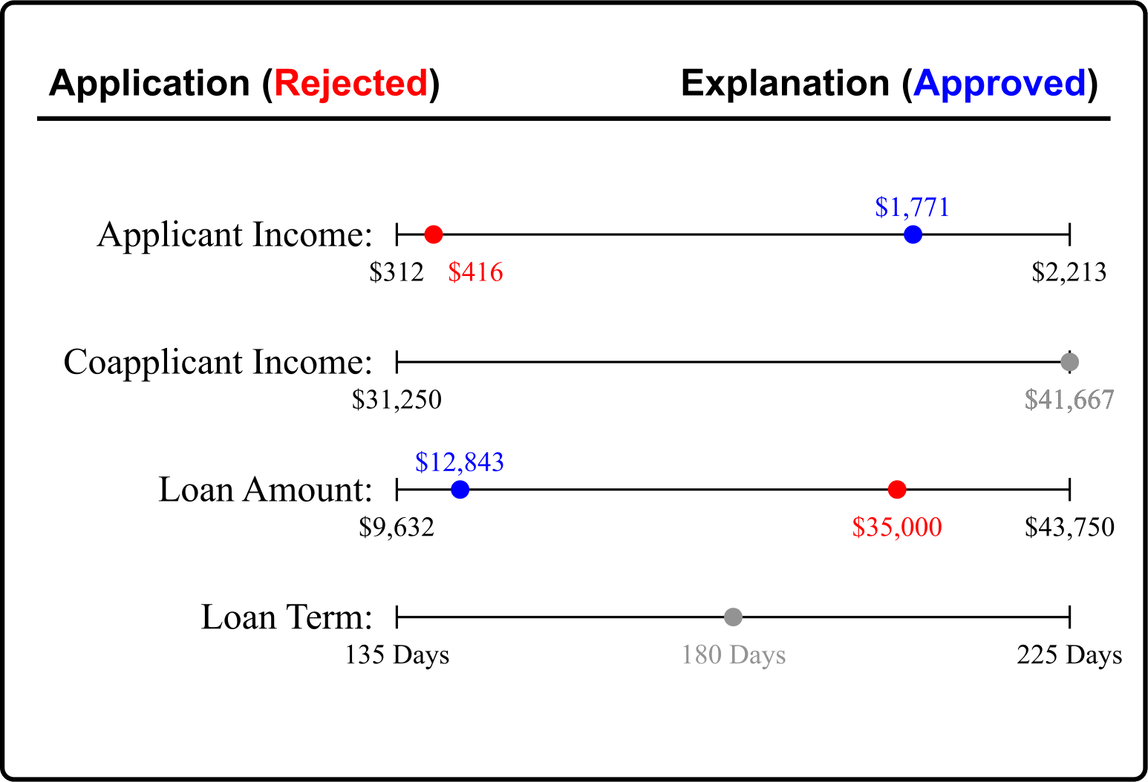
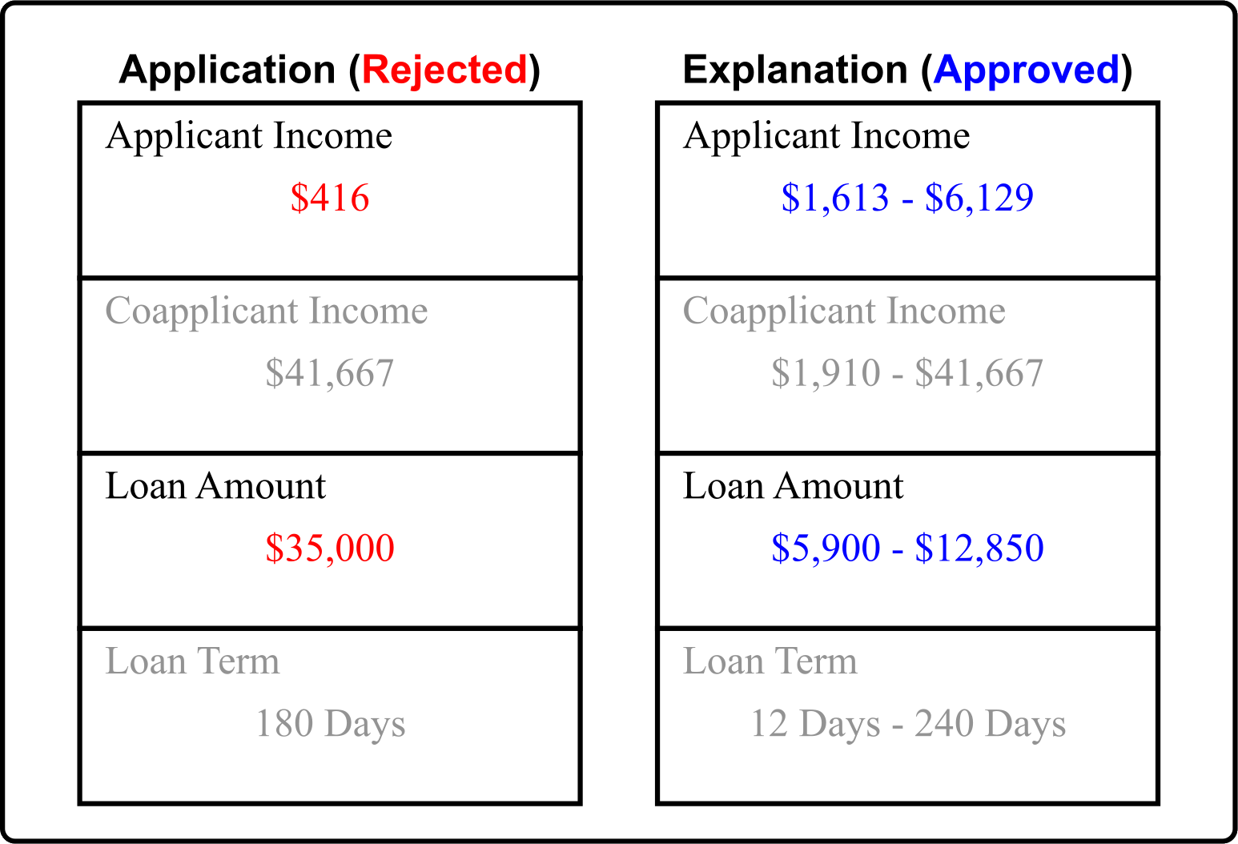
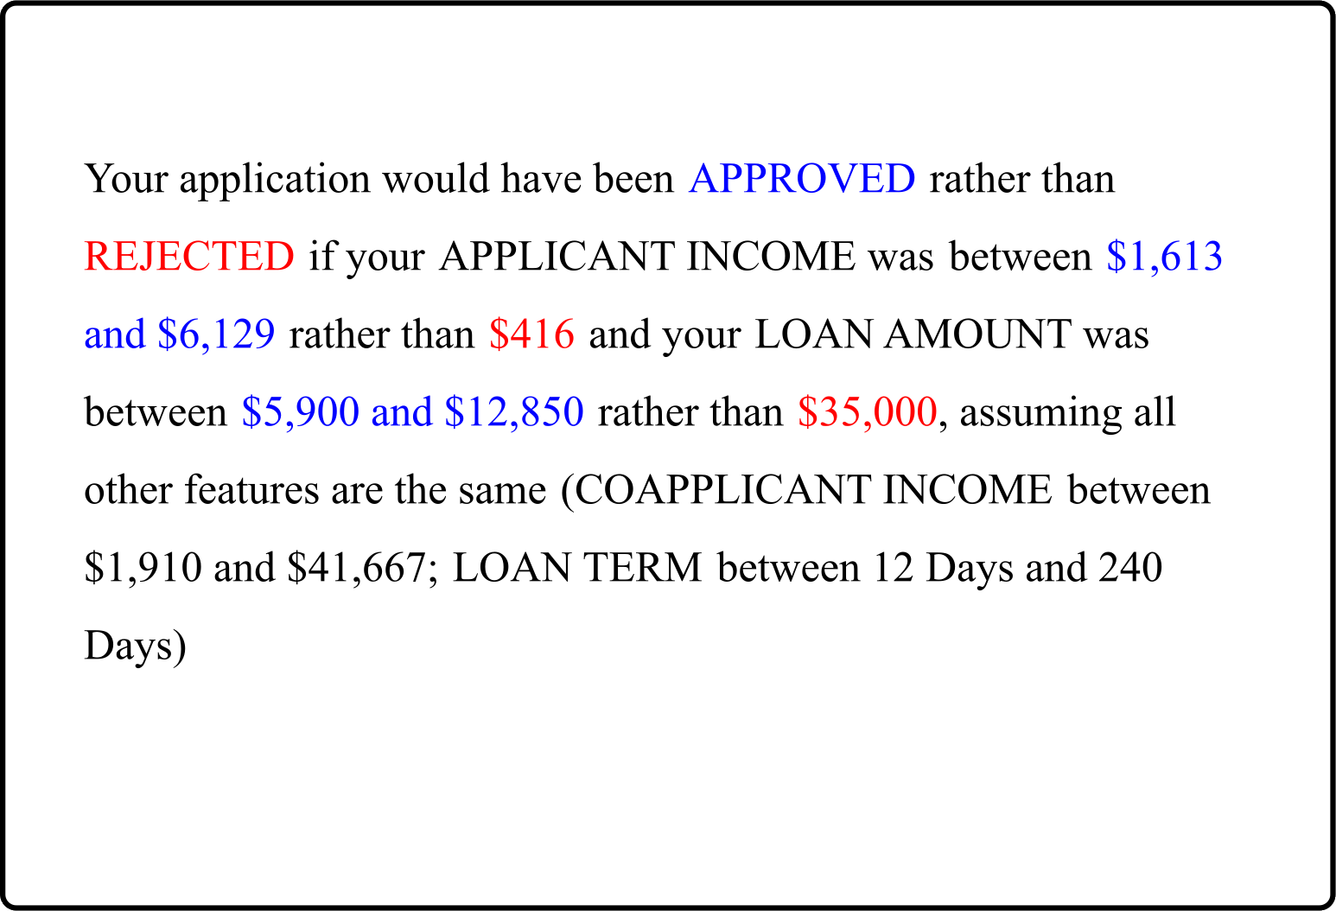
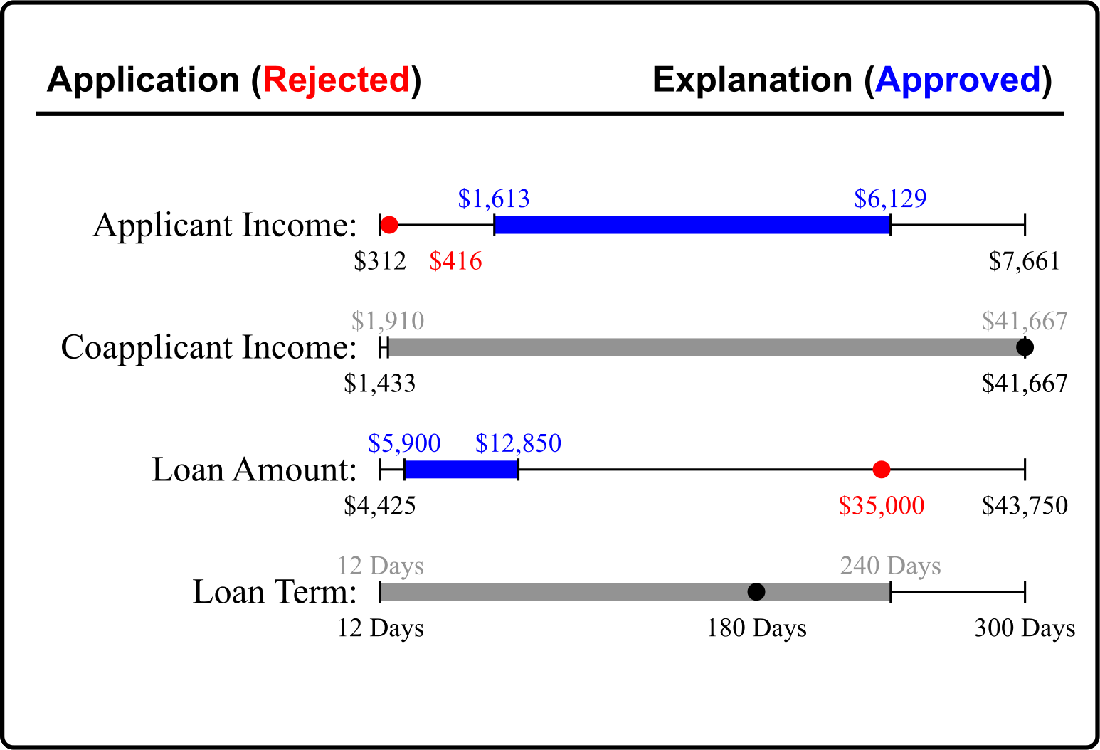
We evaluate 6 configurations of counterfactual explanation (2 Types x 3 Presentations)
Numeric
Natural Language
Visual
Point
Region

Slide 6







A crowd sourced user study finds…
counterfactual regions give users the best understanding and confidence
Presentation does not affect understanding
but does effect response time
264 Participants Prolific.com
US English Speaking Adults
$4 base + up to $2 bonus
~$14.98/hr

Slide 7

Checkout our paper for full results, qualitative analysis and more!
petervannostrand.github.io
Actionable Recourse for Automated Decisions
Examining the Effects of Counterfactual Explanation Type and Presentation on Lay User Understanding
Peter M. VanNostrand, Dennis M. Hofmann, Lei Ma, and Elke A. Rundensteiner.
ACM FAccT 2024

