Slide 1
Confidential Deep Learning Executing Proprietary Models on
Untrusted Devices
Peter M. VanNostrand*
Ioannis Kyriazis†
Michelle Cheng‡
Tian Guo†
Robert J. Walls†
University at Buffalo*, Worcester Polytechnic Institute†, Colby College‡
Notes:
This PowerPoint Template includes a series of slide masters with predefined layouts and color schemes for formatting slides
Slide Masters are displayed when you right click on a slide and select Layout from menu

Slide 2
What is this?

Slide 3
Why do we care?

Slide 4
Amazon reportedly employs thousands of people to listen to your Alexa conversations
By Jordan Valinsky, April 11th 2019
Notes:
Source: https://www.cnn.com/2019/04/11/tech/amazon-alexa-listening/index.html

Slide 5
“Good thing I don’t have an Echo”

Slide 6
Apple’s hired contractors are listening to your recorded Siri conversations, too
By Chain Gartenberg, July 26th 2019
Notes:
Source: https://www.theverge.com/2019/7/26/8932064/apple-siri-private-conversation-recording-explanation-alexa-google-assistant

Slide 7
Google to cease listening to Assistant recordings in EU pending investigation
By Kyle Bradshaw, August 1st 2019
Notes:
Source: https://9to5google.com/2019/08/01/google-to-cease-listening-to-assistant-recordings-in-eu-pending-investigation/

Slide 8
Always Present

Slide 9
Often Listening

Slide 10
What do they hear?

Slide 11
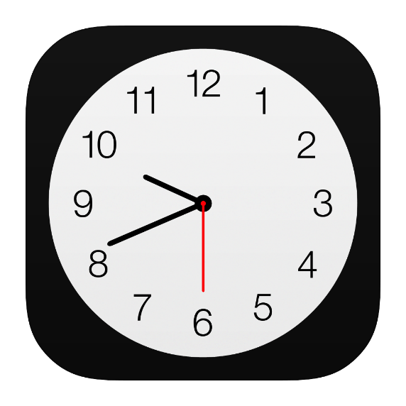

Timers?
Weather?
Notes:
Icons from http://www.iconarchive.com

Slide 12


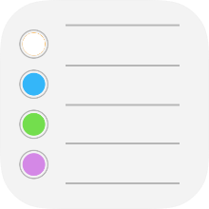
Discussions between doctors and patients
Apple Contractor speaking to The Guardian
Business Deals
Sexual Encounters
Notes:
Source: https://www.theguardian.com/technology/2019/jul/26/apple-contractors-regularly-hear-confidential-details-on-siri-recordings
Icons from http://www.iconarchive.com

Slide 13
Why?

Slide 14
Convenient

Slide 15
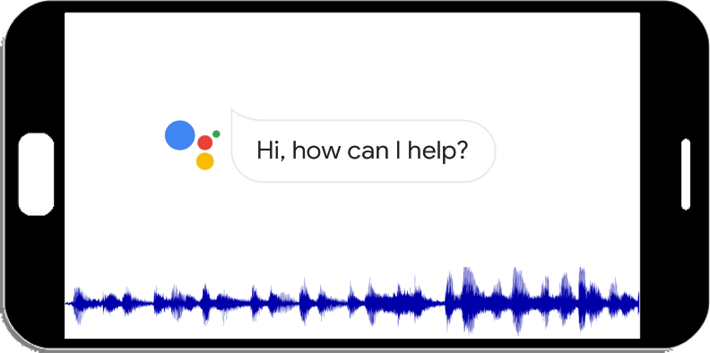


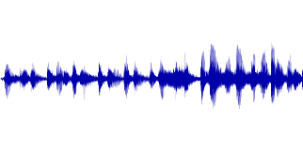
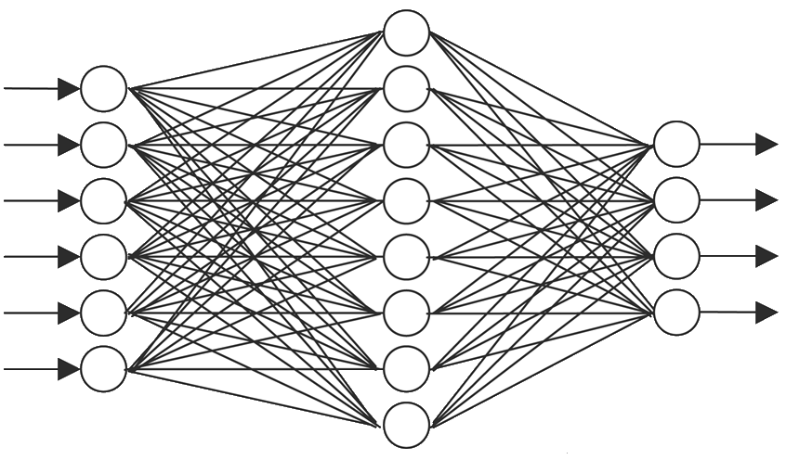
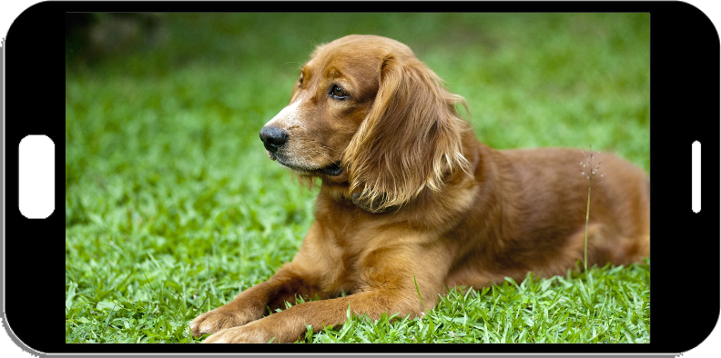
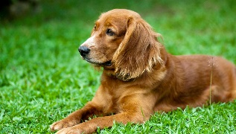
Q: How’s the
weather?
A: Partly cloudy
A: Partly cloudy
dog
dog
grass
laying
grass
laying

Slide 16
Can we do better?

Slide 17





Client Inference
Private
Personalized
Offline
Fast
Q: How’s the
weather?
A: Partly cloudy
dog
laying
grass

Slide 18
Challenge: Confidentiality
Proprietary Models
Untrusted Devices
Large investment to create model
Trained on sensitive data
Intellectual property
Client devices are untrusted
User has full access to device
OS or apps may be used to copy and redistribute models

Slide 19
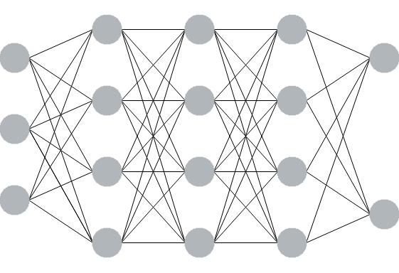








Goal: Keep Models Confidential
What needs protection?
Structure
Weights and biases
Activations
Models
Convolutional Neural Network (CNN)
Weighted sum
$$w_{1}$$
$$b$$
$$a_{1}$$
$$w_{2}$$
$$w_{3}$$
$$a_{2}$$
$$a_{3}$$
$$y=w_{1}a_{1}+w_{2}a_{2}+w_{3}a_{3}+b$$

Slide 20
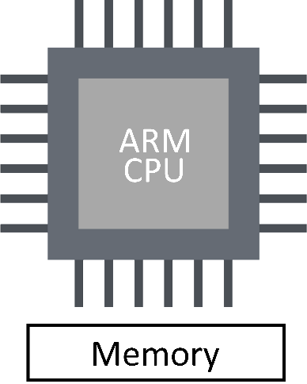
Solution: Build Trust With Hardware
ARM TrustZone
Hardware module
In most smartphones
Difficult to modify
Acts as root of trust
Divides Hardware
Normal World (NW)
Secure World (SW)
Normal World
Secure World
X

Slide 21
Solution: Software Model
Separate software stacks
NW = Linux/Android
SW = Trusted Exec. Environ.
Trusted Execution Environment
Manages SW resources
Hosts Trusted Applications
Provides APIs to these apps
Uses NW OS for most syscalls
Normal World
Secure World
Secure Monitor
Client Application
Trusted Application
Normal World OS
Secure World OS

Slide 22
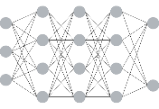

Solution: Memory Model
Shared memory
NW memory registered with TEE
Accessible from TA
Insecure, must keep contents encrypted
Pass model from CA to TA via shared memory
Normal World
Secure World
Client Application
Trusted Application
dzbkayohovlflbj
Shared Memory
Register SM
Decrypt
dzbkayohovlflbj

Slide 23
Challenges
Installing secure OS on client device
Verifying integrity of application code
Trusted board boot implementation
Distributing encrypted models and applications
Preventing side channel and Iago attacks
Very limited memory in secure world
Critical obstacle we will focus on

Slide 24
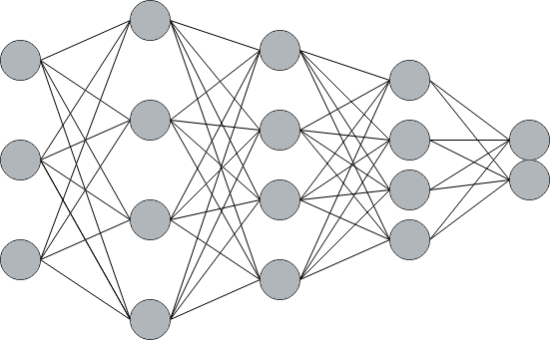
Memory Limitations
Client Application
DNNs
0.6
-
1.5 GB
CA
~2 GB
TA
7 MB
Full model won’t fit into Secure World memory
ERR: Insufficient Memory
Trusted Application

Slide 25
What now?

Slide 26
Privacy
Personalization
Give up?
Offline Access
Performance

Slide 27
Make models smaller?

Slide 28
Smaller = Less Accurate

Slide 29
MobileNet
NasNet Mobile
SqueezeNet
ShuffleNet

Slide 30
What if we break model into pieces?

Slide 31
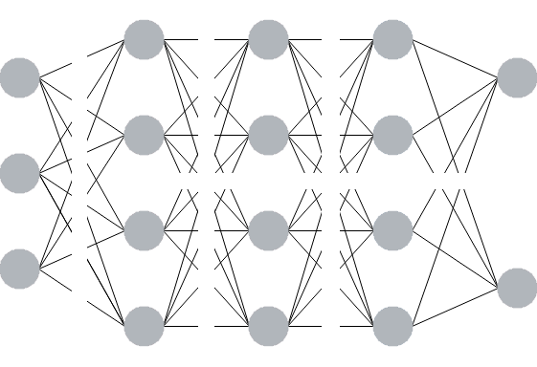
Model Partitioning
W&B
W&B
W&B
Split model into multiple partitions
Each has own weights file
Run partitions sequentially
If partitions are small they fit in secure memory
Results
W&B
Results
W&B
W&B
W&B

Slide 32
Where do we put partition points?

Slide 34
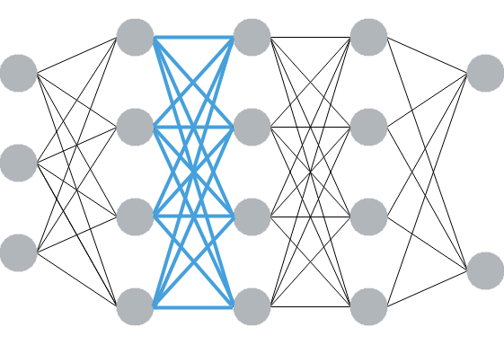
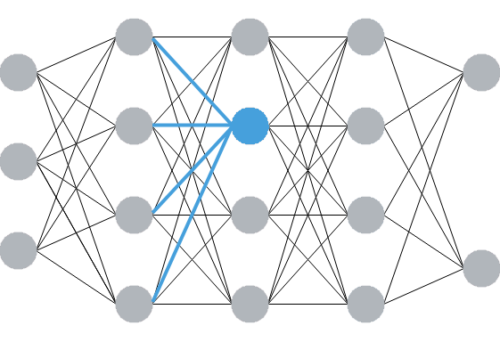






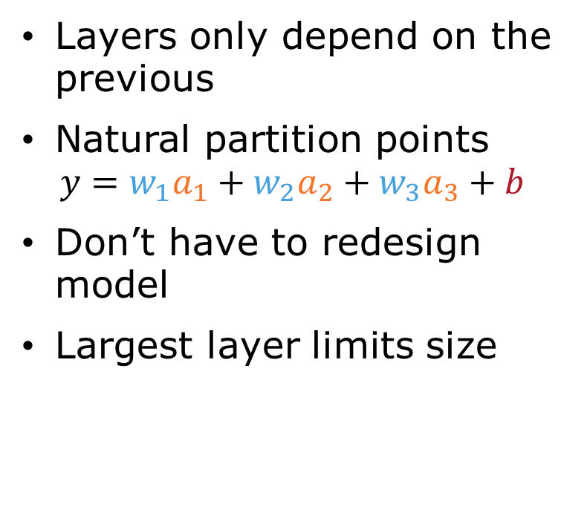





Layer-Based Partitioning
$$n activations$$
$$n biases$$
Layers only depend on the previous
Natural partition points
$$y=w_{1}a_{1}+w_{2}a_{2}+w_{3}a_{3}+b$$
Don’t have to redesign model
Largest layer limits size
$$a$$
$$b$$
$$a$$
$$b$$
$$a$$
$$b$$
$$a$$
$$b$$
$$n^{2} weights$$

Slide 35
What if layer is too large?

Slide 36
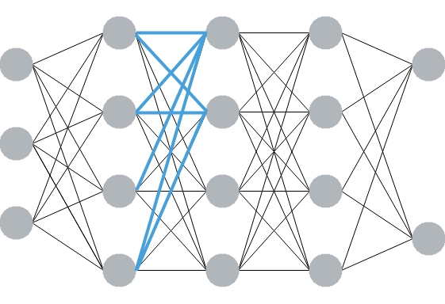



Sub-Layer Partitioning
$$n activations$$
$$s biases$$
Break each layer into subsets
Select size of subset to keep memory use small
Significantly smaller memory usage
Still no changes to model
Number of activations may be large
$$a$$
$$b$$
$$a$$
$$b$$
$$a$$
$$a$$
$$sxn weights$$

Slide 37
What happens if activations exceed the memory size?

Slide 38
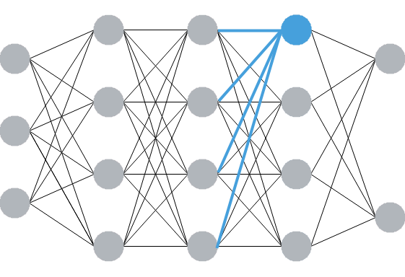

Slide 39
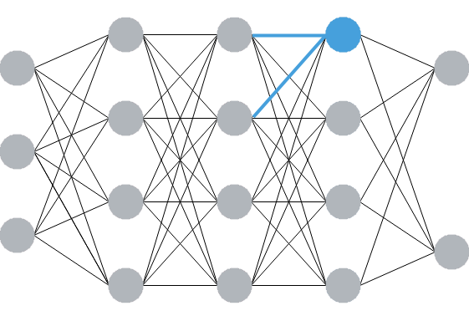

Slide 40
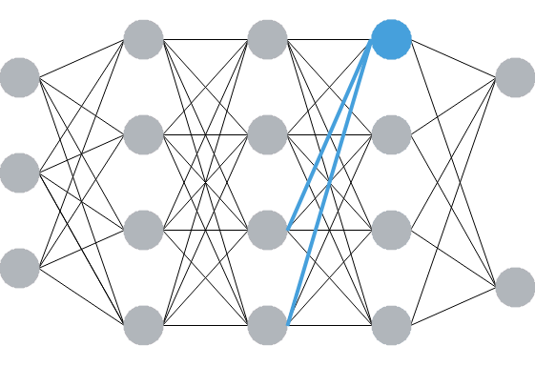

Slide 41
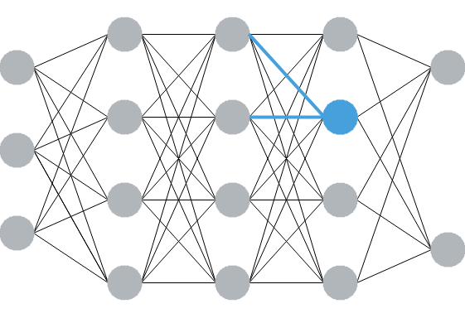

Slide 42
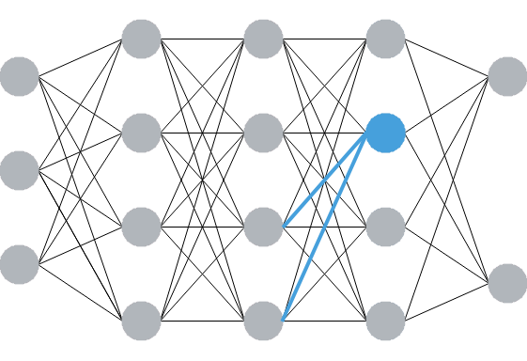

Slide 43
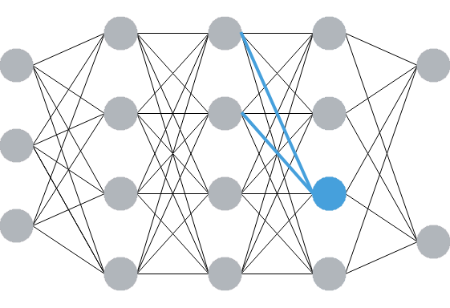

Slide 44
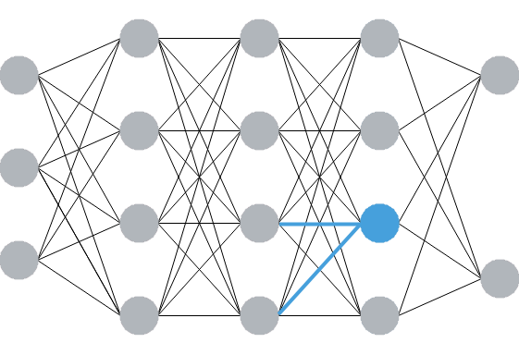

Slide 45
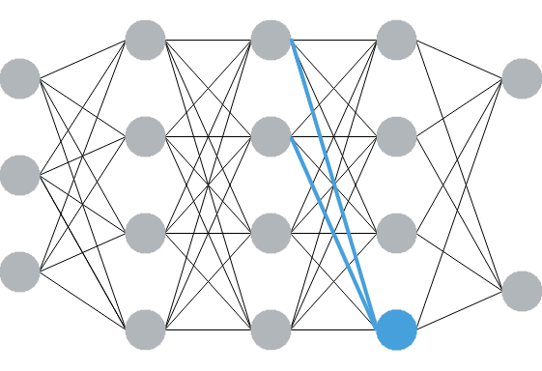

Slide 46
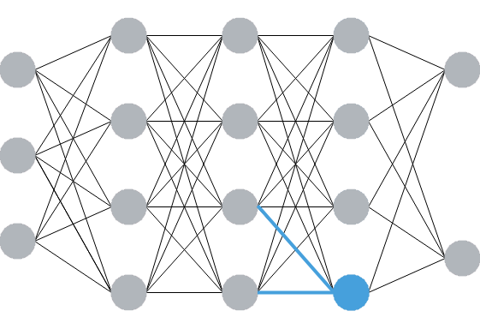

Slide 47
Needing to switch activations incurs a performance cost

Slide 48
In worst case need to decrypt same values many times

Slide 49
Can we reduce the number of activations needed?

Slide 51
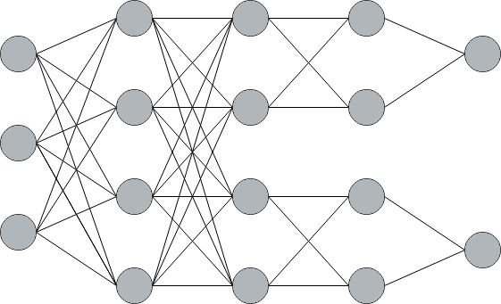

Slide 52
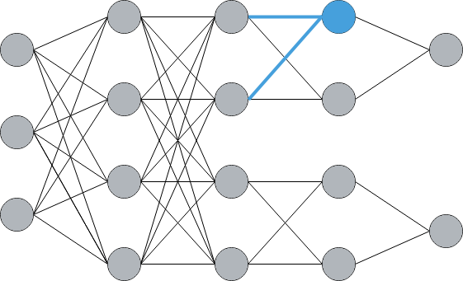

Slide 53
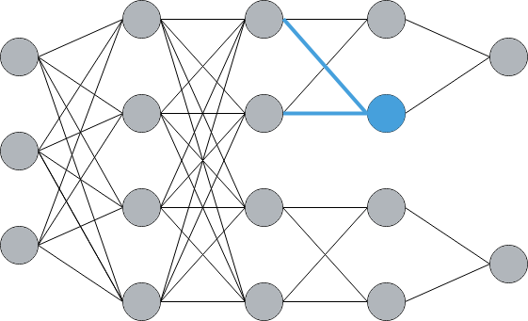

Slide 54
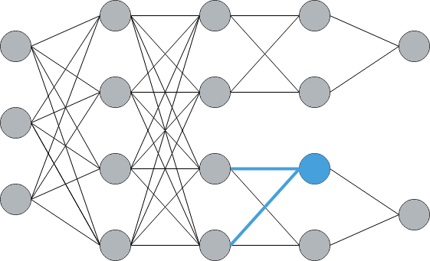

Slide 55
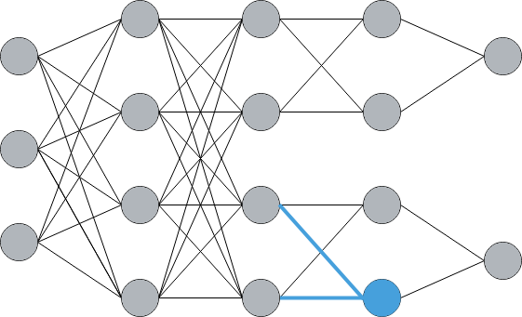

Slide 56
Branched Execution Partitioning
Normal World
Secure World
Branches have few required values
Run these in Secure World memory
Early layers are large, run in Normal World

Slide 57
Doesn’t this reveal critical information?

Slide 58
Information in CNNs
Early layers learn simple features
Later layers learn complex features
Edges
Corners
Characters
Faces

Slide 59
For some models keeping later layers confidential may be sufficient

Slide 60
Branched Execution Partitioning
Benefits
Limitations
Small memory footprint
Activations used once, then discarded
Sequential operations optimize well
Requires model redesign
Using NW is security compromise

Slide 61
Summary: Model Partitioning
 | Small Models | Medium Models | Large Models
Consideration | Limited Development Time | Avoid Costly Operations | Best Performance
Partitioning Schema | Layer Based Partitioning | Sub-Layer Partitioning | Branched Execution Partitioning

Slide 62

Takeaways
Client Inference
Private
Offline
Personalized
Proprietary Models
Trained on sensitive data
Must protect weights, biases, structure
Checkout our paper
ARM TrustZone
Provides Secure World
Acts as root of trust on untrusted devices
Protects models
Model Partitioning
Reduces instantaneous memory size
Allow models to run in Secure World
https://bit.ly/2k2ZIg0

Slide 63
Questions?

