Slide 1
Ransomware Attack
Strongly Encrypting the World

Slide 2
Contents
Statistics
Cyber Kill Chain
Cryptography
Demo
Questions

Slide 3
Ransomware Statistics in %

Slide 4
Cyber Kill Chain
Advanced Persistent Threat

Slide 5
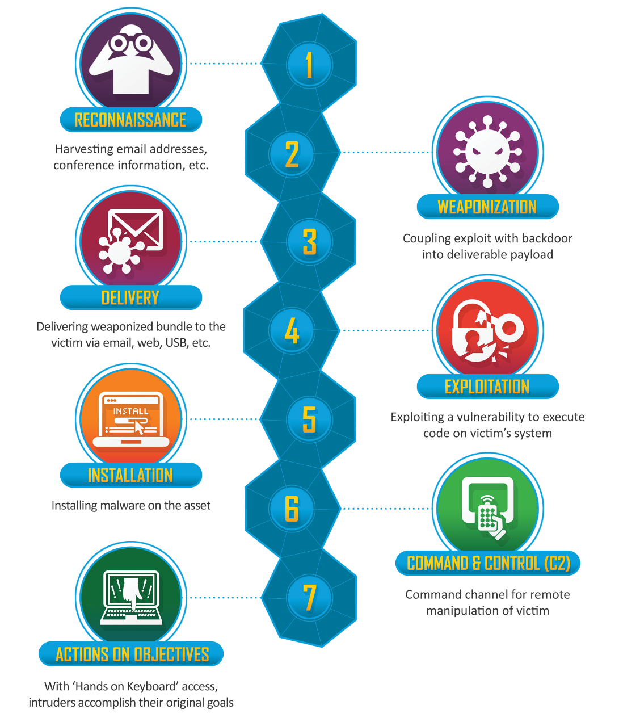
Reconnaissance
Weaponization
Delivery
Exploitation
Installation
C2
Actions On Objectives

Slide 6
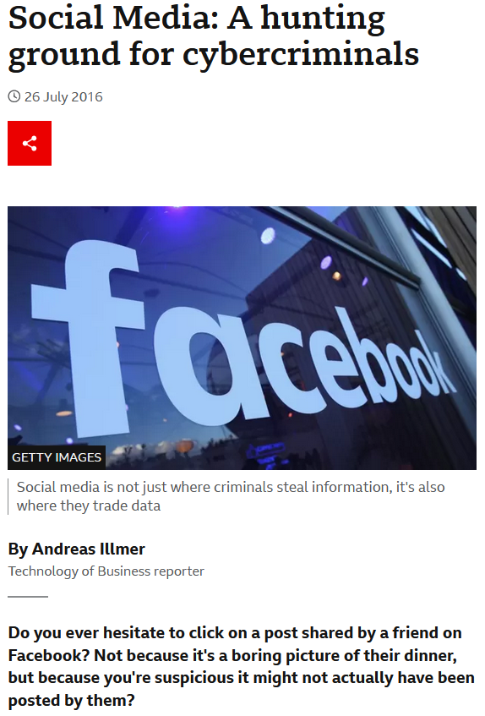
Reconnaissance Passive Active

Slide 7
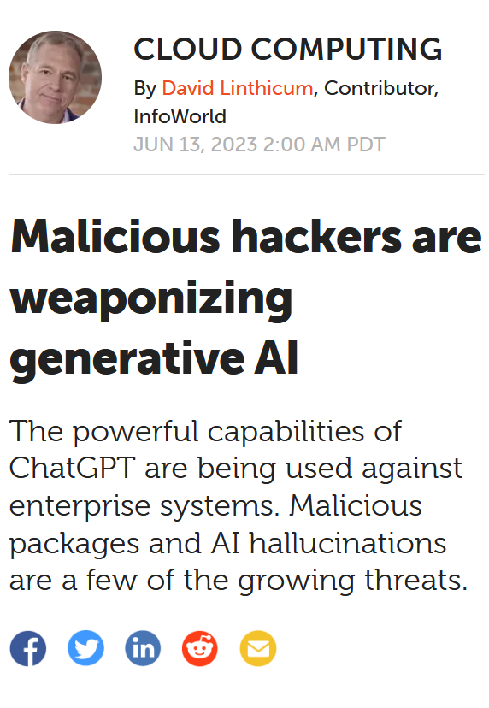
Weaponization Payload

Slide 8
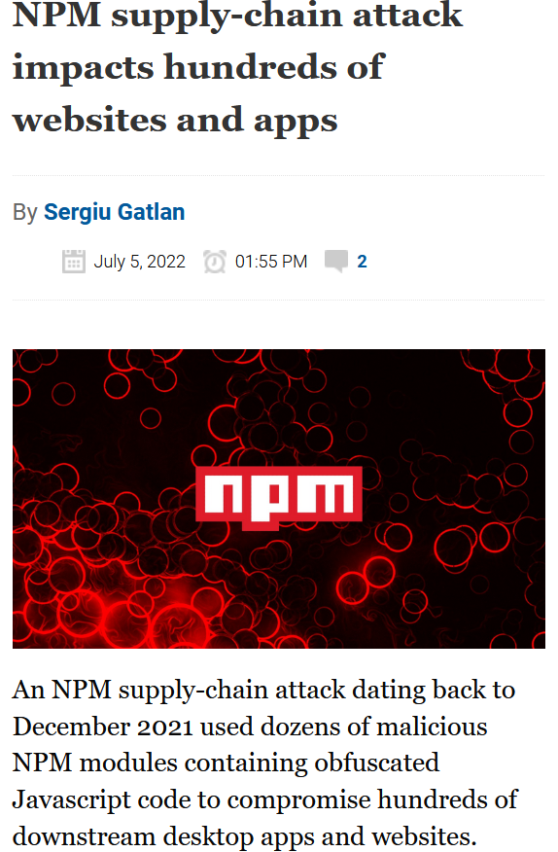
Delivery Phishing, Packages …

Slide 9
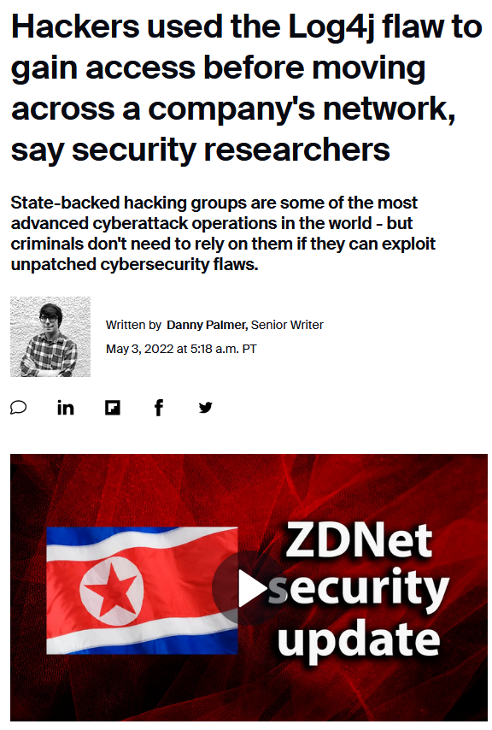
Exploitation Execute

Slide 10
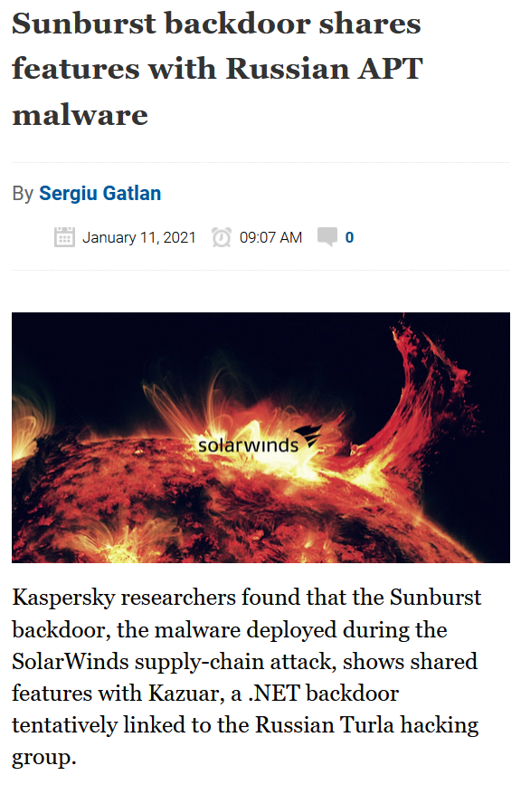
Installation Malware, RAT …

Slide 11
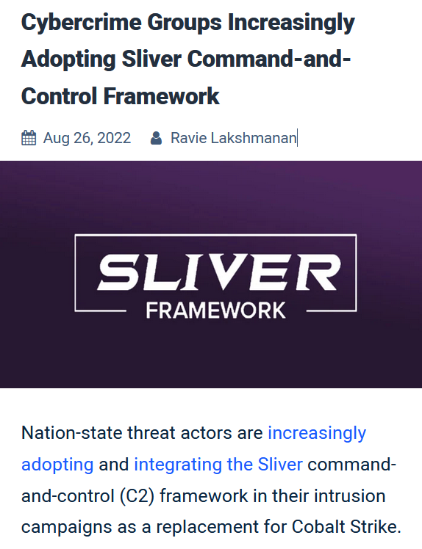
Command & Control

Slide 12
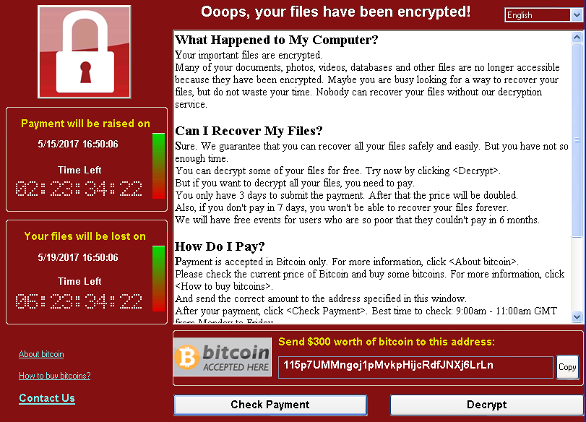
Actions On Objectives

Slide 13
Cryptography

Slide 14
Symmetric or Private Key Encryption
Encryption and decryption using same key.
AES, DES, and 3DES
Faster than Asymmetric
Better performance
Optimized for bulk amounts of data
Easy Implementation

Slide 15
Asymmetric or Public Key Encryption
Encryption and decryption using different keys.
RSA, ECC
Uses: TLS/SSL handshake, Sharing keys for symmetric key cryptography.
Tamper Proof
Proof of owner

Slide 16
Program Demo Symmetric Encryption

Slide 17
Thank you
github.com/PeterWalker-Inc/ransomware
in.linkedin.com/in/peterwalkera

