Slide 1
Pysindy Nonlocal Interactions
Qichen Xu

Slide 2
08/15

Slide 3
Overview
Objective: Make sure that nonlocal library performs well with a different test trajectory, starting with alpha near 2.
Expected output: nonlocal lib should output the same as the PDE lib.
Setup: Compare between four setups for alpha between 1 and 3
Nonloc lib with derivative order 2
Nonloc lib with derivative order 3
PDE lib with derivative order 2
PDE lib with derivative order 3

Slide 4
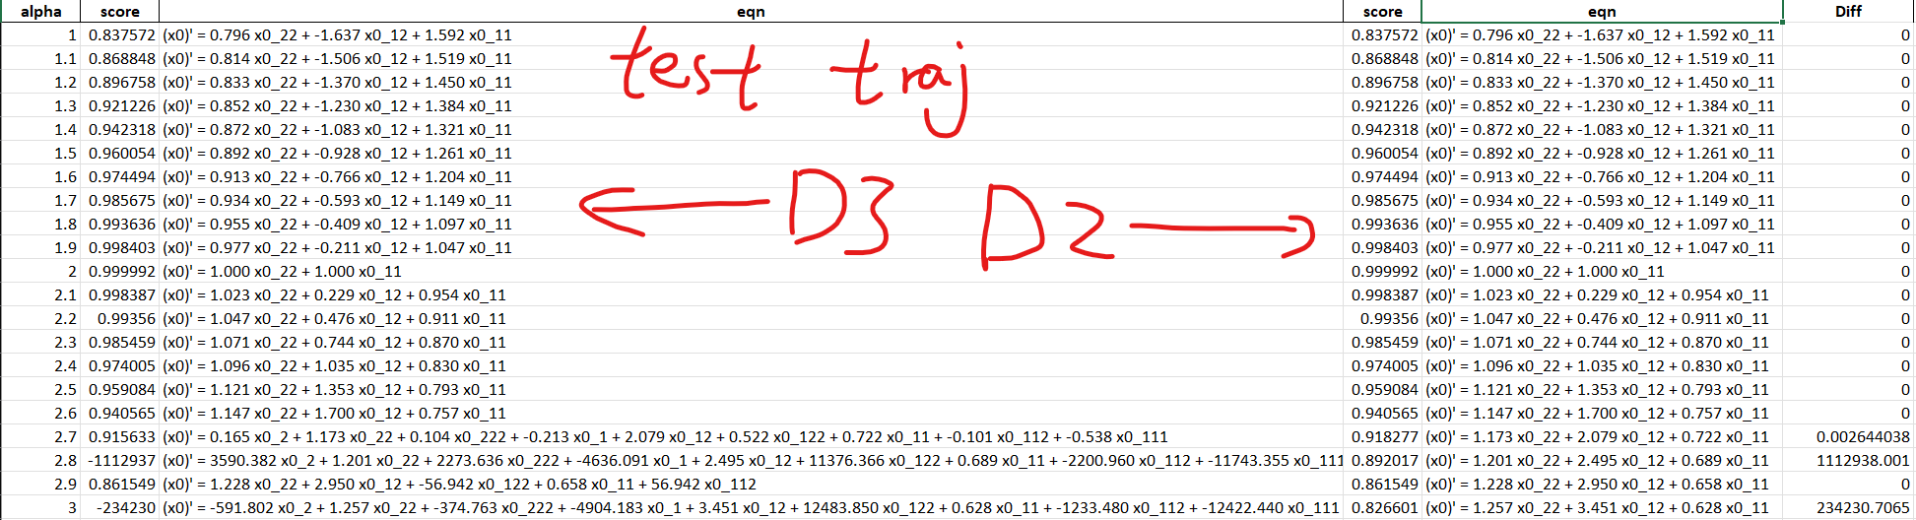
Observations
nonloc lib with derivative order 2 outputs the right model for alpha = 2.
PDE lib with derivative order 2 performs identical with PDE lib with derivative order 3 for the most part, but performs significantly better for certain alpha values.
When alpha = 2.8 or alpha = 3, PDE lib with derivative order 3 produces very bad score when tested with a different trajectory, while derivative order 2 remains stable (score ~0.85).

Slide 5
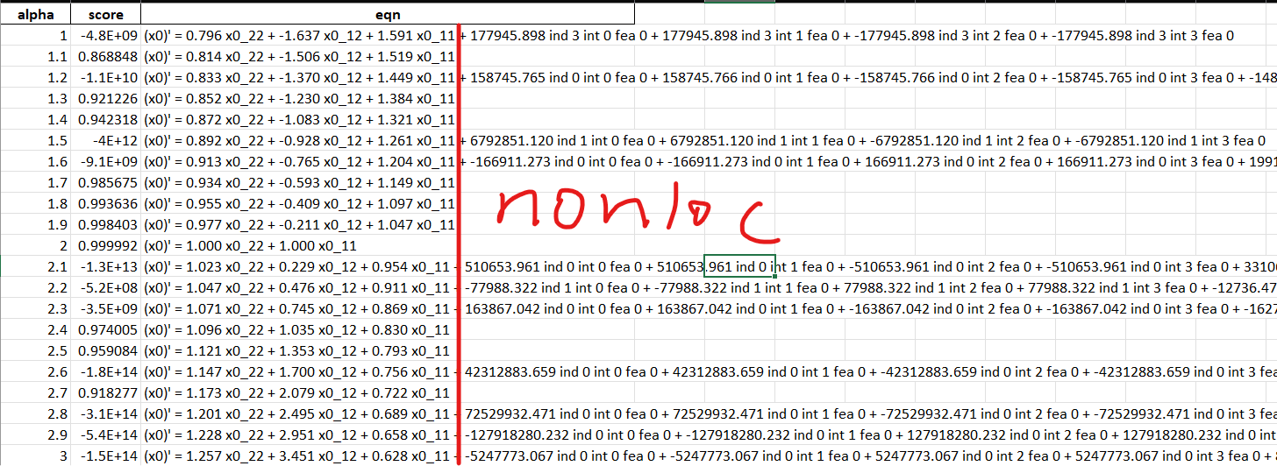
Problem 1
Even though having derivative order set to 2 produces the right model for alpha = 2 with the nonlocal library, it only works for a few parameters. Even in those cases, the produced models contain no nonlocal elements.
Overfitting

Slide 6
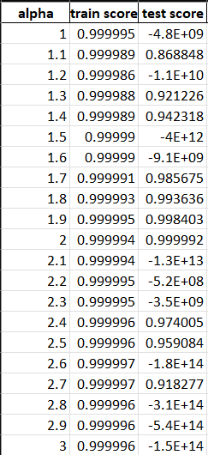
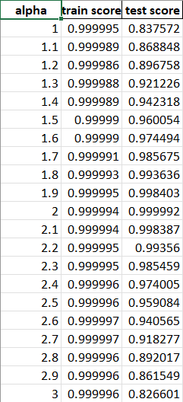
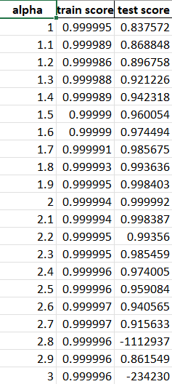
Verify Problem
Nonloc PDE D2 PDE D3
All three models have practically perfect training score, indicating good fitting with PDE library with derivative order 2. PDE lib with derivative order 3 and nonloc lib further increased the number of features and variables, which could lead to overfitting.

Slide 7
Problem 2
The nonlocal computation scales very fast with K.
The number of nonlocal features is of order prod(K)^2, where K is the list containing the number of subdomains in each axis.
For reference, a 10x10 grid of subdomains requires allocating about 240Gib of ram.
We may need to employ some batch processing/garbage collecting techniques, but the tradeoff between ram usage and efficiency needs investigated. Currently the program runs relatively fast but consumes a tremendous amount of ram.
On the other hand, the number of K shouldn’t be the cause of poor performance in the current test model. I think overfitting is a much more significant problem at hand.

Slide 8
Resolution Attempts
To battle overfitting:
More data:
More trajectories for training.
More data by increasing nt.
Possibly also increase spatial resolution?
More data augmentation schemes?
Regularize the model?
Is it common for Sindy to suffer from overfitting?
Is it common for multiple trajectories to be required for training?

Slide 9
Plan
Battle overfitting.
Once overfitting is remedied, I expect the test score to be stable around a certain value, instead of being either very close to 1 or very small.
Test the effectiveness of our addition with varying K value. Observe change in test score.
Might require Lambda machine for extensive ram usage at this stage
Improve the model for better performance and/or lower ram requirements.

