Slide 1

Apache Tomcat
Representation and Management of Data on the Web

Slide 2
What is Tomcat?
Tomcat is a Servlet container (Web server that interacts with Servlets) developed under the Jakarta Project of Apache Software Foundation
Tomcat implements the Servlet and the Java Server Pages (JSP) specifications of Sun Microsystems
Tomcat is an open-source, non commercial project
  Licensed under the Apache Software License
Tomcat is written in Java (OS independent)

Slide 3
A Servlet Example
public class HelloWorld extends HttpServlet {
public void doGet(HttpServletRequest request,
HttpServletResponse response)
throws ServletException, IOException {
PrintWriter out = response.getWriter();
out.println("<html><head><title>Hello</title></head>");
out.println("<body>");
out.println("<h2>" + new java.util.Date() + "</h2>");
out.println("<h1>Hello World</h1></body></html>");
}
}
HelloWorld.java
http://localhost/dbi/hello

Slide 4
A JSP Example
<html>
<head>
<title>Hello World</title>
</head>
<body>
<h2><%= new java.util.Date() %></h2>
<h1>Hello World</h1>
</body>
</html>
hello.jsp
http://localhost/dbi/hello.jsp

Slide 5
Another JSP Example
<html>
<head><title>Numbers</title></head>
<body>
<h1>The numbers 1 to 10:</h1>
<ul>
<% int i;
for (i=1; i<=10; ++i) { %>
<li>Number <%=i%> </li>
<%}%>
</ul>
</body>
</html>
numbers.jsp
http://localhost/dbi/numbers.jsp

Slide 6
Running Tomcat

Slide 7
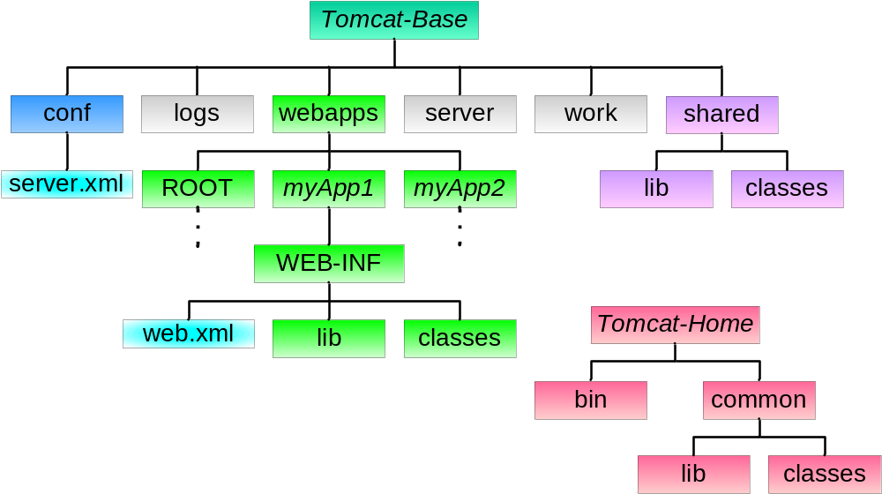
Tomcat Directory Structure

Slide 8
Base and Home Directories
The directory TOMCAT-HOME contains executables and libraries required for the server launching, running and stopping
  This directory is placed under /usr/local/…
The directory TOMCAT-BASE contains the Web-site content, Web applications and configuration data
  This directory is placed under your home directory

Slide 9
Installing Tomcat
Create a directory for tomcat base
  For example: mkdir ~/tomcat-base
Set the environment variable CATALINA_BASE to your tomcat-base directory
  For example: setenv CATALINA_BASE ~/tomcat-base
  Insert this line into your .cshrc file
Run ~dbi/tomcat/bin/setup
$CATALINA_BASE is now a regular Tomcat base directory, and Tomcat is ready to run

Slide 10
Running Tomcat
To start tomcat use ~dbi/tomcat/bin/catalina run
Or, in background, ~dbi/tomcat/bin/catalina start
To stop tomcat use ~dbi/tomcat/bin/catalina stop
To see the default page of Tomcat from your browser use the URL http://<machine-name>:<port>/
  machine-name is the name of the machine on which Tomcat runs and port is the port you chose for Tomcat
You can also use http://localhost:<port>/ if your browser runs on the same machine as Tomcat

Slide 11
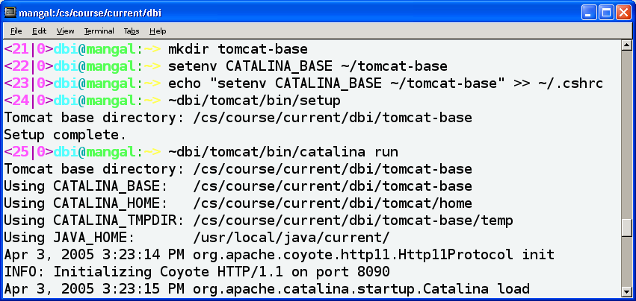
From Scratch to Server

Slide 12
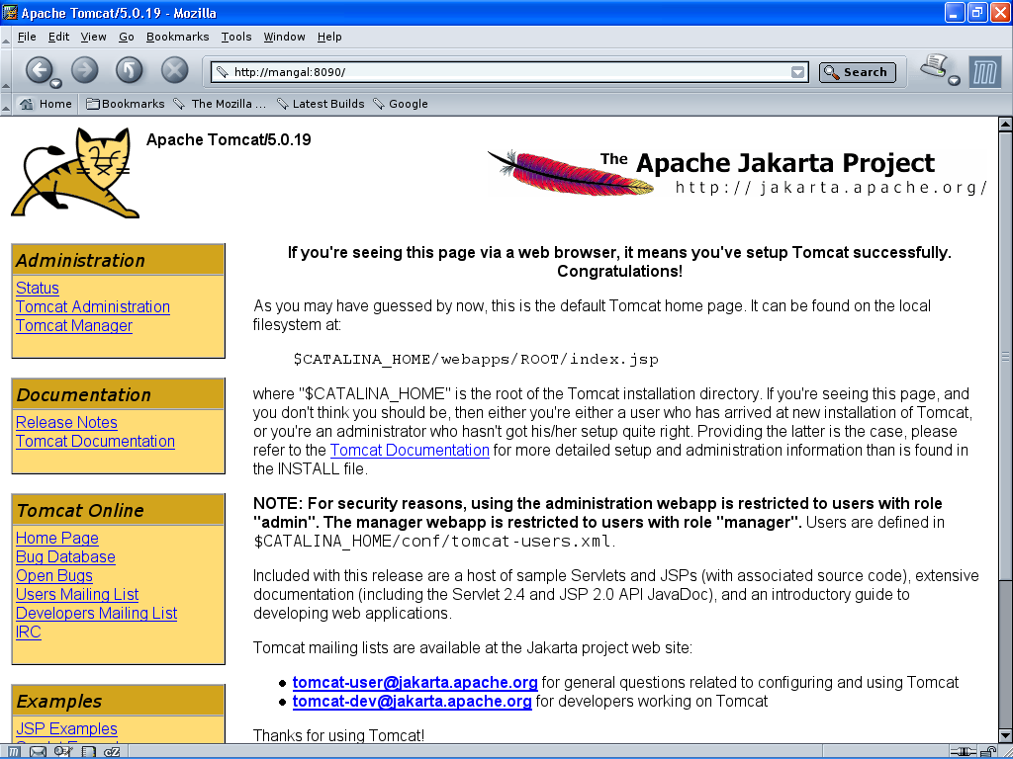

Slide 13
Choosing a port for Tomcat
In the file $CATALINA_HOME/conf/server.xml you will find the element Connector of Service “Catalina”
Choose a port (greater than 1024) and change the value of the port attribute to your chosen one:
<Server>
…
<Service name="Catalina”>
<Connector port="8090"/>
…
</Service>
…
</Server>

Slide 14
Creating Web Applications

Slide 15
Creating Web Applications
A Web application is a self-contained subtree of the Web site
A Web application usually contains several Web resources like HTML files, Servlets, JSP files, and other resources like Database tables
Each Web application has its own subdirectory under the directory
$CATALINA_BASE/webapps/

Slide 16
The Directory Structure of a Web Application
Tomcat automatically identifies a directory $CATALINA_BASE/webapps/myApp/ with the relative URL /myApp/
For example, a file named index.html in myApp is mapped to by the following URLs:
  http://machine:port/myApp/index.html
  http://machine:port/myApp/

Slide 17
The Directory Structure of a Web Application
You can also use subdirectories under myApp
For example: the file myApp/myImages/im.gif is mapped to by the URL
http://machine:port/myApp/myImages/im.gif
By default, Tomcat maps the root directory (http://localhost:8090/) to the directory webapps/ROOT/
  You can change this default

Slide 18
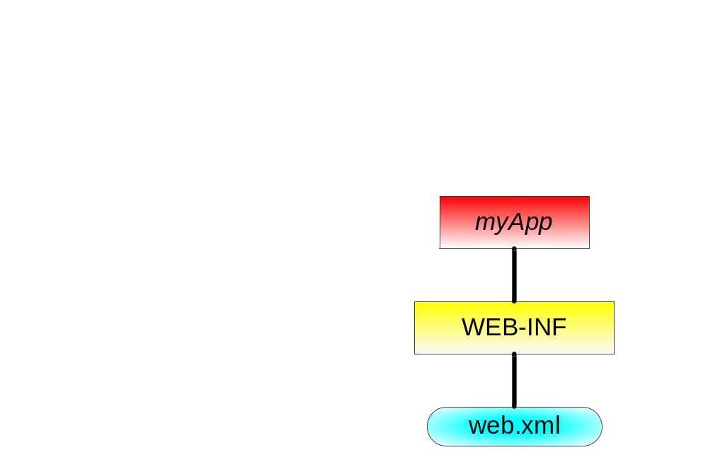
The Directory Structure of a Web Application
An application's directory must contain the following:
  The directory WEB-INF/
  A legal web.xml file under WEB-INF/
<web-app>
</web-app>

Slide 19
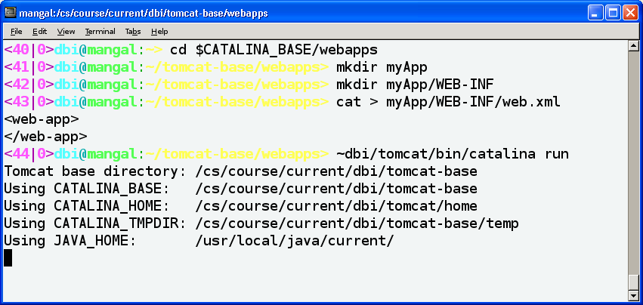
From Scratch to Applications

Slide 20
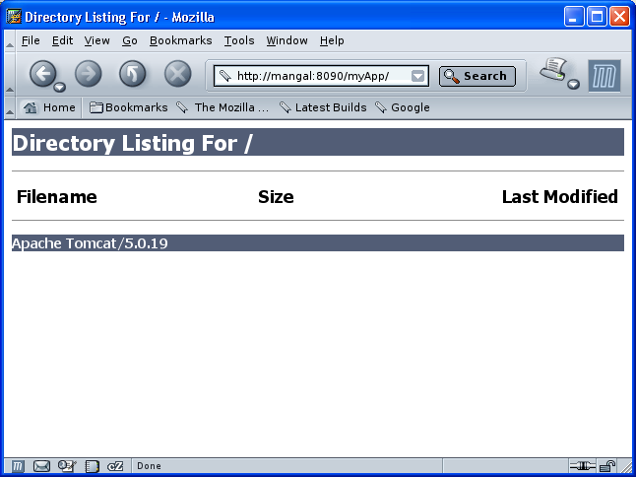

Slide 21
Configuring a Web Application
Application-specific configuration and declarations are written in the file myApp/WEB-INF/web.xml
This file contains:
  Servlet declarations, mappings and parameters
  Default files for directory requests
  Error pages (sent in cases of HTTP errors)
  Security constraints
  Session time-out specification
  Context (application) parameters
  And more…

Slide 22
Error Pages
Use the error-page element to define the page sent in case of an HTTP error that occurs within the application context
An error page element has two sub elements:
  error-code - the HTTP error status code
  location - the page that should be sent

Slide 23
Welcome Page Example
<html>
<head><title>Not Found</title></head>
<body>
<h1 style="text-align:center; color:green">
Sorry, no such file...
</h1>
</body>
</html>
my404.html
<web-app>
<error-page>
<error-code>404</error-code>
<location>/my404.html</location>
</error-page>
</web-app>
web.xml

Slide 24
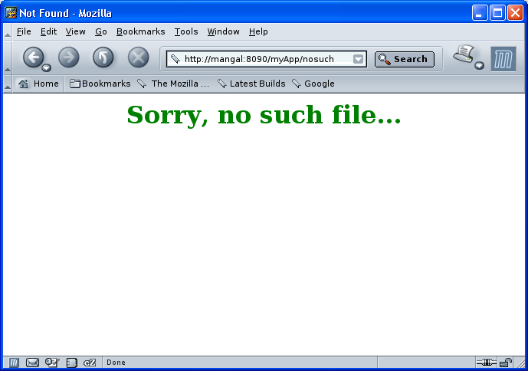

Slide 25
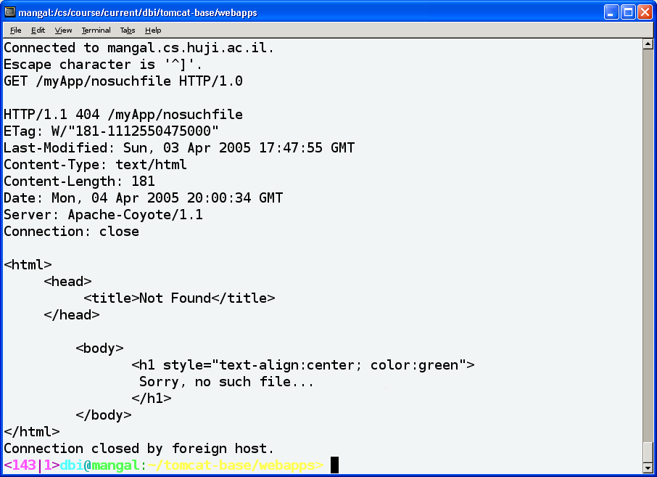

Slide 26
Welcome Pages
The (optional) welcome-file-list element contains a list of file names
When the URL request is a directory name, Tomcat automatically brings the first file on the list
If that file is not found, the server then tries the next file in the list, and so on
This file can be of any type, e.g., HTML, JSP, image, etc.
The default welcome list for all applications is set in $CATALINA_BASE/conf/web.xml

Slide 27
Welcome Page Example
<html>
<head><title>Welcome</title></head>
<body>
<h1 style="text-align:center; color:red">
Welcome Dear Visitor!
</h1>
</body>
</html>
welcome.html
<web-app>
<welcome-file-list>
<welcome-file>welcome.html</welcome-file>
<welcome-file>index.html</welcome-file>
<welcome-file>index.jsp</welcome-file>
</welcome-file-list>
</web-app>
web.xml

Slide 28
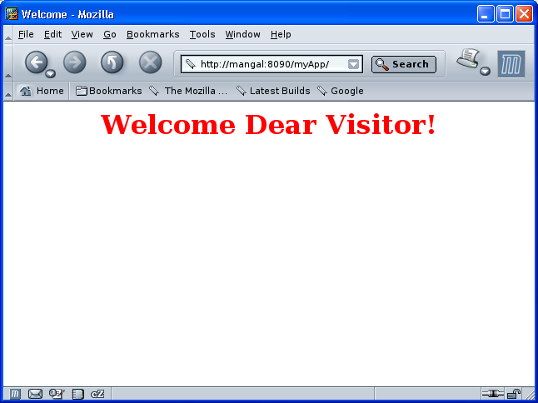

Slide 29
Tomcat and Java Classes
Tomcat uses Java classes you provide in order to run Servlets and JSP files
  For example, the Servlets themselves!
Tomcat 5.x initialization scripts ignore your environment CLASSPATH variable
Classes are expected to be placed (or linked) at some predefined places in its directories

Slide 30
Java Class Locations
Tomcat expects to find Java classes in class files (in a directory named classes) and JAR files (in a directory named lib) in the following places:
TOMCAT-HOME/common/
  Basic runtime classes. No need to touch this directory
$CATALINA_BASE/shared/
  Classes that are used by all the Web applications
$CATALINA_BASE/webapps/myApp/WEB-INF/
  Application-specific classes (Servlets are typically here)

Slide 31
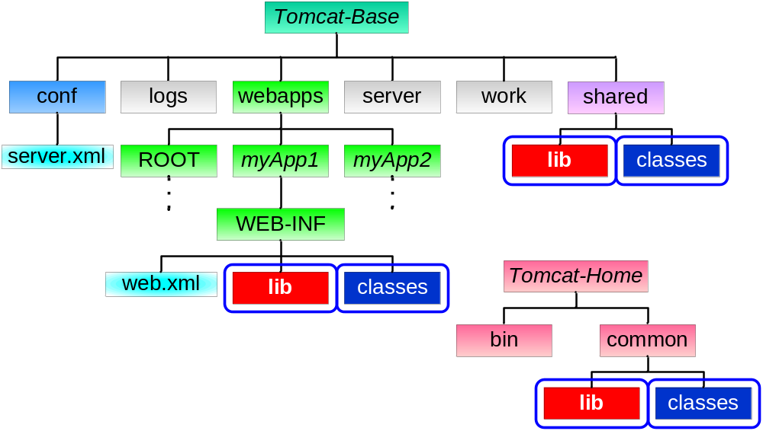
Java Class Locations

Slide 32
Classes Provided by DBI
In order to provide the classes you need, like ORACLE, SAX and DOM-related packages, the Tomcat-setup script links the directory $CATALINA_BASE/shared/lib/ to ~dbi/tomcat/shared/lib/, thus the latter packages are automatically known by your Tomcat server

Slide 33
Advertising a Servlet
We know how file resources (e.g HTML, JSP, images) are advertised using Tomcat
In order to advertise a Servlet in Tomcat, we have to do the following:
  Put the class file in a proper place
  Tell Tomcat that the class acts as a Servlet
  Tell Tomcat the URL mapping of the Servlet
2 and 3 are discussed in the following slide

Slide 34
Servlet Declaration and Mapping
The element <servlet> declares a Servlet
The sub element <init-param> defines an parameter passed to the Servlet
  Access using ServletConfig.getInitParameter()
The element <servlet-mapping> maps a URL to a specific Servlet
  The URL is relative to the application’s base URL (http://machine:port/myApp/)

Slide 35
Publishing a Servlet -An Example
<web-app>
<servlet>
<servlet-name>hello</servlet-name>
<servlet-class>HelloWorld</servlet-class>
</servlet>
<servlet-mapping>
<servlet-name>hello</servlet-name>
<url-pattern>/hi</url-pattern>
</servlet-mapping></web-app>
</web-app>
web.xml
myApp/WEB-INF/classes/HelloWorld.class
http://localhost/myApp/hi

Slide 36
A Tip
Tomcat provides a Servlet that enables invoking an existing Servlets without declarations and mappings
To enable this feature, uncomment the elements servlet and servlet-mapping of the Servlet called invoker in $CATALINA_BASE/conf/web.xml
To call the compiled Servlet myServlet.class in the application myApp use this URL: http://<machine>:<port>/myApp/servlet/myServlet
NEVER publish a Web-site with this feature enabled!
  Otherwise, your security restrictions are easily bypassed

Slide 37
web.xml DTD
Your web.xml file must conform to the web-app DTD:
<!ELEMENT web-app (icon?, display-name?, description?, distributable?, context-param*, filter*, filter-mapping*, listener*, servlet*, servlet-mapping*, session-config?, mime-mapping*, welcome-file-list?, error-page*, taglib*, resource-env-ref*, resource-ref*, security-constraint*, login-config?, security-role*, env-entry*, ejb-ref*, ejb-local-ref*)>

Slide 38
The Whole web.xml
<web-app>
<servlet>
<servlet-name>hello</servlet-name>
<servlet-class>HelloWorld</servlet-class>
</servlet>
<servlet-mapping>
<servlet-name>hello</servlet-name>
<url-pattern>/hi</url-pattern>
</servlet-mapping></web-app>
web.xml

Slide 39
The Whole web.xml
<welcome-file-list>
<welcome-file>welcome.html</welcome-file>
<welcome-file>index.html</welcome-file>
<welcome-file>index.jsp</welcome-file>
</welcome-file-list>
<error-page>
<error-code>404</error-code>
<location>/my404.html</location>
</error-page>
</web-app>
web.xml

Slide 40
Web Application Development

Slide 41
Web Archives
A WAR (Web ARchive) file is a JAR file that contains a whole Web-application directory
For example, to create a WAR file of myApp do:
  jar cvf myApp.war webapps/myApp/*
Tomcat unpacks all WAR files found in $CATALINE_BASE/webapps/ at statup
  The unpacked directory and context will be named as the WAR file name (without the .war extension)
  The WAR will not be unpacked if webapps/ already contains the directory and the WAR is not newer...

Slide 42
Reflecting Application Changes
Changes in your Java classes may not be reflected in your application
  Old versions may already have been loaded
  The application needs to be reloaded
Changes in other files like HTML or JSP are always reflected
Modification of web.xml automatically causes the application to be reloaded

Slide 43

Tomcat 5.0 Manager
Tomcat 5.0 comes with a Web application called “manager”, which supports functions for managing Web applications
You can either use the HTML interface at http://<machine>:<port>/manager/html/ or send direct HTTP requests to it
You will need to authenticate as a privileged user
  Use the username “admin” with no password

Slide 44
Tomcat 5.0 Manager
Using the manager, you can
  Deploy a Web application by posting a WAR file
  Undeploy a deployed Web application
  Start/stop a Web application (make it available/unavailable)
  Reload an existing Web application (unpack new WARs)
Warning: while “stop” makes an application unavailable, “undeploy” deletes the application directory and WAR file from webapps/

Slide 45
Tomcat and Eclipse
You can use an Eclipse plugin for Tomcat Web-application development
The “Sysdeo Eclipse Tomcat Launcher” plugin is installed in CS
Using this plugin, you can start/stop the server, reload an application, etc.
Detailed explanations in the course home-page

Slide 46
