Slide 1

Hacking Tomcat
Secrets Revealed

Slide 2
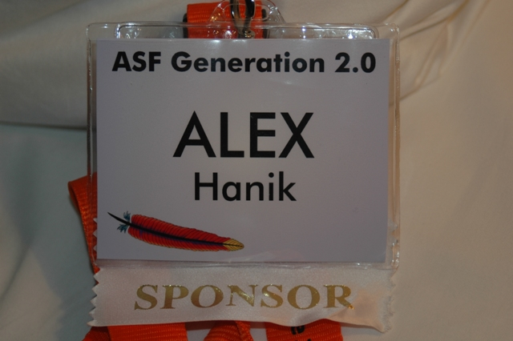
Talk Sponsored
By

Slide 3
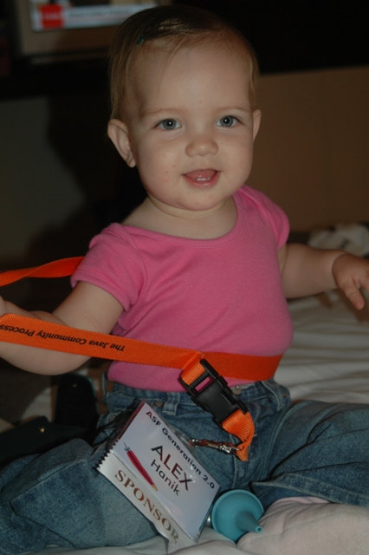
Actual
Sponsor

Slide 4
Who am I – bla bla
fhanik@apache.org
Tomcat Committer / ASF member
Co-designed the Comet implementation
Implemented NIO connector in 6
Responsible for session replication and clustering
Been involved with ASF since 2001

Slide 5
Who are We
Top Level Project – tomcat.apache.org
24 committers on file
Active/core group is much smaller
Find us on dev@tomcat.apache.org
Work on what interests you and work without guidance
Our people skills are improving ;)

Slide 6
Welcome to Tomcat
We are Hiring!!!

Slide 7
What we will cover
History of Tomcat
The Basics
  Configuration and Container Architecture
The Advanced
  Swappable Components
  Tomcat Connectors
  Servlet Container
  JSP Compiler
  Developing/Debugging Tomcat

Slide 8
What We Will Not Cover
Too Basic stuff – This is a technical presentation
Configuration details
How the actual JSP .jsp to .java compiler works
Forked Tomcat code bases, how they differ and why they happened
Older versions of Tomcat, we will work with Tomcat 6, no looking back ☺

Slide 9
History of Tomcat
Started out as a reference implemenation by Sun Microsystem
Donated to ASF – Tomcat 3 (roughly 1999)
Tomcat 4 – New specs & First rewrite – Codename Catalina
Tomcat 5.0 New specs
Tomcat 5.5 – 2nd Rewrite – Performance
Tomcat 6.0 – New specs, New Cool Features

Slide 10
Basics
server.xml
  Main configuration file
  Builds server on “the fly”
  Parsed using commons-digester
  Tomcat has hard coded rule sets for the parsing
  Every element/component is swappable

Slide 11
Basics
<ElementName
className=“the implementation”
attribute=“call setAttribute”/>
Example:
<Server className=“o.a.c.core.StandardServer”
port="8005“
shutdown="SHUTDOWN">

Slide 12
Basics
Entire server.xml parsed based on rules
Look for these rules:
  Catalina.java
  org/apache/catalina/startup/
Even web.xml is parsed using the digester

Slide 13
Basics
Catalina.java-createStartDigester
Digester digester = new Digester();
digester.setValidating(false);
digester.setClassLoader(
StandardServer.class.getClassLoader());
digester.addObjectCreate("Server",
"org.apache.catalina.core.StandardServer“,
"className");
digester.addSetProperties("Server");

Slide 14
Basics
The exception <Connector>
<Connector
className=“ignored”
protocol=“nested object”
ConnectorCreateRule.java - begin
digester.push(
new Connector(
attributes.getValue("protocol")));
protocol -> nested className

Slide 15

Basics
Tomcat – The Server
Services
Engine (Catalina)
Hosts
Realm
AJP Connector
Valves
Context
8009
SSL Connector
JSPs
Servlets
Valves
8443
HTTP Connector
Valves
8080

Slide 16
Basics
Service/Engine/Host/Context
  All are “Containers”
  All implement LifecycleListeners
LifecycleEvents
  How objects get initialized, started and stopped
Object relationships are established during creation(digester parsing)

Slide 17
Basics
Last Basics – I promise
conf/web.xml
  Default web.xml
  Merged with webapps WEB-INF/web.xml
  DefaultServlet –static content
  JSP Servlet – JSP files
conf/context.xml
  Merged with apps <Context> definition

Slide 18
Advanced
Connectors – the entry point
Servlet Engine and Container Design
Jasper – The JSP engine
Valves – interceptor pattern
Developing and Debugging
How to join – if you are interested

Slide 19
Performance Tip
Tomcat produces very little GC
  Most objects are pooled
  Even though makers of VM say, never pool objects
  Prevents CPU/GC jigsaw pattern
  Resetting fields is faster than GC old object, create new object and initialize
  No GC lock up surprises

Slide 20
Connectors
HTTP Connector – protocol=
  o.a.coyote.http11.Http11Protocol
  o.a.coyote.http11.Http11AprProtocol
  o.a.coyote.http11.Http11NioProtocol
  HTTP/1.1 aliased to Http11 and Http11Apr
AJP Connector
  org.apache.jk.server.JkCoyoteHandler
  org.apache.coyote.ajp.AjpAprProtocol
  AJP/1.3 aliased to the two above

Slide 21
Connectors
Connector
Protocol
Processor
<Handler>
Adapter
EndPoint
Engine
There are some pretty ugly interdependencies here.
While re-factoring would resolve that, time has been
spent improving performance.

Slide 22
Connectors
Request Process
Connector
Protocol
Processor
Adapter
EndPoint
Engine
Once the request is parsed
The CoyoteAdapter (bridge between connector and engine)
Passes the request to the servlet engine
Processor sets up input/output buffers
HTTP Parsing logic is in here
Parses request, if request is available
1. New HTTP Request
All java.io/java.nio/apr socket logic is in the EndPoint

Slide 23
Performance Tip
MessageBytes.java
All HTTP Parsing doesn’t deal with strings
Every chunk of data gets parsed into a MessageBytes object
This object represents a ‘string’ in the HTTP header
Avoid string comparison routines
Doesn’t contain copy of byte[], but a pointer to the original data with an offset and length

Slide 24
Performance Tip
Use Http11Protocol
  Keep Alive is turned off
  Kernel accept filter is in place
Use Http11AprProtocol
  Take advantage of SEND_FILE
  Native SSL handling
  Comet Support
Use Http11NioProtocol
  Take advantage of SEND_FILE
  Large number of sockets using Keep Alive
  APR is not available or JNI is not preferred
  Comet Support

Slide 25
Advanced
CoyoteAdapter.java
  Creates Request/Response objects
  Maps Request/Response to
    A Host object (StandardHost)
    A Context object (StandardContext)
    A Servlet (StandardWrapper)
  Parses Session Cookie
    URL
    Cookie
  Grabs Engine’s valve and passes the request into the servlet engine

Slide 26
Performance Tip
DefaultServlet.java
  Handles all static content
  Gets deployed into every webapp through conf/web.xml
  If SEND_FILE support is enabled it will use it
  It’s a REGULAR SERVLET!!
  Files and their attributes are cached
  You can replace with your own implementation

Slide 27
Advanced
Servlet Invokation Chain
o.a.c.servlets.DefaultServlet.doGet
javax.servlet.http.HttpServlet.service
o.a.c.core.ApplicationFilterChain.doFilter
o.a.c.core.StandardWrapperValve.invoke
o.a.c.core.StandardContextValve.invoke
o.a.c.core.StandardHostValve.invoke
o.a.c.valves.ErrorReportValve.invoke
o.a.c.core.StandardEngineValve.invoke
o.a.c.connector.CoyoteAdapter.service
o.a.coyote.http11.Http11NioProcessor.process
o.a.coyote.http11.Http11NioProtocol$Http11ConnectionHandler.process
o.a.tomcat.util.net.NioEndpoint$SocketProcessor.run
java.util.concurrent.ThreadPoolExecutor$Worker.runTask
java.util.concurrent.ThreadPoolExecutor$Worker.run
java.lang.Thread.run
8. StandardHostValve
Sets context class loader
11. ApplicationFilterChain
Represents Servlet (spec)
FilterChain, invokes servlet
7. ErrorReportValve
Catches Throwable
Reports 400+ errors
6. StandardEngineValve
First valve in the engine
container
9. StandardContextValve
Invokes (spec)
ServletRequestListeners
3. SocketProcessor –
Simple Runnable to invoke
Handler.process
1. Everything starts with the thread
12. The Servlet
Execution of the servlet
10. StandardWrapperValve
Invokes (spec)
FilterChain
4. HttpProcessor –
parses HTTP request
5. CoyoteAdapter
Creates Request
Response pair
2. NIO Connector defaults
to ThreadPoolExecutor

Slide 28
Advanced
Reading Data From the InputStream
o.a.c.http11.InternalNioInputBuffer$SocketInputBuffer.doRead
o.a.c.http11.filters.ChunkedInputFilter.readBytes
o.a.c.http11.http11.filters.ChunkedInputFilter.parseChunkHeader
o.a.c.http11.http11.filters.ChunkedInputFilter.doRead
o.a.c.http11.http11.InternalNioInputBuffer.doRead
o.a.c.http11.Request.doRead
o.a.catalina.connector.InputBuffer.realReadBytes
o.a.t.u.buf.ByteChunk.substract
o.a.catalina.connector.InputBuffer.read
o.a.catalina.connector.CoyoteInputStream.read
comet.CometEchoServlet.echo

Slide 29
Performance Tip
JspServlet.java
  Handles all JSP files
  Gets deployed into every webapp through conf/web.xml
  Mapping done through URL patterns (per spec)
  It’s a REGULAR SERVLET!!
  Connects into the Jasper engine

Slide 30
Advanced
How are JSP files handled
  Through the JspServlet (same invocation path)
  JspServletWrapper created
    Contains JspCompilationContext
    Holds a JSP class loader
    Invokes compile on the compilation context
    Processes annotations
    Loads .class file through class loader
    Finally invokes service(req,resp) on the generated servlet
  o.a.jasper.compiler.Compiler
    Generates .java file from .jsp
  o.a.jasper.compiler.JDTCompiler
    Generates .class file from .java

Slide 31
Advanced
Deployment of Applications
<Context> - StandardContext
<Listener> - LifecycleListener
<Loader> - WebappLoader
<Manager> - StandardManager
<Realm> - No default
<Resources> - FileDirContext
<Valve> - No default
</Context>
ContextRuleSet.java – parses contexts in server.xml

Slide 32
Advanced
Deployment of applications
  The deployer is HostConfig.java
  Each StandardHost.java object holds a reference to a HostConfig
  Deploy order
    context.xml files
    WAR files
    Directories
  /ROOT is hardcoded for path=“”
  Runtime deployment triggered by LifecycleEvent

Slide 33
Advanced
Developing/Debugging
  SVN Repo for TC 6 is simplified
  trunk/java – all you need
  svn co/ant download/ant – builds the system
  Run inside a debugger by emulating the catalina.sh/catalina.bat if you wish
  Everything is java, breakpoints anywhere

Slide 34
Performance Tip
Does it scale
  Yes, its been tested with 16k concurrent and active connections on a –Xmx512m system
  Performance increases well as new CPUs are added
  RAM is your “max # concurrent connection” limitation
  Simple tests run at http://blog.covalent.net/roller/covalent/entry/20070308

Slide 35
Performance Tip
Tuning
  Mostly in the application itself, Tomcat default is pretty good
  When it comes down to nuts and bolts, the tuning is in the connectors
  NIO connector, by far the most tuning options (see docs)
  Socket and App buffers usually the most important aspect for “write-speed”
  APR connector, speedy little devil, not as many options, but relies on APR below being well tuned.

Slide 36
Performance Tip
Tuning the servlet engine
  Sure, it can be done, but not through configuration
  Most common bottlenecks turn out to be synchronized statements or locks
  Compared to the webapp or the connector, spending time tuning the engine is not worth the time

Slide 37
Conclusion
Not so difficult on first impression
Slightly confusing on second impression
Once you get a hang of it, go crazy
Modular design, and nasty deps
Not the typical text book java design
Find something interesting? want to contribute? – take initiative, don’t be shy

Slide 38
Want to join?
Ideas for needed projects
  Better deployer
  Documentation
  Administration tool
  Better JMX support
  Remote and Cluster deployments
  Live status – dash board
  SIP support
  The list goes on, take your pick!

Slide 39
Q & A
Lots and Lots covered
  Only a drop in the sea, but enough to get you started
  not enough time
fhanik@apache.org – anytime
dev@tomcat.apache.org – be brave
http://people.apache.org/~fhanik for the presentation

