Slide 1
The UNIX Programming Environment – Chapter8: Program Development

Slide 2
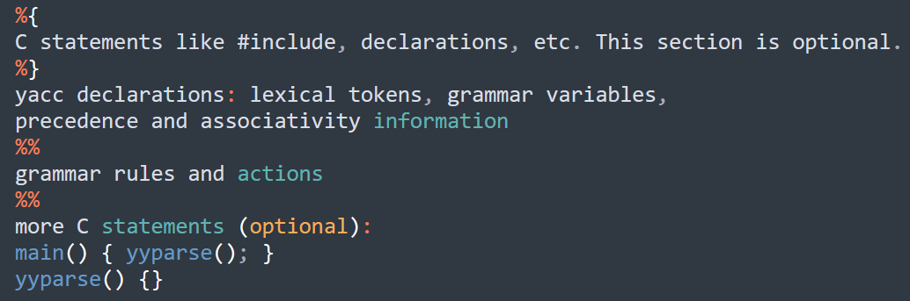
How to develop a program under UNIX
Method
Code -> Compile -> Executable
1. precompile
2. compile
3. link
.y file syntax
.y file -> .c file -> .o file
Syntax analysis
Compile

Slide 3
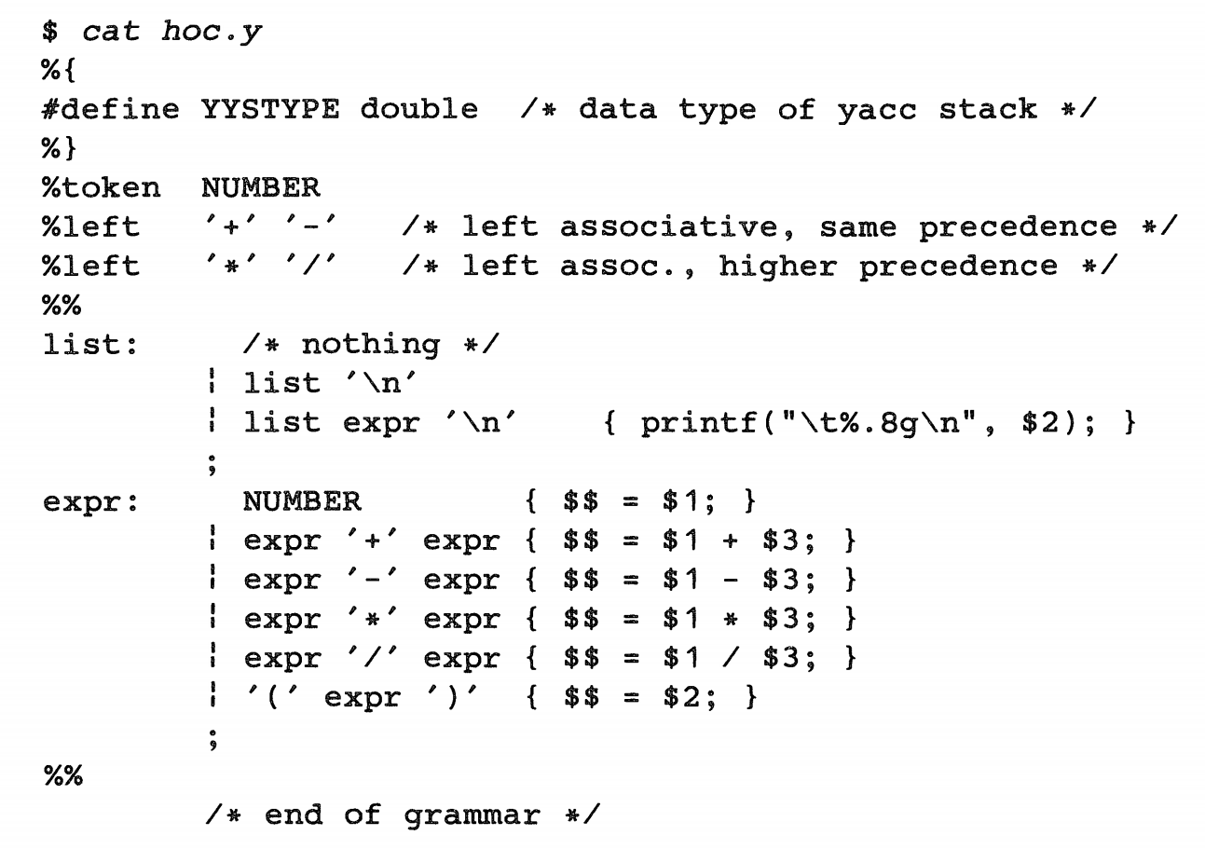
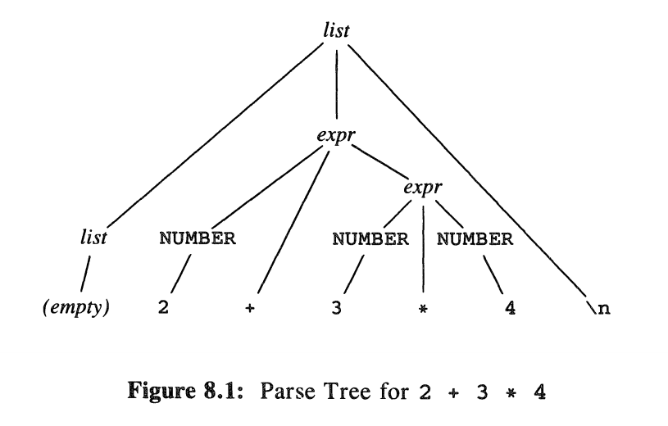
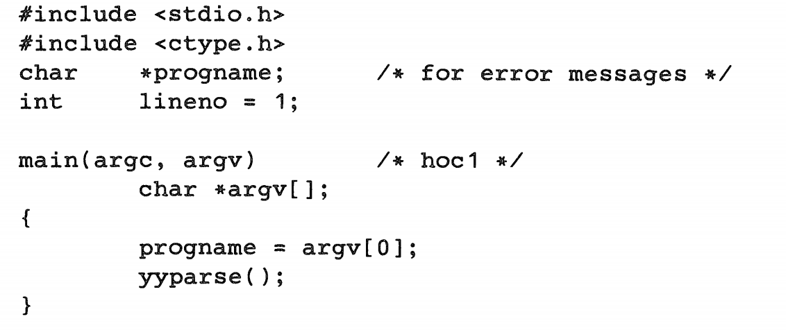
How to develop a program under UNIX
.y file syntax

Slide 4
How to develop a program under UNIX
Tools
yacc, a parser generator, a program that generates a parser from a grammatical description of a language;
make, a program for specifying and controlling the processes by which a complicated program is compiled;
lex, a program analogous to yacc, for making lexical analyzers.

Slide 5
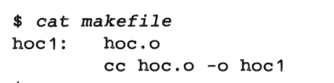
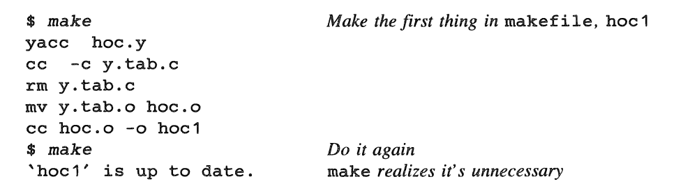
How to develop a program under UNIX
make, a program for specifying and controlling the processes by which a complicated program is compiled;
make [ -f makefile ] [ options ] ... [ targets ] ...

Slide 6
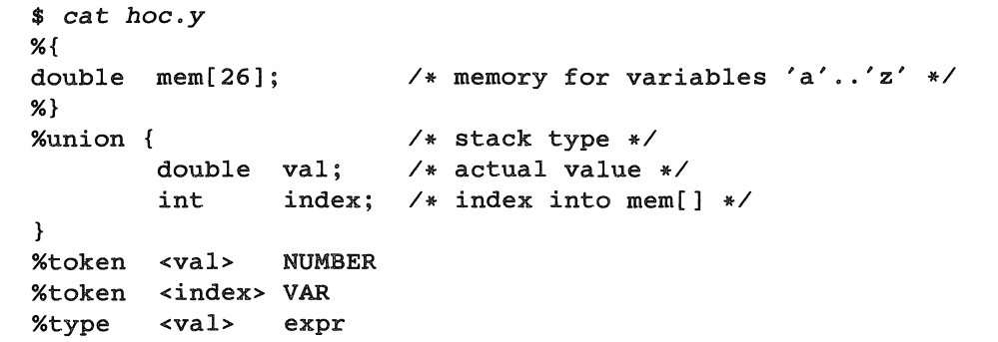
How to develop a program under UNIX
Variables

