Slide 1


Volume Fractions of Texture Components
A. D. Rollett
27-750 Texture, Microstructure & Anisotropy
Last revised: 2nd Feb. ‘16

Slide 2
Lecture Objectives
Explain how to compute intensities in a discrete OD from counts of grains, points or volumes.
Define volume fraction as the fraction of material whose orientation lies within a specified range of orientations.
Explain how to calculate volume fractions given a discrete orientation distribution.
Describe the calculation of orientation distance as a subset of the calculation of misorientations. Also discuss how to apply symmetry, and some of the pitfalls.
Illustrate the binning scheme used for 5-parameter grain boundary description, as part of the discussion of how to obtain MRD values for specific examples.

Slide 3
Notation
g - orientation
f(g) - orientation distribution
O - symmetry operator
O₄₃₂ - 432 point group
O_{C} - crystal symmetry operator
O_{S} - sample symmetry operator
tr - trace of a matrix
∆g - misorientation
V_{f} – physical volume fraction of grain, material, orientation
φ₁, Φ, φ₂ - Euler angles
Ω, ∆Ω - Volume of orientation space, increment of volume
popLA – preferred orientation package Los Alamos, a software package written in the early 1990s to analyze texture data, based on the DOS operating system.

Slide 4
In Class Questions
How do we compute intensities from volume fractions?
What is the difference between cell-edge and cell-centered coordinates?
What do we mean by the volume fraction of a texture component?
How do we compute the volume fraction of a component?
What is a capture angle or tolerance angle or capture radius?
What is a partition map?
Why is the density of randomly chosen orientations (in Euler space) not uniform?
Describe two ways to compute orientation distance.
Why is misorientation useful for computing orientation distance?
How do we apply symmetry to compute misorientation?
Why do different components (e.g. cube vs. S) have different volume fractions in a random texture?

Slide 5
Intensity from Volume Fractions
Objective: given information on volume fractions (e.g. numbers of grains of a given orientation), how do we calculate the intensity in the OD?
• General relationships:
Reminder on units of the OD: the way that normalization is performed means that the units of the OD are Multiples of a Random Density (MRD). If there is no texture or preferred orientation then the value of “f” is one everywhere.

Slide 6
Discrete vs. Continuous Distributions
These notes emphasize the use of discrete distributions for obtaining volume fractions.
If a continuous distribution is available, e.g., from fitting generalized spherical harmonics (from the “series expansion” method) then other ways of integrating over orientation space are used. Brief notes about how to use this approach are provided at the end.
For data obtained as discrete points, e.g., from EBSD maps, performing calculations directly on the data makes the least assumptions about the material. On the other hand, prior knowledge may provide a justification for using a particular fitted function.

Slide 7
Intensity from V_{f} , contd.
For each cell, we assign an intensity equal to the volume fraction in that cell, ∆V, divided by the volume of orientation space associated with that cell, ∆Ω and multiplied by the total volume of orientation space .
If we have points with equal area or volume (e.g. EBSD data) the volume fraction, ∆V_{i}, is simply the number of points in the i^{th} cell, n_{i}, divided by the total number of points, N: ∆V_{i}=n_{i}/N.
For 5x5x5° discretization in a 90x90x90° space, we particularize to:

Slide 8
Discrete OD
Normalization also required for discrete OD
Normalization depends on the size of the sub-space of orientation, and on the measure used (radians versus degrees).
Sum the intensities over all the cells.
0≤φ₁ ≤2π, 0≤Φ ≤π, 0≤φ₂ ≤2π 0≤φ₁ ≤90°, 0≤Φ ≤90°, 0≤φ₂ ≤90°

Slide 9
Volume fraction calculations
Choice of cell size determines size of the volume increment, which depends on the value of the second angle (Φ or Θ).
Some grids start at the specified value.
More typical for the specified value to be in the center of the cell.
popLA: grids are cell-centered.

Slide 10
Discrete ODs
dA=sinΦdΦdφ₁: ∆A=∆(cosΦ)∆φ₁
Each layer: ∆Ω = Σ∆A∆φ₂ = 90(°)
φ₁
Cell edge discretization
Total: Ω = 8100(°)²
0°
10°
20°
80°
90°
0°
f(10,0,30)
10°
Φ
∆ Φ=10°
f(10,10,30)
20°
Section at φ₂= 30° ∆φ₂=10°
80°
f(10,80,30)
90°
∆ φ₁ =10°

Slide 11
Centered Cells
dA=sinΦdΦdφ₁: ∆A=∆(cosΦ)∆φ₁
Different treatment of end and corner cells to exclude volume outside the subspace
φ₁
0°
10°
20°
90°
0°
f(10,0,30)
∆ Φ=5°
10°
f(10,10,30)
….
∆ Φ=10°
Φ
20°
80°
f(10,90,30)
90°
∆ φ₁ =10°
∆ φ₁ =5°
Cell centered discretization

Slide 12
Discrete orientation information
Typical text data.ANG file from TSL EBSD system (e.g. SmallIN100/Slice_1.ang available in SmallIN100.zip):
# WorkDirectory /usr/OIM/rollett
# OIMDirectory /usr/OIM
………...
#
4.724 0.234 4.904 0.500 0.866 1.0 1.000 0 0
4.491 0.024 5.132 7.500 0.866 1.0 1.000 0 0
4.932 0.040 4.698 19.500 0.866 1.0 1.000 0 0
4.491 0.024 5.132 20.500 0.866 1.0 1.000 0 0
4.491 0.024 5.132 21.500 0.866 1.0 1.000 0 0
4.932 0.040 4.698 22.500 0.866 1.0 1.000 0 0
4.932 0.040 4.698 23.500 0.866 1.0 1.000 0 0
4.932 0.040 4.698 24.500 0.866 1.0 1.000 0 0
Each dataset may have millions of points
φ₁
Φ
φ₂
x
y
(Euler angles, radians)
(spatial coordinates, microns)

Slide 13
Binning individual orientations in a discrete OD
φ₁
0°
10°
20°
80°
90°
0°
10°
Φ
∆ Φ=10°
20°
Section at φ₂= 30°
individual orientation
80°
90°
∆ φ₁ =10°
Notes:
OIM/EBSD data has the same area for each point, so one can bin points in the cells and treat the number as equivalent to volume fractions

Slide 14
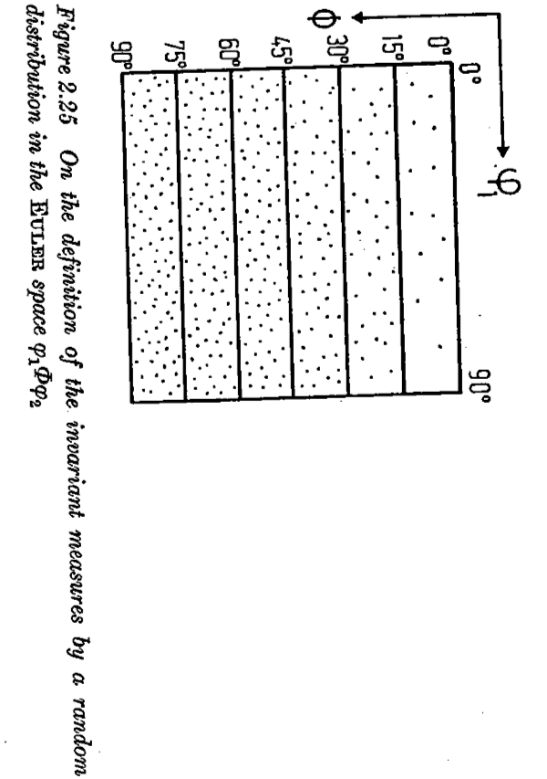
Example of random orientation distribution in Euler space
[Bunge]
Note the smaller densities of points (arbitrary scale) near Φ = 0°. When converted to intensities, however, then the result is a uniform, constant value of the OD (because of the effect of the volume element size, sinΦdΦdφ₁dφ₂). If a material had randomly oriented grains all of the same size then this is how they would appear, as individual points in orientation space.

Slide 15
OD from discrete points: pseudo-code
Compute the volume of the chosen orientation space, e.g. Euler space, e.g. 90° x 90° x 90° ⇒ Ω =∫dg = 8100 °². Also compute the volume of each cell; in this case dΩ(φ₁,Φ,φ₂) = ∆(cosΦ)∆φ₁∆φ₂
Bin each orientation into a cell in the OD
Sum number (or weight, if each orientation represents a different physical volume) in each cell
Divide the number (or physical volume) in each cell by the total number of grains (or total physical volume) to obtain V_{f}
Convert from V_{f} to f(g): f(g) =V_{f}*Ω/dΩ = 8100 V_{f} / {∆(cosΦ)∆φ₁∆φ₂}
Ω =∫dg
dΩ =cell volume

Slide 16
Discrete OD from points
The same V_{f} near Φ=0° will have much larger f(g) than cells near Φ =90°.
Unless large number (>10⁴, texture dependent) of grains are measured, the resulting OD will be noisy, i.e. large variations in intensity between cells.
Typically, smoothing is used to facilitate presentation of results: always do this last and as a visual aid only!
An alternative to smoothing an ODF plot is to replace individual points by Gaussians and then evaluate the texture. This is particularly helpful (and commonly applied) when performing a series expansion fit to a set of individual orientation measurements, such as OIM data.

Slide 17
Volume fraction calculation
In its simplest form: sum up the intensities multiplied by the value of the volume increment (invariant measure) for each cell.
Check that when you compute this sum for the entire space the result is equal to one (else the normalization is not correct).

Slide 18
Simple results
Φ (°) | ∆cosΦ(g) | Intensity (MRD)
0 | 0.0152 | 5331
10 | 0.0451 | 1795
20 | 0.0737 | 1100
30 | 0.1 | 810
40 | 0.1233 | 657
50 | 0.1428 | 567
60 | 0.1580 | 512
70 | 0.1684 | 481
80 | 0.1736 | 466
What if all the orientations/grains/sets_of_Euler_angles fall in one cell?
Answer: the intensity (in units of Multiples of a Random Density, MRD) in that cell depends on its location in the space (assuming uniformly divided space by angle), and the intensity in all other cells is exactly zero.
Example: cell-edge coordinates with 10° increments in a 90x90x90 space (total volume, Ω = 8100 (°²); each cell has volume ∆Ω(g) = 100x∆cos(Φ)). Note that the sum of the second column is one, as it must be for the integral of sin(Φ) over the interval [0..π/2].
More exactly: f(g) = Ω / ∆Ω(g)
The magnitude of the peak depends on the cell size in relation to the volume, not on the measure (degrees versus radians).

Slide 19
Simple results: 2
What if all, say, 9/10ths of the grains fall in one cell and the rest are randomly distributed?
Answer: the intensity in that cell once again depends on its location in the space (assuming uniformly divided space by angle), and the intensity in all other cells is fixed at 0.1/{remaining volume}, where the “remaining volume” is the total volume minus the volume of the individual cell that contains 9/10ths of the volume.
Example: cell-edge coordinates with 10° increments in a 90x90x90 space (total volume = 8100; each cell has volume 100x∆cos(Φ)). Note that the sum of the second column is one.
More exactly (in the single cell): f(g) = 0.9 Ω / ∆Ω(g), - “peak” or elsewhere, since ∫f(g) = Ω f(g) = 0.1 Ω / (Ω − ∆Ω(g)) - “random”
Φ (°) | ∆cosΦ(g) | Intensity in Cell (MRD) | f(g) elsewhere (10⁻⁵ MRD)
0 | 0.0152 | 4779 | 0.10002
10 | 0.0451 | 1615 | 0.10006
20 | 0.0737 | 990 | 0.10009
30 | 0.1 | 729 | 0.10012
40 | 0.1233 | 591 | 0.10015
50 | 0.1428 | 510 | 0.10017
60 | 0.1580 | 461 | 0.10019
70 | 0.1684 | 433 | 0.10020
80 | 0.1736 | 420 | 0.10021

Slide 20
Grain Boundary Space
As a preview to dealing with grain boundaries, we explain the binning scheme and show how to compute intensities and expected area fractions.
A grain boundary requires five (5) macroscopic parameters to describe its crystallographic character (which ignores translational parameters at the atomic scale).
Generally, it is convenient to separate these parameters into the disorientation and the normal of the boundary plane.
For the purposes of this lecture, assume that the disorientation is the difference in orientation across the boundary, reduced to a fundamental zone (FZ). Assume that the normal is a unit vector described by two spherical angles, which can be referred to either one of the two crystal lattices (orientations).
Assume a binning scheme in which the disorientation is expressed as Euler angles thus (φ₁, cos(Φ), φ₂); each dimension is divided into equal size cells. The use of the cosine provides cells of equal volume. We bin the normal according to (β, cos(α)), where alpha is the co-latitude and beta the longitude.
For cubic materials, we can use a 90°x90°x90° space for disorientation (which contains multiple copies of the FZ) and a 90°x360° space for the normal (which has only one copy of the FZ).

Slide 21
Area Fractions of Grain Boundaries
A reasonable discretization uses 9 intervals (cells) in all dimensions except we use 36 for the longitude of the normal. This provides an approximate 10° resolution.
Multiplying out the dimensions, 9*9*9*9*36 = 288,684. Crystal symmetry provides a reduction of a factor of 36 (1152/96, the number of copies of the FZ in the disorientation space), down to 8,019 independent cells. This means that, if we want an average of ten data points per bin (on average) then we need of order 80,000 points.
Consider the intensity associated with coherent twin boundaries in an fcc metal, such as copper or silver. This GB type corresponds to a single disorientation (S3, explained elsewhere) and a single normal, (111). If 1/3 of the boundaries are of this type (i.e. the area fraction is 1/3) then all the corresponding data points fall into a single bin/cell. Therefore the intensity associated with that cell is the area fraction divided by the fraction of bins for that type, but there is only 1 cell. Therefore the intensity in units of MRD is 8019/3 = 2,673 (“times random”).

Slide 22
Texture Component Fractions: Partitioning by Misorientation
Now we discuss how to compute the volume fraction of material associated with a particular texture component.
The physical analogy is, how many (equal sized) grains will we find in a material that correspond to a particular texture component?
The simplest way to think about volume fractions is to consider that all cells within a certain angle of the location of the position of the texture component of interest belong to that component.
Although we will need to use the concept of orientation distance (equivalent to misorientation), for now we can use a fixed angular distance or acceptance angle to decide which component a particular cell belongs to.
This latter approach introduces the concept of orientation distance, or the difference between two rotations/orientations, which is itself a rotation or misorientation. Note that rotations are not Cartesian vectors and so we cannot use Euclidean distance; however, the angle associated with the difference in orientation (misorientation angle) provides a suitable measure of orientation distance. Symmetry has to be included in order to find the smallest possible misorientation angle.

Slide 23
Acceptance Angle Schematic
• In principle, one might want to weight the intensity in each cell as a function of distance from the component location.
• For now, however, we will assign equal weight to all cells included in the volume fraction estimate.

Slide 24
Illustration of Acceptance Angle
As a basic approach, include all cells within 10° of a central location.
 |  |  | √
 |  | √ | √ | √
 | √ | √ | • | √ | √
 |  | √ | √ | √
 |  |  | √
φ₁
Φ

Slide 25
Copper component example
15° acceptance angle; location of maximum intensity 5° off ideal position
CUR80-2 6/13/88 35 Bwimv iter: 2.0%FON= 0 13-APR-** strength= 2.43
CODK 5.0 90.0 5.0 90.0 1 1 1 2 3 100 phi= 45.0
15 12 8 3 3 6 14 42 89 89 89 42 14 6 3 3 8 12 15
5 5 5 6 8 20 43 53 57 65 65 45 21 14 12 10 8 9 7
12 11 10 14 20 30 60 118 136 84 49 16 2 1 1 1 2 4 5
22 21 32 49 68 81 100 123 132 108 37 12 6 3 3 3 3 2 1
321 284 228 185 172 190 207 178 109 48 19 7 5 5 4 3 3 1 1
955 899 770 575 389 293 223 131 55 12 3 2 2 1 1 1 0 0 0
173015471100 652 382 233 132 62 23 7 2 1 1 1 1 0 1 0 0
15131342 881 436 191 90 53 29 17 6 2 1 0 0 1 0 0 0 0
137 135 109 77 59 41 24 10 4 2 1 0 0 0 0 0 0 0 0
1 0 1 3 5 10 13 14 10 3 1 1 0 0 0 0 0 0 0
0 1 1 1 1 1 1 1 1 0 0 0 0 0 0 0 0 0 0
0 0 0 1 1 1 1 1 1 1 0 0 0 0 0 1 1 1 1
0 0 0 0 1 0 1 2 2 1 1 1 2 2 3 4 5 6 7
0 0 0 0 1 1 2 4 5 5 5 4 3 6 8 6 6 7 5
2 2 2 2 2 2 2 2 4 3 3 3 4 7 9 6 12 17 16
3 4 4 4 4 7 33 80 86 66 42 29 29 31 33 40 51 46 40
7 7 9 14 31 71 144 179 145 81 31 11 7 7 10 17 25 23 23
203 190 188 193 224 304 417 486 410 249 109 51 36 26 16 12 12 12 8
301 315 404 559 752100511801140 861 494 237 132 65 42 29 26 31 30 30
φ₁
Φ

Slide 26
Partitioning Orientation Space
Problem!
If one chooses too large an acceptance angle, overlap occurs between different components
Solution:
It is necessary to go through the entire space and partition the space into separate regions with one subregion for each component. Each cell is assigned to the “nearest” component.
Copper(#3)
35.66º
19.41º
Brass(#1)
19.41º
S(#5)

Slide 27
Distance in Orientation Space
What does “distance” mean in orientation space?
Note: distance is not the Cartesian distance (Pythagorean, √{∆x²⁺∆y²⁺∆z²})
This is an issue because the volume increment varies with [the sine of the] the 2nd Euler angle.
Answer:
Distance in orientation space is measured by misorientation.
This provides a better method for partitioning the space.
Misorientation distance is the minimum available rotation angle between a pair of orientations.
Symmetry must be included.

Slide 28
Misorientation Calculation
Compute misorientation by “reversing” one orientation and then applying the other orientation. More precisely stated, compose the inverse of one orientation, g_{A}, with the other orientation, g_{B}.
|∆g| = min_{ij}{ cos⁻¹( { tr([O_{i}^{xtal}g_{A}O_{j}^{sample}]g_{B}^{T}) -1}/2 )}
The symbol “tr()” means the trace of (sum of leading diagonal entries) of the matrix within the parentheses. The minimum function indicates that one chooses the particular combination of crystal symmetry operator, O_{i}∈O₄₃₂, and sample symmetry operator, O_{j}∈O₂₂₂, that results in the smallest angle (for cubic crystals, computed for all 24 proper rotations in the crystal symmetry point group). Thus i=1..24 and j=1..4.
Superscript T indicates (matrix) transpose which gives the inverse rotation. Subscripts A and B denote first and second component. For this purpose, the order of the rotations does not matter (but it will matter when the rotation axis is important!).
Note that including the symmetry operators allows points near the edges of orientation space to be close to each other, even though they may be at opposite edges of the space.
Including sample symmetry ensures that a given cell in orientation space is associated with the nearest of any variant of a given component.
More details provided in later slides.

Slide 29
Partitioning by Misorientation
For each point (cell) in the orientation space, compute the misorientation of that point with every component of interest (including all 3 variants of that component within the space); this gives a list of, say, six misorientation values between the cell and each of the six components of interest.
Assign the point (cell) to the component with which it has the smallest misorientation, provided that it is less than the acceptance angle.
If a point (cell) does not belong to a particular component (because it is not close enough), label it as “other” or “random”.

Slide 30
Partition Map, COD, φ₂ = 0°
Acceptance angle (degrees) = 15.
AL 3/08/02 99 WIMV iter: 1.2%,Fon= 0 20-MAY-** strength= 3.88
CODB 5.0 90.0 5.0 90.0 1 1 1 2 3 0 6859Phi2= 0.0
1 1 1 4 4 4 4 0 0 0 0 0 4 4 4 4 1 1 1
1 1 1 4 4 4 4 0 0 0 0 0 4 4 4 4 1 1 1
2 2 2 4 4 4 4 0 0 0 0 0 4 4 4 4 5 5 5
2 2 2 2 4 0 0 0 0 0 0 0 0 0 0 0 5 5 5
2 2 2 0 0 0 0 0 0 0 0 0 0 0 0 0 5 5 5
2 2 2 0 0 0 9 9 9 0 0 0 0 0 0 0 0 0 0
3 3 3 7 0 9 9 9 9 9 0 0 0 0 0 0 0 0 0
3 3 3 7 7 9 9 9 9 9 0 0 0 0 0 0 0 0 0
3 3 7 7 7 7 8 8 8 8 0 0 0 0 0 0 0 0 0
3 7 7 7 7 7 8 8 8 8 0 0 0 0 0 0 0 0 0
3 3 7 7 7 7 8 8 8 8 0 0 0 0 0 0 0 0 0
3 3 3 7 7 9 9 9 9 9 0 0 0 0 0 0 0 0 0
3 3 3 7 0 9 9 9 9 9 0 0 0 0 0 0 0 0 0
2 2 2 0 0 0 9 9 9 0 0 0 0 0 0 0 0 0 5
2 2 2 0 0 0 0 0 0 0 0 0 0 0 0 0 5 5 5
2 2 2 0 4 0 0 0 0 0 0 0 0 0 0 0 5 5 5
2 2 2 4 4 4 4 0 0 0 0 0 4 4 4 4 5 5 5
1 1 1 4 4 4 4 0 0 0 0 0 4 4 4 4 1 1 1
1 1 1 4 4 4 4 0 0 0 0 0 4 4 4 4 1 1 1
Cube
Cube
Brass
Cube
Cube
The number in each cell indicates which component it belongs to. 0 = “random”; 8 = Brass; 1 = Cube.

Slide 31
Partition Map, COD, φ₂ = 45°
AL 3/08/02 99 WIMV iter: 1.2%,Fon= 0 20-MAY-** strength= 3.88
CODB 5.0 90.0 5.0 90.0 1 1 1 2 3 0 6859Phi2= 45.0
0 0 4 4 4 4 4 1 1 1 1 1 4 4 4 4 4 0 0
0 0 0 4 4 4 4 1 1 1 1 1 4 4 4 4 0 0 0
0 0 0 4 4 4 4 6 6 6 6 6 4 4 4 4 0 0 0
0 0 0 0 0 0 6 6 6 6 6 6 6 0 11 11 12 12 12
0 0 0 0 0 0 0 6 6 6 6 6 0 11 11 11 12 12 12
0 0 0 0 0 0 0 6 6 6 6 6 0 11 11 11 12 12 12
0 0 0 0 0 0 0 0 0 6 0 0 0 11 11 11 12 12 12
0 0 0 0 0 0 0 0 0 0 0 0 0 11 11 11 12 12 12
0 0 0 0 0 0 0 0 0 0 0 0 0 0 11 11 12 12 12
0 0 0 0 0 0 0 0 0 0 0 0 0 0 0 0 0 0 0
0 0 0 0 0 0 0 0 0 0 0 0 0 0 0 0 0 0 0
0 0 0 0 0 0 0 0 0 0 0 0 0 0 0 0 0 0 0
0 0 0 0 0 0 0 0 0 0 0 0 0 0 0 0 0 0 0
0 0 0 0 0 0 0 0 0 0 0 0 0 0 0 0 0 0 0
0 0 0 0 0 0 0 0 0 0 10 10 0 0 0 0 0 0 0
0 0 0 0 0 0 0 0 0 10 10 10 10 0 0 0 0 0 0
0 0 0 0 0 0 0 0 0 9 9 9 9 9 7 7 7 7 3
0 0 0 0 0 0 0 0 0 8 8 8 8 7 7 7 7 7 3
0 0 0 0 0 0 0 0 8 8 8 8 8 7 7 7 7 7 3
Copper
Brass
Component numbers: 0:=random; 8:=Brass; 11:= Dillamore; 12:=Copper.

Slide 32
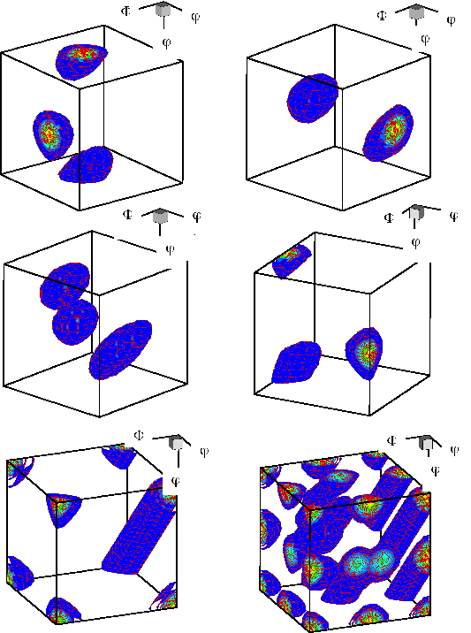
Component Volumes: fcc rolling texture
copper
brass
S
Goss
These contour maps of individual components in Euler space are drawn for an acceptance angle of ~12°.
Cube

Slide 33
How to calculate misorientation?
The next set of slides describe how to calculate misorientations, how to deal with crystal symmetry and sample symmetry, and some of the pitfalls that can arise.
For orientation distance, only the magnitude of the difference in orientation needs to be calculated. Therefore some of the details that follow go beyond what you need for volume fraction. Nevertheless, you need to be aware of these issues so that you do not become confused in subsequent exercises.
This misorientation calculation is not available in popLA but is available in TSL/HKL software. It is completely reliable but does not allow you to control the application of symmetry.

Slide 34
Objective
To make clear how it is possible to express a misorientation in more than (physically) equivalent fashion.
To allow researchers to apply symmetry correctly; mistakes are easy to make!
It is essential to know how a rotation/orientation/texture component is expressed in order to know how to apply symmetry operations.

Slide 35
Worked Example
In this example, we take a pair of orientations that were chosen to have a 60°<111> misorientation between them (rotation axis expressed in crystal coordinates). In fact the pair of orientations are the two sample symmetry related variants of the Copper component. The Copper component can be written with Miller indices as (112)[11-1].
We calculate the 3x3 Rotation matrix for each orientation, g_{A} and g_{B}, and then form the misorientation matrix, ∆g=g_{B}g_{A}⁻¹.
From the misorientation matrix, we calculate the angle, = cos⁻¹(trace(∆g)-1)/2), and the rotation axis.
In order to find the smallest possible misorientation angle, we have to apply crystal symmetry operators, O, to the misorientation matrix, O∆g, and recalculate the angle and axis.
First, let’s examine the result….

Slide 36
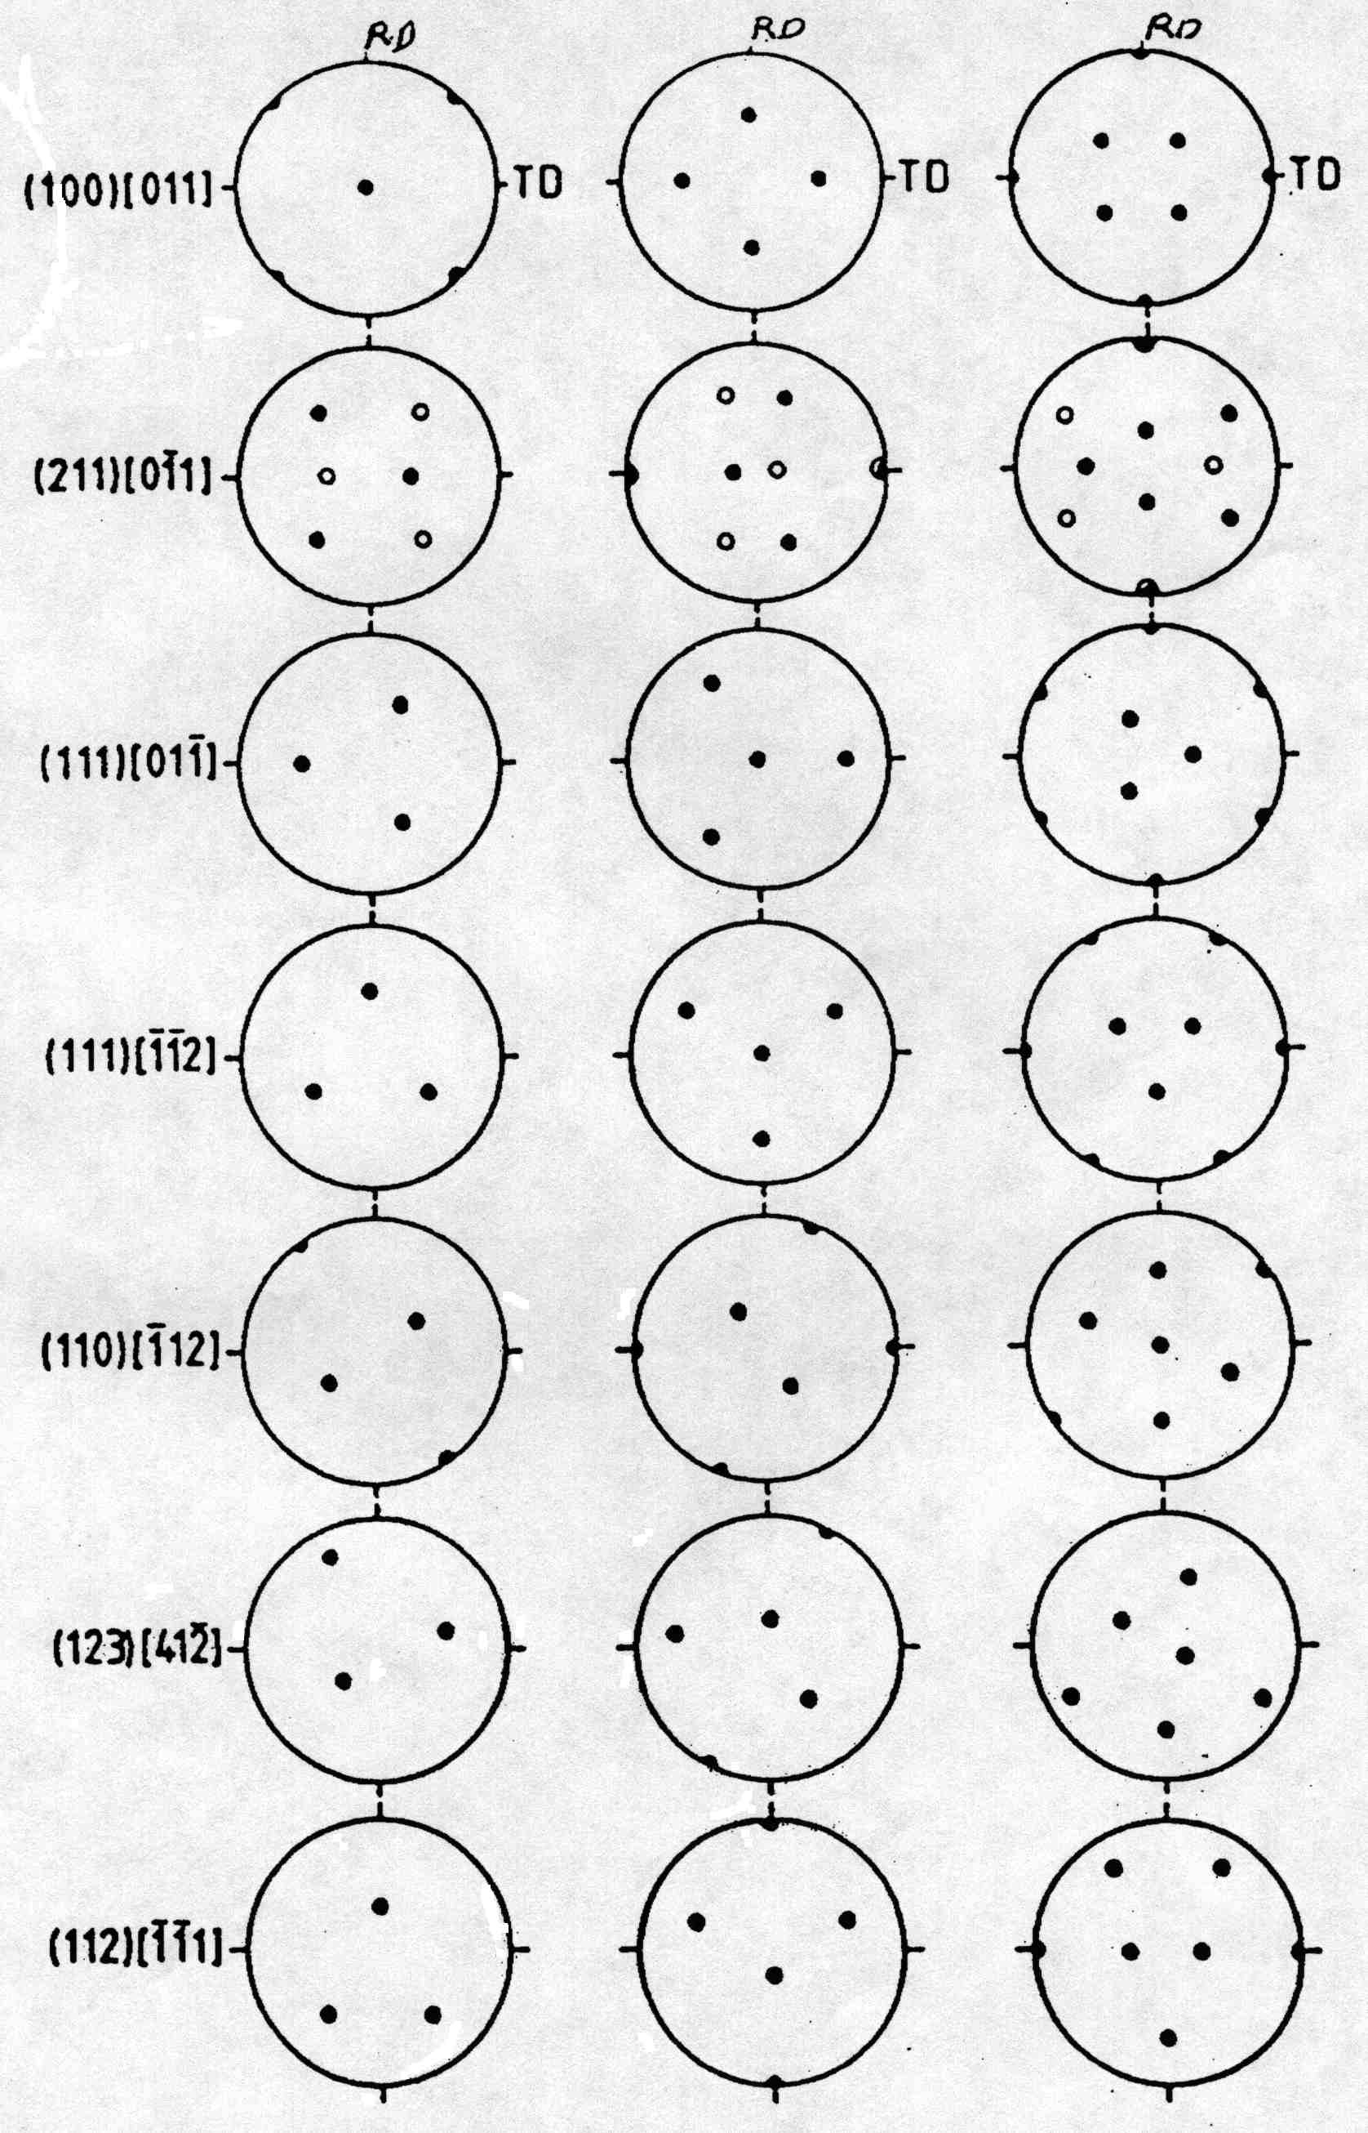
Worked Example
angles.. 90. 35.2599983 45.
angles.. 270. 35.2599983 45.
1st Grain: Euler angles: 90. 35.2599983 45.
2nd Grain: Euler angles: 270. 35.2599983 45.
1st matrix:
[ -0.577 0.707 0.408 ]
[ -0.577 -0.707 0.408 ]
[ 0.577 0.000 0.817 ]
2nd matrix:
[ 0.577 -0.707 0.408 ]
[ 0.577 0.707 0.408 ]
[ -0.577 0.000 0.817 ]
Product matrix for gA X gB^-1:
[ -0.667 0.333 0.667 ]
[ 0.333 -0.667 0.667 ]
[ 0.667 0.667 0.333 ]
MISORI: angle= 60. axis= 1 1 -1
{100} pole figures
+
As it happens, the result is 60°[11-1], which looks reasonable, but is it, in fact, the smallest angle?

Slide 37
Output with Symmetry Applied
Symmetry operator number 5
Product matrix for gA X gB^-1:
[ -0.667 -0.667 -0.333 ]
[ 0.333 -0.667 0.667 ]
[ -0.667 0.333 0.667 ]
Trace = -0.666738987
angle = 146.446442
Symmetry operator number 6
Product matrix for gA X gB^-1:
[ 0.667 0.667 0.333 ]
[ 0.333 -0.667 0.667 ]
[ 0.667 -0.333 -0.667 ]
Trace = -0.666738987
angle = 146.446442
Symmetry operator number 7
Product matrix for gA X gB^-1:
[ 0.667 -0.333 -0.667 ]
[ 0.333 -0.667 0.667 ]
[ -0.667 -0.667 -0.333 ]
Trace = -0.333477974
angle = 131.815872
Symmetry operator number 8
Product matrix for gA X gB^-1:
[ 0.667 -0`.333 -0.667 ]
[ -0.333 0.667 -0.667 ]
[ 0.667 0.667 0.333 ]
Trace = 1.66695571
angle = 70.5199966
Symmetry operator number 9
Product matrix for gA X gB^-1:
[ 0.333 -0.667 0.667 ]
[ 0.667 -0.333 -0.667 ]
[ 0.667 0.667 0.333 ]
Trace = 0.333477855
angle = 109.46682
Symmetry operator number 10
Product matrix for gA X gB^-1:
[ -0.333 0.667 -0.667 ]
[ -0.667 0.333 0.667 ]
[ 0.667 0.667 0.333 ]
Trace = 0.333477855
angle = 109.46682
Symmetry operator number 11
Product matrix for gA X gB^-1:
[ -0.333 0.667 -0.667 ]
[ 0.667 0.667 0.333 ]
[ 0.667 -0.333 -0.667 ]
Trace = -0.333261013
angle = 131.807526
Symmetry operator number 12
Product matrix for gA X gB^-1:
[ 0.667 0.667 0.333 ]
[ 0.667 -0.333 -0.667 ]
[ -0.333 0.667 -0.667 ]
Trace = -0.333261073
angle = 131.807526
Symmetry operator number 13
Product matrix for gA X gB^-1:
[ -0.333 0.667 -0.667 ]
[ -0.667 -0.667 -0.333 ]
[ -0.667 0.333 0.667 ]
Trace = -0.333261013
angle = 131.807526
Symmetry operator number 14
Product matrix for gA X gB^-1:
[ -0.667 -0.667 -0.333 ]
[ -0.667 0.333 0.667 ]
[ -0.333 0.667 -0.667 ]
Trace = -1.
angle = 180.
Symmetry operator number 15
Product matrix for gA X gB^-1:
[ 0.333 -0.667 0.667 ]
[ -0.667 -0.667 -0.333 ]
[ 0.667 -0.333 -0.667 ]
Trace = -1.
angle = 180.
Symmetry operator number 16
Product matrix for gA X gB^-1:
[ -0.667 -0.667 -0.333 ]
[ 0.667 -0.333 -0.667 ]
[ 0.333 -0.667 0.667 ]
Trace = -0.333260953
angle = 131.807526
Symmetry operator number 17
Product matrix for gA X gB^-1:
[ 0.333 -0.667 0.667 ]
[ 0.667 0.667 0.333 ]
[ -0.667 0.333 0.667 ]
Trace = 1.66652203
angle = 70.533165
Symmetry operator number 18
Product matrix for gA X gB^-1:
[ 0.667 0.667 0.333 ]
[ -0.667 0.333 0.667 ]
[ 0.333 -0.667 0.667 ]
Trace = 1.66652203
angle = 70.533165
Symmetry operator number 19
Product matrix for gA X gB^-1:
[ 0.333 -0.667 0.667 ]
[ -0.667 0.333 0.667 ]
[ -0.667 -0.667 -0.333 ]
Trace = 0.333044171
angle = 109.480003
Symmetry operator number 20
Product matrix for gA X gB^-1:
[ 0.667 -0.333 -0.667 ]
[ 0.667 0.667 0.333 ]
[ 0.333 -0.667 0.667 ]
Trace = 2.
angle = 60.
Symmetry operator number 21
Product matrix for gA X gB^-1:
[ 0.667 0.667 0.333 ]
[ -0.333 0.667 -0.667 ]
[ -0.667 0.333 0.667 ]
Trace = 2.
angle = 60.
Symmetry operator number 22
Product matrix for gA X gB^-1:
[ 0.667 -0.333 -0.667 ]
[ -0.667 -0.667 -0.333 ]
[ -0.333 0.667 -0.667 ]
Trace = -0.666522205
angle = 146.435211
Symmetry operator number 23
Product matrix for gA X gB^-1:
[ -0.667 -0.667 -0.333 ]
[ -0.333 0.667 -0.667 ]
[ 0.667 -0.333 -0.667 ]
Trace = -0.666522026
angle = 146.435196
Symmetry operator number 24
Product matrix for gA X gB^-1:
[ -0.333 0.667 -0.667 ]
[ 0.667 -0.333 -0.667 ]
[ -0.667 -0.667 -0.333 ]
Trace = -0.999999881
angle = 179.980209
MISORI: angle= 60. axis= 1 1
MISORI: angle= 60. axis= 1 1 -1-1
1st matrix:
[ -0.691 0.596 0.408 ]
[ -0.446 -0.797 0.408 ]
[ 0.569 0.100 0.817 ]
2nd matrix:
[ 0.691 -0.596 0.408 ]
[ 0.446 0.797 0.408 ]
[ -0.569 -0.100 0.817 ]
Symmetry operator number 1
Product matrix for gA X gB^-1:
[ -0.667 0.333 0.667 ]
[ 0.333 -0.667 0.667 ]
[ 0.667 0.667 0.333 ]
Trace = -1.
angle = 180.
Symmetry operator number 2
Product matrix for gA X gB^-1:
[ -0.667 0.333 0.667 ]
[ -0.667 -0.667 -0.333 ]
[ 0.333 -0.667 0.667 ]
Trace = -0.666738808
angle = 146.446426
Symmetry operator number 3
Product matrix for gA X gB^-1:
[ -0.667 0.333 0.667 ]
[ -0.333 0.667 -0.667 ]
[ -0.667 -0.667 -0.333 ]
Trace = -0.333477736
angle = 131.815857
Symmetry operator number 4
Product matrix for gA X gB^-1:
[ -0.667 0.333 0.667 ]
[ 0.667 0.667 0.333 ]
[ -0.333 0.667 -0.667 ]
Trace = -0.666738927
angle = 146.446442
This set of tables shows each successive result as a different symmetry operator is applied to ∆g. Note how the angle and the axis varies in each case! Note that #20 is the one that gives a 60° angle.
Pajarito.materials.cmu.edu/rollett/texture_subroutines : look for rexgbs-[date].f90

Slide 38
Misorientations
Misorientations: ∆g=g_{B}g_{A}⁻¹ transform from crystal axes of grain A back to the reference axes, and then transform to the axes of grain B.
Note that this use of “g” is based on the standard Bunge definition (transformation of axes)

Slide 39
Notation
In some texts, misorientation formed from axis transformations is written with a tilde.
Standard A->B transformation is expressed in crystal axes. The reason for this is that we generally want to know the common axis between the two crystals in terms of crystal coordinates.

Slide 40
Misorientation +Symmetry
∆g = (O_{c} g_{B})(O_{c} g_{A})⁻¹ = O_{c}g_{B}g_{A}⁻¹O_{c}⁻¹.
Note the presence of symmetry operators pre- & post-multiplying
Note that removing the parentheses from the term with the inverse swaps the order of the two matrices.

Slide 41
Symmetry: how many equivalent representations of misorientation?
Axis transformations: 24 independent operators (for cubic) present on either side of the misorientation. Two equivalents from switching symmetry, i.e. the fact that there is no (physical) difference between passing from grain A to grain B, versus passing from grain B to grain A.
Number of equivalents = 24x24x2=1152.

Slide 42
When to include Sample Symmetry?
Answer: only for volume fractions
The rule is simple:
For calculating orientation distances for the purpose of partitioning orientation space, you do include sample symmetry. You only have to apply the sample symmetry, however, to either the component or the cell being tested but not both.
For calculating misorientations for the purpose of characterizing grain boundaries, you do not include sample symmetry.

Slide 43
Practical Help with Volume Fractions
To calculate volume fractions directly from popLA .SOD files (orientation distributions in popLA format), use sod2vf.f (a Fortran 77 code)
To calculate volume fractions from a list of discrete orientations in .WTS format, use wts2pop[-latest_revision_date].f, which also bins the orientations into an SOD as well as pole figures and inverse pole figures. Look at any .WTS file to learn about the format (or read the popLA manual). You can find these programs at pajarito.materials.cmu.edu/rollett/texture_subroutines
If your data source is a *.ANG orientation map (from TSL, or, a *.CTF from HKL) then first use OIM2WTS.f to convert it to the .WTS format. If your material has hexagonal symmetry be very careful about how the Cartesian x-axis is aligned with the crystal axes (TSL and HKL are, typically, different).

Slide 44
Volume fractions from Random?
Based on a list of 20,000 random orientations and a 15° acceptance angle, you should expect this set of volume fractions:
{001}<100> cube vol. frac.= 2.175 % {001}<110> NDcube vol. frac.= 2.144 % {011}<100> Goss vol. frac.= 2.310 % {110}<112> brass vol. frac.= 4.116 % Dillamore vol. frac.= 3.030 % {211}<111> Copper vol. frac.= 3.721 % {231}<124> S vol. frac.= 8.475 %
Remember that more orientations are required for greater precision (more significant figures).

Slide 45
Volume fractions from Random?
Based on a list of 20,000 random orientations and a 10° acceptance angle, you should expect this set of volume fractions: For component cube vol. frac.= 0.575 % For component NDcube vol. frac.= 0.690 % For component Goss vol. frac.= 0.715 % For component brass vol. frac.= 1.310 % For component Dillam vol. frac.= 1.103 % For component Copper vol. frac.= 1.382 % For component 231124 vol. frac.= 2.775 %
Note how the volume fractions have decreased markedly with the decrease in acceptance angle.
Eliminating the Dillamore component, which is only about 10° from Copper, the following set is found: note that Copper has increased but not by a factor of 2. For component cube vol. frac.= 0.575 % For component NDcube vol. frac.= 0.690 % For component Goss vol. frac.= 0.715 % For component brass vol. frac.= 1.310 % For component Copper vol. frac.= 1.710 % For component 231124 vol. frac.= 2.775 %

Slide 46
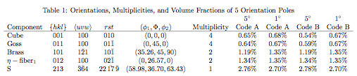
More Random/Uniform Volume Fractions by Component
Taken from unpublished work by Creuziger, Hu & Rollett (2010).

Slide 47
Variations in Random V_{f}
Why do the volume fractions vary with component location?
Answer: mainly because of variations in how close they lie to symmetry planes in orientation space.
Assume cubic-orthorhombic (crystal+sample) symmetry
An orientation such as Goss lies on one edge, so despite including 3 symmetry-related locations, its volume is only about 1/4th of, say, the S component.
Similarly the Copper component, only includes 1/2th of the space of the S component.
The rest of the variation is related to location with respect to the second Euler angle. See the next slide for illustrations of the above points.

Slide 48
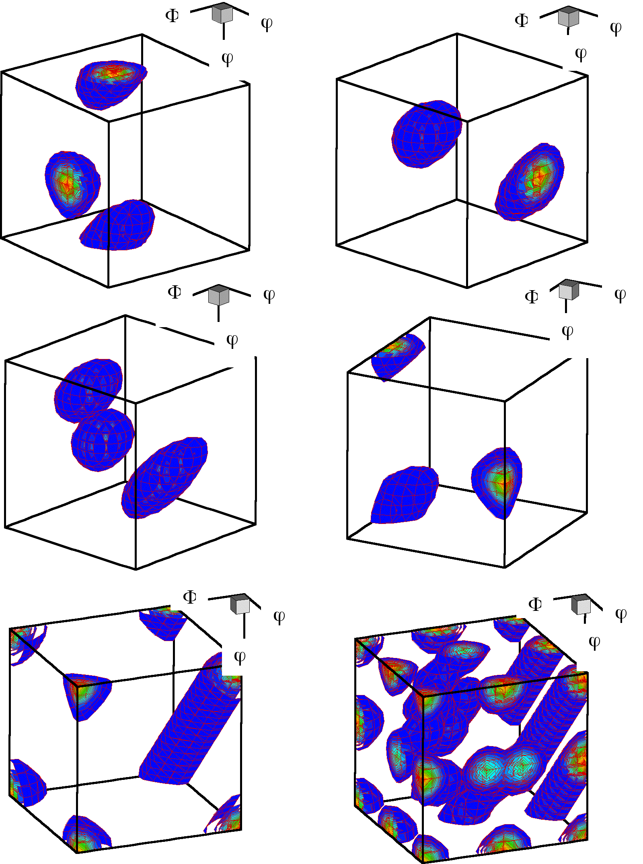
3D Views
1/2
1
1/2
1/2
1/2
a) Brass b) Copper c) S d) Goss e) Cube f) combined texture
1: {35, 45, 90}, Brass,
2: {55, 90, 45}, Brass
3: {90, 35, 45}, Copper,
4: {39, 66, 27}, Copper
5: {59, 37, 63}, S,
6: {27, 58, 18}, S,
7: {53, 75, 34}, S
8: {90, 90, 45}, Goss 9: {0, 0, 0}, cube* 10: {45, 0, 0}, rotated cube
1
1/4
1
1/4
1/4
1
1/8
1/8
* Note that the cube exists as a line between (0,0,90) and (90,0,0) because of the linear dependence of the 1st and 3rd angles when the 2nd angle = 0.
1/8
1/8
1/8
Figure courtesy of Jae-hyung Cho, KIMS, Korea

Slide 49
Scaling by Random V_{f}
It has been argued that volume fractions are more reliable than intensities partly because they reflect the physical makeup of the material more accurately. For example, the intensity at the cube position rises to very high values once the volume fraction of orientations near cube rises much above 25%, which is not true of other orientations.
Given that the volume fraction varies significantly with position in the space, especially for components near symmetry planes, it has also been argued that volume fractions should be reported as a multiple of the fraction associated with a random (uniform) texture.

Slide 50
Volume fractions from continuous distributions
Using texture components in crystal plasticity finite element simulations, D. Raabe, F. Roters, International Journal of Plasticity, 20, 339–361 (2004), doi:10.1016/S0749-6419(03)00092-5. [look in Box folder]
The iterative series-expansion method for quantitative texture analysis. I. General outline, M. Dahms and H. J. Bunge, J. Appl. Cryst. (1989). 22, 439-447, doi:10.1107/S0021889889005261
Discretization techniques for orientation distribution functions, LS Toth & P van Houtte, Textures & Microstructures (1992). [look in Box folder]
Section 3.4 (p 70) in Orientations & Rotations by A. Morawiec.
Chapter 13 in Quantitative Texture Analysis, edited by HJ Bunge and C Esling (1982).
The first paper by Raabe & Roters is based on the concept of representing each component by a Gaussian peak in orientation space. The simplest mathematical form is this: f(g) = S₀ exp(-ω²/ω₀²)
In fact, the von Mises-Fisher distribution (q.v. wikipedia) is more correct for spherical parameters, which is discussed by Morawiec and others.
If a series expansion fit for a texture is available, and the positions of a set of texture components has been identified (e.g., by inspection of the OD), then volume fractions can be obtained via a procedure that minimizes the difference between the fitted Gaussian peak and the local values of f(g), using the coefficients of the ODF.

Slide 51
Summary
Methods for calculating volume fractions from discrete orientation distributions reviewed.
Complementary method of calculating the OD from information on discrete orientations (e.g. OIM) provided.
Method for calculating orientation distance (equivalent to misorientation) given, with illustrations of the importance of how to apply symmetry operators.
For further discussion: in some cases, it is useful to compare volume fractions in a textured material to the volume fractions that would be expected in a randomly oriented material.
Different programs may well yield different volume fraction values because of differences in the procedure (e.g. how the space is partitioned).

Slide 52
Supplemental Slides
The following slides illustrate what happens with misorientations if you deal with active rotations, instead of the standard axis transformations (passive rotations) used in materials science.
This material is useful in case you have experience with solid mechanics, or you cannot get a misorientation calculation to work properly.
Note: it does not matter whether you use passive or active rotations for computing the rotation angle; it only makes a difference to the rotation axis, i.e. the skew-symmetric part of the misorientation matrix.
Caution: if you calculate the misorientation for a grain boundary with active rotations, the axis will be expressed in the sample frame. This is not what you want, generally speaking, if one is interested in the crystallographic character of the boundary.

Slide 53
Passive vs. Active Rotations
These next few slides describe the differences between dealing with passive rotations (= transformations of axes) and active rotations (fixed coordinate system)
Passive Rotations
Materials Science
g describes an axis transformation from sample to crystal axes
Active Rotations
Solid mechanics
g describes a rotation of a crystal from ref. position to its orientation.
Passive Rotations (Axis Transformations) Active (Vector) Rotations

Slide 54
Matrices
g = Z₂XZ₁ =
Note transpose relationship between the two matrices.
g = g_{φ1001}g_{Φ100}g_{φ2001} =
Passive Rotations (Axis Transformations) Active (Vector) Rotations

Slide 55
Texture +Symmetry
Symmetry Operators: O_{sample} ≡ O_{s} O_{crystal} ≡ O_{c} Note that the crystal symmetry post-multiplies, and the sample symmetry pre-multiplies.
Note the reversal in order of application of symmetry operators!
Passive Rotations (Axis Transformations) Active (Vector) Rotations

Slide 56
Groups: Sample +Crystal Symmetry
O_{c}∈O(432); proper rotations of the cubic point group.
O_{s}∈O(222); proper rotations of the orthorhombic point group.
Think of applying the symmetry operator in the appropriate frame: thus for active rotations, apply symmetry to the crystal before you rotate it.
Passive Rotations (Axis Transformations) Active (Vector) Rotations

Slide 57
Misorientations
Misorientations: ∆g=g_{B}g_{A}⁻¹; transform from crystal axes of grain A back to the reference axes, and then transform to the axes of grain B.
Note that this use of “g” is based on the standard Bunge definition (transformation of axes)
Misorientations: ∆g=g_{B}g_{A}⁻¹; the net rotation from A to B is: rotate first back from the position of grain A and then rotate to the position of grain B.
Note that this use of “g” is based on the a definition in terms of an active rotation (the “g” is the inverse, or transpose of the one on the left).
Passive Rotations (Axis Transformations) Active (Vector) Rotations

Slide 58
Notation
In some texts, misorientation formed from axis transformations is written with a tilde.
Standard A->B transformation is expressed in crystal axes.
You must verify from the context which type of misorientation is discussed in a text!
Standard A->B rotation is expressed in sample axes.
Passive Rotations (Axis Transformations) Active (Vector) Rotations

Slide 59
Misorientation +Symmetry
∆g=g_{B}g_{A}⁻¹; (g_{B}O_{c})(g_{A}O_{c})⁻¹ = g_{B}O_{c}O_{c}⁻¹g_{A}⁻¹ = g_{B}O_{c}’g_{A}⁻¹.
Note the reduction to a single symmetry operator because the symmetry operators belong to the same group!
∆g= (O_{c} g_{B})(O_{c} g_{A})⁻¹ = O_{c}g_{B}g_{A}⁻¹O_{c}⁻¹.
Note the presence of symmetry operators pre- & post-multiplying
Passive Rotations (Axis Transformations) Active (Vector) Rotations

Slide 60
Symmetry: how many equivalent representations of misorientation?
Axis transformations: 24 independent operators (for cubic) present on either side of the misorientation. Two equivalents from switching symmetry.
Number of equivalents= 24x24x2=1152.
Active rotations: Only 24 independent operators present “inside” the misorientation. 2 from switching symmetry.
Number of equivalents= 24x2=48.
Passive Rotations (Axis Transformations) Active (Vector) Rotations

Slide 61
Passive ↔ Active
Just as is the case for rotations, and texture components, g_{passive}(θ,n) = g^{T}_{active}(θ,n), so too for misorientations,
∆g_{passive}(θ,n) = ∆g^{T}_{active}(θ,n).
However, please be careful about the frame. The discussion given here (with the exception of the example that illustrated how the misorientation axis moved with the bi-crystal) is based on using the “local” or “crystal” frame, not the reference frame.
The relationship between the misorientation calculated in the local frame and the misorientation calculated in the reference frame is not at all simple. For dealing with grain boundaries, I strongly suggest that you stick to the local/crystal frame.

Slide 62
Worked example: active rotations
{100} pole figures
So what happens when we express orientations as active rotations in the sample reference frame?
The result is similar (same minimum rotation angle) but the axis is different!
The rotation axis is the sample [100] axis, or x-axis, which happens to be parallel to a crystal <111> direction because the Copper component is (112)[11-1].
60° rotation about RD

Slide 63
Active rotations example
Symmetry operator number 1
Product matrix for gB X gA^-1:
[ -1.000 0.000 0.000 ]
[ 0.000 -1.000 0.000 ]
[ 0.000 0.000 1.000 ]
Trace = -1.
angle = 180.
Symmetry operator number 2
Product matrix for gB X gA^-1:
[ -0.333 0.000 0.943 ]
[ 0.816 -0.500 0.289 ]
[ 0.471 0.866 0.167 ]
Trace = -0.666738927
angle = 146.446442
Symmetry operator number 3
Product matrix for gB X gA^-1:
[ 0.333 0.817 0.471 ]
[ 0.817 0.000 -0.577 ]
[ -0.471 0.577 -0.667 ]
Trace = -0.333477914
angle = 131.815872
…………..
angles.. 90. 35.2599983 45.
angles.. 270. 35.2599983 45.
1st Grain: Euler angles: 90. 35.2599983 45.
2nd Grain: Euler angles: 270. 35.2599983 45.
1st matrix:
[ -0.577 0.707 0.408 ]
[ -0.577 -0.707 0.408 ]
[ 0.577 0.000 0.817 ]
2nd matrix:
[ 0.577 -0.707 0.408 ]
[ 0.577 0.707 0.408 ]
[ -0.577 0.000 0.817 ]
MISORInv: angle= 60. axis= 1 0 0
Note: same angle, different axis, now in sample frame

Slide 64
Active rotations
What is stranger, at first sight, is that, as you rotate the two orientations together in the sample frame, the misorientation axis moves with them, if expressed in the reference frame (active rotations).
On the other hand, if one uses passive rotations, so that the result is in crystal coordinates, then the misorientation axis remains unchanged, as you rotate the pair of cr.

Slide 65
Active rotations example
Symmetry operator number 1
Product matrix for gB X gA^-1:
[ -1.000 0.000 0.000 ]
[ 0.000 -1.000 0.000 ]
[ 0.000 0.000 1.000 ]
Trace = -1.
angle = 180.
Symmetry operator number 2
Product matrix for gB X gA^-1:
[ -0.478 0.004 0.878 ]
[ 0.820 -0.355 0.448 ]
[ 0.314 0.935 0.167 ]
Trace = -0.666738808
angle = 146.446426
Symmetry operator number 3
Product matrix for gB X gA^-1:
[ 0.044 0.824 0.564 ]
[ 0.824 0.289 -0.487 ]
[ -0.564 0.487 -0.667 ]
Trace = -0.333477765
angle = 131.815857
…………..
Add 10° to the first Euler angle so that both crystals move together:
angles.. 100. 35.2599983 45.
angles.. 280. 35.2599983 45.
1st matrix:
[ -0.691 0.596 0.408 ]
[ -0.446 -0.797 0.408 ]
[ 0.569 0.100 0.817 ]
2nd matrix:
[ 0.691 -0.596 0.408 ]
[ 0.446 0.797 0.408 ]
[ -0.569 -0.100 0.817 ]
MISORInv: angle= 60. axis= 6 1 0
Note the change in the misorientation axis from 100 to 610!

