Slide 1
OMP
Stopping Criteria Selection

Slide 2
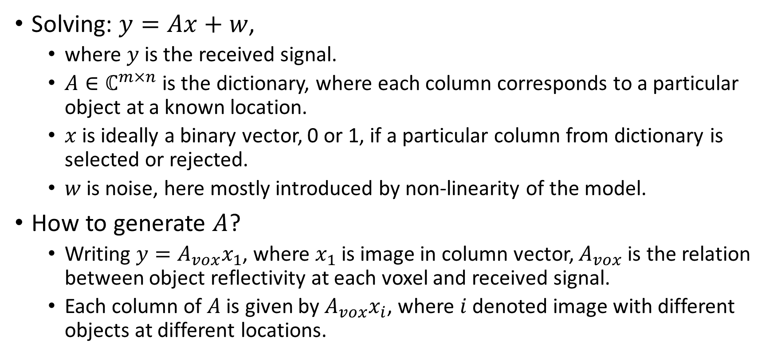
Problem
Solving: $y=Ax+w$,
where $y$ is the received signal.
$A∈ℂ^{m×n}$ is the dictionary, where each column corresponds to a particular object at a known location.
$x$ is ideally a binary vector, 0 or 1, if a particular column from dictionary is selected or rejected.
$w$ is noise, here mostly introduced by non-linearity of the model.
How to generate $A$?
Writing $y=A_{vox}x_{1}$, where $x_{1}$ is image in column vector, $A_{vox}$ is the relation between object reflectivity at each voxel and received signal.
Each column of $A$ is given by $A_{vox}x_{i}$, where $i$ denoted image with different objects at different locations.

Slide 3

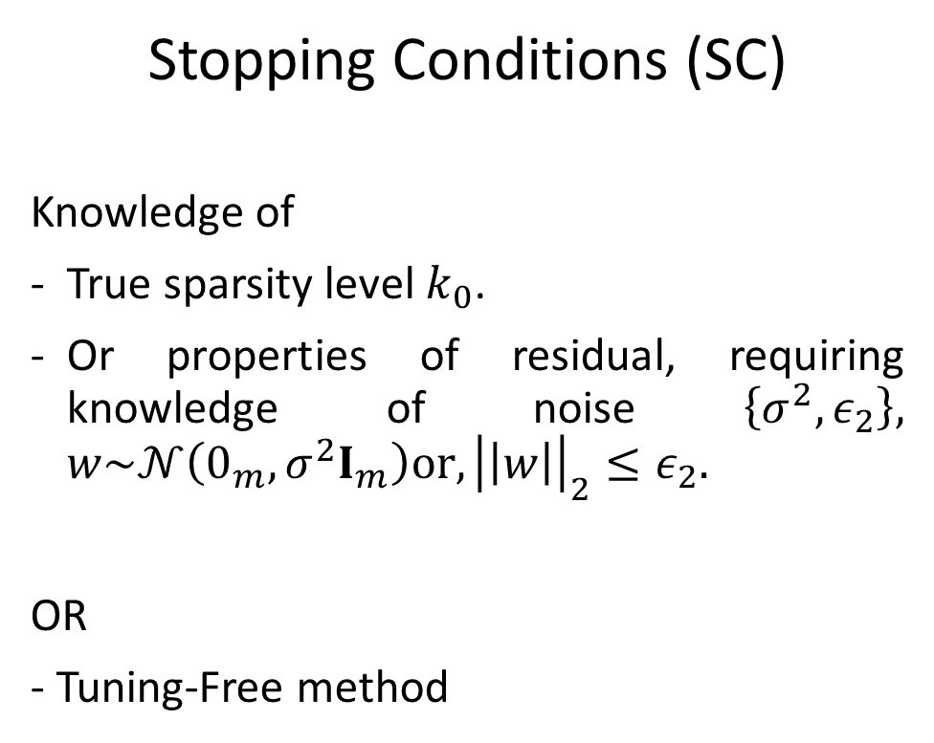
OMP algorithm
Stopping Conditions (SC)
Knowledge of
- True sparsity level $k_{0}$.
Or properties of residual, requiring knowledge of noise $\left\{σ^{2},ε_{2}\right\}, w\sim 𝒩\left(0_{m},σ^{2}I_{m}\right){or, \left|\left|w\right|\right|}_{2}≤ε_{2}.$
OR
- Tuning-Free method
Initialize residual $r^{(0)}=y. \hat{x}=0.$
Support estimate $𝒯^{0}=φ,$iteration counter, $k=1.$
Find column most correlated with the current residual $r^{(k−1)},$ ie, $t_{k}=argmax |A^{T}r^{(k−1)}$|, $tε\left\{1,…,n\right\}.$
Check if that column has not been previously selected. Otherwise repeat 2.
Update support estimate $𝒯^{k}=𝒯^{k−1}∪t_{k}.$
Estimate $x$ using current support $\hat{x}=A_{𝒯^{k}}^{†}y.$
Update residual $r^{(k)}=y−A\hat{x}=\left(I_{m} −P_{𝒯^{k}}\right)y.$
Increment $k=k+1.$
Repeat $2−6,$ until Stopping Criteria (SC) is met.
Output: $𝒯^{k}$ and $\hat{x}$.
Notations:
$A^{†}={\left(A^{T}A\right)}^{−1}A^{T},$Moore-Penrose pseudo inverse.
$P_{A}=AA^{†}. P_{A_{𝒯}}$ is denoted by $P_{𝒯}.$

Slide 4
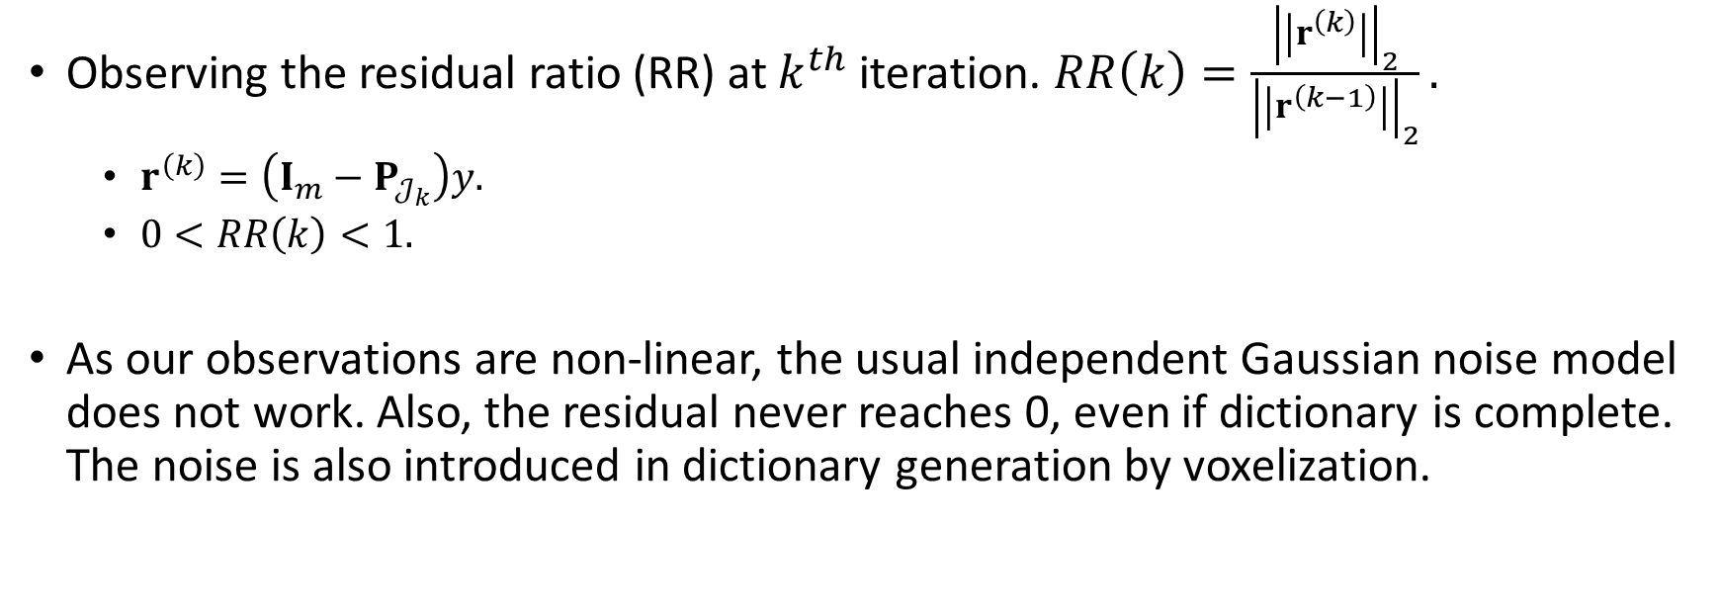
Tuning Free OMP^{1,2}
Observing the residual ratio (RR) at $k^{th}$ iteration. $RR\left(k\right)=\frac{{\left|\left|r^{\left(k\right)}\right|\right|}_{2}}{{\left|\left|r^{\left(k−1\right)}\right|\right|}_{2}}.$
$r^{\left(k\right)}=\left(I_{m}−P_{𝒥_{k}}\right)y.$
$0<RR\left(k\right)<1.$
As our observations are non-linear, the usual independent Gaussian noise model does not work. Also, the residual never reaches 0, even if dictionary is complete. The noise is also introduced in dictionary generation by voxelization.
^{[1]}S. Kallummil and S. Kalyani, “Tuning free orthogonal matching pursuit,” arXiv preprint arXiv:1703.05080, 2017.
^{[2]}S. Kallummil and S. Kalyani, “Signal and noise statistics oblivious sparse reconstruction using omp/ols,” arXiv preprint arXiv:1707.08712, 2017.

Slide 5
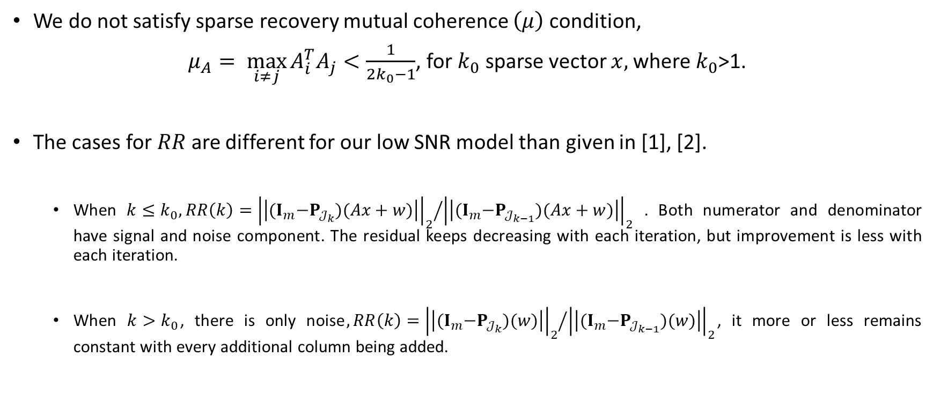

Recovery and Relative Residual ($RR$)
We do not satisfy sparse recovery mutual coherence $\left(μ\right)$condition,
$μ_{A}= \max_{i≠j}{A_{i}^{T}A_{j}}<\frac{1}{2k_{0}−1}$, for $k_{0}$ sparse vector $x,$where $k_{0}$>1.
The cases for $RR$ are different for our low SNR model than given in [1], [2].
When $k≤k_{0}, RR\left(k\right)={{\left|\left|{(I}_{m}−P_{𝒥_{k}})(Ax+w)\right|\right|}_{2}}/{{\left|\left|{(I}_{m}−P_{𝒥_{k−1}})(Ax+w)\right|\right|}_{2}}$ . Both numerator and denominator have signal and noise component. The residual keeps decreasing with each iteration, but improvement is less with each iteration.
When $k>k_{0}$, there is only noise$, RR\left(k\right)={{\left|\left|{(I}_{m}−P_{𝒥_{k}})(w)\right|\right|}_{2}}/{{\left|\left|{(I}_{m}−P_{𝒥_{k−1}})(w)\right|\right|}_{2}}$, it more or less remains constant with every additional column being added.

Slide 6
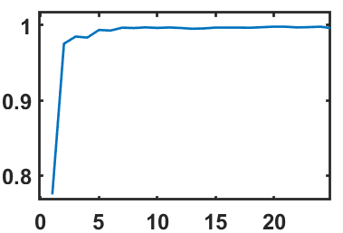
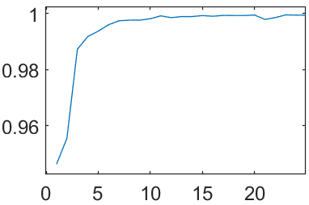
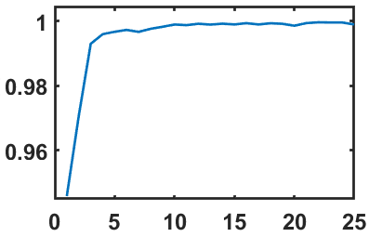
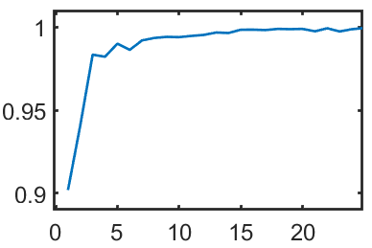

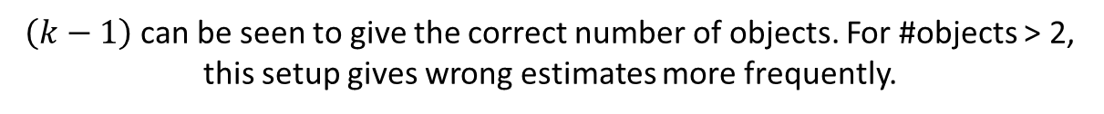



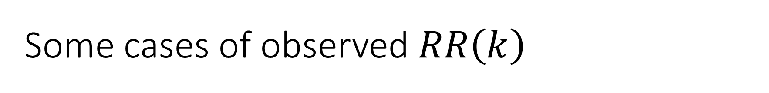






Some cases of observed $RR\left(k\right)$
Fig: Setup: (a) Ellipsoidal object is placed in the imaging domain. The Tx/Rx antenna arrangement on the side walls is shown. 9 antennas are on the ceiling. (b) Ceiling arrangement, where all antennas are Tx. [Lib4, posRxTx=4]
1 Object (Case 1)
2 Objects (Case 1, 11)
2 Objects (Case 1, 41)
2 Objects (Case 1, 19)
$$k=2$$
$$k=3$$
$$k=3$$
$$RR(k)$$
$$RR(k)$$
$$k=3$$
$$RR(k)$$
$$RR(k)$$
$$k$$
$$k$$
$$k$$
$$k$$
$\left(k−1\right)$ can be seen to give the correct number of objects. For #objects > 2, this setup gives wrong estimates more frequently.

Slide 7
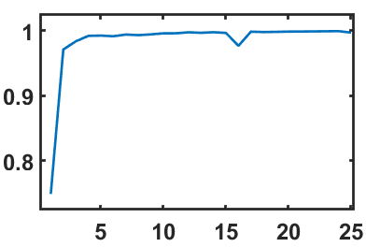
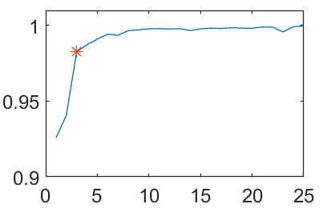
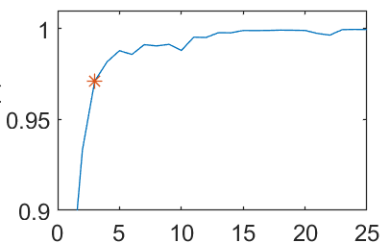
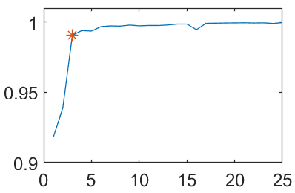
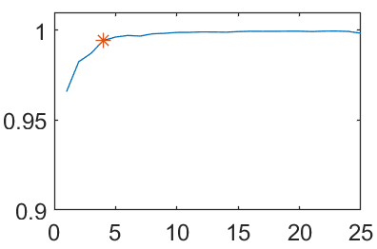

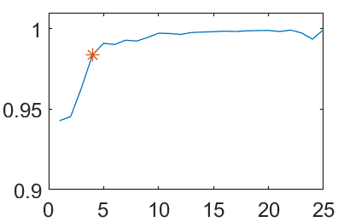
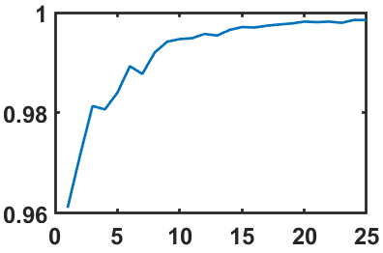








Fig: Setup: (a) Ellipsoidal object is placed in the imaging domain. The Tx/Rx antenna arrangement on the side walls is shown. 9 antennas are on the ceiling. (b) Ceiling arrangement, where all antennas are Rx. [Lib5, posRxTx=5]
1 Object (Case 1)
2 Objects (Case 1, 11)
2 Objects (Case 1, 19)
2 Objects (Case 1, 41)
$$k=2$$
$$k=3$$
$$k=3$$
$$k=3$$
$$RR(k)$$
$$RR(k)$$
$$RR(k)$$
$$RR(k)$$
$$k$$
$$k$$
$$k$$
$$k$$
6 Objects (Case 101, 148, 212, 292, 315, 460)
3 Objects (Case 1, 41, 62)
3 Objects (Case 1, 41, 79)
3 Objects (Case 2, 88, 99)
$$k=4$$
$$k=4$$
$$k=4$$
$k=$7
$$RR(k)$$
$$RR(k)$$
$$RR(k)$$
$$RR(k)$$
$$k=3$$
$$k$$
$$k$$
$$k$$
$$k$$

Slide 8
Additional Observations
Using shelled ellipsoids instead of filled, do not change the results. The detected locations are same, and also the possible prediction using RR curve will be similar (results may not be exactly similar, possible slight improvement).
Without ceiling antennas, the results are not good. For some case when 2 objects are present (1,11), it cannot even predict number of objects, no L-curve observed. Locations are also incorrect.
With increase in height of sidewall antennas, the results were poorer. In the checked case, the ceiling antennas were present.
Shape sensitivity test was performed. A library full of cuboids of the same edge length as ellipsoid axes were generated. It didn’t affect the results, locations were correctly estimated. For a mixed library, with both ellipsoids and cuboids, in some cases cuboids were detected as objects (if object axes were > 0.8 times the original). If object sizes were reduced by <0.7*object axes, only ellipsoids were predicted, at 0.8*object axes, one was ellipsoid and one cuboid. But if more ellipsoids are added by only 10% reduction in size, the results do not change. So due to nonlinearity present, it can give wrong predictions easily, although for same shape, it is sensitive to some size difference.

