Slide 1
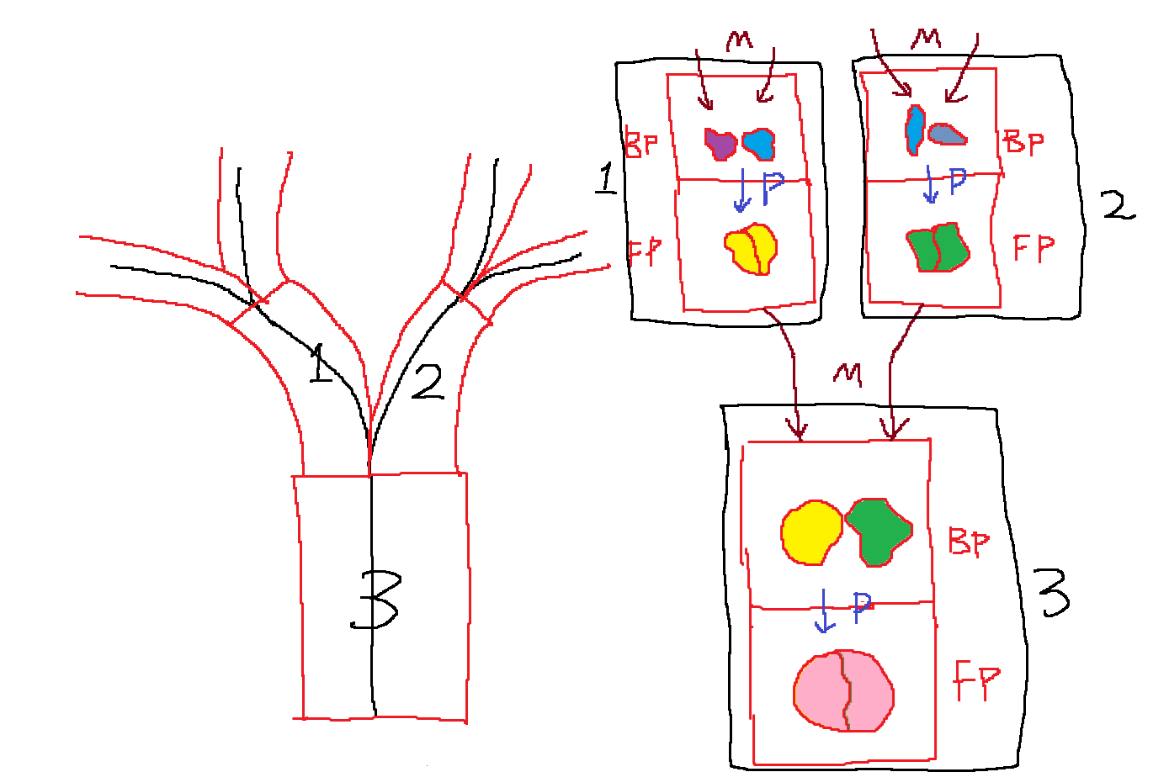
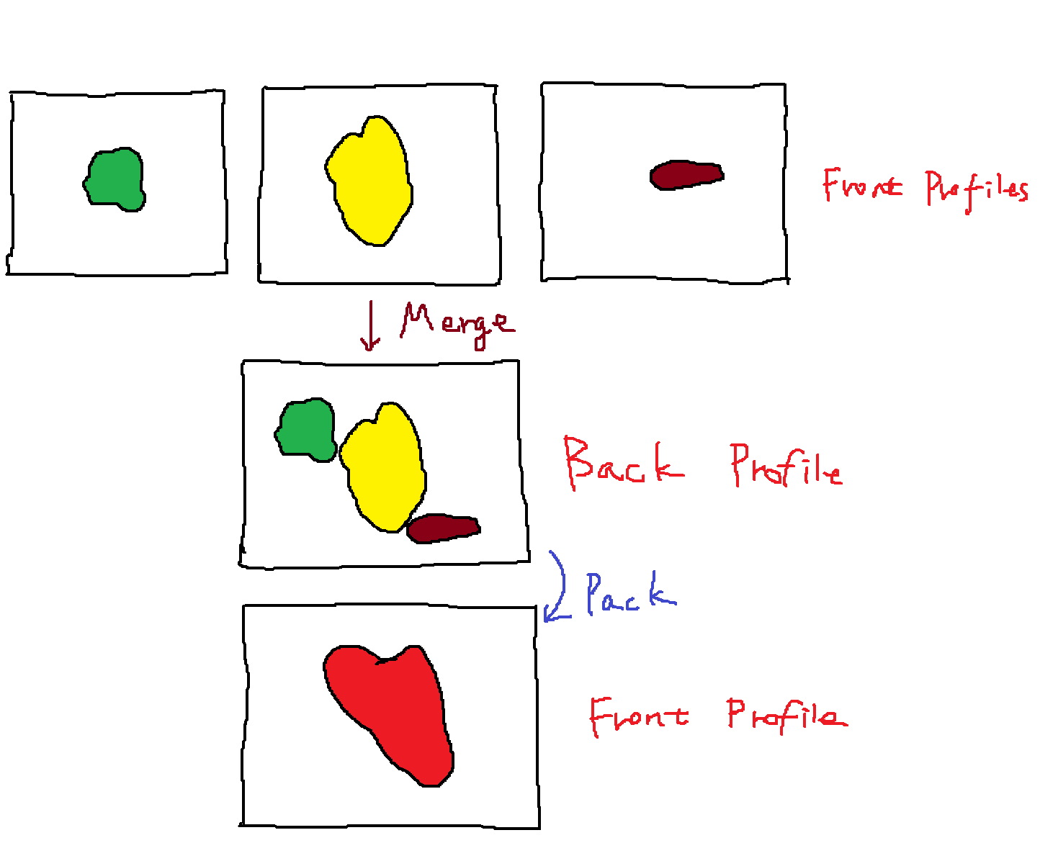
Establish Profiles from skeleton
For each branch on the skeleton, create an entity that contains front and back profile
From root to end nodes
If root: Allocate group of pipes (now only one pipe)
If apical branch: extend all parent pipes
If lateral branch: extend all parent pipes, and allocate new group of pipes (now only one pipe) and build pipe from root to current node
From end nodes to root:
For the current node (Merge step):
If it’s end node:
Simply position cells at the center for the current node’s back profile.
If the node has 1 child:
Simply re-apply positions for all cells from child node’s front profile with same pipe for the current node’s back profile.
If node has more than 1 child
Select main child
Re-apply positions for cells from the main child node’s front profile at the center of the current node’s back profile.
Re-apply positions for cells from the other child node’s front profile at empty space of the current node’s back profile close to center with offset.
Copy position from current node’s back profile to current node’s front profile
Pack (squeeze) cells with physics simulation
Note: This step is very slow because the parent profile is based on children’s profiles which makes this step impossible to run concurrently.
Adjust graph if profiles gets too close at trunk.
Calculate pipe segment position/rotation by interpolating back profiles, and form strands for rendering.

