Slide 1
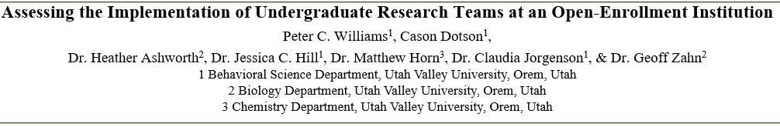
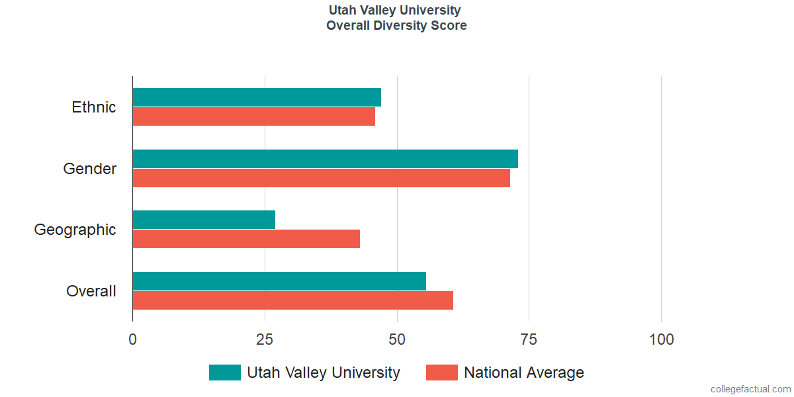
Background
Project Outcomes
Undergraduate research is a high-impact practice that serves as a robust intervention for students, particularly minorities, who are at risk of dropping out of college (Jones, Barlow, & Villarejo, 2010; Kuh, 2008; Lopatto, 2010). By engaging students within their first and second years, a sense of community within the institution is developed, and they gain access to faculty members as mentors, thus becoming more resilient to difficulties encountered during their educational career (Jones et al., 2010). As a complement to strong gains in discipline- and career-related skills, early participants in undergraduate research are significantly more likely to complete their undergraduate education (Jones et al., 2010; Lopatto, 2010). The literature on outcomes associated with participation in undergraduate research is broad, encompassing large public research institutions, private institutions, and liberal arts colleges (Kaiser, Mishler, Peoples, & Wells, 2014). None of the institutions represented in the literature have comparable challenges related to the characteristics and composition of the student body as Utah Valley University (UVU). As an open enrollment institution serving a large body of non-traditional, minority, and first-generation students, UVU struggles to retain students. For example, considering the 2015 cohort of full-time bachelor’s degree seeking students, only 63% persisted beyond the first year (https://www.uvu.edu/retention/data/dashboard.html). Further, those who do persist beyond the first year, complete their degree at a rate lower than the national average. For instance, within the 2012 cohort, only 57% of students had completed their degree by 2016.
Despite many opportunities for undergraduate research provided by faculty members across campus, few students consistently participate. We propose this is likely due to the implementation of successful empirically based models from other institutions that do have the same student body composition as UVU. We seek to catalog and assess a sample of undergraduate research opportunities across all colleges in order to determine what models are successful for UVU’s student body through survey, interview, and observational data.
Upon completion of this study, we will be able to offer meaningful data on the state of undergraduate research at UVU as well as recommendations on the structure and organization of research experiences to faculty members. We hope to be able to provide information on best practices for engaging traditionally underserved populations on campus (e.g., first-generation students).
Understanding the most effective mechanisms for mentoring students in undergraduate research experiences is in the best interest of professors who are active in or desire to participate in UR.
Some faculty have expressed a desire to drop students from their research programs due to unanticipated challenges related to managing undergraduates at an open enrollment institution. However, the literature is replete with the benefits of UR. Thus, understanding the best practices for motivating students becomes imperative in order for faculty to provide positive research experiences that create life- and career-changing opportunities for our students (HIP 7).
Effective mentorship and research team management is also critical to faculty success due to the intensive teaching loads at open-enrollment universities, particularly considering the American Association of University Professors (AAUP) recommendation that teaching-intensive tenure-track positions have no research expectations (AAUP, 2016). Thus, it is crucial that mentoring faculty best utilize both their time and resources for purposes of career development and avoiding burnout.
Our results would be foundational in supporting tenure-track faculty who must work with open-enrollment students in UR. We could advise incoming faculty or faculty struggling to maintain a UR agenda on the best practices for mentoring an open-enrollment student body as they participate in research. This advice could occur via a collaboration with the Office of Teaching and Learning as an empirically-supported list of best practices. Perhaps most importantly, our results and their application will build open-enrollment university representation as institutions that provides serious UR experiences, which promote engaged, inclusive, intellectual growth.
Future Directions
Successful analysis of our data would lead to a hopeful establishment of successful mentoring strategies for open-enrollment institutions.
These strategies would be implemented into a mentoring guideline brochure that could be distributed to incoming faculty mentors to the institution.
Findings will be used to develop training materials including a Handbook for Undergraduate Mentorship in Creative and Scholarly Works at Open Enrollment Institutions. This may include the following chapters: Recruiting Mentees, Team Structure, Project Management, Team Interactions: Managing the Mentor-Mentee Relationship, Time Management, Assessing Mentoring Strategies, Obtaining Administrative Support.
References
Bonnie Nicole Kaiser, Dennis M. Mishler, Whitney A. Peoples, & Alexis S. Wells. (2014). Undergraduate Research and a Liberal Arts Education: Similar Goals, Similar Solutions. Journal of College Science Teaching, 43(5), 48. Retrieved from http://ezproxy.uvu.edu/login?url=http://search.ebscohost.com/login.aspx?direct=true&db=edsjsr&AN=edsjsr.43633228&site=eds-live
David Lopatto. (2010). Undergraduate Research as a High-Impact Student Experience. Association of American Colleges & Universities, Retrieved from
https://www.aacu.org/publications-research/periodicals/undergraduate-research-high-impact-student-experience
Kuh, G. D. (2012). High-Impact Educational Practices: What They Are, Who Has Access to Them, and Why They Matter. Peer Review, (3), 29. Retrieved from http://ezproxy.uvu.edu/login?url=http://search.ebscohost.com/login.aspx?direct=true&db=edsgao&AN=edsgcl.311500181&site=eds-live
Melanie T. Jones, Amy E. L. Barlow, & Merna Villarejo. (2010). Importance of Undergraduate Research for Minority Persistence and Achievement in Biology. The Journal of Higher Education, 81(1), 82. Retrieved from http://ezproxy.uvu.edu/login?url=http://search.ebscohost.com/login.aspx?direct=true&db=edsjsr&AN=edsjsr.27750767&site=eds-live
Method
Participants:
Assistant, Associate, and full Professors of UVU conducting scholarly activities and their individual teams.
Materials Distributed to Participants
GREEN Survey
Mentor Competency Assessment Tool (MCAT)
Motivational and Self-Regulated Learning Components
Impact of Student-Faculty Relationships
Next Step:
Observation data will be collected from the faculty mentor’s team meeting
Data analysis will be conducted using R
Notes:
One word: both computers have more
Two word: same
Three word: same

