Slide 1
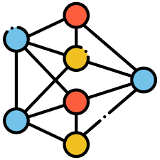













































Clean Pool $P_{m}$
Stage II: Loss Entropy Early-stop
$$O_{3}$$
0.84
$$O_{7}$$
1.21
Sorted $P_{c}$
$$O_{1}$$
$$O_{1}$$
0.97
Detected Noisy set
$$O_{16}$$
3.12
$$O_{2}$$
$$O_{4}$$
$$O_{8}$$
1.02
$$O_{19}$$
$$O_{16}$$
3.12
2.87
$$O_{8}$$
0.67
Train on clean pool
STOP ?
Yes
$$O_{18}$$
2.05
Add top-k
$$O_{19}$$
2.87
$$O_{1}$$
$$O_{18}$$
$$O_{3}$$
$$O_{7}$$
$$O_{13}$$
1.99
2.05
$$O_{6}$$
$$O_{10}$$
1.66
. . .
$$O_{5}$$
$$O_{20}$$
$$O_{2}$$
1.53
$$O_{11}$$
1.96
$$O_{10}$$
. . .
No
$$O_{11}$$
Train few epochs
$$O_{9}$$
$$O_{15}$$
$$O_{12}$$
Dirty Pool $P_{c}$
$$O_{14}$$
$$O_{13}$$
$$O_{11}$$
1.96
$$O_{16}$$
$$O_{19}$$
$$O_{18}$$
2.05
$$O_{17}$$
$$O_{13}$$
1.99
Stage III: Influence Evaluation on $M_{c}$
$$O_{18}$$
$$O_{16}$$
3.12
Dataset $D_{noisy}$
$$O_{19}$$
2.87
Stage I: Early Loss Detection
Delete detected top-k from $D_{noisy}$

